Slide 1
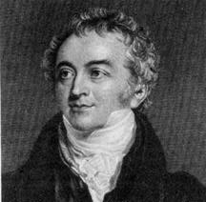
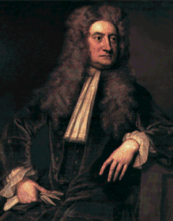
If light diffracts
and interferes
then it must be a wave!
Rubbish!
light is
made of
particles.
So is Light a Wave?
Newton
Young

Slide 2
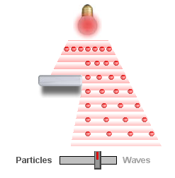
Wave particle duality web link

Slide 3
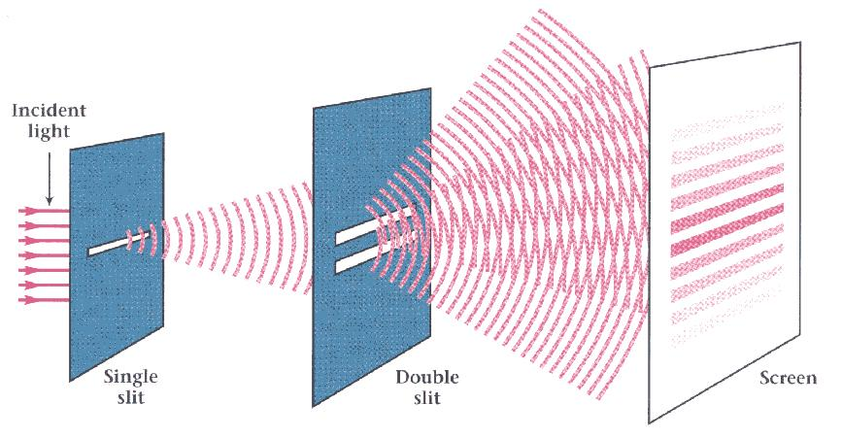
Young’s Double Slit Experiment
If light is a wave, interference effects will be seen, where one part of wavefront can interact with another part.
One way to study this is to do a double-slit experiment (Young’s):

Slide 4
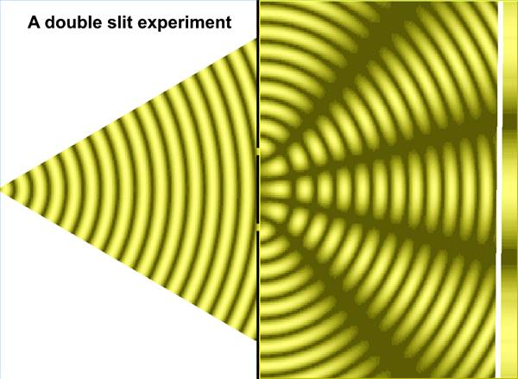

Slide 5
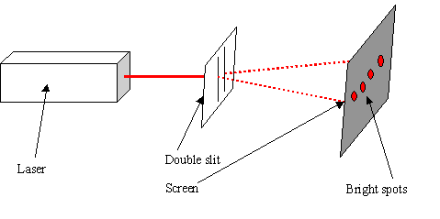

Slide 6
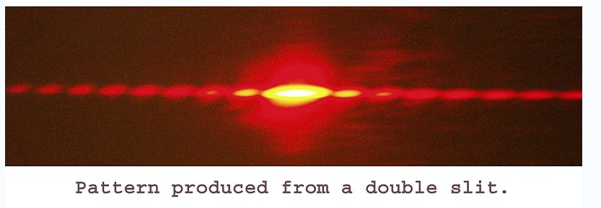

Slide 7
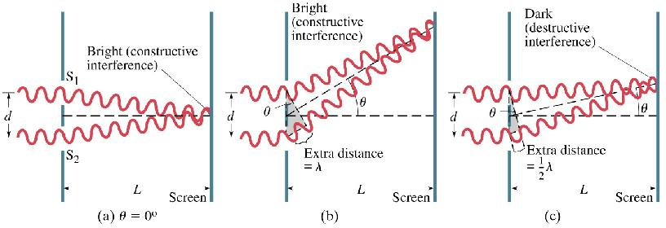
The interference occurs because each point on the screen is not the same distance from both slits. Depending on the path length difference, the wave can interfere constructively (bright spot) or destructively (dark spot ~ no light).

Slide 8
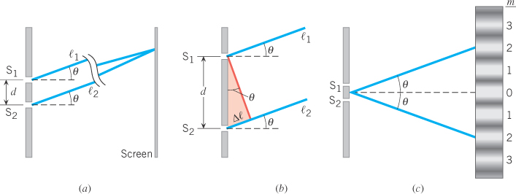
Young’s Double Slit Experiment
Note: l₁ & l₂ are approximately parallel as d is very small
Bright fringes
of a double-slit
Dark fringes
of a double-slit

Slide 9
Constructive Interference
Bright
x
S₁
d
θ
S₂
L
Use only if θ <10°
screen

Slide 11
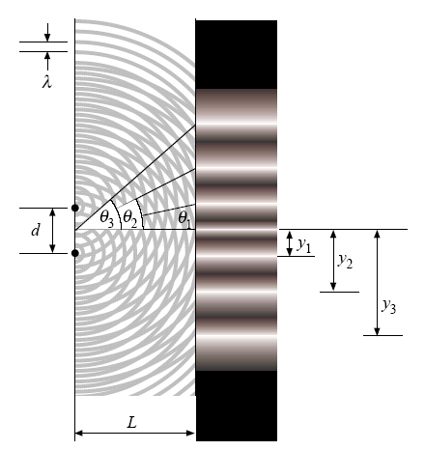

Slide 12
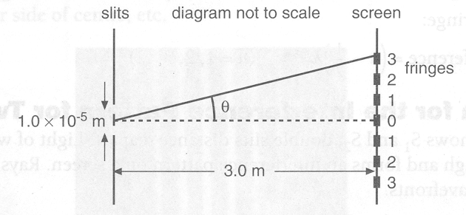
In the diagram below monochromic light of wavelength 600nm passes through two slits 1.0 x 10⁻⁵ m apart and shines on a screen 3.0m away.
At what angle to the central fringe is the 3rd bright fringe formed?
What is distance x₃ (between central fringe and m₃)?
x₃

Slide 13
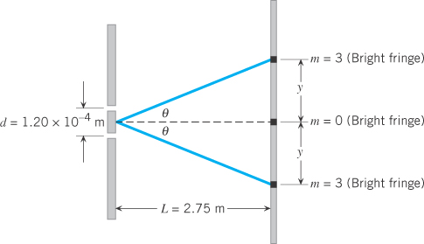
Red light (664 nm) is used in Young’s experiment with slits separated
by 0.000120 m. The screen is located a distance 2.75 m from the slits.
Find the distance on the screen between the central bright fringe and
the third-order bright fringe.

Slide 14
A Young’s two slit experiment was done and the measurements were as follows.
The slits were 0.08 mm apart, the screen was 3 m from the slits and the bright fringes on the screen were 0.9 cm apart.
Calculate the frequency of the light incident on the slits.

Slide 15
b) The slits were replaced with another slide in which the slits were further apart. Describe the effect this would have on the diffraction pattern observed on the screen.
Increasing d will cause x to decrease so the bright bands will be closer.

Slide 16
c) Light of a higher frequency was now shone on these slits. What effect would this have on the screen pattern?
Higher frequency means shorter wavelength. The bright bands closer together.

Slide 17
When green light (λ = 505 nm) passes through a pair of double slits, the interference pattern shown in (a) is observed. When light of a different colour passes through the same pair of slits, the pattern shown in (b) is observed.
Is the wavelength of the second colour greater than or less than 505 nm? Explain your answer.

Slide 18
