Slide 1
1)Doppler Effect
1
2

Slide 2
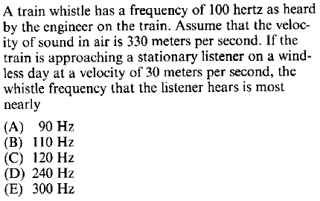
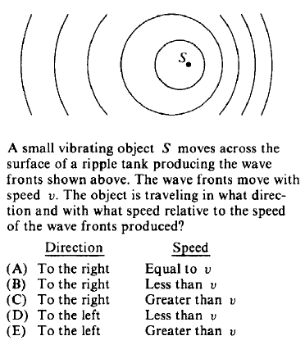
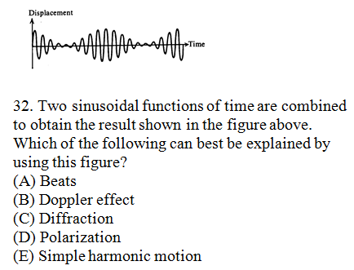
4
3
5
84#40

Slide 3
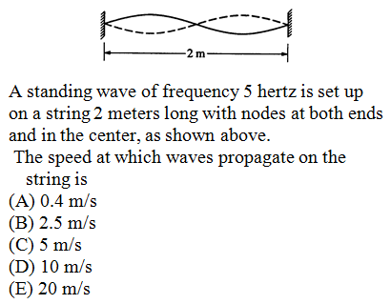
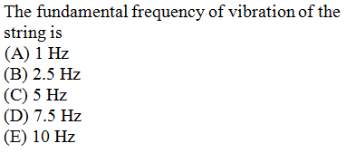
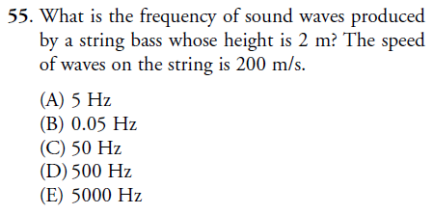
1
Qu 2 & 3
3
2
4
5
In a pipe closed at one end and filled with air, a 384-Hz tuning fork resonates when the pipe is 22-cm long; this tuning fork does not resonate for any smaller pipes. For which of these closed pipe lengths will this tuning fork also resonate?
2) Harmonics
(A) 11 cm (B) 44 cm (C) 66 cm (D) 88 cm (E) 384 cm

Slide 4
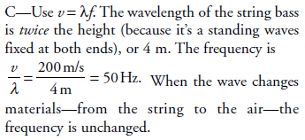
4
5
Selected
Answers

Slide 5
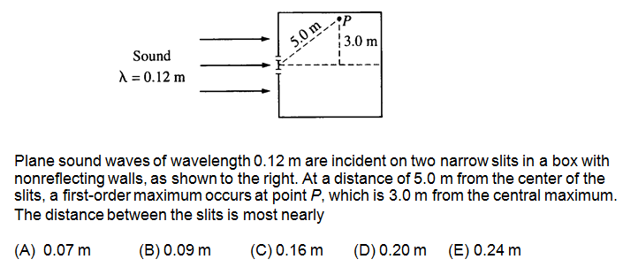
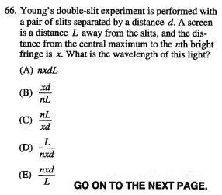
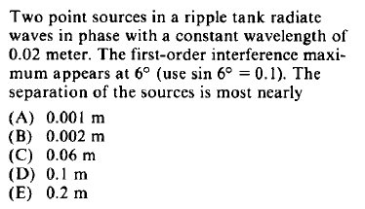
3) Interference
1
98 # 51
2
3

Slide 6
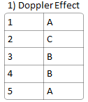
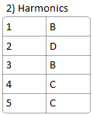
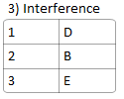
Do expect the odd mistake – be prepared to debate your answers!

