Slide 1
What is scholarship?
Scholarship provides recognition and monetary reward to top students in their last year of schooling. Scholarship exams enable candidates to be assessed against challenging standards, and are demanding for the most able candidates in each subject.
Scholarship candidates are expected to demonstrate high-level critical thinking, abstraction and generalisation, and to integrate, synthesise and apply knowledge, skills, understanding and ideas to complex situations.
From NZQA website http://www.nzqa.govt.nz/qualifications-standards/awards/scholarship/ emphasis is mine.

Slide 2
What is scholarship?
Not a qualification but appears on record of learning
$500 to $10,000 for three years
Scholarship provides recognition and monetary reward to top students in their last year of schooling. Scholarship exams enable candidates to be assessed against challenging standards, and are demanding for the most able candidates in each subject.
Scholarship candidates are expected to demonstrate high-level critical thinking, abstraction and generalisation, and to integrate, synthesise and apply knowledge, skills, understanding and ideas to complex situations.
From NZQA website http://www.nzqa.govt.nz/qualifications-standards/awards/scholarship/
3% of Level 3 cohort
That means it will be hard, involve multiple concepts at once, and you may not have seen the examples before

Slide 3
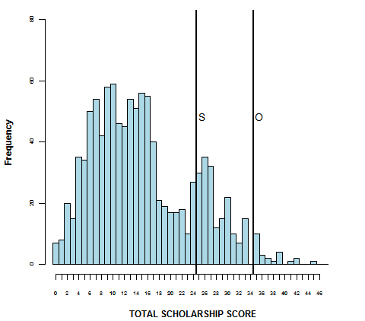
How good do I need to be?
2009
2013:
21/40 would give you scholarship
31/40 would give you outstanding scholarship

Slide 4
Level 3 and scholarship
Students who do well at scholarship will also do well at level 3.
The reverse is not true. Doing well at level 3 (statistically) says nothing about your performance on the scholarship exam.
The scholarship exam is very different to a level 3 assessment. Prepare for it separately to preparing for level 3.

Slide 5
Successful candidates
Answers were:
Logical, well-structured, concise, used diagrams, used appropriate language
Students could:
Use many concepts together / handle lots of steps
Plan their answers
Explain answers using appropriate language (English and maths)
Use physics before their maths
Do algebra correctly
Students knew:
Physics (at all levels)
Relevant History

Slide 6
What about unsuccessful candidates?
Students couldn’t
Explain things properly (either mathematically or in English)
Identify the relevant concepts
Do algebra and maths
See if their answers were reasonable
Students didn’t have enough subject knowledge
Paraphrased from NZQA 2013 Scholarship Physics Examiners’ Report

Slide 7
Time for you to have a go…
From 2010 Scholarship Physics exam
Can you discuss this accurately, using your physics terminology correctly?

Slide 8
Some resources
Past exam papers
All can be accessed on NZQA website
Model answers too!
Examiners’ comments are useful
www.nzqa.govt.nz and search for ‘scholarship physics’
Videos on physicslounge (thanks to Sam Hight)
www.physicsloung.org/scholarship-dr-marcus-wilson
Scholarship preparation sessions
http://coursecast.its.waikato.ac.nz/Panopto/Pages/Viewer/Default.aspx?id=743e26c8-44a2-4c3f-a1c5-a023e40d9f2b
http://coursecast.its.waikato.ac.nz/Panopto/Pages/Viewer/Default.aspx?id=da332ebb-7167-4c09-809f-65633b65a121

Slide 9
Final advice
Is a student realistically in with a chance of scholarship?
Are they getting merits/excellences?
Look at resources on NZQA website
Practise questions: particularly writing explanations with
Clear, concise English
Appropriate use of diagrams
Well presented mathematics

