Slide 1
UNIFORM CIRCULAR MOTION - UCM
Is when a objects motion is in a circle of constant radius moving at a constant speed.
The distance of one complete revolution / cycle around the perimeter of a circle (circumference) is
The time to travel one revolution / cycle is the period (T).
The object speed is
Frequency is the # of revolutions / cycles in 1 second
Unit: Hz or s⁻¹

Slide 2
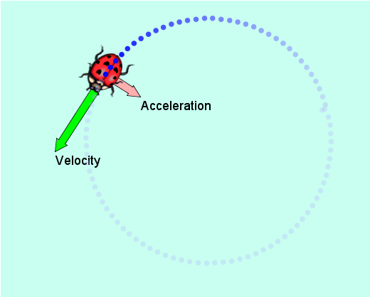
PhET ladybug-motion-2d_en applet

Slide 3
A mass is being spun in a circle as shown
Mass = 250 g; time for half a revolution 6.7 s; radius = 1.4 m
Calculate the period.
Calculate the frequency.
Which way is the mass rotating?

Slide 4
A mass is being spun in a circle as shown
Mass = 250 g; time for half a revolution 6.7 s; radius = 1.4 m
Calculate the period.
Calculate the frequency.
Which way is the mass rotating?
Calculate the period.
6.7s to turn half revolution
13.4s to turn one revolution
Period T = 13 s

Slide 5
A mass is being spun in a circle as shown
Mass = 250 g; time for half a revolution 6.7 s; radius = 1.4 m
Calculate the period.
Period T = 13 s
2. Calculate the frequency.

Slide 6
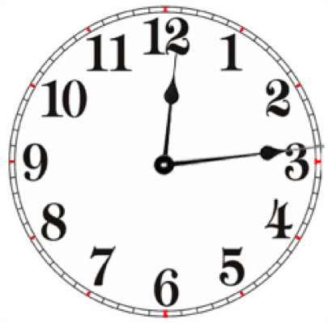
A mass is being spun in a circle as shown
Mass = 250 g; time for half a revolution 6.7 s; radius = 1.4 m
Which way is the mass rotating?
anti-clockwise
During rotation the direction the object is moving is continuously changing.
The clock face is a convenient way to describe the direction of rotation.
The rotation is either going the same way as the movement of the hands on the clock (clockwise)
or
going the opposite way to the movement of the hands on the clock (anti-clockwise)

Slide 7
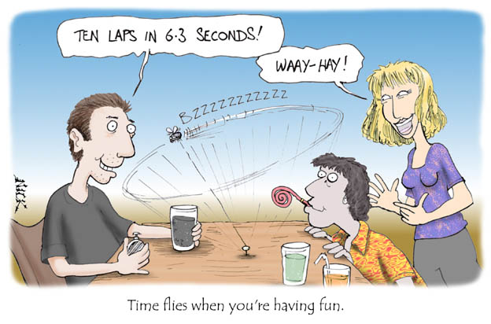

Slide 8
A ball moves around a circle at 10 rpm (rev/min)
Convert 10 rpm into Hz or s⁻¹
Determine the ball speed if the horizontal circle has a 50 cm radius.

Slide 9
Acceleration involves a change in velocity (speed or direction); it is caused by an unbalanced force (or net force).
In UCM, the object moves at constant speed but it’s velocity is changing because its direction is constantly changing.
Therefore it is undergoing Acceleration!
v₂
v₁

Slide 10
For an object doing UCM, acceleration is toward the center of the circle. This is called centripetal acceleration
As acceleration is directed toward the center of the circle, so to is net force. This is called centripetal force (F_{c})
This net force must be applied by other objects.
v
a_{r}
r
F_{c}

Slide 11
A mass is being spun in a horizontal circle as shown
Mass = 250 g; time for half a revolution 6.7 s; radius = 1.4 m
Show the direction of the following vectors acting on the mass. Label each vector.
the acceleration on the mass.
the instantaneous velocity
the unbalanced force (assume F=0.25a)
State the displacement of the mass after ONE revolution, explain your answer.

Slide 12
A mass is being spun in a horizontal circle as shown
Mass = 250 g; time for half a revolution 6.7 s; radius = 1.4 m
Show the direction of the following vectors acting on the mass. Label each vector.
the acceleration on the mass.
the instantaneous velocity
a
v
F
the unbalanced force
Using F = ma
assume F = 0.25a

Slide 13
A mass is being spun in a horizontal circle as shown
Mass = 250 g; time for half a revolution 6.7 s; radius = 1.4 m
State the displacement after ONE revolution, explain your answer.
d = 0
Although the distance travelled by the object = 2πr
≈ 8m
the object has arrived back at its starting position so its total displacement is zero.

Slide 14
A mass is rotated through a horizontal plane ie., parallel to the ground as shown.
Mass = 250 g; time for half a revolution 6.7 s; radius = 1.4 m
Show the tangential velocity is 0.66 ms⁻¹
Calculate the centripetal acceleration.
Calculate the unbalanced force.

Slide 15
A mass is rotated through a horizontal plane ie., parallel to the ground as shown.
Mass = 250 g; time for half a revolution 6.7 s; radius = 1.4 m
Show the tangential velocity is 0.66 m s⁻¹
A

Slide 16
A mass is rotated through a horizontal plane ie., parallel to the ground as shown.
Mass = 250 g; time for half a revolution 6.7 s; radius = 1.4 m
Show the tangential velocity is 0.66 ms⁻¹
Calculate the centripetal acceleration.
A

Slide 17
A mass is rotated through a horizontal plane ie., parallel to the ground as shown.
Mass = 250 g; time for half a revolution 6.7 s; radius = 1.4 m
Show the tangential velocity is 0.66 ms⁻¹
The centripetal acceleration. a = 0.31 m s⁻¹
Calculate the unbalanced force.
or
A

Slide 18
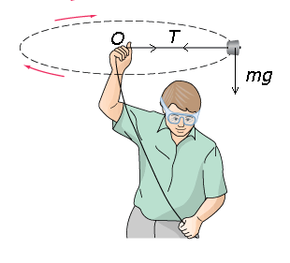
Motion in a horizontal circle
When an object is whirled on the end of a string round a horizontal circle, the centripetal force that enable the object to move in a circle is the tension T in the string.

Slide 19
Problems:
A moving ball is spun in a circle with a diameter of 1 m at a speed of 3 m/s. What is its centripetal acceleration?
A 250 g mass is spun in a horizontal circle. It is held at the end of a 1 m length of string. If it is spun at 15 m/s, what force is applied?

Slide 20
A ball weighing 5 N is attached to a 1 m string and swung in a horizontal circle above one's head at the rate of 5 rev/sec (5 rps). What centripetal force is required?

Slide 21
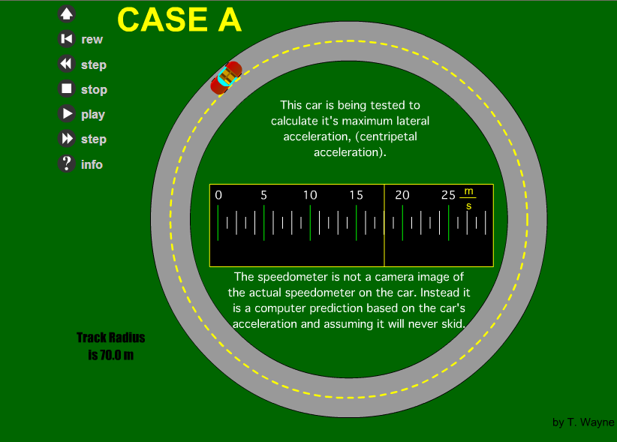
Show car spinning out applet

Slide 22
The average person on the street has heard of centrifugal force. When asked, they would describe this force as the one pushing an object to the outside of a circle. There is only one problem with this description. There is NO FORCE pushing an object to the outside.
For a person riding in a car while traveling in a circle, he perceives a force pushing him to the outside of the circle. But what force is physically pushing him? It can not be friction. Frictional forces oppose the direction of motion. It cannot be a normal force¹ . There is not a surface pushing the rider to the outside. To travel in a circle, a force pointing to the inside of the circle, or curve, is needed. The force pointing to the inside is called the centripetal force.
To understand a source for the misconception of the direction of this force, consider what it feels like when traveling around a corner in the back seat of a car. Everyone who has been in this situation knows that the passenger will slide to the outside of the curve. To understand that there is no force pushing the passenger to the outside, a change of reference frame is needed. Move the point of view from inside the car to a location outside, above, the car.

Slide 23
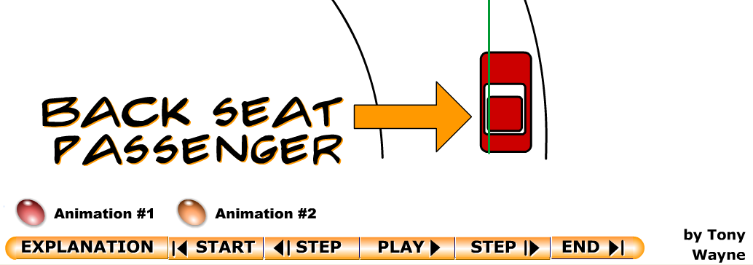
Show Back seat passenger.swf applet

Slide 24
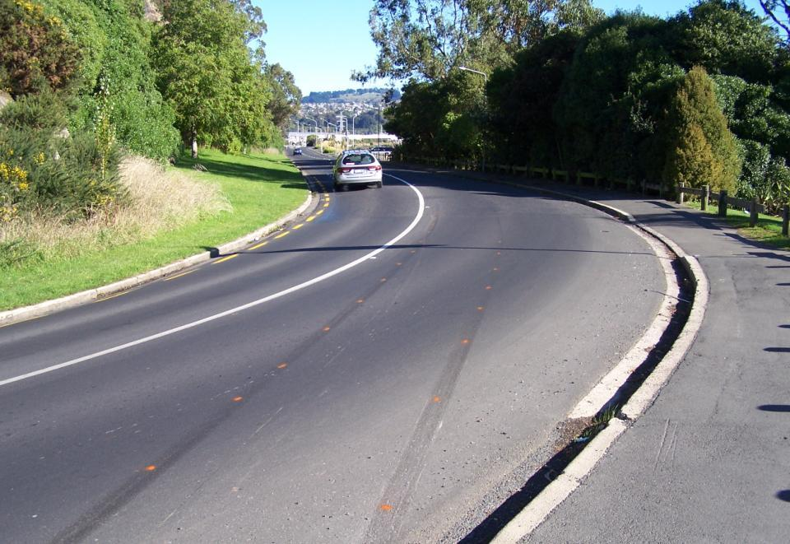

Slide 25
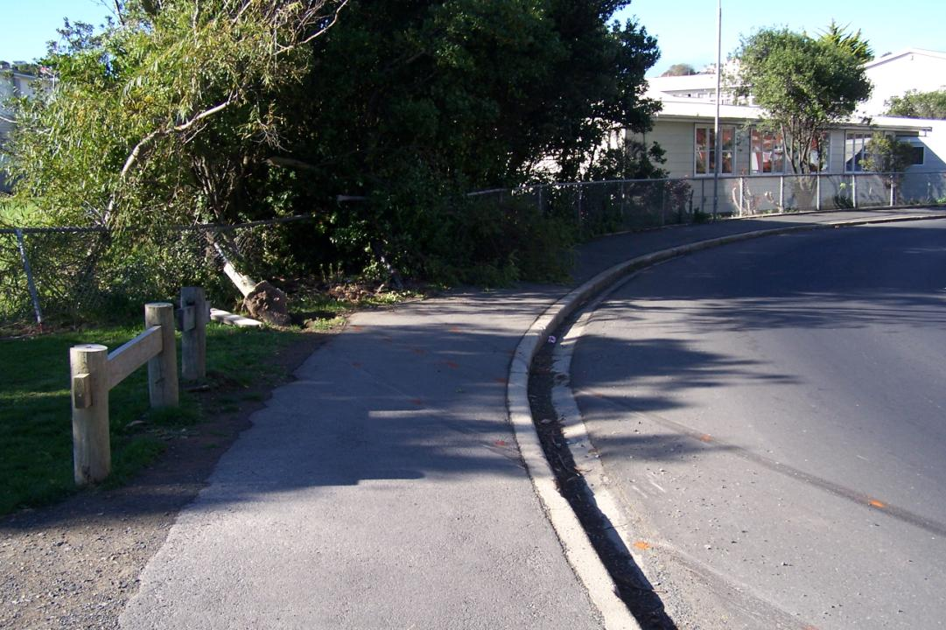

Slide 26
Centripetal force keeps an object in circular motion.
Centripetal forces can be exerted in a variety of ways.
The “string” that holds the moon on its almost circular path, for example, is gravity.
Electrical forces provide the centripetal force acting between an orbiting electron and the atomic nucleus in an atom.
Anything that moves in a circular path is acted on by a centripetal force.

Slide 27
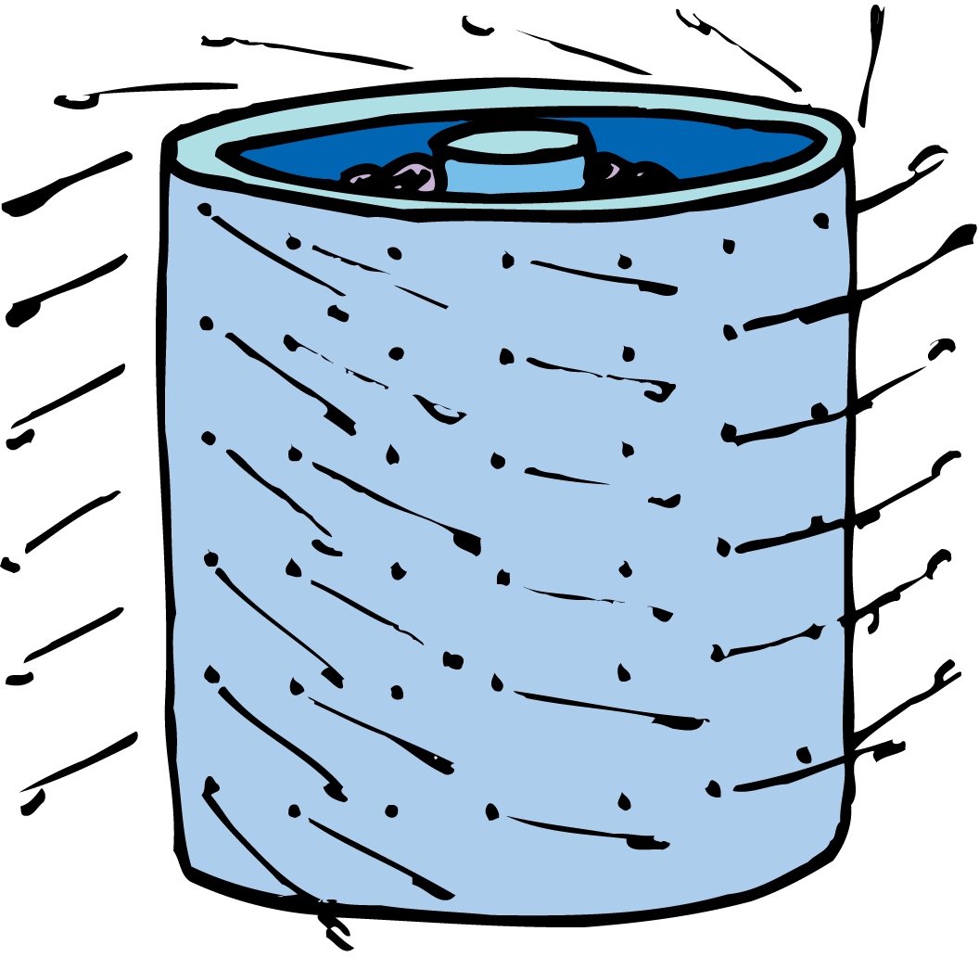
The clothes in a washing machine are forced into a circular path, but the water is not, and it flies off tangentially.

Slide 28
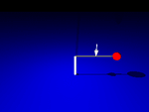
Ex: Ball on a string
If the ball’s mass is 2.0 kg, its speed is 3.0 m/s, and the radius of the circle is 1.0 m, find
a) the ball’s acceleration
b) the tension in the string

Slide 29
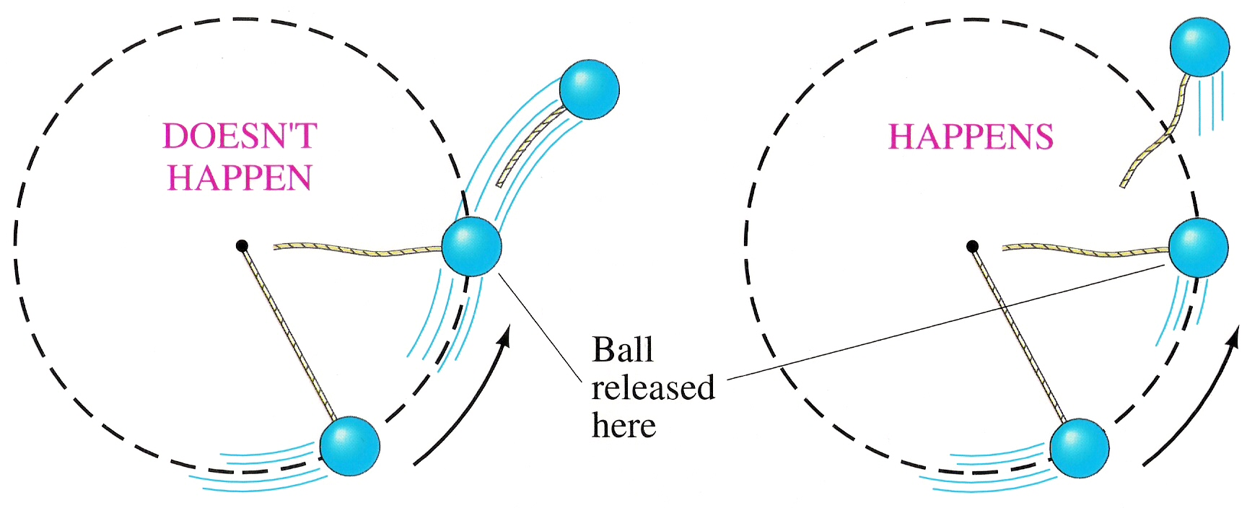

Slide 30
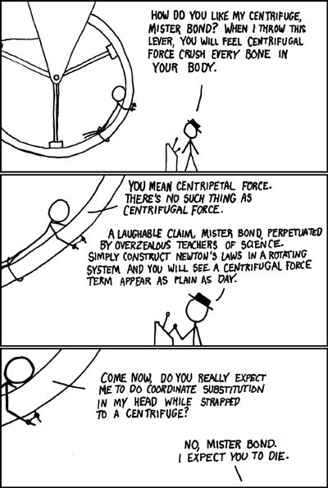

Slide 31
This car is travelling on the open road at a constant speed of 28 m s^{–1}. Part of the road forms the arc of a circle of radius 80 m. The mass of the car and its four occupants is 1357 kg.
Which arrow shows the direction of the resultant force acting on the car as it travels around the corner at constant speed?
b
a
c
Explain why the resultant force acts in the direction you have chosen?
d
Calculate the value of the resultant force. Give your answer to the correct number of significant figures
F = ma F = m
F = -kx

Slide 32
This car is travelling on the open road at a constant speed of 28 m s^{–1}.
Part of the road forms the arc of a circle of radius 80 m.
The mass of the car and its four occupants is 1357 kg.
Which arrow shows the direction of the resultant force acting on the car as it travels around the corner at constant speed? ANS: C
b
A
a
M
c
Explain why the resultant force acts in the direction you have chosen?
The Δv from north to east is because of an unbalanced force acting towards the center of the circle
d
Calculate the value of the resultant force. Give your answer to the correct number of significant figures
A

Slide 33
2010
easy

Slide 34
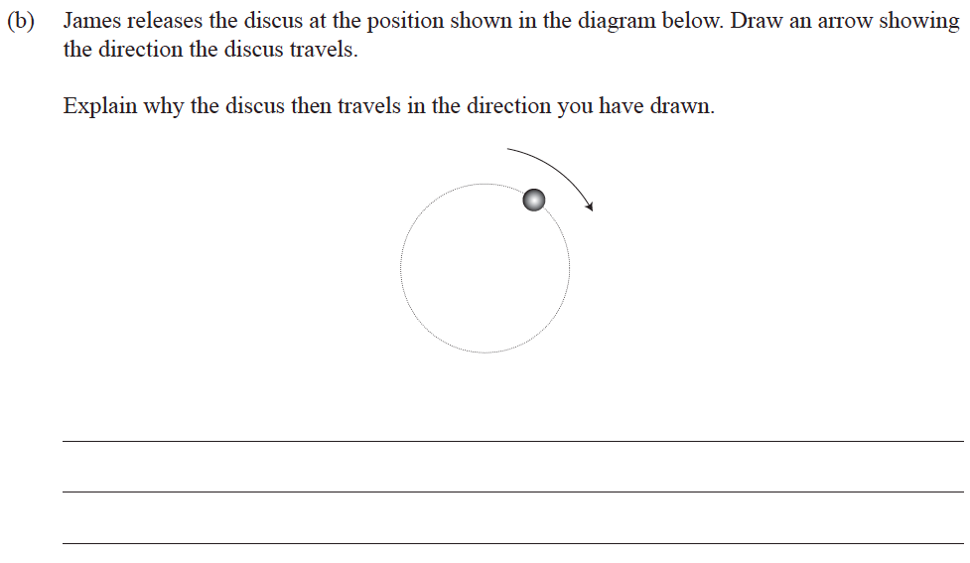
Ex

Slide 35
Hard!

