Slide 1
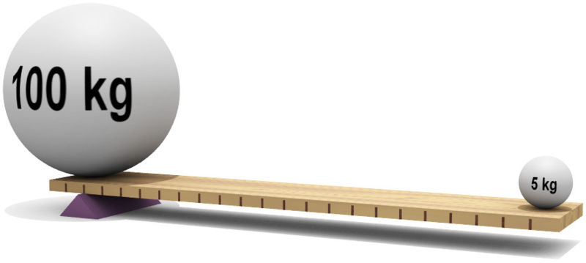
Torque

Slide 2
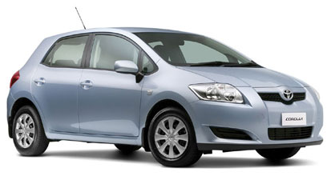
Toyota Corolla Hatch GX
Power = 100kW @ 6000 rpm
Max Torque = 175 Nm @ 4400 rpm
7.4 L/100km fuel consumption
Engine Capacity: straight 4, 1.8L

Slide 3

SS Holden Commodore
Power = 270 kW @ 5700 rpm
Torque = 530 Nm @ 4400 rpm
Engine capacity: V8, 6L

Slide 4
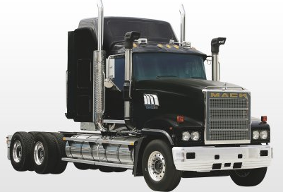
Mack Truck
Power = 373kW @ 1900 rpm
Max Torque = 2,508 Nm @ 1,900 rpm
Engine Capacity: 6 cylinder, 15L

Slide 5

Movement
Torque
Stationary
in equilibrium

Slide 6
4 m
1 m
2 m
F₁
F₂
100 N
800 N
Find F₁ and F₂

Slide 7

A man walks across a shark infested creek. The mass of the bridge is 45 kg and is 5.2 m long. A man of mass 85 kg tentatively walks to a point 1.3 m from end A to get a better view of the sharks below. The man is unaware that termites have weaken support B so that it will support only 500 N. Does the man get wet?
1.3 m
A
B
5.2 m

Slide 8
Torque ~ Turning Force
e.g. the force used to open a door
d
F
Torque is a vector:
direction of either clockwise or anti-clockwise
Units for torque are Nm
The Pivot (or fulcrum) is the point around which the object rotates.

Slide 9
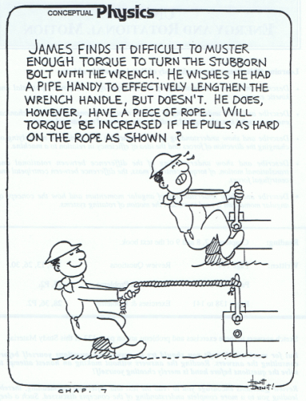

Slide 10
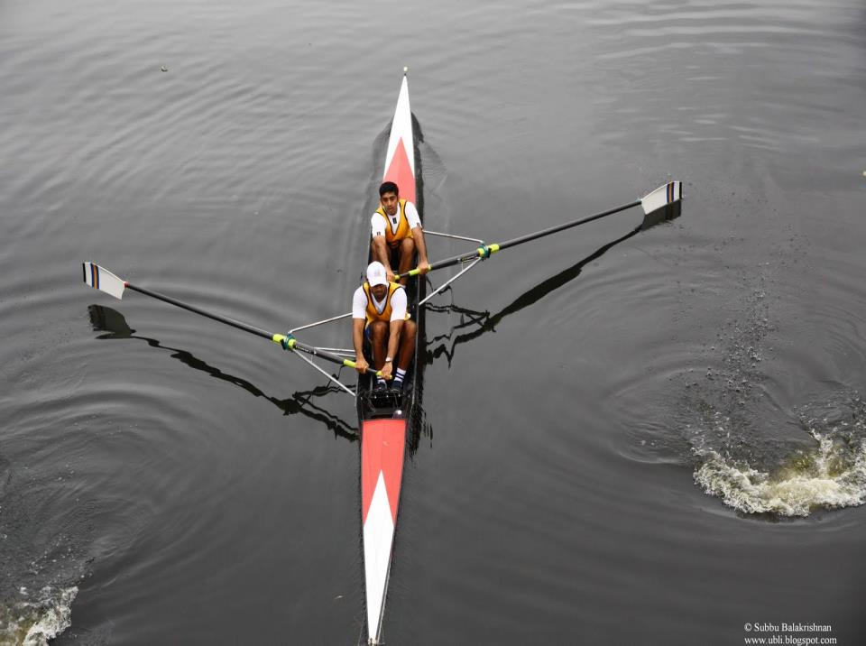

Slide 11
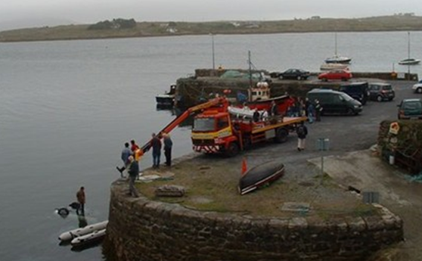

Slide 12
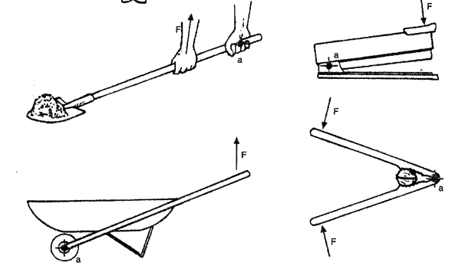
Common tools that you exert forces (F) on, thus creating torques around axes (a)

Slide 13
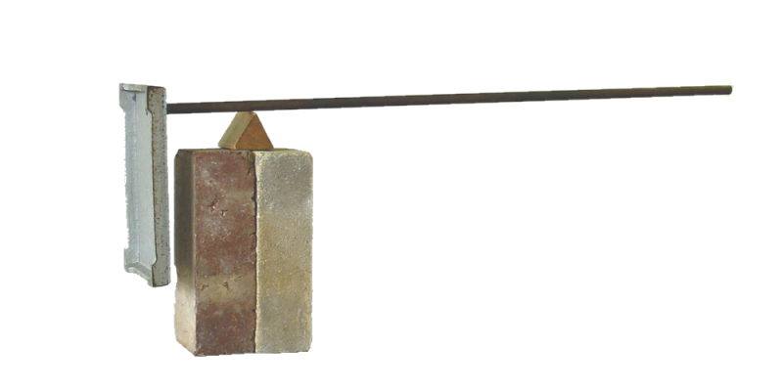
Centre of mass
contact force of pivot
weight of stand
The point on an object where all its weight seems to be concentrated is called the centre of mass.

Slide 14
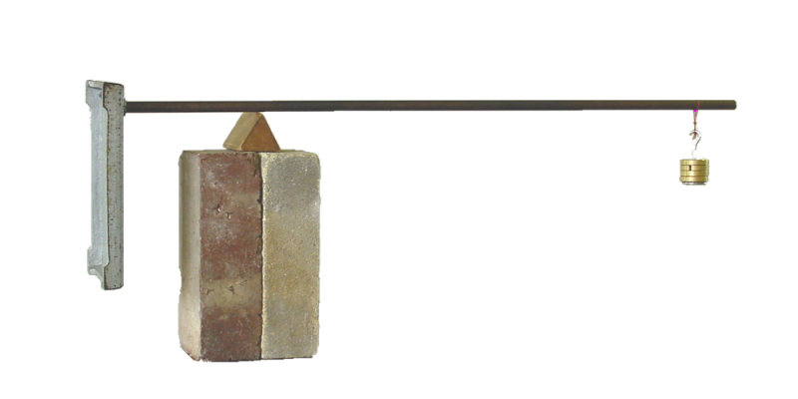
Centre of mass
contact force of pivot
weight of stand
weight of mass
An object in Equilibrium means…

Slide 15
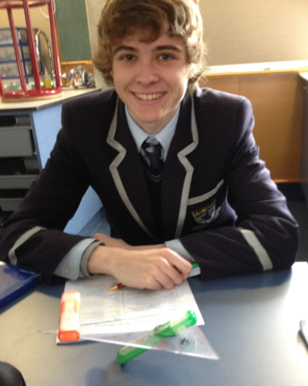

Slide 16
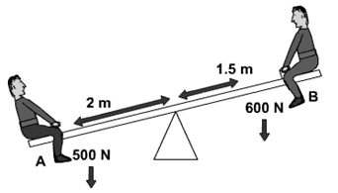
Example: Is the seesaw in this picture balanced?
Στ = 0
A: Moment = Force x distance
= 500 N x 2 m
= 1000 Nm
B: Moment = Force x distance
= 600 N x 1.5 m
= 900 Nm
No, the seesaw is not balanced. It will turn anticlockwise.

Slide 17

∑F=ma If ∑F = 0 then a = 0
∑τ=Iα If ∑τ = 0 then α = 0
Y13
If these conditions are met, we say that something is in Equilibrium.
∑F_{x} = 0
∑F_{y} = 0
∑τ = 0
the total of all the clockwise torques
the total of all the anti- clockwise torques
=

Slide 18
The mass of the boy and the tray is 65 kg.
Show the mass of the plank is 11 kg
Take g = 9.8 m s⁻²
F₁ = 370 N
F₂ = 370 N
740 N
2.5 m
5 m

Slide 19
The mass of the boy and the tray is 65 kg.
Show the mass of the plank is 11 kg
Take g = 9.8 m s⁻²
F₁ = 370 N
F₂ = 370 N
740 N
2.5 m
5 m
Students succeed better in Physics when answers that require calculations:
Show all working i.e., equation, substitution and answer. (Criterion 2);
Have correct significant figures (Criterion 1); and
Show the correct unit (Criterion 1)
The support forces and the weight forces are balanced.
The upward forces = downward forces
370 N + 370 N = weight of the boy + weight of plank
740 N = 637 N + 103 N
Weight = mass x gravity mass = 103/9.8 = 10.5
mass = 11 kg (2sig.fig)
M
Merit

Slide 20
A 40.0 kg gymnast stands at one end of the beam as shown. The beam is uniform and weighs 680 Newtons. The beam is held off the ground by two supports, which are 0.75 m from each end of the beam. ( g = 10 Nkg⁻¹)
Show that the sum of the clockwise torques about point A is 2890 Nm.
Assuming the beam is in equilibrium, determine the anticlockwise torque about point A.
Calculate the support force at A.
5.00 m
2.50 m
0.75 m
A
B
F_{W}
680 N
Floor
0.75 m

Slide 21
Show the mass of the 1 m ruler is about 200 g. Take g = 9.8 m s⁻²
The weight of the ruler F_{w} acts at the centre 0.5 m from the end.
The support force is labeled F_{s}
15 N
F_{s}
0.05 m
0.1 m
0.5 m
1 m

Slide 22
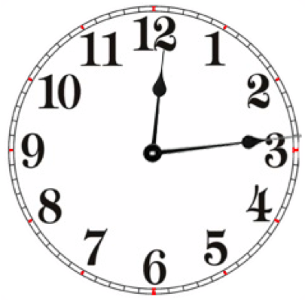
Show the mass of the 1 m ruler is about 200 g. Take g = 9.8 m s⁻²
The weight of the ruler F_{w} acts at the centre 0.5 m from the end.
The support force is labeled F_{s}
15 N
F_{w (ruler)}
F_{s}
0.05 m
Take moments about the support force Fs.
0.1 m
0.5 m
Excellence
E

Slide 23
The plank has a weight of 98 N.
The boy and tray have a weight of 637 N.
How far to the left (d) of the fulcrum (F_{LS}) can the boy stand without the plank tipping?
F_{B} = 637 N
F_{LS}
F_{RS} = 0
F_{w} = 98 N
d
2.5m
0.40 m
5.0 m
Take moments about F_{LS}
Excellence
E

Slide 24
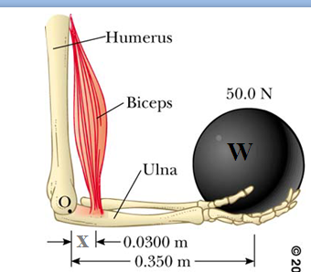
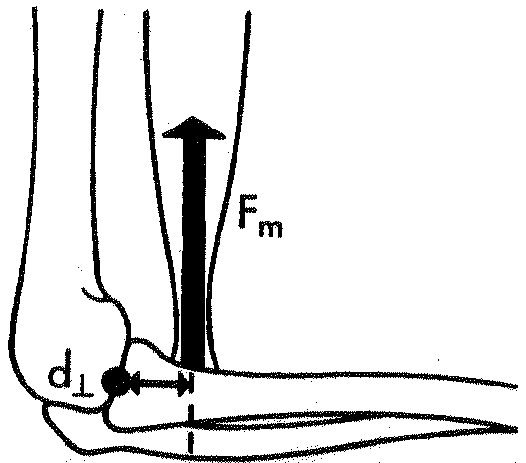
Torques in the Arm

Slide 25
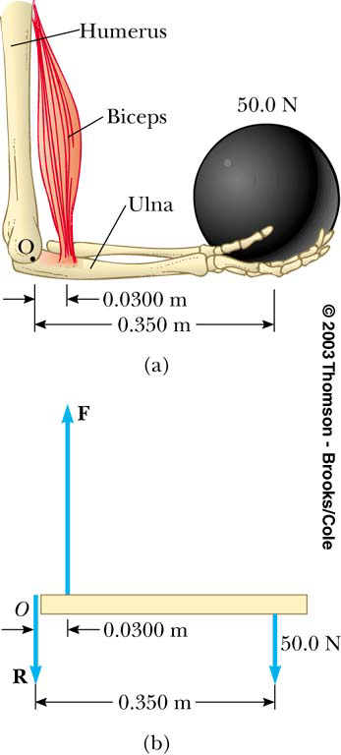
Given: W=50 N, L=0.35 m,
x=0.03 m
Find the tension in the muscle
W
x
L

Slide 26
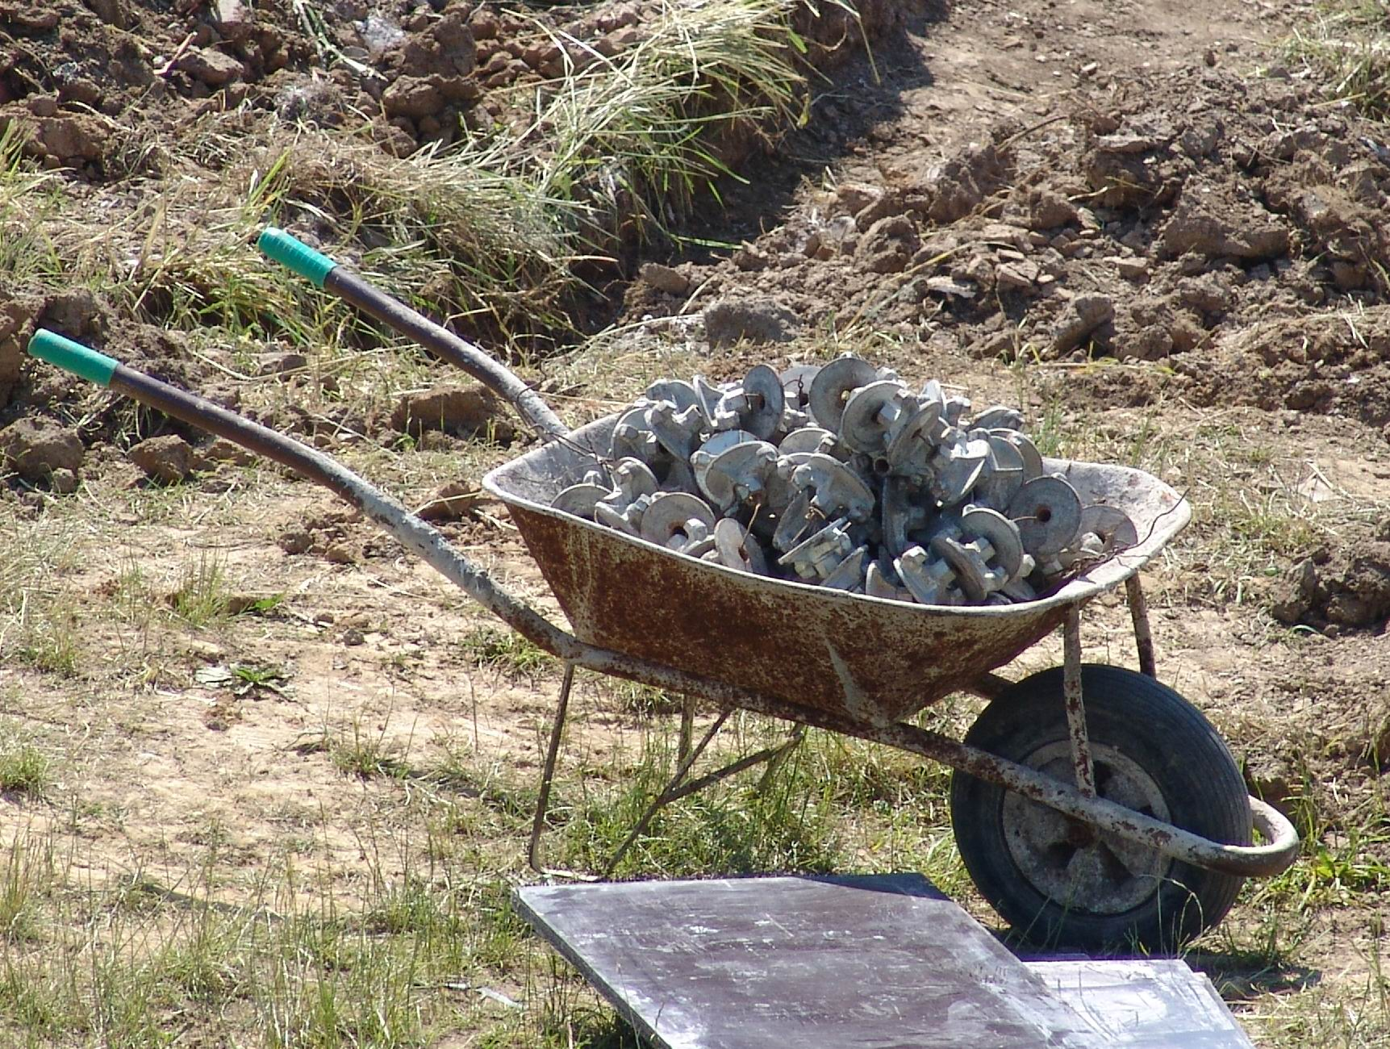
This is a picture of a loaded wheelbarrow.
Draw a free body diagram when Mutu lifts the handles and holds the wheelbarrow steady.
Label the reaction/support force at the pivot, the load force and the effort force.

Slide 27
This is a picture of a loaded wheelbarrow.
Draw a free body diagram when Mutu lifts the handles and holds the wheelbarrow steady.
Label the reaction/support force at the pivot, the load force and the effort force.
Free body diagram
Effort force
Load force
Support force
Merit
M

Slide 28
This is a picture of a loaded wheelbarrow with a superimposed free body diagram.
Show the effort force required to lift the legs off the ground is 240 N.
Effort force
distance d_{e} = 1.7 m
Free body diagram
Support force
Taking moments about the Support force
M
Load force
F_{L} = 1000 N
d_{L} = 0.40 m

Slide 29
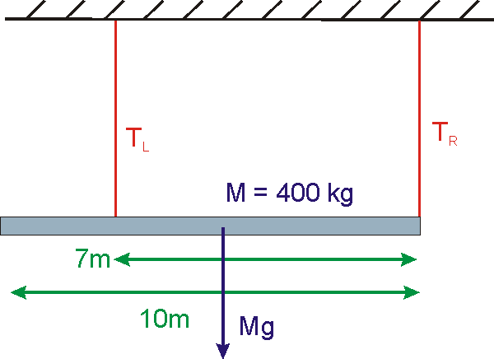
Problems with TWO
Pivot points
Consider the 400-kg
beam shown below.
Find T_{R}

Slide 30
An man walks across a shark infested creek. The mass of the bridge is 45 kg and is 5.2 m long. A man of mass 85 kg tentatively walks to a point 1.3 m from end A to get a better view of the sharks below. The man is unaware that termites have weaken support B so that it will support only 500 N. Does the man get wet?
1.3 m
A
B
5.2 m
At what point does he get wet?

