Slide 1
String wave Speed
v = fλ
v
Tension in
the String
(N)
Speed of
the Wave
(m/s)
Linear Density
of the String
(kg/m)

Slide 2
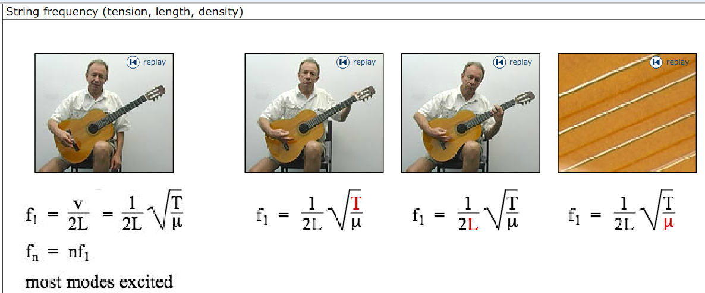
Standing waves_tension plus

Slide 3
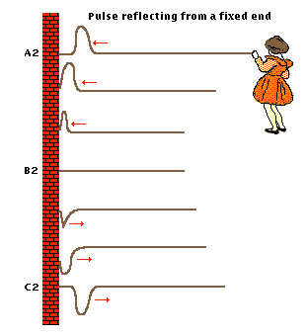
Properties of Pulse Waves
Reflection
The pulse reflects upside down from a fixed end.

Slide 4
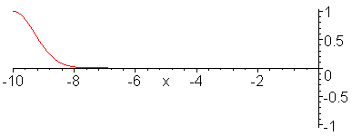
The pulse reflects upside down from a fixed end.

Slide 5
Wave hits the wall and reflects back
If the frequency is just right, an exact /stable number of these (?) can be seen on the string: a standing wave formed.
Rugby balls or Lemons?

Slide 6
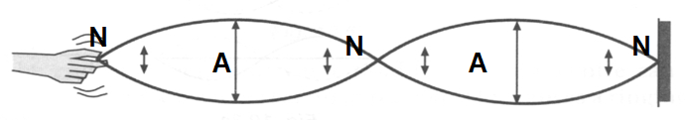
2012 ~ Lemons
2013 ~ Rugby balls
2014 ~ Lemons
1λ = 2 Lemons

Slide 7
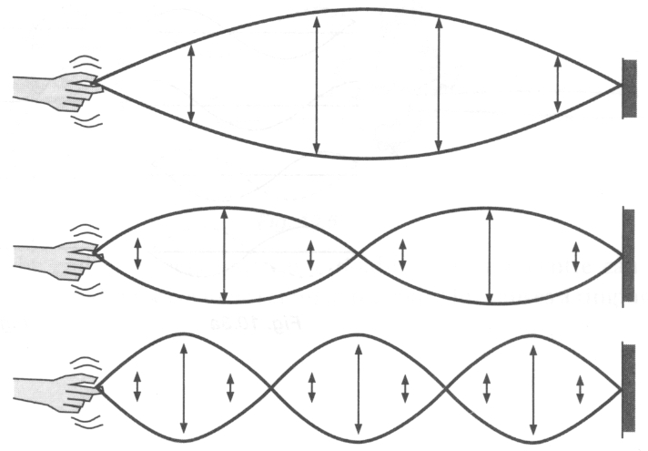
Transverse Standing waves
When a traveling wave reflects back on itself (undergoes a Phase Change), it creates traveling waves in both directions. The wave and its reflected wave interfere.
With exactly the right frequency, the wave will appear to stand still, this is called a standing wave and the frequency is the Resonance frequency. Note at Resonance wave energy is amplified!
Node: point of zero displacement on a standing wave (all particles are at rest at all times).
N
N
N
A
A
Antinode: point of maximum displacement on a standing wave
(all particles moving up & down).
For a standing wave λ = 2 x (distance between adjacent nodes) or…
1 λ = 2 lemons

Slide 8

Resonance ~Driven or Forced Harmonic Motion
When a system is disturbed by a periodic driving force and then oscillates, this is called forced oscillation. A system is said to have a ‘natural’ or resonance frequency ( f_{o} ) which is independent of the frequency of the driving force.
If the driving force frequency matches the natural frequency…
Driving Force
then the amplitude can becoming large (and potentially dangerous). This is called Resonance.
Resonance frequencies will be explored in Waves (standing waves / harmonics) & AC Circuits (tuning radios).

Slide 9
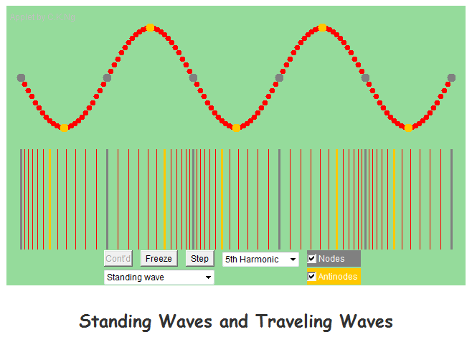
http://ngsir.netfirms.com/englishhtm/TwaveStatA.htm

Slide 10
String instruments and harmonic frequencies

Slide 11
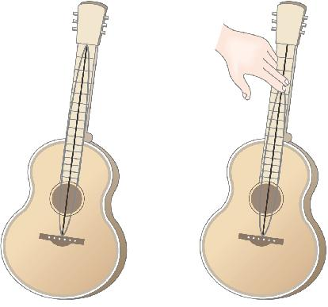
Sources of Sound: Vibrating Strings
The length of string that vibrates is determined by finger placement. The placement determines the wavelength and pitch (frequency) of the sound formed.
The pitch of a string of a given length can also be altered by changing the string density or tension that the string is under.
Physics Guitar demo

Slide 12
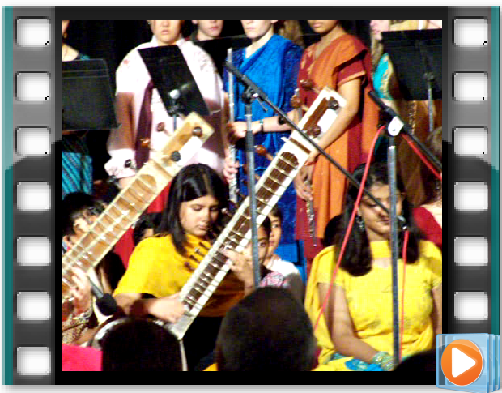

Slide 13
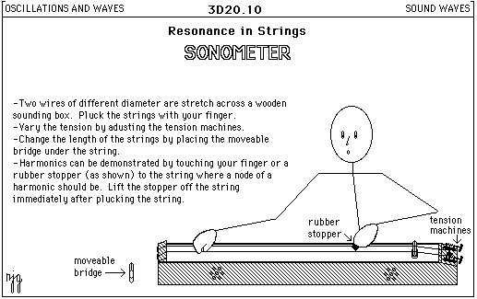

Slide 14
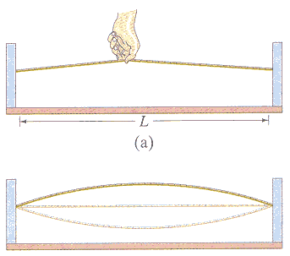

Slide 15
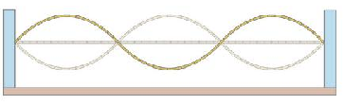
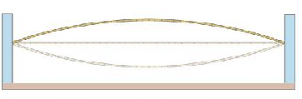
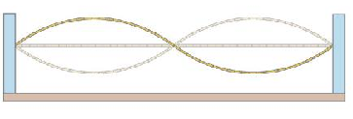
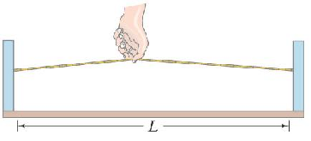
First Harmonic - Fundamental
Second Harmonic
Third Harmonic

Slide 16
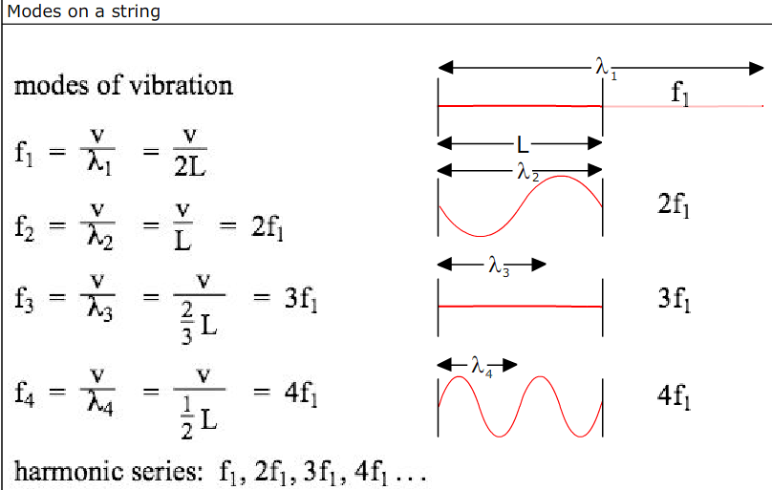

Slide 17
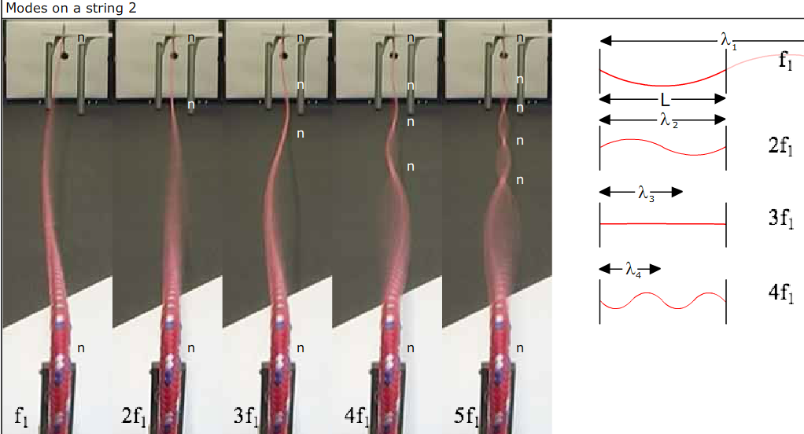

Slide 18
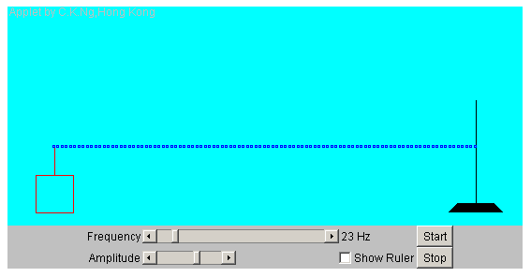
Resonance on a vibrating string Applet

Slide 19
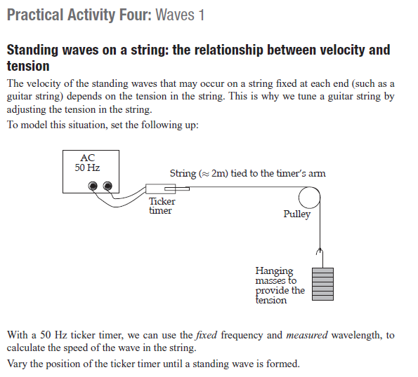

Slide 20
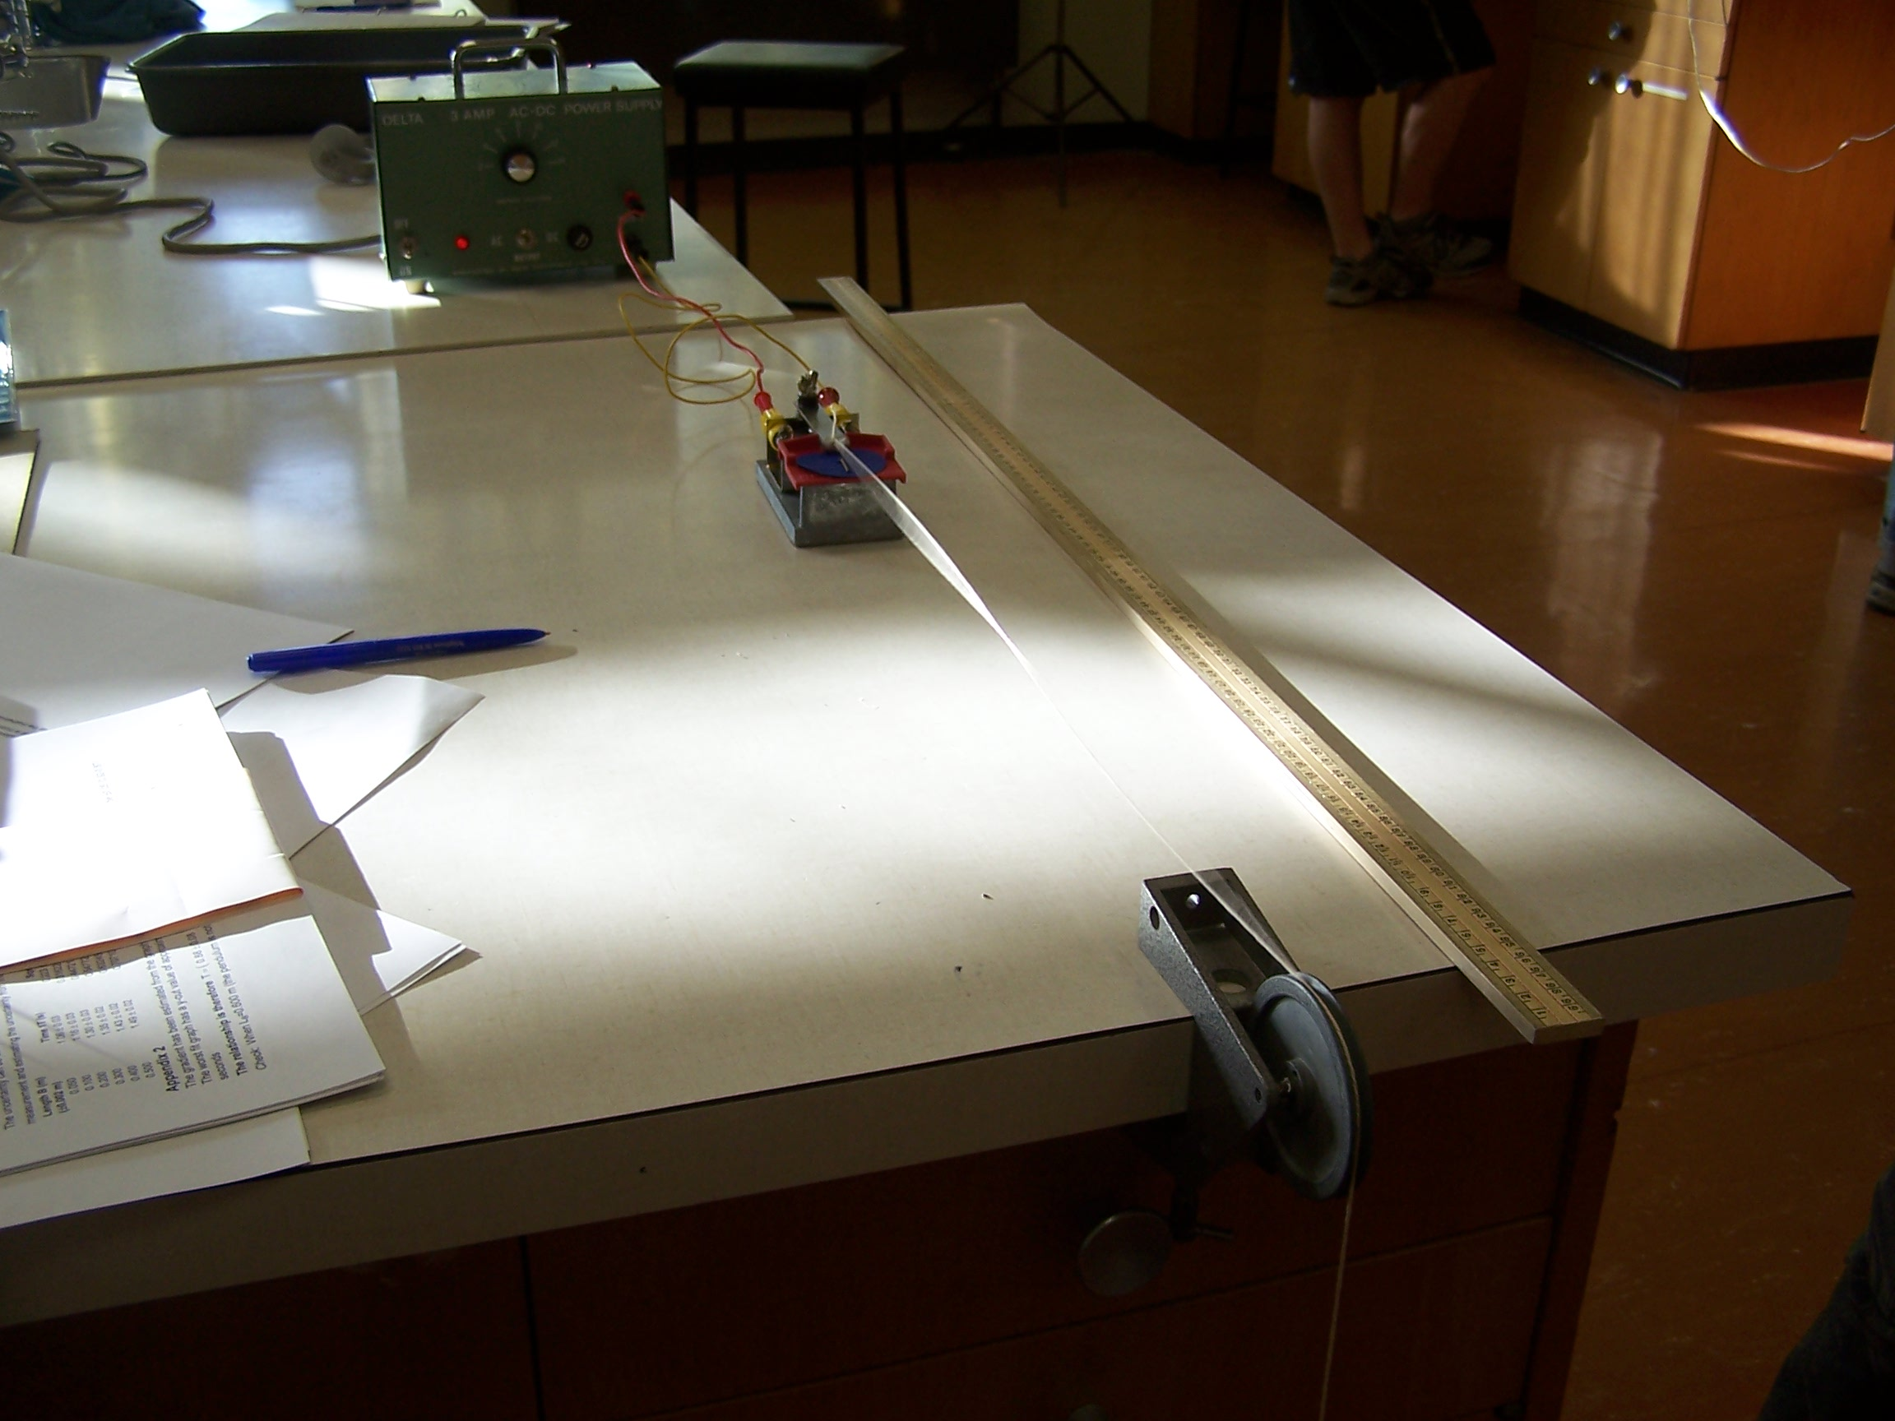

Slide 21
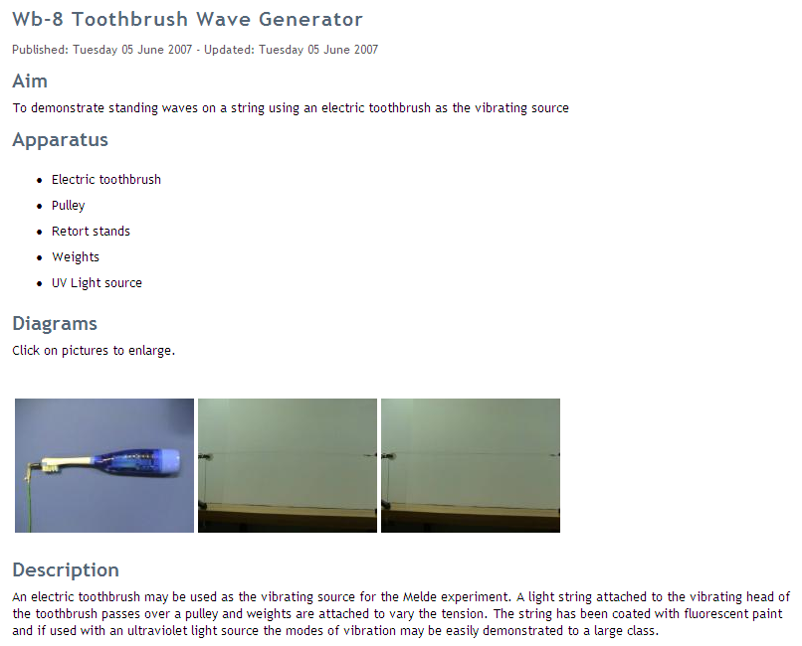

Slide 22
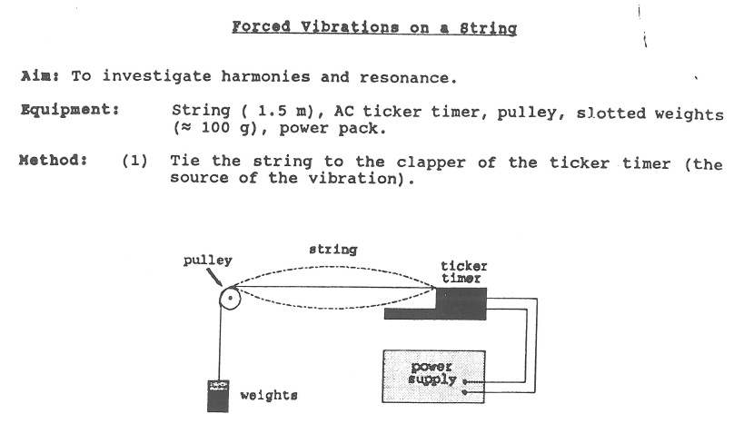

Slide 23
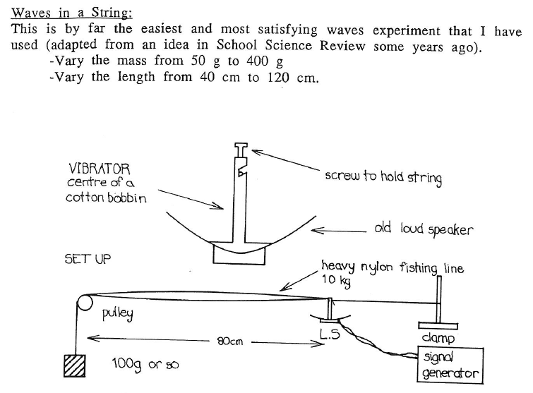

Slide 24


Closed End Transverse waves
N
N
A
N
A
A
Meter ruler demo
# of Rugby balls ?

