Slide 1
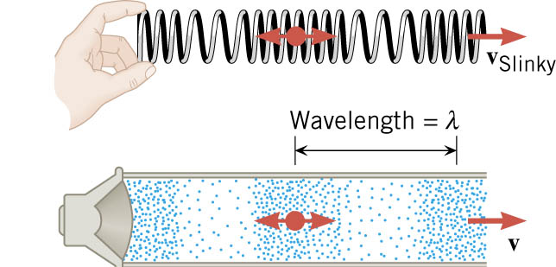
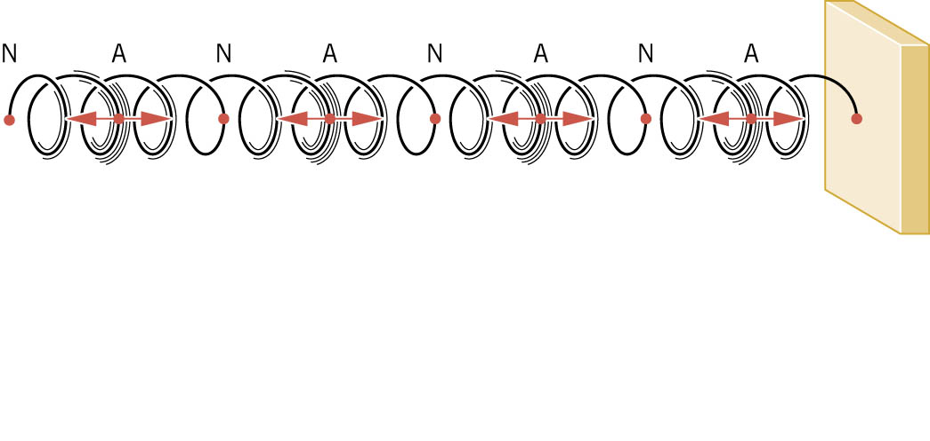
Longitudinal Standing Waves
antinodes (max. vibration)
nodes (no vibration)

Slide 2
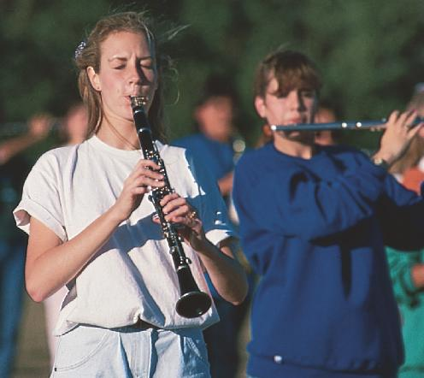
Wind instruments create sound through standing waves in a column of air.

Slide 3
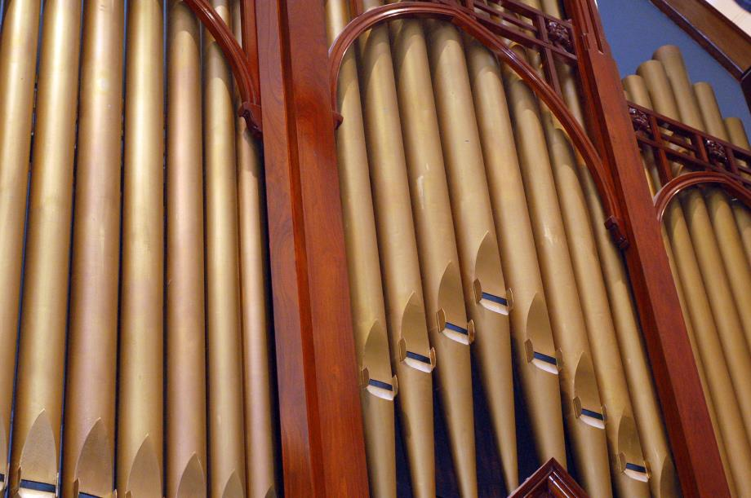

Slide 4

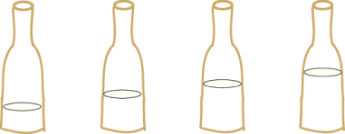
When air is blown over a bottle, it creates a standing longitudinal (sound) wave
open end: antinode
Remember, this is a longitudinal wave even though we draw it like this to visualize the shape.
vibrating air molecules
closed end: node

Slide 5
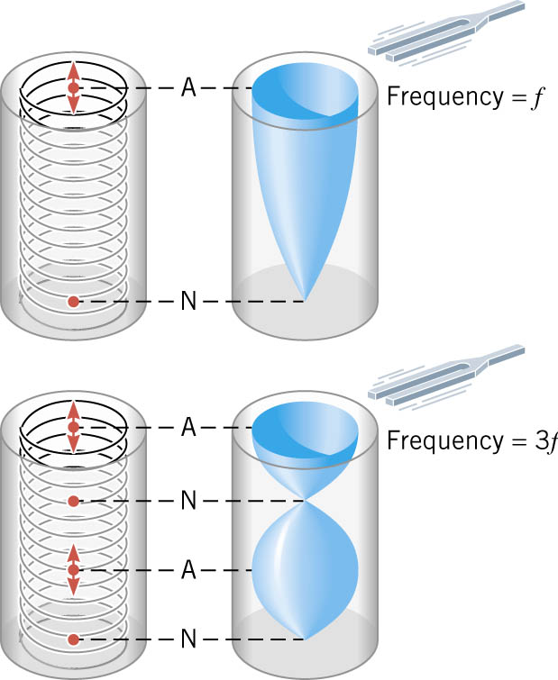

You can also ring a tuning fork over a bottle or tube, and if it creates wavelengths of just the right length, you’ll get a standing wave (loud sound).

Slide 6
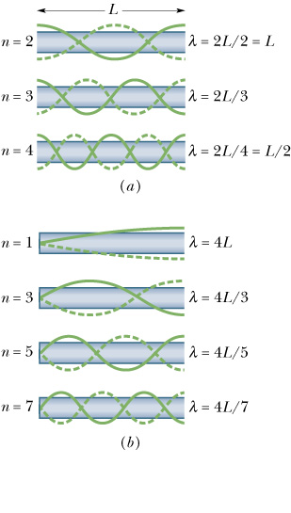
CLOSED PIPE
Just like we did for strings, we can also derive a formula to calculate……
The Harmonic Frequencies for a tube open at one end
speed of sound
odd harmonics only
n = 1,3,5,…

Slide 7
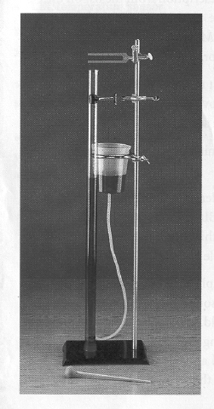
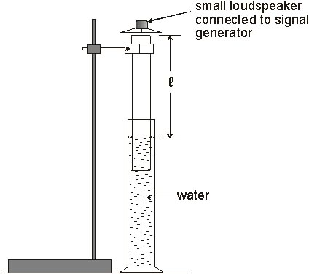

Slide 8
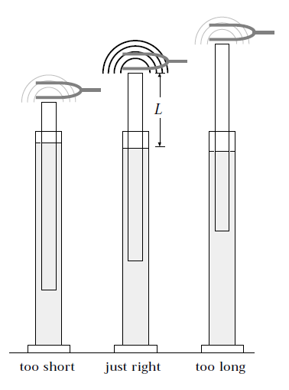

Slide 9
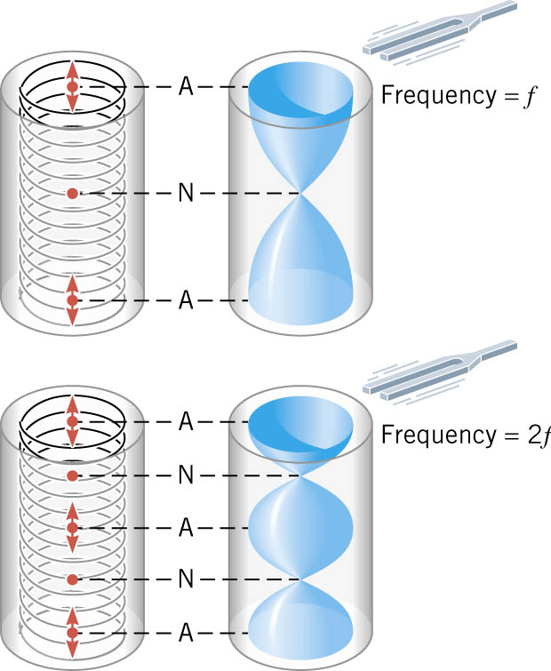
OPEN PIPE
Standing waves can also occur in a tube that is open at both ends

Slide 10
OPEN PIPE
A tube open at both ends has displacement antinodes, at the ends.
Harmonic Frequencies for a tube open at both ends
n = 1,2,3,4,…
Web Link: Flute

Slide 11
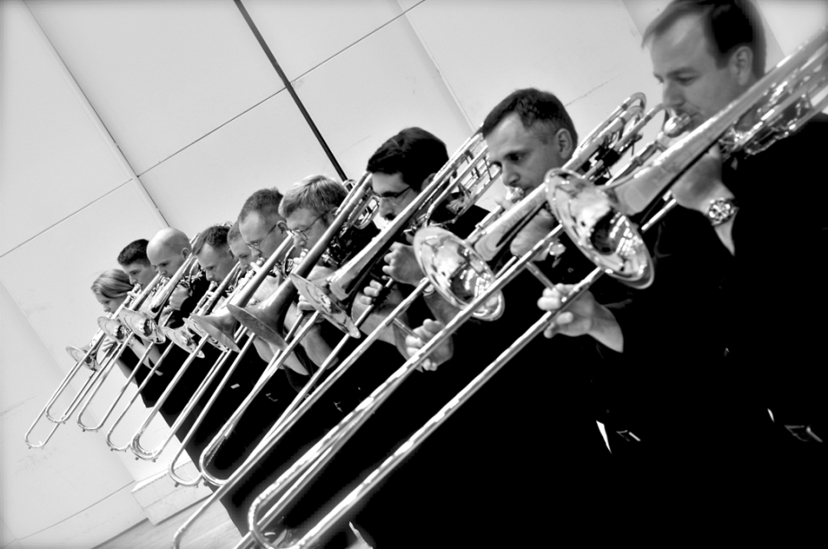

Slide 12
Resonance Lab – 3.1 pRACTISE
AIM To determine the speed of sound by means of a resonance tube.

Slide 13
