Slide 1
Scholarship 2014 Physics
Scholarship 2014
Physics
Solutions
Time allowed: Three hours
Total marks: 40
You are asked to answer ALL the FIVE questions in this exam. Each is worth 8 marks.
For all ‘describe’ or ‘explain’ questions, the answers should be written or drawn clearly with all logic fully explained.
For all numerical answers, full working must be shown and the answer must be rounded to the correct number of significant figures and given with the correct SI unit.
Marks are awarded for each question in a similar way. The rubric is given on the next slide.

Slide 2
Marking rubric for questions 1 - 5
1-4 marks | 5-6 marks | 7-8 marks
Thorough understanding of these applications of physics. OR Partially correct mathematical solution to the given problems AND / OR Partial understanding of these applications of physics. | (Partially) correct mathematical solution to the given problems. AND / OR Reasonably thorough understanding of these applications of physics. I have used the marks awarded to the top scholar paper as a guide to the mark allocation in the solutions here. | Correct mathematical solution to the given problems. AND Thorough understanding of these applications of physics. I have animated the solutions so you can just click to advance through them step by step. Jonathan Jaffrey

Slide 3
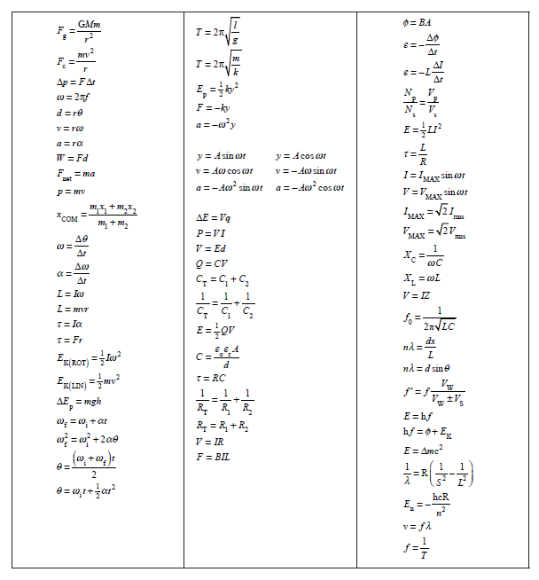

Slide 4
QUESTION ONE: GENERAL RELATIVITY
Planck’s constant = 6.63 x10^{–34} J s
Speed of light = 3.00 x 10⁸ m s^{–1}
Charge on the electron= –1.60 x 10^{–19} C Acceleration due to gravity = 9.81 m s^{–2}
In an experiment carried out in 1959 at Harvard University, Einstein’s General Theory of Relativity was tested. The experiment involved measuring the change in frequency of 14.0 keV gamma rays emitted from a radioactive isotope of iron-57 as the gamma rays fall through the gravitational field of the Earth. Einstein’s theory predicts that the frequency of the gamma rays increases.
(a) Calculate the frequency of a 14.0 keV gamma ray.
(b) In the Harvard University experiment the gamma rays fell through a distance of 22.5 m. The change in frequency can be attributed to the change in gravitational potential energy described by the relationship ΔE = (EgΔx)/c² , where E is the original energy of the 14 keV gamma ray and Δx is the distance fallen.
Show that Δ f / f = 2.45 x 10⁻¹⁵.
Answers to (a) & (b) on the next slide ………

Slide 5
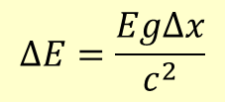
(a) Calculate the frequency of a 14.0 keV gamma ray.
ΔV = Eq
14.0 keV = 14.0 x 10³ x 1.6 x 10^{–19} = 2.24 x 10^{–15} J
E = hf
2.24 x 10^{–15} J = 6.63 x 10⁻³⁴ f
f = 3.38 x 10¹⁸ Hz
✓
(b) The gamma rays dropped 22.5 m. The change in frequency Δ f can be attributed to the change in gravitational potential energy described by the relationship ΔE = (EgΔx)/c² , where E is the original energy of the 14 keV gamma ray and Δx is the distance fallen.
Show that Δ f / f = 2.45 x 10⁻¹⁵.
$$∆E=\frac{Eg∆x}{c^{2}}$$
✓
$$\frac{∆E}{E}=\frac{h∆f}{hf}=\frac{Eg∆x}{Ec^{2}}=\frac{9.81x22.5}{9x10^{16}}$$
✓
$$\frac{h∆f}{hf}=\frac{∆f}{f}=2.4525 x 10^{−15}$$
Three marks were given here

Slide 6
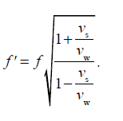
(c) The detector in the experiment is another sample of iron-57, positioned at the base of the experiment. The gamma rays can be detected if they are absorbed by the detector. However, they will be absorbed only if their frequency has not changed.
By considering the Doppler Effect, explain an experimental technique that will allow the gamma rays to arrive at the detector with the original emitted frequency.
(d) The Doppler Effect equation for electromagnetic radiation is
This equation can be approximated by the following expression
Given that Δf = f ' – f, use the expression to show that
and explain when this would be an acceptable approximation to the Doppler Effect equation given above.
Answers to (c) & (d) on the next slide ………

Slide 7
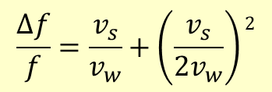
(c) The gamma rays can be detected if they are absorbed by the detector. However, they will be absorbed only if their frequency has not changed.
By considering the Doppler Effect, explain an experimental technique that will allow the gamma rays to arrive at the detector with the original emitted frequency.
The frequency of the incident gamma rays can be reduced by moving the source or detector away from each other.
The velocity of them moving apart will give an increase in the wavelength of the waves. This will cause the frequency to decrease as needed because the wave velocity is constant.
✓
✓
(d) The Doppler Effect equation for electromagnetic radiation can
be approximated to …..
Given that Δf = f ' – f, use the expression to show that ……..
and explain when this would be an acceptable approximation.
$$∆f=f^{′}−f=f\left(1+\frac{v_{s}}{2v_{w}}\right)2−f$$
$$\frac{∆f}{f}=\left(1+\frac{v_{s}}{2v_{w}}\right)2−1$$
✓
Expand and subtract 1
$$\frac{∆f}{f}=\frac{v_{s}}{v_{w}}+\left(\frac{v_{s}}{2v_{w}}\right)2$$
Given v_{w} = 3 x 10⁸ m s^{–1}, the assumption is good.
v_{s} would be at most ~100 m s^{–1} in a lab so the second term is negligible.
✓
✓
Five marks were given here

Slide 8
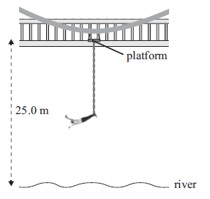
QUESTION TWO: BUNGY JUMPING
Acceleration due to gravity = 9.81 m s^{–2}
Standing on a platform that is 25.0 m above a river, Emma, of height 2.00 m and mass m, is tied to one end of an elastic rope (the bungy) by her ankles, while the other end of the bungy is fixed to a platform. The length of the bungy is adjusted so that Emma’s downward motion stops at the instant her head reaches the water surface. When Emma is at rest, in equilibrium, at the end of the bungy, her head is 8.00 m above the water. The unstretched length of the bungy is L, and it has a spring constant of k. Assume Emma’s centre of mass is halfway up her body.
(a) By considering energy conservation, show that at the lowest point in the jump,
mgh = ½ k(23 - L)², where h is the change in height of Emma’s centre of mass.
Explain all reasoning
(b) Show that, at the equilibrium position, mg = k(15 – L)
(c) Show that the value of L is 13.0 m
Answers to (a) (b) (c) on the next slides ………

Slide 9
(a) Use energy conservation to show mgh = ½ k(23 - L)², at the lowest point in the jump. Emma is 2m, her C of M falls h .
At the top of the jump, Emma’s centre of mass is 1 m above the platform. At the bottom of the jump, Emma’s centre of mass is
1 m above the river. So Emma’s centre of mass moves 25 m down from the platform to the bottom of the jump.
Loss of gravitational potential energy is mgh.
Extension of bungy spring is x = (25 – 2) – L.
Gain in potential energy of the spring is 0.5kx² = 0.5k(23 – L)²
So gravitational potential energy = spring potential energy and
mgh = 0.5k(23 – L)²
✓
(b) Show that at the equilibrium position: mg = k(15 – L)
At equilibrium, downward force of gravity = upward force of spring
mg = kx = k(25 – 10 – L)
mg = k(15 – L)
✓
Two marks were given here

Slide 10
(c) Show that the value of L is 13.0 m
From Two (a) and Two (b), equating expressions for mgh
0.5k(23 – L)² = k(15 – L)h The “k”s cancel, and h is 25 m.
So 0.5 (23 – L)² = (15 – L)25 therefore
(23 – L)² = (15 – L)50
529 + L² – 46L = 750 – 50L
L²+ 4L – 221 = 0
(L + 17)(L – 13) = 0
Solving this and taking the positive root gives L = 13 m.
✓
✓
Two marks were given here

Slide 11
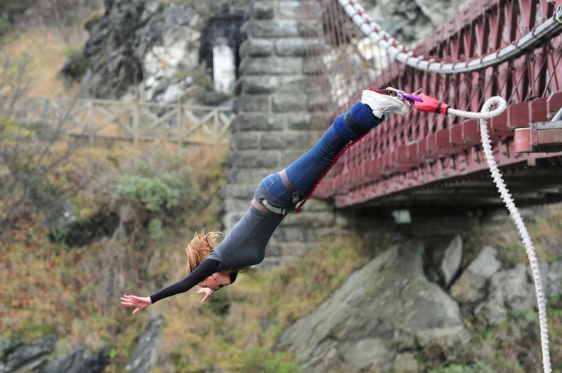
(d) (i) Calculate Emma’s maximum speed.
(ii) Calculate Emma’s maximum acceleration.
Explain what will happen to the spring constant of the
bungy when its length is reduced by 50%.
Answers to (d) & (e) on the next slides ………

Slide 12
(d) (i) Calculate Emma’s maximum speed.
Maximum speed occurs at the point that Emma feels zero acceleration (before this acceleration is downwards, and after this the acceleration is upwards, reducing velocity).
When F_{nett} = O we have zero acceleration and mg = kx
mg = k(15 – L) & mg =2k
Therefore, zero acceleration at x = 2.
Loss of potential energy at x = 2 is mg(L + 2 + 2)
= mg(L + 4)
Gain of spring potential energy at x = 2 is
ΔE = ½ kx² = ½ k2² = 2k Therefore,
KE = mg(13 + 4) – 2k = 17 mg – 2k but mg = 2k
½ mv² = 16 mg v² = 313.92 v = 17.7 ms⁻¹
✓
✓
Two marks were given here

Slide 13
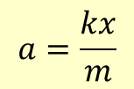
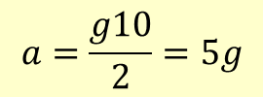
(ii) Calculate Emma’s maximum acceleration.
Maximum acceleration downwards is g. But we know that the bungy counteracts this and actually turns around the motion at the bottom.
Maximum acceleration due to bungy is :
$$F=ma=kx$$
$$a=\frac{kx}{m}$$
and is maximum when x is a maximum. The maximum value of x is 10 m, and from (b)
mg =2k
$$a=\frac{g10}{2}=5g$$
So maximum acceleration due to the bungy is 5g (49.05 m s^{–2}). Subtract the acceleration due to gravity, & get max of 4 g = 39.24 m s^{–2}.
✓
(e) Explain what happens to the spring constant when bungy length is reduced by 50%.
If force F is applied to the bungy, the change in length of the whole bungy will be x.
If we imagine the bungy to be made up of two parts, each part will extend by ½ x.
Since the force is the same, the spring constant has doubled.
✓
Two marks were given here

Slide 14
QUESTION THREE: THE BLOCK
Eight small blocks, of dimensions 3 cm by 3 cm by 3 cm, are glued together to form a cube, as shown. Each block has a mass of 100 grams. The cube is placed on a frictionless surface and a 10 g projectile is fired into the cube at velocity of
60 ms^{–1}, as shown. The projectile enters the cube
3 cm from the base (through the horizontal plane of the centre of mass), and 1 cm from the right-hand edge. Assume that the projectile stops inside the cube on the same line as it entered.
10 g projectile
60 m s^{–1}
(a) Show that once the projectile stops, the velocity of the centre of mass of the cube and projectile is 0.74 m s^{–1}.
(b) Show that once the projectile stops, the angular velocity of the cube and projectile is given by
where d is the perpendicular distance from the centre of mass of the cube to the initial direction of the projectile, I is the rotational inertia of the cube (about a vertical axis through the centre of mass), r is the distance from the centre of mass to the final position of the projectile, and ω is the angular velocity of the cube and projectile.
Answers to (a) & (b) on the next slide ………

Slide 15
Show that once the projectile stops, the velocity of the centre of mass of the cube and
projectile is 0.74 m s^{–1}.
Momentum of projectile = 0.01 kg x 60 m s^{–1} Momentum of cube plus projectile = 0.81 kg x v m s^{–1}
Equating them, 0.01 x 60 = 0.81v
v = 0.741 ms⁻¹
✓
Show that once the projectile stops, the angular velocity of
the cube and projectile is given by
$$ω=\frac{\text{m}\text{projectile}\text{v}\text{projectile}\text{d} }{\text{I} \text{+ }\text{m}\text{projectile} \text{r} \text{2}}$$
Angular momentum initially = mvr
= m_{projectile}v_{projectile} d
This is the angular momentum of the cube plus projectile
= Iω + m_{projectile} r ²ω
Iω + m_{projectile} r ²ω = m_{projectile}v_{projectile}d
ω(I + m_{projectile} r ²) = m_{projectile}v_{projectile}d
✓
✓
$$ω=\frac{\text{m}\text{projectile}\text{v}\text{projectile}\text{d} }{\text{I} \text{+ }\text{m}\text{projectile} \text{r} \text{2}}$$
Three marks were given here

Slide 16
(c) Show that
is the fraction of the initial kinetic energy that goes into moving the centre of mass of the cube and projectile.
(d) Explain what has happened to the rest of the projectile’s initial energy.
(e) Four blocks are removed from the cube to create a new object, as shown below
If the projectile were fired at the new object (in the horizontal plane of the centre of mass of the new object and again 1 cm in from the right-hand edge of the object, as shown above), explain what differences would be seen in the motion of the new object compared to the original cube.

Slide 17
(c) Show that the fraction of the initial KE that goes into moving the centre of mass of the cube and projectile is:
Initial KE = ½ m_{proj}v_{proj}²
Final KE = ½ (m_{proj} + m_{cube}) v_{c}²
$$\frac{Final KE}{Initial KE}=\frac{\frac{1}{2}(m_{p}+m_{c})v_{c}^{2}}{\frac{1}{2}m_{p}v_{p}^{2}}$$
$$m_{p}v_{p}=(m_{p}+m_{c})v_{c}$$
Substitute for v_{c}
$$\frac{Final KE}{Initial KE}=\frac{ \left(m_{p}+m_{c}\right)}{m_{p}v_{p}^{2}}x\left(\frac{m_{p}v_{p}}{\left(m_{p}+m_{c}\right)}\right)2$$
$$\frac{Final KE}{Initial KE}=\left(\frac{m_{p}}{m_{p}+m_{c}}\right)$$
✓
(d) Explain what has happened to the rest of the projectile’s initial energy.
Some energy has gone to rotational KE = ½ I ω²
where I = moment of inertia of cube plus projectile.
The remainder has been lost as heat and in deforming the blocks.
✓
✓
Three marks were given here

Slide 18
(e) Four blocks are removed to create a new object :
If the projectile were fired at the new object (in the horizontal plane of the centre of mass of the new object and again 1 cm in from the right-hand edge of the object, as shown above), explain what differences would be seen in the motion of the new object compared to the original cube.
The shape will have its centre of mass move with approximately twice the velocity of the original cube (because the mass is half as much).
The moment of inertia is significantly reduced and so the final angular velocity must also increase.
L is slightly reduced with the reduction in r to the new CoM but I is reduced significantly leading to an increase in angular velocity.
✓
✓
Two marks were given here

Slide 19
QUESTION FOUR: THE WOODEN SHEETS
Uniform sheets of wood of mass 50 kg and length 2.40 m are moved around a production mill by powered rollers. After their initial acceleration, the wooden sheets move without slipping at a constant velocity of 2.00 m s^{–1}.
The frictional force between the rollers and the wood can be calculated using F_{friction} = µN, where µ is the coefficient of friction between the wood and the rollers, and N is the normal reaction force on the wood.
2.0 ms⁻¹
(a) Explain why no work is done on the wooden sheet when it is travelling at constant
velocity.
The work-energy theorem states that work done = ΔE_{K}. Since no change has occurred to the velocity and therefore the kinetic energy, no work has been done on the sheets.
There is no slipping on the rollers and we assume no other frictional losses.
One mark was given here

Slide 20
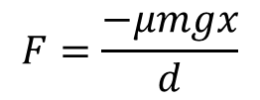
A
B
(b) One of the rollers has a drive gear malfunction and rotates in the opposite direction, as shown above. The wooden sheet is initially displaced towards the right-hand roller.
Show, by taking moments about the centre of mass of the sheet, that the normal reaction force acting through point A is
$$N_{A}=\frac{mg(d−x)}{2d}$$
where 2d is the distance between the centres of the two rollers, and x is the displacement of the centre of mass of the wooden sheet from the midpoint between the rollers.
(c) It can be shown that the normal reaction force at point B is
$$N_{B}=\frac{mg(d+x)}{2d}$$
Using this result and the result from (b) above, show that the sheet undergoes simple harmonic motion described by the following expression
$$F=\frac{−μmgx}{d}$$

Slide 21
(b) One roller rotates in the opposite direction, as shown. Show, by taking moments about the centre of mass of the sheet, that the normal reaction force acting through point A is
x
A
B
$$N_{A}=\frac{mg(d−x)}{2d}$$
2d
N_{A}(d + x) = N_{B}(d – x)
Since mg = N_{A} + N_{B}
N_{A}(d + x) = (mg – N_{A})(d – x)
N_{A}(d + x) = mg(d – x) – N_{A}(d – x)
Therefore: N_{A}(d + x +d – x) = mg(d – x)
✓
✓
✓
$$N_{A}=\frac{mg(d−x)}{2d}$$
Three marks were given here

Slide 22
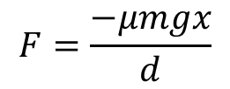
(c) It can be shown that the normal reaction force at point B is
x
$$N_{B}=\frac{mg(d+x)}{2d}$$
A
B
2d
Using these results for N_{A} and N_{B} , show that the sheet undergoes simple harmonic motion described by the expression:
$$F=\frac{−μmgx}{d}$$
$$N_{A}=\frac{mg(d−x)}{2d}$$
The frictional forces at A and B are given by:
$$F_{A}=μN_{A}$$
$$F_{B}=μN_{B}$$
$$F_{A}=\frac{μmg(d−x)}{2d}$$
$$F_{B}=\frac{μmg(d+x)}{2d}$$
✓
These two frictional forces are in opposite directions so the nett force acting on the sheet on the sheet is given by F_{B} – F_{A} and directed left.
$$F_{nett}=\frac{μmg(d+x−(d−x))}{2d}$$
$$F_{nett}=\frac{μmgx}{d}$$
However, if the sheet moves to the right and x is positive, roller B will move it to the left and F_{nett} must be negative. When it moves left, and x is negative, F_{nett} must be directed right and positive. This is simple harmonic motion as the force is proportional to the displacement but oppositely directed.
✓
$$F_{nett}=−\frac{μmgx}{d}$$
Two marks were given here

Slide 23
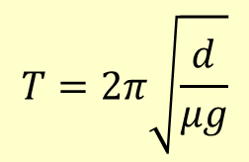
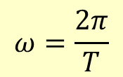
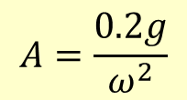
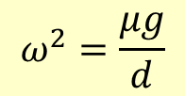
(d) (i) Show that the period of the oscillation is 2.46 s when d is 0.600 m and µ_{WR} is 0.400.
$$a=−ω^{2}y$$
$$F=ma so a=\frac{−μgx}{d}$$
$$F=\frac{−μmgx}{d}$$
$$ω^{2}=\frac{μg}{d}$$
$$ω=\frac{2π}{T}$$
$$T=2π\sqrt{\frac{d}{μg}}$$
✓
$$T=2.4569…=2.46 s$$
(ii) An object is dropped onto the oscillating sheet of wood. If the μ_{OW} between the object and the wood is 0.200, show that the maximum amplitude A_{max} for the wood moving horizontally without the object slipping is 0.300 m.
Maximum frictional force on the object is = μ_{OW} N_{O} = 0.2N_{O} = 0.2Mg where M = mass of the object)
Max acceleration without slipping is 0.2g
Max acceleration = A_{max}ω² = 0.2g
$$A=\frac{0.2g}{ω^{2}}$$
$$ω^{2}=\frac{μ_{WR}g}{d}=\frac{0.4g}{0.6}$$
$$A=\frac{0.2gx0.6}{0.4g}=0.300m$$
✓
Two marks were given here

Slide 24
QUESTION FIVE: CAPACITORS AND DIELECTRICS
In the circuit below, the switch S has been closed for a time sufficiently long for the capacitor to become fully charged.
S
12.0 kΩ
(i) Calculate the steady-state
current in each resistor.
10.0 µF
9.00 V
15.0 kΩ
Show that the charge on
the capacitor is 50.0 µC
3.00 kΩ
The switch S is now opened.
Calculate the maximum value of the current through the 3.00 kΩ resistor.

Slide 25
S
12.0 kΩ
The capacitor is fully charged.
10.0 µF
9.00 V
15.0 kΩ
(i) Calculate the steady-state
current in each resistor.
3.00 kΩ
At the steady state condition, no current will flow in the branch with the capacitor present. Therefore the current in the 3kΩ resistor will be zero.
The rest of the circuit becomes a simple series circuit with resistance 27 kΩ and voltage 9 V therefore the current is
✓
$$I=\frac{V}{R}=9÷27k=0.333 mA$$
✓
Show that the charge on
the capacitor is 50.0 µC
Q = CV
But here the pd is that across the 15kΩ which is (15/27) x 9 V
Q = 10 x 10⁻⁶ x 5 ( or we can use V = IR to get V_{15k} )
Q = 50 μC
✓
Three marks were given here

Slide 26
S
12.0 kΩ
10.0 µF
9.00 V
15.0 kΩ
3.00 kΩ
The switch S is now opened.
Calculate the maximum value of the current through the 3.00 kΩ resistor.
On opening the switch, the circuit becomes a simple series circuit, with a source voltage of 5.00 V and a total resistance of 18.0 kΩ
$$I=\frac{V}{R}=5÷18k=0.278 mA$$
One mark was given here

Slide 27
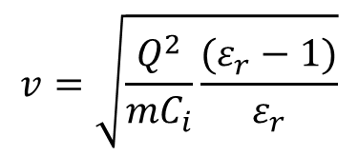
In a separate experiment, a dielectric material is placed next to a charged parallel-plate capacitor, as shown in the diagram. The dielectric material experiences an electrostatic force that pulls it into the gap between the capacitor plates.
(b) Explain why the dielectric material is attracted into the gap between the plates.
If the dielectric material is able to move without friction,
show, by considering conservation of energy, that the
maximum speed reached by the dielectric material is
given by
$$v=\sqrt{\frac{Q^{2}}{mC_{i}}\frac{(ε_{r}−1)}{ε_{r}}}$$
where
Q = original charge on the capacitor
ε_{r} = dielectric constant for the dielectric material
m = mass of the dielectric material
C_{i} = initial capacitance of the capacitor
(d) A capacitor is often referred to as a “store of charge”. Comment on this.
Answers to (b) (c) (d) on the next slides ………

Slide 28
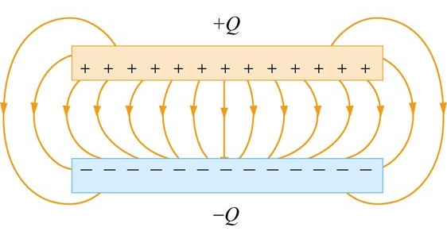
(b) Explain why the dielectric material is attracted into the gap between the plates.
The field lines at the edge of the capacitor are not vertical. They are arced and so have a component acting parallel to the capacitor plate surface. This component will attract the polarised charges of the dielectric (in the same way as charged objects can “pick up” small objects).
One mark was given here

Slide 29
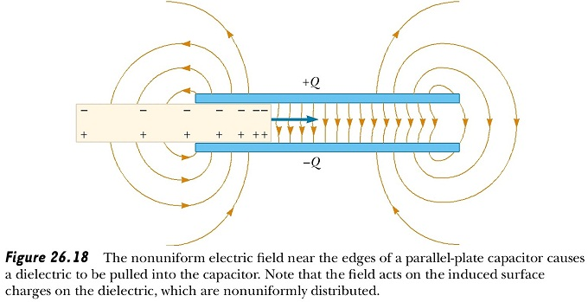
Image taken from: kshitij-iitjee.com

Slide 30
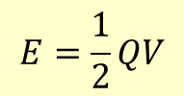
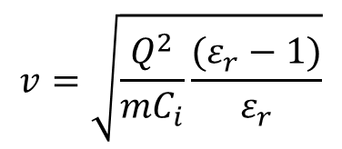
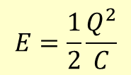
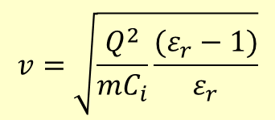
If the dielectric material is able to move without friction,
show, by considering conservation of energy, that the
maximum speed reached by the dielectric material is
given by
$$v=\sqrt{\frac{Q^{2}}{mC_{i}}\frac{(ε_{r}−1)}{ε_{r}}}$$
where
Q = original charge on the capacitor
ε_{r} = dielectric constant for the dielectric material
m = mass of the dielectric material
C_{i} = initial capacitance of the capacitor
Energy stored on the capacitor is:
$$E=\frac{1}{2}QV$$
$$Q=CV$$
$$E=\frac{1}{2}\frac{Q^{2}}{C}$$
Maximum KE is the loss of energy on the capacitor as C increases:
$$KE=∆E=\frac{1}{2}\frac{Q^{2}}{C_{i}}−\frac{1}{2}\frac{Q^{2}}{C_{r}}$$
✓
$$C_{r}=ε_{r}C_{i}$$
$$\frac{1}{2}mv^{2}=\frac{1}{2}\frac{Q^{2}}{C_{i}}−\frac{1}{2}\frac{Q^{2}}{{ε_{r}C}_{i}}$$
$$v^{2}=\frac{Q^{2}}{mC_{i}}\left(1−\frac{1}{ε_{r}}\right)$$
$$v=\sqrt{\frac{Q^{2}}{mC_{i}}\frac{(ε_{r}−1)}{ε_{r}}}$$
✓
Two marks were given here

Slide 31
(d) A capacitor is often referred to as a “store of charge”. Comment on this.
Capacitors store energy. They do this by way of charge separation (increasing the electric potential energy of the charges, creating an electric field between the plates).
The total unbalanced charge of any capacitor is always zero.
One mark was given here

