Slide 1
Scholarship 2014 Physics
Scholarship 2013
Physics
Solutions
Time allowed: Three hours
Total marks: 40
You are asked to answer ALL the FIVE questions in this exam. Each is worth 8 marks.
For all ‘describe’ or ‘explain’ questions, the answers should be written or drawn clearly with all logic fully explained.
For all numerical answers, full working must be shown and the answer must be rounded to the correct number of significant figures and given with the correct SI unit.
Marks are awarded for each question in a similar way. The rubric is given on the next slide.

Slide 2
Marking rubric for question ONE
1-4 marks | 5-6 marks | 7-8 marks
Some understanding of these applications of physics. With no mathematical part to the question the rubric is slightly different for the first question. | (Reasonably thorough understanding of these applications of physics. I have used the marks awarded to the top scholar paper as a guide to the mark allocation in the solutions here. | Thorough understanding of these applications of physics. I have animated the solutions so you can just click to advance through them step by step. Jonathan Jaffrey

Slide 3
Marking rubric for questions 2 - 5
1-4 marks | 5-6 marks | 7-8 marks
Thorough understanding of these applications of physics. OR Partially correct mathematical solution to the given problems AND / OR Partial understanding of these applications of physics. | (Partially) correct mathematical solution to the given problems. AND / OR Reasonably thorough understanding of these applications of physics. | Correct mathematical solution to the given problems. AND Thorough understanding of these applications of physics.

Slide 4
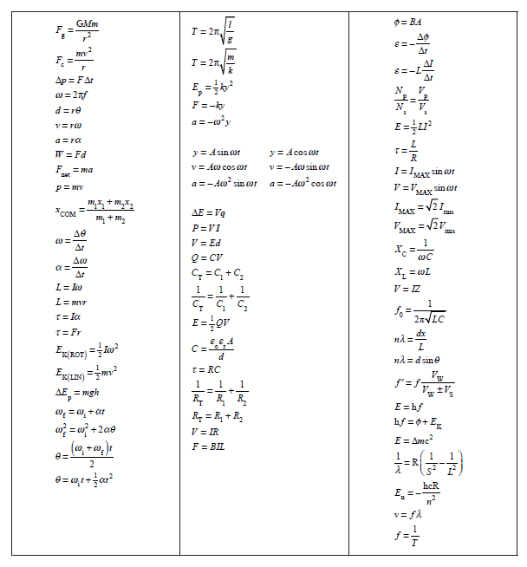

Slide 5
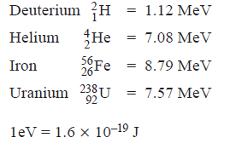
QUESTION ONE: MODERN PHYSICS
(a) Albert Einstein and Niels Bohr provided explanations for the photoelectric effect and the emission spectrum of the hydrogen atom.
Explain in detail the key underlying physics of each explanation, and describe the fundamental physical connection between these two phenomena.
(b) With reference to the data below, explain how fission and fusion processes differ in their release of energy.
Binding energies per nucleon:
(c) Visible radiation with a continuous spectrum of wavelengths passes through hydrogen gas before passing through a diffraction grating. A series of dark lines (absorption spectrum) is produced in the resulting interference pattern. Explain, in detail, why this occurs.
Answers on the next slide ………

Slide 6
QUESTION ONE: MODERN PHYSICS
(a) Albert Einstein and Niels Bohr provided explanations for the photoelectric effect and the emission spectrum of the hydrogen atom. Explain in detail the key underlying physics of each explanation, and describe the fundamental physical connection between these two phenomena.
Photoelectric effect:
When light is shone on a metal surface electrons are not released for any wavelength longer than some critical value λ_{o} . For wavelengths progressively shorter than λ_{o} electrons are released with increasing kinetic energy. Einstein explained that electromagnetic radiation, although a wave, is quantised into distinct packets as photons with each carrying a defined amount of energy given by E = hf . These can be absorbed by an electron with part of the energy providing the energy to overcome the work function of the metal and the rest appearing as KE of the emitted electron. Thus a single photon can release an electron from the surface.
✓
✓
Hydrogen emission spectrum.
The electron associated with a single proton (forming a hydrogen atom) has a restricted set of possible energy values. We say the energy held by the electron is quantised because when the electron changes from large PE to less PE, the energy change is released as an electromagnetic photon and these photons always have precise energy values. These form well defined bright lines of the hydrogen emission spectrum.
The quantisation of energy is the link between these phenomena.
✓
✓
Four marks were given here

Slide 7
(b) With reference to the data below, explain how fission and fusion processes differ in their release of energy.
Binding energies per nucleon:
The fusion of deuterium to helium will release about 6 MeV per nucleon.
The fission of U to Fe (the largest possible fission energy gap) will release about 1 MeV per nucleon. Fusion releases more energy per nucleon than fission, but fission processes involve more nucleons, and so can release greater total amounts of energy per fission reaction than a fusion reaction will release.
✓
✓
Two marks were given for this

Slide 8
(c) Visible radiation with a continuous spectrum of wavelengths passes through hydrogen gas before passing through a diffraction grating. A series of dark lines (absorption spectrum) is produced in the resulting interference pattern. Explain, in detail, why this occurs.
The atoms of the intervening hydrogen interact with photons that have frequencies that deliver exactly the correct energy.
The electrons of hydrogen atoms can accept only specific amounts of energy in the process of becoming excited. Only photons of specific frequency will carry these precise energy amounts, and it is these photons that will be absorbed (and “used” to excite electrons) in the passage of the radiation through the hydrogen. The emerging light will therefore be missing just those frequencies that can excite hydrogen electrons. The missing frequencies will show up as dark lines in the spectrum of the light.
The excited electrons will soon reradiate the missing photons, but the re-radiation will be in a random direction and so not many of the reradiated photons will travel in the direction of the original beam.
✓
✓
Two marks were given for this

Slide 9
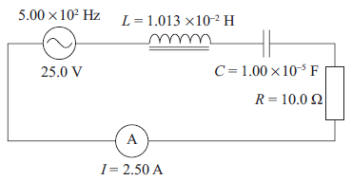
QUESTION TWO: AC CIRCUIT THEORY
The LCR circuit shown in the diagram is in resonance. The inductor and the capacitor
are both ideal.
Show that the voltages at resonance across the inductor and the capacitor are both 79.6 V AND explain why voltages larger than the source voltage are created.
Answers on the next slide ………

Slide 10
Show that the voltages at resonance across the inductor and the capacitor are both 79.6 V AND explain why voltages larger than the source voltage are created.
At resonance V_{L} = –V_{C} and so cancel each other. V_{S} =V_{R}
X_{C} = X_{L}
V_{L} = I X_{L} = I 2πf L = 2.5 x2 xπ x 500 x 1.013 x10^{–2}
= 79.56 = 79.6 V
V_{C} = I X_{C} = I / (2πf C) = 2.5/ (2π500 x 1x10⁻⁵)
= 79.58 = 79.6 V
✓
In the inductor, the maximum voltage depends on the rate of change of current which is large for a high frequency and so the maximum induced V_{L} is larger than the source voltage.
For the capacitor, the maximum voltage depends on the maximum stored charge, which may be larger than the source voltage can drive onto the plates. This is because the high frequency causes excess charge to surge onto the plates, driving up the V_{C} that is going to stop any more charge arriving
✓
Two marks were given for this

Slide 11
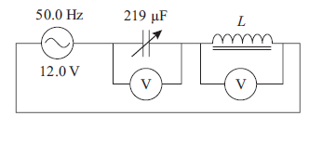
Two students, Ali and Sue, are trying to find the inductance of a coil. Using a 12.0 V,
50.0 Hz AC supply, Ali connects a variable capacitor, whose capacitance can be varied
over the range of 100 to 300 μF, in series with the coil. Ali adjusts the variable
capacitor until the voltages across it and the coil are exactly equal in magnitude.
The value of the variable capacitor when this happens is 219 μF. Ali then uses the relation given below to get a value of 46.3 mH for the inductance, L. Show how Ali carried out his calculation, and explain what he has assumed about the coil.
Answers on the next slide ………

Slide 12
C = 219 μF. Calculates 46.3 mH = L
Explain what he has assumed about the coil.
He simply substituted into the equation for resonant frequency:
$$50=\frac{1}{2π\sqrt{L219x{10}^{−6}}}$$
✓
$$L=0.0462654=46.3mH$$
He has assumed that equal voltages across the components means the circuit is at resonance. He has forgotten that the inductance will have some resistance which must be taken into account in the calculation.
✓
Two marks were given for this

Slide 13
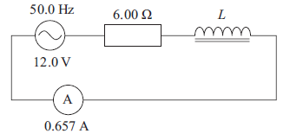
Sue constructs a new circuit where she uses a 6.00 Ω resistor connected in series with the coil and an ideal AC ammeter. They are all connected in series to the same 12.0 V,
50.0 Hz AC supply.
Sue measures the RMS current to be 0.657 A.
Show that Sue needs to use the results from both circuits to determine that the true value of the inductance of the coil is 40.2 mH.
A series LCR circuit has a resonant frequency of 1460 Hz. When set to another, higher
frequency, the circuit has a capacitive reactance of 5.00 Ω and an inductive reactance
of 28.0 Ω.
Calculate the values of the inductance and capacitance in the circuit.
Answers on the next slide ………

Slide 14
Here we have from Ali :
V_{L}
V_{L+r}
V_{r}
V_{C} = V_{L+r}
IX_{C} = IX_{L+r}
X_{C}² = X_{L}² + r²
V_{C}
$$\frac{1}{4π^{2}f^{2}C^{2}}=\sqrt{X_{L}^{2}+r^{2}}$$
$$X_{L}^{2}+r^{2}=2.11257446 Ω$$
We’ll use this result on the next slide …

Slide 15
Now from Sue :
V_{L}
V_{L+r}
V_{r}
$${12^{2}= I^{2}\{X}_{L}^{2}+{(r}^{2}+6)\}$$
$${144=0.657^{2}\{X}_{L}^{2}+r^{2}+12r+36\}$$
IX_{L}
✓
12
$$X_{L}^{2}+r^{2}=211.257446 Ω$$
$${144=0.657^{2}(211.257446 }_{ }^{}+12r+36)$$
I(r+6)
$$r=7.195Ω$$
$$X_{L}=12.629Ω$$
✓
$$X_{L}=2πfL$$
$L=0.040198=40.2mH$
Two marks were given for this

Slide 16
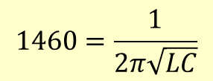
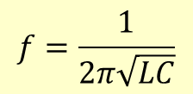
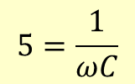
A series LCR circuit has a resonant frequency of 1460 Hz. When set to another, higher
frequency, the circuit has a capacitive reactance of 5.00 Ω and an inductive reactance
of 28.0 Ω. Calculate the values of the inductance and capacitance in the circuit.
$$5=\frac{1}{ωC}$$
$$28=ωL$$
$$f=\frac{1}{2π\sqrt{LC}}$$
$$5ωC=1$$
$$1460=\frac{1}{2π\sqrt{LC}}$$
$$140ωC=ωL$$
✓
$$1460=\frac{1}{2π\sqrt{140C.C}}$$
$$140C=L$$
$$C=9.213x10^{−6}C$$
✓
$$L=1.29x10^{−3}H=1.3mH$$
Two marks were given for this

Slide 17
QUESTION THREE: INTERFERENCE
A pair of narrow parallel slits is illuminated by monochromatic light of wavelength 500 nm to produce Young’s fringes on a screen.
(a) Explain the differences and similarities between the interference patterns produced by monochromatic illumination on a double slit and on a diffraction grating of the same slit separation.
The fringes from the grating would be brighter and sharper.
The fringes will be brighter, having contributions from every slit in the grating.
The fringes will be sharper because the destructive interference in between the bright fringes will be greater (than in the double slit case).
The fringes will have the same separation in both cases.
✓
✓
✓
Three marks were given for this

Slide 18
The space between the slits and the screen is then completely filled with a block of transparent material for which the refractive index, n, is 1.6. Assume the refractive index is constant for all wavelengths.
(b) Describe and explain the changes that will take place in the pattern of the Young’s fringes.
Answers on the next slide ………

Slide 19
(b) Describe and explain the changes that will take place in the pattern of the Young’s fringes.
The separation of the fringes will become smaller.
The wavelength of the light will reduce, as its velocity has decreased while the frequency has remained constant.
With reduced wavelength, a smaller displacement is needed for the interfering waves to find positions of constructive interference
✓
✓
Two marks were given for this

Slide 20
The block of material is removed and a very thin slice of the transparent material from the block is used to cover the top slit, as shown in the diagram below. When this is done, the central maximum bright fringe (zeroth order) is observed to move up the screen.
transparent material
(c) Explain why the pattern shifts up the screen.
(d) The slice of material has thickness, t, and the central maximum shifts up the screen to take the position originally held by the fifth order bright fringe produced when no material was between the slits and the screen.
Show that the thickness of the slice is less than or equal to 4.17 × 10^{–6} m.
The monochromatic illumination is replaced by sunlight.
Explain how this will assist the experimenter to determine the position of the new central maximum bright fringe.
Answers on the next slide ………

Slide 21
(c) Explain why the pattern shifts up the screen.
The light through the top slit is slowed down for whilst passing through the thin slice of n = 1.6.
So it is out of phase with the bottom slit light when at the original position of the central maximum.
The position on the screen where the two rays will be in phase must have the bottom slit light move through more phases (travel further) to realign the phases.
This happens at some position up the screen.
One mark was given for this

Slide 22
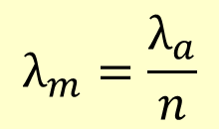
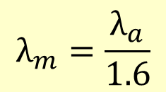
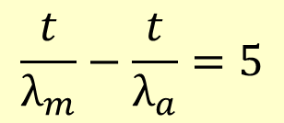
(d) The slice of material has thickness, t, and the central maximum shifts up the screen to take the position originally held by the fifth order bright fringe produced when no material was between the slits and the screen.
Show that the thickness of the slice is less than or equal to 4.17 × 10^{–6} m.
The ray from the uncovered slit must travel an extra 5λ to compensate for the extra phase difference introduced by the thin film.
That extra path difference is the number of wavelengths travelled through the material minus the number of wavelengths travelled through the same distance in air.
$$\frac{t}{λ_{m}}−\frac{t}{λ_{a}}=5$$
$${1.6t−t=5λ}_{a}$$
$$λ_{m}=\frac{λ_{a}}{n}$$
$$t=8.333x500x10^{−9}$$
$$t=4.166x10^{−6}=4.17μm$$
$$λ_{m}=\frac{λ_{a}}{1.6}$$
t is the distance travelled; therefore the thickness of the slice will be ≤ t.
One mark was given for this

Slide 23
(e) The monochromatic illumination is replaced by sunlight.
Explain how this will assist the experimenter to determine the position of the new central maximum bright fringe.
With monochromatic light, the zero order fringe is not obviously different from other fringes.
With white light rather than monochromatic, the zero order fringe will be obviously white while the others will be variously coloured.
There will be a white central maximum flanked by overlapping coloured fringes.
One mark was given for this

Slide 24
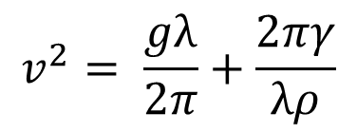
QUESTION FOUR: WAVE MOTION
A cork floats on the surface of a pond across which a sinusoidal wave-train of wavelength 10 m and amplitude 0.20 m is travelling. The velocity, v, of waves of wavelength, λ, on a liquid surface is given by
$$v^{2}= \frac{gλ}{2π}+\frac{2πγ}{λρ}$$
where ρ is the density (1.0 × 10³ kg m^{–3} for water) and γ is the surface tension, which for water has the value 7.2 × 10^{–2} N m^{–1}.
(a) Show that the equation is dimensionally consistent.
(b) Calculate the wave speed.
(c) Calculate the maximum speed of the cork as it rises and falls in the water.
Sea waves of wavelength 150 m and velocity of 15.3 m s^{–1} are heading North. A cruise ship is also travelling North at 8.0 m s^{–1}.
(d) Calculate the frequency of the ship’s up and down movement

Slide 25
The natural pitch period of the ship (the period of oscillation produced by pulling the
front of a ship down in completely flat water) is about 8 s.
By considering the ship when it is travelling normal to the wavefront, explain why the ship must avoid certain speeds.
If the wave has a speed of 10.8 m s^{–1} and wavelength of 75 m, calculate the speeds that should be avoided.
Answers on the next slide ………

Slide 26
(a) Show that the equation is dimensionally consistent.
$$v^{2}= \frac{gλ}{2π}+\frac{2πγ}{λρ}$$
where ρ is the density (1.0 × 10³ kg m^{–3} for water) and γ is the surface tension, which for water has the value 7.2 × 10^{–2} N m^{–1}.
v² = m² s^{–2}
g λ = m s^{–2} m = m² s^{–2} and 2π is dimensionless
Newtons from F=ma are: kgms⁻² so :
2 π γ = kg m s^{–2} m^{–1} = kg s^{–2}
λρ = m kg m^{–3} = kg m^{–2} so all three terms are m²s⁻²
✓
✓
Two marks were given for this

Slide 27
(b) Calculate the wave speed.
$$v^{2}= \frac{gλ}{2π}+\frac{2πγ}{λρ}$$
wavelength 10 m
amplitude 0.20 m
ρ is 1.0 × 10³ kg m^{–3}
γ 7.2 × 10^{–2} N m^{–1}.
$$v^{2}= \frac{9.8x10}{2π}+\frac{2π0.072}{10000}$$
$$v^{2}=15.597+4.52x10^{−5}$$
$$v=3.95ms^{−1}$$
✓
(c) Calculate the maximum speed of the cork as it rises and falls in the water.
$$f=\frac{v}{λ}$$
$$f=\frac{3.95}{10}=0.395m$$
$$v_{max}=2πfxA$$
✓
$$v_{max}=2π0.395x0.2=0.496ms^{−1}$$
Two marks were given for this

Slide 28
Sea waves of wavelength 150 m and velocity of 15.3 m s^{–1} are heading North. A cruise ship is also travelling North at 8.0 m s^{–1}.
(d) Calculate the frequency of the ship’s up and down movement
$$f=\frac{v}{λ}=\frac{15.3−8}{150}=0.049Hz$$
✓
The natural pitch period of the ship is about 8 s. By considering the ship when it is travelling normal to the wavefront, explain why the ship must avoid certain speeds.
If the wave has a speed of 10.8 m s^{–1} and wavelength of 75 m, calculate the speeds that
should be avoided.
The ship does not want its natural pitch frequency to be the same as the frequency with which the waves are moving the ship. This resonance will produce increasing amplitudes in the ship’s rise and fall, could strain the structure of the ship and become more uncomfortable for the passengers.
The ship has to avoid frequency 0.125 Hz (1/8 Hz).
The speed to avoid is given by:
✓
✓
$$f=\frac{v}{λ} 0.125=\frac{v_{ship}±v_{wave}}{λ} = \frac{v_{ship}±10.8}{75}$$
✓
$$v_{ship}=9.375±10.8=1.425 or 20.2ms^{−1}$$
Four marks were given for this

Slide 29
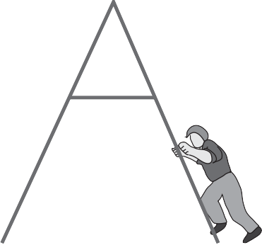
QUESTION FIVE: THE A-FRAME LADDER
failed bulb
At the local ice rink one of the light bulbs has failed and must be replaced. A lightweight ladder is placed on the frictionless ice so that it is directly under the light bulb, and an electrician climbs the ladder to reach the bulb. Treat the ladder as having zero mass.
For the initial position of the ladder and electrician shown in the diagram, the electrician will not be able to reach the light bulb.
Explain:
ice

Slide 30
For the initial position of the ladder and electrician shown in the diagram, the electrician will not be able to reach the light bulb.
Explain:
failed bulb
The ladder’s mass is zero (lightweight!). The centre of mass of the man and ladder system is therefore where the man is.
As he climbs the ladder the horizontal position of the centre of mass must stay in its original position (at the foot of the ladder) because, on the frictionless ice, no unbalanced horizontal force can be exerted on the ladder / man system to move the centre of mass to the left.
As the man climbs, moving left relative to the ladder, the ladder will move, relative to the ice, to the right so that the position of the centre of mass doesn’t move (except upwards).
As the man climbs there is a component of the force he exerts acting to the right which moves the ladder to the right.
✓
ice
✓
Two marks were given for this

Slide 31
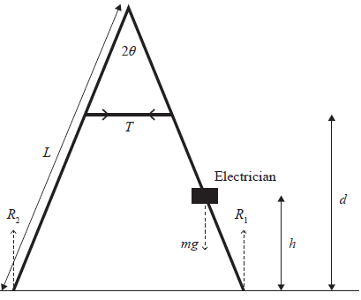
With no friction acting on the base of the ladder, the only force preventing the collapse of the ladder is the tension, T, in the cross-tie bar.
The angle between the legs of the ladder is 2θ, and the reaction forces acting on these legs are shown in the diagram.
The vertical distance to the cross-tie bar is d and the length of each leg is L.
The mass of the electrician is m.
(b) By taking moments about the top of the ladder, show that when the electrician is at a height, h, above the ground the tension in the cross-tie bar will be:
$$T=\frac{mghtanθ}{2(Lcosθ−d)}$$
Answers on the next slide ………

Slide 32
mg = R₁ + R₂
Taking moments about the top of the ladder
Each side can be treated separately
Both sides must individually have zero net torque acting.
R₂ x L sinθ = T x (L cosθ – d)
R₁ x L sinθ = T x (Lcosθ – d) + mg x (Lcosθ – h) tanθ
Add both
L sinθ (R₁ + R₂) = 2 T (L cosθ – d) + mg (L cos θ – h) tanθ
Substitute for R₁ + R₂ and rearrange
mg (L sinθ – L cosθ tanθ + h tanθ) = 2 T (L cosθ – d)
✓
cosθ tanθ = sinθ
✓
$$so T=\frac{mghtanθ}{2(Lcosθ−d)}$$
Two marks were given for this

Slide 33
$$T=\frac{mghtanθ}{2(Lcosθ−d)}$$
The angle, 2θ, between the legs of the ladder is 60⁰, and the cross-tie bar is one third the way down the leg.
Calculate the maximum tension in the cross-tie bar when the electrician has a mass of 70 kg and the legs of the ladder are 3 m long.
Explain what effect increasing the angle will have on this maximum tension assuming the cross-tie bar remains fixed to the same points on the ladder.
Explain why it is important that the electrician climbs the ladder at a slow and steady
speed.
Answers on the next slide ………

Slide 34
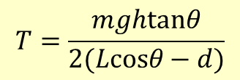
2θ is 60⁰, cross-tie bar one third down leg.
T_{max} if electrician mass 70 kg & legs of ladder 3 m.
$$T=\frac{mghtanθ}{2(Lcosθ−d)}$$
T_{max} when he is at the top so :
$$T=\frac{70x9.81x3cos30tan30}{2(3cos30−2cos30)}$$
✓
$$T=594.7N$$
Explain what effect increasing the angle will have on this maximum tension assuming the cross-tie bar remains fixed to the same points on the ladder.
$$T=\frac{mghtanθ}{2(Lcosθ−d)}$$
$$T=\frac{mgLcosθtanθ}{2(3cosθ−2cosθ)}=ktanθ$$
As θ increases tanθ increases rapidly.
All the other terms are constant so ½ mgL = k.
The tension will increase with θ.
✓
Two marks were given for this

Slide 35
Explain why it is important that the electrician climbs the ladder at a slow and steady speed.
To climb the ladder, the electrician must accelerate upwards. If this acceleration is large (so that he gets to the top quickly), the reaction forces from the ground must be greater to supply the force needed for acceleration.
The reaction forces will require an increased tension in the tie bar and a slow steady climb will keep the tension as low as possible, so reducing the risk that the tie will snap.
✓
✓
Two marks were given for this

