Slide 1
Scholarship 2014 Physics
Scholarship 2012
Physics
Solutions
Time allowed: Three hours
Total marks: 48
You are asked to answer ALL the SIX questions in this exam. Each is worth 8 marks.
For all ‘describe’ or ‘explain’ questions, the answers should be written or drawn clearly with all logic fully explained.
For all numerical answers, full working must be shown and the answer must be rounded to the correct number of significant figures and given with the correct SI unit.
Marks are awarded for each question in a similar way. The rubric is given on the next slide.

Slide 2
Marking rubric for each question
1-4 marks | 5-6 marks | 7-8 marks
Thorough understanding of these applications of physics. OR Partially correct mathematical solution to the given problems AND / OR Partial understanding of these applications of physics. | (Partially) correct mathematical solution to the given problems. AND / OR Reasonably thorough understanding of these applications of physics. I have used the marks awarded to the top scholar paper as a guide to the mark allocation in the solutions here. Jonathan Jaffrey | Correct mathematical solution to the given problems. AND Thorough understanding of these applications of physics. I have animated the solutions so you can just click to advance through them step by step.

Slide 3
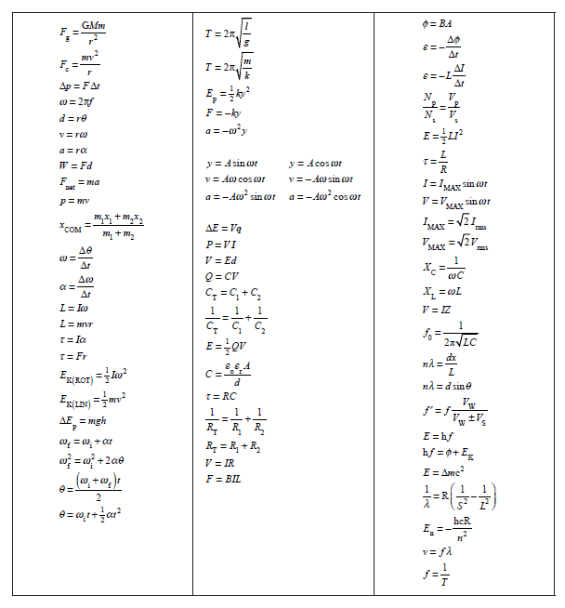

Slide 4
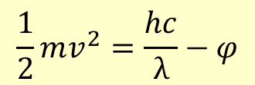
QUESTION ONE: MODERN PHYSICS (8 marks)
In an experiment to investigate the photoelectric effect, light of wavelength λ is incident on a metal surface and a current is produced. The current is reduced by applying a potential difference V between the metal surface and the collecting plate.
When the current is reduced to zero, derive an equation relating λ, V and the work
function, φ , of the metal. Provide a full explanation of the derivation.
The energy of any incident photon is given by :
E = $hf=\frac{hc}{λ}$
The minimum energy required to liberate an electron from the metal surface is φ (the work function). Any difference between the work function energy and the incident photon energy will appear as the maximum kinetic energy of the liberated electrons.
✓
The KE of the electron can also be expressed as the equivalent electric potential energy
½ mv_{max}² = V_{max}e ( where V = the potential (voltage) required to accelerate an electron from rest to velocity v )
$$\frac{1}{2}mv^{2}=\frac{hc}{λ}−φ$$
✓
So: V_{max}$e=\frac{hc}{λ}−φ$
Two marks were given for this

Slide 5
A classical wave explanation fails to explain the experimental results of the
photoelectric effect.
Discuss this statement.
The classical wave explanation would expect that increasing the intensity of incident radiation would lead to an increase in the maximum kinetic energy KE_{max} of the liberated electrons. Also light of any frequency would be capable of liberating electrons as long as sufficient time was given for the incoming energy to rise to whatever level the electrons required for liberation.
Experiment showed that intensity is proportional only to the numbers of electrons released and not to their KE_{max} .
KE_{max} is found to be dependent only on the frequency of the incident light.
It is also found that low intensity, high frequency light will still cause electron release immediately while high intensity, low frequency light never achieves electron liberation, no matter how much energy is delivered over any period of time.
The classical explanation failed and was replaced by a model of the radiation energy being delivered in small packets (quanta), photons, whose energy depended only on their frequency.
✓
✓
Two marks were given for this

Slide 6
(i) A nucleus of mass 3.93 x 10^{–25} kg, which is stationary with respect to an observer, undergoes fission. The nucleus breaks into two equal parts with total kinetic energy of 200 MeV. The two parts are brought to rest.
Calculate the total decrease in the mass in kg and therefore calculate the individual rest
mass of the two equal masses.
The mass lost Δm we get from E = mc²
$$\frac{∆E}{c^{2}}=\frac{200x{10}^{6}x1.6x{10}^{−19}}{9x{10}^{16}}$$
✓
So the mass lost Δm was 3.556 x 10⁻²⁸ kg
This gives us 1.7778 x 10⁻²⁸ kg lost for each one.
Subtract this from half of the original rest mass (3.93 x 10⁻²⁵ kg) and we get
1.963222 x 10⁻²⁵ kg as the final rest masses, assuming no other energy was lost (gamma etc)
✓
Two marks were given for this

Slide 7
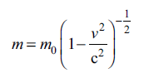
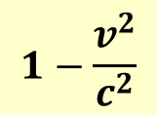
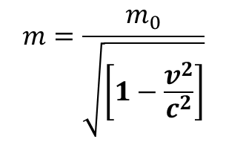
According to Einstein’s special theory of relativity, the mass m of an object with a
velocity v, relative to an observer, is given by:
$$m=\frac{m_{0}}{\sqrt{\left[1−\frac{v^{2}}{c^{2}}\right]}}$$
or
where c is the speed of light, and m₀ (the rest mass) is the mass measured when v = 0 m s^{–1}.
Discuss the physical significance of this relationship.
$$1−\frac{v^{2}}{c^{2}}$$
Because the term in brackets :
will always be less than 1 (for any moving mass) the actual mass of a moving object will always be greater than the rest mass (m_{o}). The equation expresses the gain in mass any moving object undergoes.
One mark was given for this

Slide 8
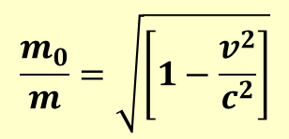
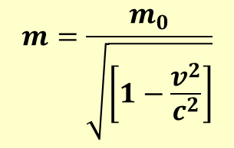
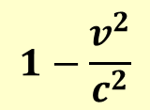
By considering the effects of the special theory of relativity, calculate the speed of
the two masses in part (i) above, before they are brought to rest.
One half of the original rest mass 3.93 x 10⁻²⁵ kg is 1.965 x 10⁻²⁵ kg
The final rest mass was 1.963222 x 10⁻²⁵ kg.
The mass difference here is the 100 MeV of kinetic energy if there is no other energy loss involved.
$$m=\frac{m_{0}}{\sqrt{\left[1−\frac{v^{2}}{c^{2}}\right]}}$$
$$\frac{m_{0}}{m}=\sqrt{\left[1−\frac{v^{2}}{c^{2}}\right]}$$
$$1−\frac{v^{2}}{c^{2}}$$
0.998189 =
v = 1.277 x 10⁷ ms⁻¹
One mark was given for this

Slide 9
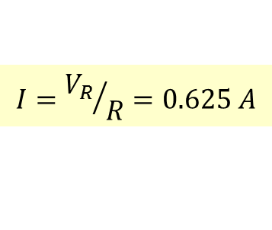
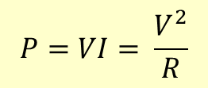
QUESTION TWO: INDUCTANCE (8 marks)
A 75 W electric light bulb (with zero inductance) is designed to run from a 50 Hz AC supply of 120 V_{rms}. If the only supply available is 240 V_{rms} and 50 Hz, the bulb can be operated at the correct power by placing in series with it, either:
(i) a resistance R, or (ii) an inductance L.
(a) Find the values of R and L and the power drawn from the supply in each case.
(i) We need to halve the voltage so need a resistor in series with the same resistance as the bulb.
This will have the same power output as the bulb so the total power will be 150W.
$$P=VI= \frac{V^{2}}{R}$$
$$R={120}^{2}÷75=192Ω$$
So 192 Ω in series drawing 75 W giving a total power of 150 W
✓
(a) (ii) The inductor will be 90⁰ out of phase with the resistor so:
$$V_{s}^{2}=V_{R}^{2}+V_{L}^{2}$$
$$V_{L}^{2}= {240}^{2}−{120}^{2}$$
$$V_{L}=207.85 V$$
$$X_{L}=\frac{V_{L}}{I}$$
$$I={V_{R}}/R=0.625 A$$
✓
$$X_{L}=\frac{207.85}{0.625}=332.56 Ω$$
$$X_{L}=ωL$$
$$L=332.56÷100π$$
$$L=1.06 H$$
✓
Power dissipation in an ideal inductor is zero so total power dissipation will be 75 W
Three marks were given here

Slide 10
When an alternating voltage is applied across a coil wrapped around an iron core, an aluminium ring around the core will “float” at some height above the coil.
Explain why this happens.
Iron core made of thin iron sheets glued together
“Floating” aluminium ring
The AC in the coil creates a strong and fluctuating magnetic field in and around the iron core. This changing magnetic flux induces a current in the aluminium ring (an eddy current). This current produces its own magnetic field, which acts in the opposite direction (is repelled by) the coil and core’s magnetic field. The repulsive force between the two can be larger than the force of gravity on the ring so the ring is moved away from the coil until it reaches a distance at which the upward magnetic repulsive force is equal to the downward gravitational force.
AC
Two marks were given for this

Slide 11
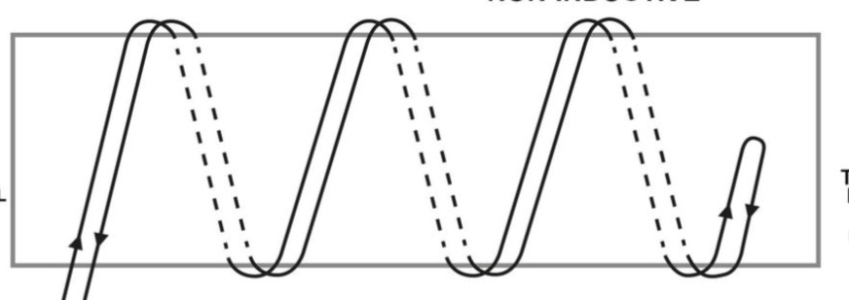
Explain, possibly with the aid of a diagram, how such a coil could be wound so that this
effect would not take place.
Make the coil “non-inductive” by reversing the direction of the windings after half have been completed in one direction.
Or
Reverse the direction of half the windings so that the amount of clockwise current is balanced by an equal amount of anticlockwise current.
✓
To reduce the heating of the iron core, thin sheets of iron are glued together. The glue that holds the thin iron sheets together must have some specific electrical properties.
Suggest at least one electrical property of the glue, and state why it is important.
The core must be laminated to reduce the induced eddy currents, which would both waste energy and produce potentially damaging heat.
The glue must be non conducting / very high resistance and must be permeable to magnetic fields.
✓
✓
Three marks were given here

Slide 12
QUESTION THREE: THE DOPPLER EFFECT (8 marks)
When the Doppler effect occurs it is known that the apparent frequency of a sound is increased as the source of the sound moves towards a stationary observer.
(a) Explain why the frequency increase occurs.
In the time between each wave crest being emitted the source of the waves is moving towards the observer. This movement means that the crest-to-crest distance (the wavelength) is reduced. Since the speed of the waves through the air is constant, any reduction in the wavelength must lead to an increase in the frequency (since v = f λ).
✓
Explain qualitatively what would happen to the apparent frequency if the observer
moved at constant velocity towards the moving source.
The frequency would increase. By moving towards a source, the observer will reach each wave crest after a shorter time interval than would be the case if the observer was stationary.
The time between adjacent crests arriving is the Periodic Time
(T) and a reduction in T means an increase in frequency (f ) (since f = 1 / T).
✓
✓
Three marks were given here

Slide 13
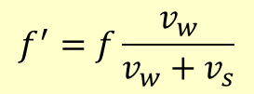
Ben is on the top floor of an apartment building, and has a phone that emits a single ringing tone of 440 Hz. Unfortunately, while picking up the ringing phone, Ben drops it so that it falls off the edge of the 0.700 m high, top floor ledge he is leaning on. Some time later Ben hears a reduced frequency of 416.2 Hz. The height of each floor is 3.10 m.
(c) Calculate the number of floors that the phone must have fallen when it emits the wave
that Ben hears as a 416.2 Hz tone. State any assumptions made.
The speed of sound in air = 340 m s^{–1} Acceleration due to gravity = 9.81 m s^{–2.}
Assumptions needed :
No air resistance and g is constant gives a uniform 9.81 ms⁻² acceleration
✓
$$f^{′}=f\frac{v_{w}}{v_{w}+v_{s}}$$
$$0.9459\left(340+v_{s}\right)=340$$
$$v_{s}=19.4426 ms^{−1}$$
✓
$$v_{f}^{2}=v_{i}^{2}+2ad$$
$$378=0+19.62d$$
$$d=19.2661 m$$
✓
$$Number of floors=\left(19.6621−0.7\right)÷3.1=5.989$$
$$Six floors$$
Three marks were given here

Slide 14
Frankie is watching Ben from the top of an identical apartment building on the other side of the street. Frankie is at the same height, but is 40.0 m away from Ben.
For the wave that Ben hears as a 416.2 Hz tone, calculate the frequency that Frankie
would hear.
40m
The line from the phone to Frankie is at an angle of
tan⁻¹(40/19.2668) or θ = 64.28⁰
19.2668m
θ=64.28⁰
The velocity away from Frankie along that line is v_{down}cosθ
This gives us v= 8.4376 ms⁻¹
✓
$$f^{′}=f\frac{v_{w}}{v_{w}+v_{s}}$$
$$f^{′}=440\frac{340}{348.4376}$$
✓
$f^{′}=429.35$
$f^{′}=429 Hz$
Two marks were given here

Slide 15
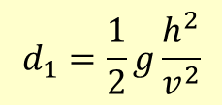
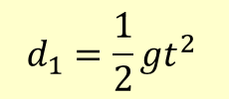
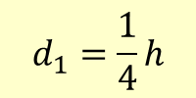
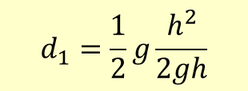
QUESTION FOUR: MOTION (8 marks)
Ball X is released from rest from a height h and hits the ground with speed v ms^{–1}. At precisely the same time as ball X is dropped, ball Y is launched straight up from the ground at v ms^{–1}.
(a) Show that the two balls will pass each other at a point ¼ h from the release point of ball X.
The balls cross after time t
t
$$d_{1}=\frac{1}{2}gt^{2 }$$
The falling ball travels d₁
h
The rising ball travels d₂
$$d_{2}=vt−\frac{1}{2}gt^{2 }$$
$$v^{2}=2gh$$
$$d_{1}+d_{2}=h$$
Substitute for t in the d₁ equation:
✓
This gives us
$$d_{1}=\frac{1}{2}g\frac{h^{2}}{v^{2}}$$
$$vt=h$$
$$t=h/v$$
Substitute for v²
Notice this t is half the time the falling ball takes to travel h to the ground.
$$d_{1}=\frac{1}{2}g\frac{h^{2}}{2gh}$$
✓
$$d_{1}=\frac{1}{4}h$$
Two marks here

Slide 16
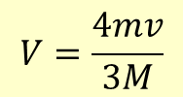
(b) Use physical principles to explain this result.
The ball rising starts off fast and loses speed – the falling one starts slow and gains speed. By the time they meet, the fast starting one must have travelled furthest. They cross beyond the half way point - ¾ the way up.
Or When they meet both have been traveling for the same time. The one moving fastest initially must have traveled the greatest distance.
✓
A ball of mass m makes a head-on elastic collision with a stationary second ball of mass
M and rebounds with a speed equal to one-third its original speed.
Show that the mass of the second ball is equal to 2m.
The collision is elastic so both momentum and KE are conserved.
✓
Momentum conservation gives :
$$p_{i}=p_{f}$$
$$mv=MV−\frac{mv}{3}$$
$$V=\frac{4mv}{3M}$$
KE conservation gives :
$$\frac{1}{2}mv^{2}=\frac{1}{2}MV^{2}+\frac{1}{2}\frac{mv^{2}}{9}$$
✓
$$\frac{8}{9}mv^{2}=\frac{M16m^{2}v^{2}}{9M^{2}}$$
✓
$$M=2m$$
Four marks here

Slide 17
A pair of balls (both of mass m) are sliding along a long, horizontal, frictionless groove towards a stationary third ball (also of mass m), as shown in the following diagram.
4 ms⁻¹ 4 ms⁻¹
A B C
For the collision of a pair of objects the coefficient of restitution, σ, is calculated by
$$σ= \frac{the difference in velocities before the collision}{the difference in velocities after the collision}$$
The coefficient of restitution σ of these balls is 0.4.
Show that there are just three collisions between the balls and that the sum of the
final velocities of the three balls is 8 m s^{–1}.

Slide 18
4 ms⁻¹ 4 ms⁻¹
A B C
$$σ= \frac{the difference in velocities before the collision}{the difference in velocities after the collision}$$
σ of these balls is 0.4
Show that there are just three collisions between the balls and that the sum of the
final velocities of the three balls is 8 m s^{–1}.
In the first collision B hits C. Since all the masses are equal we can just call them 1 and ignore m and just use the velocity. So for collision 1:
Momentum:
$$4=v_{B}+v_{C}$$
Restitution:
$$0.4=\frac{v_{C}−v_{B}}{4−0}$$
$$1.6=v_{C}−v_{B}$$
Combining these we get:
$$2v_{C}=5.6$$
$$v_{C}=2.8ms^{−1}$$
$$v_{B}=1.2ms^{−1}$$
✓
For collision 2 momentum:
$4+1.2=v_{A}+v_{B}$ = 5.2
Restitution:
$$0.4=\frac{v_{B}−v_{A}}{4−1.2}$$
$$2v_{B}=6.32$$
$$v_{B}=3.16ms^{−1}$$
$$v_{A}=2.04ms^{−1}$$
For collision 3
B hits C - momentum:
✓
$$3.16+2.8=v_{B}+v_{C}=5.96$$
$$v_{A}+v_{B}+v_{C}=8$$
Restitution:
$$0.4=\frac{v_{C}−v_{B}}{3.16−2.8}$$
$$0.144=v_{C}−v_{B}$$
$$2v_{C}=6.104$$
$$v_{C}=3.052ms^{−1}$$
$$v_{B}=2.908ms^{−1}$$
Two marks were given here

Slide 19
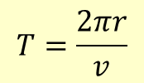
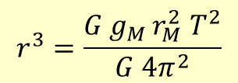
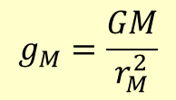
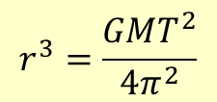
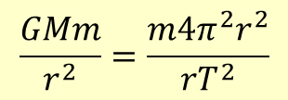
QUESTION FIVE: PHYSICS COMPILATION (8 marks)
The acceleration due to gravity on the surface of Mars is 3.71 m s^{–2}.
(a) Mars has a radius of 3395 km, and its period of revolution is 24.62 hours.
Show that a satellite needs to be positioned 2.04 x 10⁷ m from the centre of Mars so
that it remains stationary with respect to an observer on that planet.
$$F=\frac{GMm}{r^{2}}=\frac{mv^{2}}{r}$$
$$T=\frac{2πr}{v}$$
and
$$\frac{GMm}{r^{2}}=\frac{m{4π^{2}r}^{2}}{rT^{2}}$$
$$r^{3}=\frac{GMT^{2}}{4π^{2}}$$
✓
so
but at the surface:
$$g_{M}=\frac{GM}{r_{M}^{2}}$$
$$r^{3}=\frac{G{ g}_{M }r_{M}^{2} T^{2}}{G 4π^{2}}$$
$$r^{3}=\frac{3.71 x \left(3.395 x 106 \right)2 {x (24.62 x 60 x 60)}^{2}}{ 4π^{2}}=8.509 x 1021$$
✓
$r=2.041542 x 107$m
Two marks were given here

Slide 20
(b) Twelve identical one volt batteries are connected into an electrical circuit as shown in the diagram.
What will be the reading on the voltmeter?
Explain your answer.
Assume each battery has the same internal resistance and the voltmeter has infinite resistance.
V
✓
The reading will be zero. Across each cell the voltage rise (1 volt) must be equal to the voltage drop (I . R), so the total voltage change across each circuit element is zero.
✓
Or
The current through the loop is given by:
$$I=\frac{V}{R}=\frac{12}{12r}=\frac{1}{r}$$
The terminal potential difference across the three cells is given by:
$$Ε−Ir=3−\frac{1}{r}x3r=0$$
Two marks were given here

Slide 21
(c) The circuit below consists of eight resistors each with resistance r.
(i) Explain why B and D are at the same potential.
Calculate the effective resistance
between A and C.
A
⅓I
B
I
⅓I
The circuit is symmetrical. Equal sized currents must flow along the identical paths AB and AD. This means that the voltage drops across resistors AB and AD will be the same and so the potential at B and D will be the same. (The potential difference BD is zero.)
O
✓
I
D
C
DO and BO do not have any current through them so do not contribute to the resistance.
This leaves 3 parallel branches, each of resistance 2r. The total will be ⅔r Ω
✓
✓
Three marks were given here

Slide 22
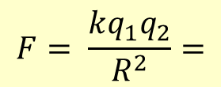
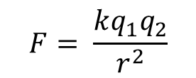
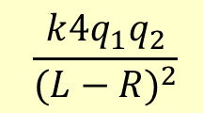
The force between a pair of charges is given by Coulomb’s Law
$$F= \frac{kq_{1}q_{2}}{r^{2}}$$
where k = constant, q₁and q₂ are the respective charges and r is the separation of the charges.
A charge q and another charge 4q are placed at the coordinates x = 0 and x = L respectively.
Find where, on the line between them, the resultant electrostatic force on a third charge is zero.
$$F= \frac{kq_{1}q_{2}}{R^{2}}=$$
$$\frac{k{4q}_{1}q_{2}}{(L−R)^{2}}$$
$$(L−R)^{2}=4R^{2}$$
$$L2−2LR−3R^{2}=0$$
$$\left(L−3R\right)\left(L+R\right)=0$$
$$L=3R$$
q₁
4q₁
One mark for this

Slide 23
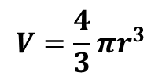
QUESTION SIX: SIMPLE HARMONIC GRAVITY (8 marks)
$$V=\frac{4}{3}πr^{3}$$
Volume of a sphere =
Radius of the Earth = 6.37 x 10⁶ m
Mean density of the Earth = 5.5 x 10³ kg m^{–3}
Universal Gravitational Constant = 6.67 x 10^{–11} N m² kg^{–2}
North Pole
Imagine that a hole is drilled from the South Pole, through the centre of the Earth to the North Pole.
(a)
By using Newton’s Law of Gravitation, show that, if Earth has uniform internal density ρ, and ignoring air resistance, an object dropped into the hole will perform simple harmonic motion.
Hint: For an object at distance r from the centre of the Earth, the net gravitational force on the object, due to those parts of the Earth’s mass that lie at distances greater than r, is zero
South Pole
(b) Calculate the period of this simple harmonic motion.
Explain in what way this period is related to the orbital period of satellites in low
Earth orbits.

Slide 24
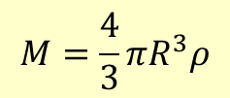
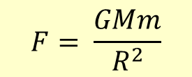
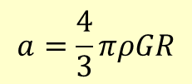
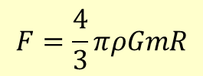
(a) By using Newton’s Law of Gravitation, show that, if Earth has uniform internal density ρ, and ignoring air resistance, an object dropped into the hole will perform SHM.
Force on an object mass m due to gravity is:
$$F= \frac{GMm}{R^{2}}$$
At distance R from the centre, the mass M of the planet acting on the object is:
$$M=\frac{4}{3}πR^{3}ρ$$
$$F=\frac{4}{3}πρGmR$$
Combining these the force is:
✓
The force on the object is in the opposite direction to the displacement R
$$F=ma$$
$$a=\frac{4}{3}πρGR$$
✓
The acceleration of the object is proportional to –R since the other terms are constants so the motion is SHM.
Two marks were given here

Slide 25
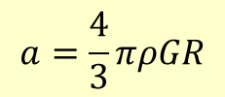
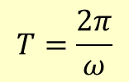
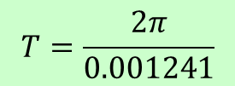
(b) Calculate the period of this simple harmonic motion.
$$a=\frac{4}{3}πρGR$$
$$a=−ω^{2}y$$
So here ω² is $\frac{4}{3}πρG$
✓
$$T=\frac{2π}{ω}$$
$$T=\frac{2π}{\sqrt{\frac{4}{3}π x 5.5 x 103 x 6.67 x 10−11}}$$
✓
$$T=5069 s$$
With no result from (a) we can still do this using g at the surface of the Earth.
$$a_{max}=−ω^{2}R$$
$$9.81=−ω^{2} 6.37x106$$
$$T=\frac{2π}{0.001241}$$
$$T=5063 s$$
Two marks were given here

Slide 26
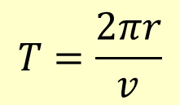
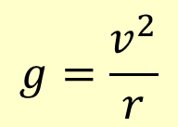
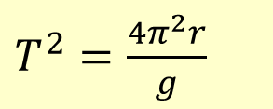
Explain in what way this period is related to the orbital period of satellites in low
Earth orbits.
The long way to do this is to work out the period of the satellite and then spot that these are the same. You can do this using :
$F=mg=\frac{mv^{2}}{r}$
$$T=\frac{2πr}{v}$$
$$g=\frac{v^{2}}{r}$$
$g=\frac{{4π^{2}r}^{2}}{T^{2}r}$
$T^{2}=\frac{4π^{2}r}{g}$
$$T=5063 s$$
It is much easier to recognise that the orbit at the surface represents the reference circle for the SHM. The vertical component of the satellite’s acceleration is equal to the acceleration of the object in the hole. The two periods are the same. The falling object has acceleration g at the limits of its motion.
✓
✓
Two marks were given here

Slide 27
Discuss the differences in the motion of the falling object that would be observed if the
hole were drilled from an equatorial position rather than from the South Pole.
North Pole
The object would start with a tangential velocity at right angles to the radius it is falling along. Deeper parts of the hole will not have as great a tangential velocity, and so the object will be going faster than the hole is going. The object will collide with the wall of the hole all the way down.
These collisions will mean that it does not perform SHM – unless the Earth stopped rotating!
…… and in true Physics style we will neglect the fact that drilling holes around 10 -15km deep is the best we can do, the Earth’s density is nowhere near uniform, the outer core is liquid Nickel / Iron ……….
South Pole
Two marks were given here

