Slide 1
Scholarship 2014 Physics
Scholarship 2014
Physics
Time allowed: Three hours
Total marks: 40
You are advised to spend approximately 35 minutes on each question.

Slide 2
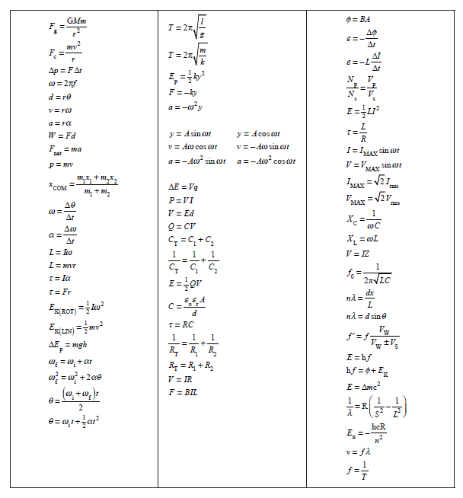

Slide 3
QUESTION ONE: GENERAL RELATIVITY
Planck’s constant = 6.63 x10^{–34} J s
Speed of light = 3.00 x 10⁸ m s^{–1}
Charge on the electron= –1.60 x 10^{–19} C Acceleration due to gravity = 9.81 m s^{–2}
In an experiment carried out in 1959 at Harvard University, Einstein’s General Theory of Relativity was tested. The experiment involved measuring the change in frequency of 14.0 keV gamma rays emitted from a radioactive isotope of iron-57 as the gamma rays fall through the gravitational field of the Earth. Einstein’s theory predicts that the frequency of the gamma rays increases.
(a) Calculate the frequency of a 14.0 keV gamma ray.
(b) In the Harvard University experiment the gamma rays fell through a distance of 22.5 m. The change in frequency can be attributed to the change in gravitational potential energy described by the relationship ΔE = (EgΔx)/c² , where E is the original energy of the 14 keV gamma ray and Δx is the distance fallen.
Show that Δ f / f = 2.45 x 10⁻¹⁵.

Slide 4
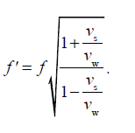
(c) The detector in the experiment is another sample of iron-57, positioned at the base of the experiment. The gamma rays can be detected if they are absorbed by the detector. However, they will be absorbed only if their frequency has not changed.
By considering the Doppler Effect, explain an experimental technique that will allow the gamma rays to arrive at the detector with the original emitted frequency.
(d) The Doppler Effect equation for electromagnetic radiation is
This equation can be approximated by the following expression
Given that Δf = f ' – f, use the expression to show that
and explain when this would be an acceptable approximation to the Doppler Effect equation given above.

Slide 5
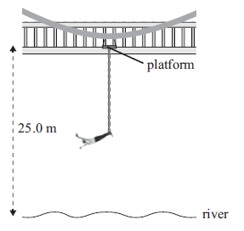
QUESTION TWO: BUNGY JUMPING
Acceleration due to gravity = 9.81 m s–2
Standing on a platform that is 25.0 m above a river, Emma, of height 2.00 m and mass m, is tied to one end of an elastic rope (the bungy) by her ankles, while the other end of the bungy is fixed to a platform. The length of the bungy is adjusted so that Emma’s downward motion stops at the instant her head reaches the water surface. When Emma is at rest, in equilibrium, at the end of the bungy, her head is 8.00 m above the water. The unstretched length of the bungy is L, and it has a spring constant of k. Assume Emma’s centre of mass is halfway up her body.
(a) By considering energy conservation, show that at the lowest point in the jump,
mgh = ½ k(23 - L)², where h is the change in height of Emma’s centre of mass.
Explain all reasoning
(b) Show that, at the equilibrium position, mg = k(15 – L)
(c) Show that the value of L is 13.0 m

Slide 6
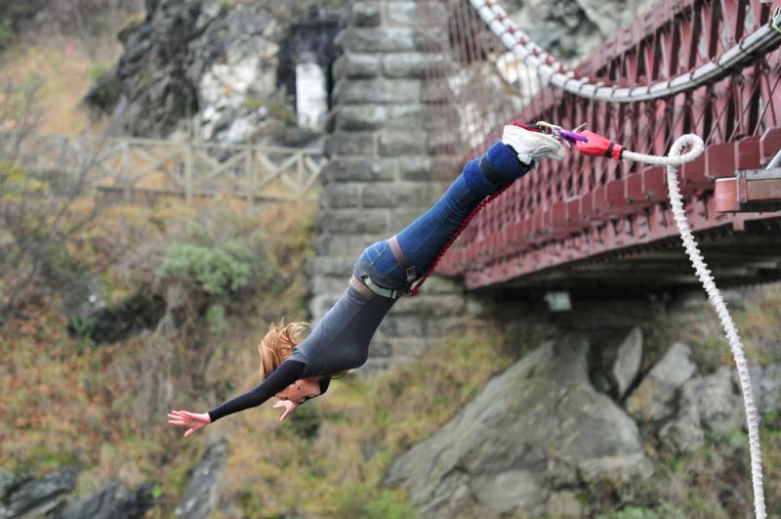
(d) (i) Calculate Emma’s maximum speed.
(ii) Calculate Emma’s maximum acceleration.
(e) Explain what will happen to the spring constant of the bungy when its length is reduced by 50%.

Slide 7
QUESTION THREE: THE BLOCK
Eight small blocks, of dimensions 3 cm by 3 cm by 3 cm, are glued together to form a cube, as shown. Each block has a mass of 100 grams. The cube is placed on a frictionless surface and a 10 g projectile is fired into the cube at velocity of
60 m s^{–1}, as shown. The projectile enters the cube 3 cm from the base (through the horizontal plane of the centre of mass), and 1 cm from the right-hand edge. Assume that the projectile stops inside the cube on the same line as it entered.
10 g projectile
60 m s^{–1}
(a) Show that once the projectile stops, the velocity of the centre of mass of the cube and projectile is 0.74 m s^{–1}.
(b) Show that once the projectile stops, the angular velocity of the cube and projectile is given by
$$ω=\frac{\text{m}\text{projectile}\text{v}\text{projectile}\text{d} }{\text{I} \text{+ }\text{m}\text{projectile} \text{r} \text{2}}$$
where d is the perpendicular distance from the centre of mass of the cube to the initial direction of the projectile, I is the rotational inertia of the cube (about a vertical axis through the centre of mass), r is the distance from the centre of mass to the final position of the projectile, and ω is the angular velocity of the cube and projectile.

Slide 8
(c) Show that
is the fraction of the initial kinetic energy that goes into moving the centre of mass of the cube and projectile.
(d) Explain what has happened to the rest of the projectile’s initial energy.
(e) Four blocks are removed from the cube to create a new object, as shown below
If the projectile were fired at the new object (in the horizontal plane of the centre of mass of the new object and again 1 cm in from the right-hand edge of the object, as shown above), explain what differences would be seen in the motion of the new object compared to the original cube.

Slide 9
QUESTION FOUR: THE WOODEN SHEETS
Uniform sheets of wood of mass 50 kg and length 2.40 m are moved around a production mill by powered rollers. After their initial acceleration, the wooden sheets move without slipping at a constant velocity of 2.00 m s^{–1}.
The frictional force between the rollers and the wood can be calculated using F_{friction} = µN, where µ is the coefficient of friction between the wood and the rollers, and N is the normal reaction force on the wood.
2.0 ms⁻¹
(a) Explain why no work is done on the wooden sheet when it is travelling at constant
velocity.

Slide 10
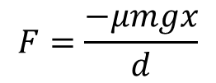
A
B
(b) One of the rollers has a drive gear malfunction and rotates in the opposite direction, as shown above. The wooden sheet is initially displaced towards the right-hand roller.
Show, by taking moments about the centre of mass of the sheet, that the normal reaction force acting through point A is
$$N_{A}=\frac{mg(d−x)}{2d}$$
where 2d is the distance between the centres of the two rollers, and x is the displacement of the centre of mass of the wooden sheet from the midpoint between the rollers.
(c) It can be shown that the normal reaction force at point B is
$$N_{B}=\frac{mg(d+x)}{2d}$$
Using this result and the result from (b) above, show that the sheet undergoes simple harmonic motion described by the following expression
$$F=\frac{−μmgx}{d}$$

Slide 11
(d) (i) Show that the period of the oscillation is 2.46 s when d is 0.600 m and µ is 0.400.
(ii) An object is dropped onto the oscillating sheet of wood.
If the coefficient of friction between the object and the wood is 0.200, show that the maximum amplitude with which the wood can move horizontally without causing the object to slip is 0.300 m.

Slide 12
QUESTION FIVE: CAPACITORS AND DIELECTRICS
In the circuit below, the switch S has been closed for a time sufficiently long for the capacitor to become fully charged.
S
12.0 kΩ
(i) Calculate the steady-state
current in each resistor.
10.0 µF
9.00 V
15.0 kΩ
Show that the charge on
the capacitor is 50.0 µC
3.00 kΩ
The switch S is now opened.
Calculate the maximum value of the current through the 3.00 kΩ resistor.

Slide 13
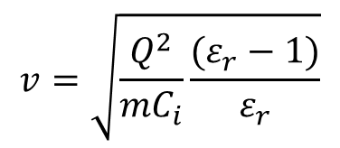
In a separate experiment, a dielectric material is placed next to a charged parallel-plate capacitor, as shown in the diagram. The dielectric material experiences an electrostatic force that pulls it into the gap between the capacitor plates.
(b) Explain why the dielectric material is attracted into the gap between the plates.
If the dielectric material is able to move without friction,
show, by considering conservation of energy, that the
maximum speed reached by the dielectric material is
given by
$$v=\sqrt{\frac{Q^{2}}{mC_{i}}\frac{(ε_{r}−1)}{ε_{r}}}$$
where
Q = original charge on the capacitor
ε_{r} = dielectric constant for the dielectric material
m = mass of the dielectric material
C_{i} = initial capacitance of the capacitor
(d) A capacitor is often referred to as a “store of charge”. Comment on this.

