Slide 1
Scholarship 2014 Physics
Scholarship 2013
Physics
Time allowed: Three hours
Total marks: 40
There are FIVE questions each worth a maximum of 8 marks.
You are advised to spend approximately 35 minutes on each question.

Slide 2
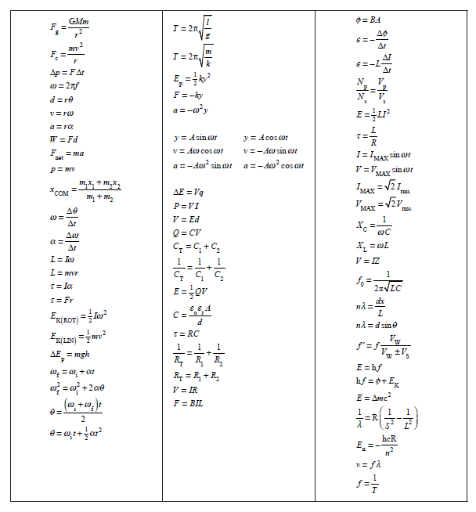

Slide 3
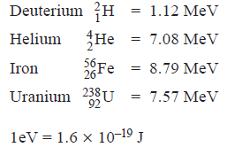
QUESTION ONE: MODERN PHYSICS
(a) Albert Einstein and Niels Bohr provided explanations for the photoelectric effect and the emission spectrum of the hydrogen atom.
Explain in detail the key underlying physics of each explanation, and describe the fundamental physical connection between these two phenomena.
(b) With reference to the data below, explain how fission and fusion processes differ in their release of energy.
Binding energies per nucleon:
(c) Visible radiation with a continuous spectrum of wavelengths passes through hydrogen gas before passing through a diffraction grating. A series of dark lines (absorption spectrum) is produced in the resulting interference pattern. Explain, in detail, why this occurs.

Slide 4
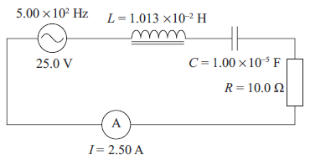
QUESTION TWO: AC CIRCUIT THEORY
The LCR circuit shown in the diagram is in resonance. The inductor and the capacitor
are both ideal.
Show that the voltages at resonance across the inductor and the capacitor are both 79.6 V AND explain why voltages larger than the source voltage are created.

Slide 5
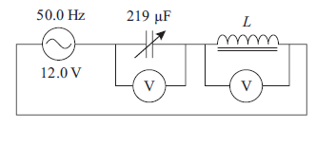
Two students, Ali and Sue, are trying to find the inductance of a coil. Using a 12.0 V,
50.0 Hz AC supply, Ali connects a variable capacitor, whose capacitance can be varied
over the range of 100 to 300 μF, in series with the coil. Ali adjusts the variable
capacitor until the voltages across it and the coil are exactly equal in magnitude.
The value of the variable capacitor when this happens is 219 μF. Ali then uses the relation given below to get a value of 46.3 mH for the inductance, L. Show how Ali carried out his calculation, and explain what he has assumed about the coil.

Slide 6
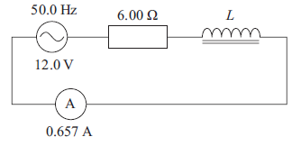
Sue constructs a new circuit where she uses a 6.00 Ω resistor connected in series with the coil and an ideal AC ammeter. They are all connected in series to the same 12.0 V,
50.0 Hz AC supply.
Sue measures the RMS current to be 0.657 A.
Show that Sue needs to use the results from both circuits to determine that the true value of the inductance of the coil is 40.2 mH.
A series LCR circuit has a resonant frequency of 1460 Hz. When set to another, higher
frequency, the circuit has a capacitive reactance of 5.00 Ω and an inductive reactance
of 28.0 Ω.
Calculate the values of the inductance and capacitance in the circuit.

Slide 7
QUESTION THREE: INTERFERENCE
A pair of narrow parallel slits is illuminated by monochromatic light of wavelength 500 nm to produce Young’s fringes on a screen.
(a) Explain the differences and similarities between the interference patterns produced by monochromatic illumination on a double slit and on a diffraction grating of the same slit separation.
The space between the slits and the screen is then completely filled with a block of transparent material for which the refractive index, n, is 1.6. Assume the refractive index is constant for all wavelengths.

Slide 8
The space between the slits and the screen is then completely filled with a block of transparent material for which the refractive index, n, is 1.6. Assume the refractive index is constant for all wavelengths.
(b) Describe and explain the changes that will take place in the pattern of the Young’s fringes.

Slide 9
The block of material is removed and a very thin slice of the transparent material from the block is used to cover the top slit, as shown in the diagram below. When this is done, the central maximum bright fringe (zeroth order) is observed to move up the screen.
transparent material
(c) Explain why the pattern shifts up the screen.
(d) The slice of material has thickness, t, and the central maximum shifts up the screen to take the position originally held by the fifth order bright fringe produced when no material was between the slits and the screen.
Show that the thickness of the slice is less than or equal to 4.17 × 10^{–6} m.
(e) The monochromatic illumination is replaced by sunlight.
Explain how this will assist the experimenter to determine the position of the new central maximum bright fringe.

Slide 10
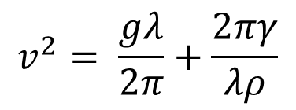
QUESTION FOUR: WAVE MOTION
A cork floats on the surface of a pond across which a sinusoidal wave-train of wavelength 10 m and amplitude 0.20 m is travelling. The velocity, v, of waves of wavelength, λ, on a liquid surface is given by
$$v^{2}= \frac{gλ}{2π}+\frac{2πγ}{λρ}$$
where ρ is the density (1.0 × 10³ kg m^{–3} for water) and γ is the surface tension, which for water has the value 7.2 × 10^{–2} N m^{–1}.
(a) Show that the equation is dimensionally consistent.
(b) Calculate the wave speed.
(c) Calculate the maximum speed of the cork as it rises and falls in the water.
Sea waves of wavelength 150 m and velocity of 15.3 m s^{–1} are heading North. A cruise ship is also travelling North at 8.0 m s^{–1}.
(d) Calculate the frequency of the ship’s up and down movement

Slide 11
The natural pitch period of the ship (the period of oscillation produced by pulling the
front of a ship down in completely flat water) is about 8 s.
By considering the ship when it is travelling normal to the wavefront, explain why the ship must avoid certain speeds.
If the wave has a speed of 10.8 m s^{–1} and wavelength of 75 m, calculate the speeds that should be avoided.

Slide 12
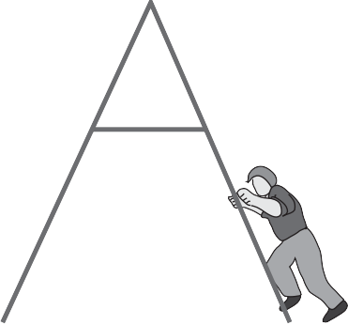
QUESTION FIVE: THE A-FRAME LADDER
failed bulb
At the local ice rink one of the light bulbs has failed and must be replaced. A lightweight ladder is placed on the frictionless ice so that it is directly under the light bulb, and an electrician climbs the ladder to reach the bulb. Treat the ladder as having zero mass.
For the initial position of the ladder and electrician shown in the diagram, the electrician will not be able to reach the light bulb.
Explain:
ice

Slide 13
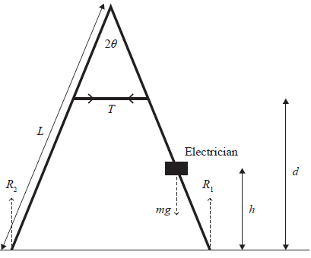
With no friction acting on the base of the ladder, the only force preventing the collapse of the ladder is the tension, T, in the cross-tie bar.
The angle between the legs of the ladder is 2θ, and the reaction forces acting on these legs are shown in the diagram.
The vertical distance to the cross-tie bar is d and the length of each leg is L.
The mass of the electrician is m.
(b) By taking moments about the top of the ladder, show that when the electrician is at a height, h, above the ground the tension in the cross-tie bar will be:
$$T=\frac{mghtanθ}{2(Lcosθ−d)}$$

Slide 14
$$T=\frac{mghtanθ}{2(Lcosθ−d)}$$
The angle, 2θ, between the legs of the ladder is 60⁰, and the cross-tie bar is one third the way down the leg.
Calculate the maximum tension in the cross-tie bar when the electrician has a mass of 70 kg and the legs of the ladder are 3 m long.
Explain what effect increasing the angle will have on this maximum tension assuming the cross-tie bar remains fixed to the same points on the ladder.
Explain why it is important that the electrician climbs the ladder at a slow and steady
speed.

