Slide 1
Scholarship 2014 Physics
Scholarship 2012
Physics
Time allowed: Three hours
Total marks: 48
You should answer ALL the SIX questions in this booklet. Each is worth 8 marks.
For all ‘describe’ or ‘explain’ questions, the answers should be written or drawn clearly with all logic fully explained.
For all numerical answers, full working must be shown and the answer must be rounded to the correct number of significant figures and given with the correct SI unit.

Slide 2
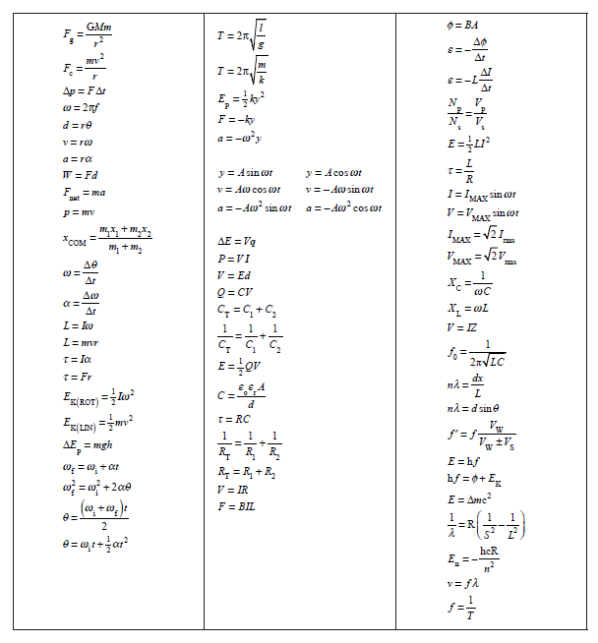

Slide 3
QUESTION ONE: MODERN PHYSICS (8 marks)
Charge on the electron = –1.6 x 10^{–19} C Speed of light = 3.00 x 10⁸ m s^{–1}
In an experiment to investigate the photoelectric effect, light of wavelength λ is incident on a metal surface and a current is produced. The current is reduced by applying a potential difference V between the metal surface and the collecting plate.
When the current is reduced to zero, derive an equation relating λ, V and the work
function, f, of the metal.
Provide a full explanation of the derivation.
A classical wave explanation fails to explain the experimental results of the
photoelectric effect.
Discuss this statement.

Slide 4
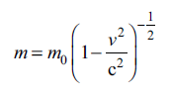
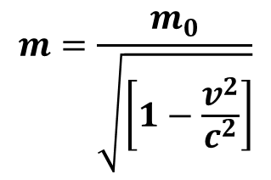
(i) A nucleus of mass 3.93 x 10^{–25} kg, which is stationary with respect to an observer, undergoes fission.
The nucleus breaks into two equal parts with total kinetic energy of 200 MeV.
The two parts are brought to rest.
Calculate the total decrease in the mass in kg and therefore calculate the individual rest
mass of the two equal masses.
According to Einstein’s special theory of relativity, the mass m of an object with a
velocity v, relative to an observer, is given by:
$$m=\frac{m_{0}}{\sqrt{\left[1−\frac{v^{2}}{c^{2}}\right]}}$$
or
where c is the speed of light, and m₀ (the rest mass) is the mass measured when v = 0 m s^{–1}.
Discuss the physical significance of this relationship.
By considering the effects of the special theory of relativity, calculate the speed of
the two masses in part (i) above, before they are brought to rest.

Slide 5
QUESTION TWO: INDUCTANCE (8 marks)
A 75 W electric light bulb (with zero inductance) is designed to run from a 50 Hz AC supply of 120 V_{rms}. If the only supply available is 240 V_{rms} and 50 Hz, the bulb can be operated at the correct power by placing in series with it, either:
(i) a resistance R, or (ii) an inductance L.
(a) Find the values of R and L and the power drawn from the supply in each case.
When an alternating voltage is applied across a coil wrapped around an iron core, an aluminium ring around the core will “float” at some height above the coil.
Explain why this happens.
Iron core made of thin iron sheets glued together
“Floating” aluminium ring
Explain, possibly with the aid of a diagram,
how such a coil could be wound so that this
effect would not take place.
To reduce the heating of the iron core, thin
sheets of iron are glued together. The glue that
holds the thin iron sheets together must have
some specific electrical properties.
Suggest at least one electrical property of the
glue, and state why it is important.
AC

Slide 6
QUESTION THREE: THE DOPPLER EFFECT (8 marks)
The speed of sound in air = 340 m s^{–1} Acceleration due to gravity = 9.81 m s^{–2.}
When the Doppler effect occurs it is known that the apparent frequency of a sound is increased as the source of the sound moves towards a stationary observer.
(a) Explain why the frequency increase occurs.
Explain qualitatively what would happen to the apparent frequency if the observer
moved at constant velocity towards the moving source.
Ben is on the top floor of an apartment building, and has a phone that emits a single ringing tone of 440 Hz. Unfortunately, while picking up the ringing phone, Ben drops it so that it falls off the edge of the 0.700 m high, top floor ledge he is leaning on. Some time later Ben hears a reduced frequency of 416.2 Hz. The height of each floor is 3.10 m.
Calculate the number of floors that the phone must have fallen when it emits the wave
that Ben hears as a 416.2 Hz tone.
State any assumptions made.
Frankie is watching Ben from the top of an identical apartment building on the other side of the street. Frankie is at the same height, but is 40.0 m away from Ben.
For the wave that Ben hears as a 416.2 Hz tone, calculate the frequency that Frankie
would hear.

Slide 7
QUESTION FOUR: MOTION (8 marks)
Ball X is released from rest from a height h and hits the ground with speed v m s^{–1}. At precisely the same time as ball X is dropped, ball Y is launched straight up from the ground at v m s^{–1}.
(a) Show that the two balls will pass each other at a point ¼ h from the release point of ball X.
(b) Use physical principles to explain this result.
A ball of mass m makes a head-on elastic collision with a stationary second ball of mass
M and rebounds with a speed equal to one-third its original speed.
Show that the mass of the second ball is equal to 2m.

Slide 8
A pair of balls (both of mass m) are sliding along a long, horizontal, frictionless groove towards a stationary third ball (also of mass m), as shown in the following diagram.
4 ms⁻¹ 4 ms⁻¹
A B C
For the collision of a pair of objects the coefficient of restitution, σ, is calculated by
$$σ= \frac{the difference in velocities before the collision}{the difference in velocities after the collision}$$
The coefficient of restitution σ of these balls is 0.4.
Show that there are just three collisions between the balls and that the sum of the
final velocities of the three balls is 8 m s^{–1}.

Slide 9
QUESTION FIVE: PHYSICS COMPILATION (8 marks)
The acceleration due to gravity on the surface of Mars is 3.71 m s^{–2}.
Mars has a radius of 3395 km, and its period of revolution is 24.62 hours.
Show that a satellite needs to be positioned 2.04 x 10⁷ m from the centre of Mars so
that it remains stationary with respect to an observer on that planet.
(b) Twelve identical one volt batteries are connected into an electrical circuit as shown in the diagram.
What will be the reading on the voltmeter?
Explain your answer.
Assume each battery has the same internal resistance and the voltmeter has infinite resistance.
V

Slide 10
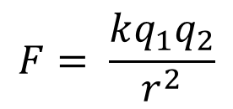
(c) The circuit below consists of eight resistors each with resistance r.
(i) Explain why B and D are at the same potential.
Calculate the effective resistance
between A and C.
A
B
I
O
The force between a pair of charges is
given by Coulomb’s Law,
I
$$F= \frac{kq_{1}q_{2}}{r^{2}}$$
D
C
where k = constant, q₁and q₂ are the respective charges and r is the separation of the charges. A charge q and another charge 4q are placed at the coordinates x = 0 and x = L respectively.
Find where, on the line between them, the resultant electrostatic force on a third charge is zero.

Slide 11
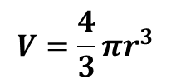
QUESTION SIX: SIMPLE HARMONIC GRAVITY (8 marks)
$$V=\frac{4}{3}πr^{3}$$
Volume of a sphere =
Radius of the Earth = 6.37 x 10⁶ m
Mean density of the Earth = 5.5 x 103 kg m^{–3}
Universal Gravitational Constant = 6.67 x 10^{–11} N m² kg^{–2}
North Pole
Imagine that a hole is drilled from the South Pole, through the centre of the Earth to the North Pole.
(a)
By using Newton’s Law of Gravitation, show that, if Earth has uniform internal density ρ, and ignoring air resistance, an object dropped into the hole will perform simple harmonic motion.
Hint: For an object at distance r from the centre of the Earth, the net gravitational force on the object, due to those parts of the Earth’s mass that lie at distances greater than r, is zero
South Pole
(b) Calculate the period of this simple harmonic motion.
Explain in what way this period is related to the orbital period of satellites in low
Earth orbits.

Slide 12
Discuss the differences in the motion of the falling object that would be observed if the
hole were drilled from an equatorial position rather than from the South Pole.
North Pole
South Pole

