Slide 1
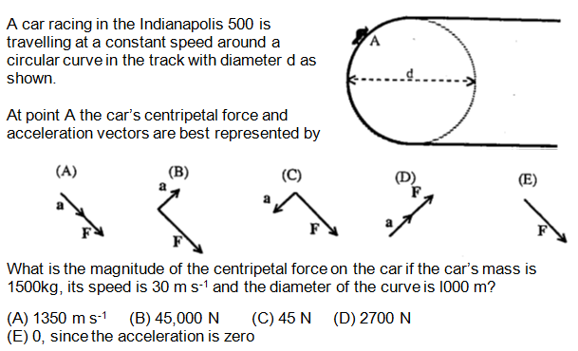
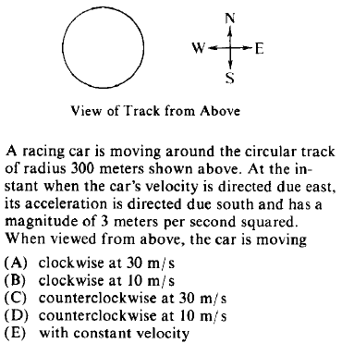
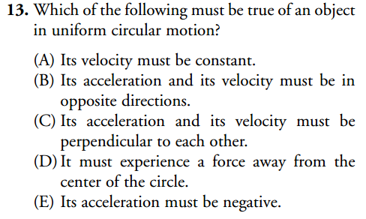
Uniform
Circular
Motion
1
2
3
4

Slide 2
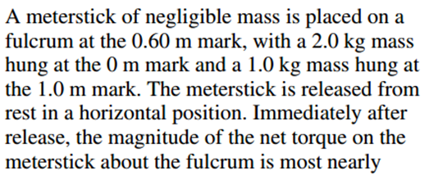
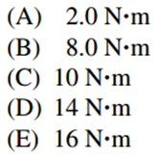
Torque, Objects in Rotational Equilibrium
1
2
3
4

Slide 3
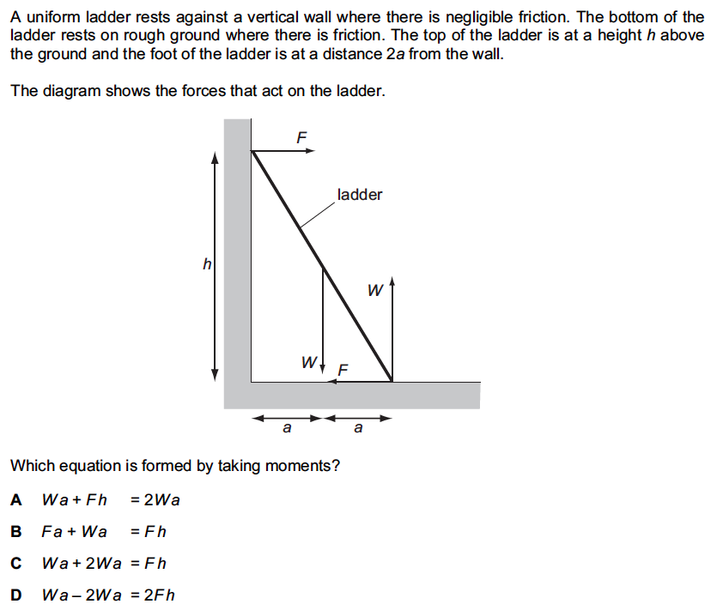
5
Hint pivot point

Slide 4
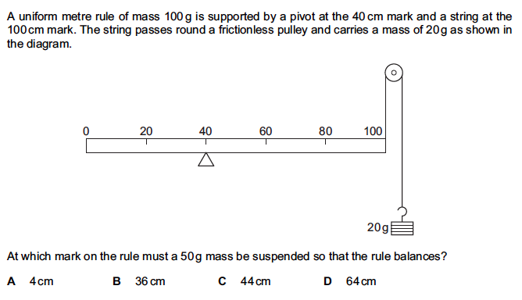
6

Slide 5
Hooke’s law & Springs
1
2
3
Hint: Use energy transfer and work out how much the
Spring is compressed

