Slide 1
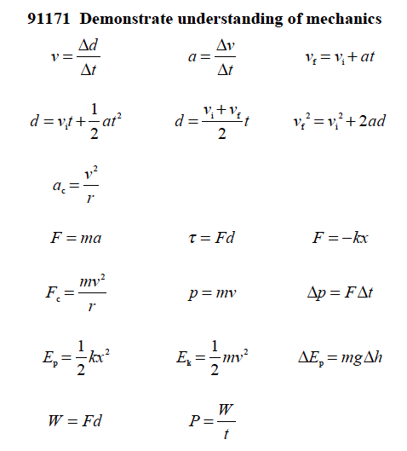
Motion, Vectors & Energy

Slide 2
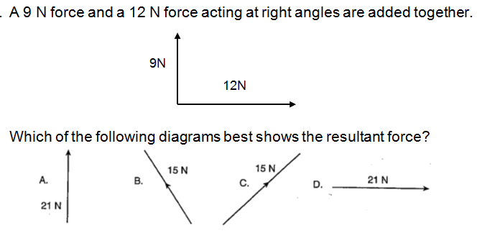
Motion, Vectors & Energy
1
Which of the following is a SCALAR quantity?
(A) Power. (B) Force. (C) Velocity. (D) Acceleration.
Which of the following gives three vector quantities?
(A) Weight, mass, acceleration (C) Velocity, acceleration, force
(B) Work, force, distance (D) Voltage, resistance, current
2
Vectors
3

Slide 3
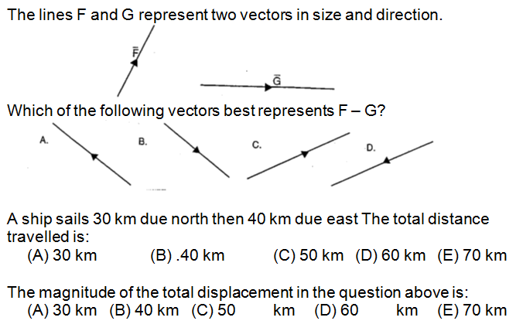
4
5
6

Slide 4
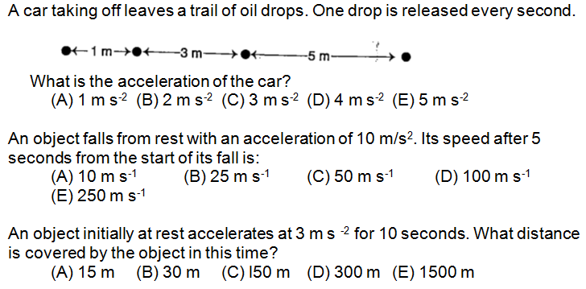
Motion - Kinematics
1
2
3
4

Slide 5
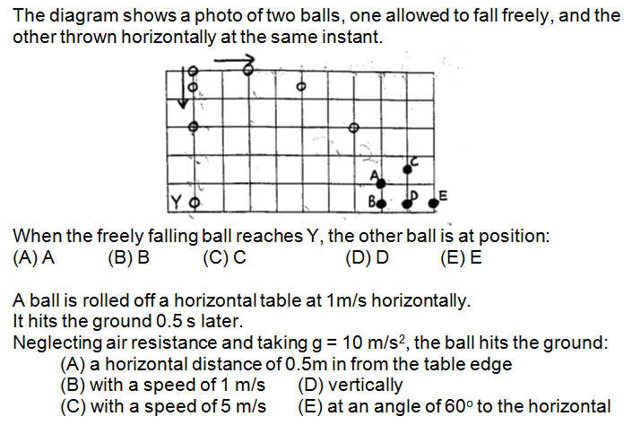
Motion - Projectiles
1
2

Slide 6
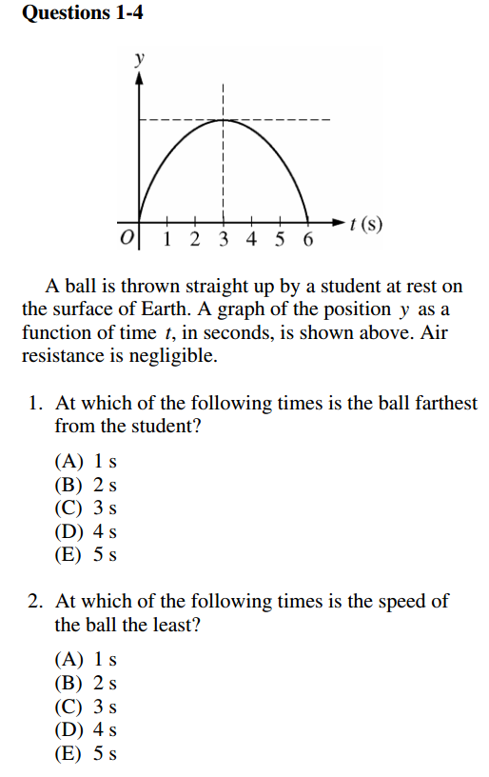
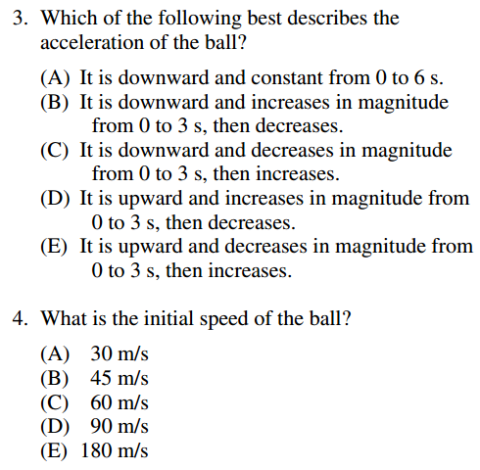
5
3
6
4

Slide 7
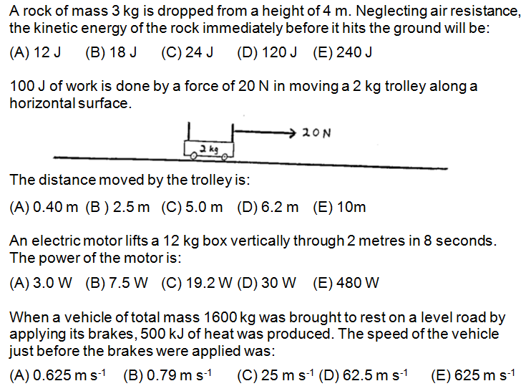
Energy
1
2
3
4

