Slide 1
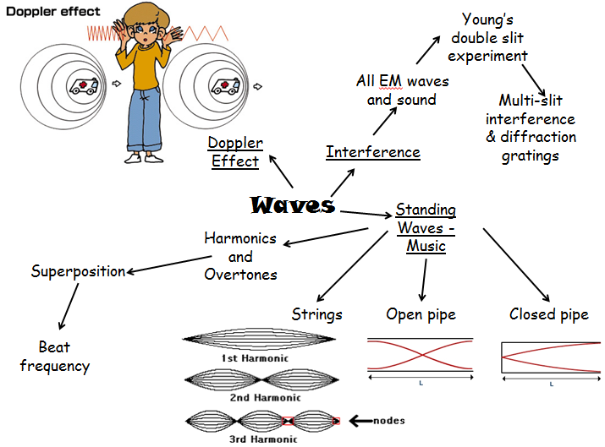

Slide 2
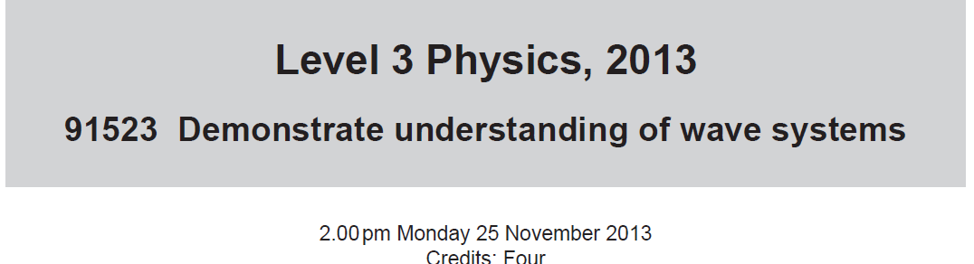


Slide 3
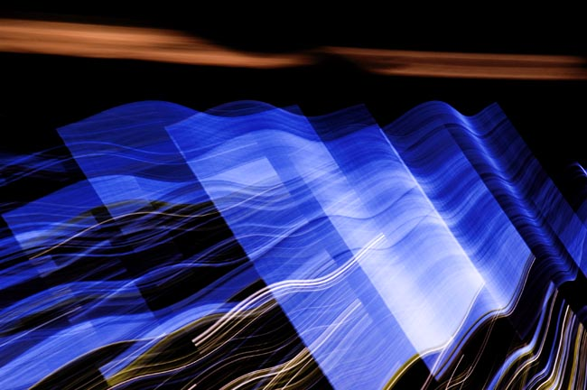
Light
Has wave properties.
Can diffract.
Can constructively or destructively interfere.

Slide 4
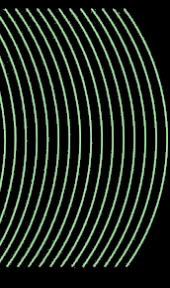
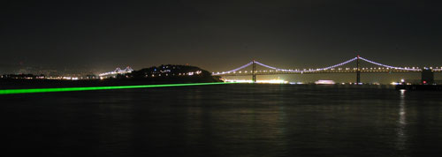
Coherent Light
A beam of light that has the same frequency, wavelength, phase, and direction is called coherent.
There is no interference of waves within the beam and the beam will not spread out and diffuse.

Slide 5
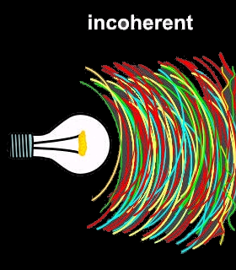
Incoherent Light
Light emitted by a common lamp is incoherent. It has many phases of vibration as well as many frequencies.
Incoherent light spreads out after a short distance and loses intensity.

Slide 6
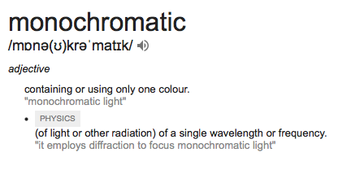

Slide 7
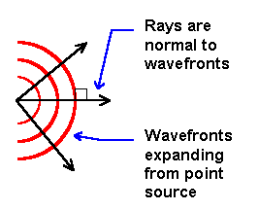
Wave Fronts
Lines that are perpendicular to the motion of the wave.
Indicate the location of the crests in the waves that are traveling together.

Slide 8


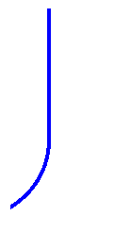


Diffraction.
Waves have the ability to bend around corners.
Diffraction around obstacles

Slide 9
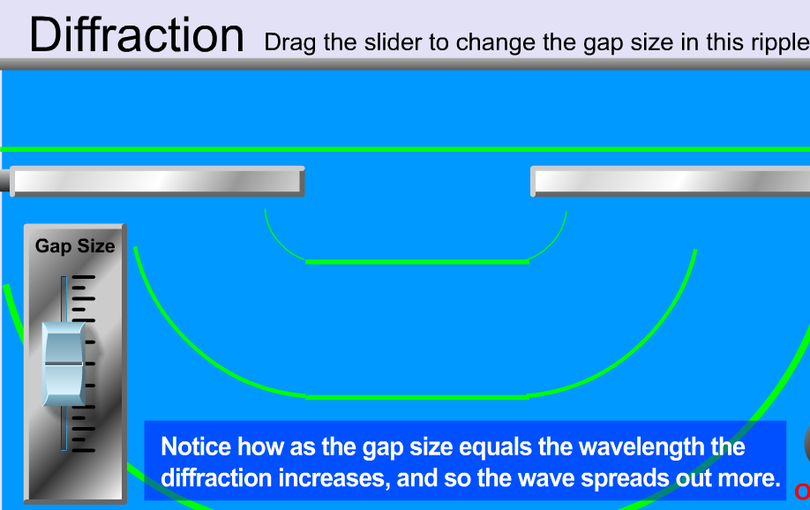
See Diffraction slit adjustable applet

Slide 10


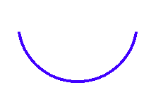
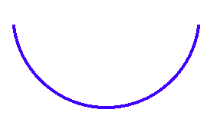




Diffraction through gaps
What is the relationship between λ and gap size?
Compare sound and light diffraction

Slide 11
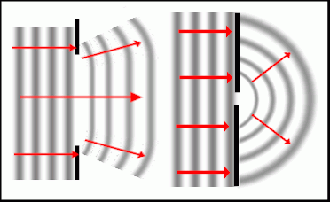
……gap getting narrower

Slide 12
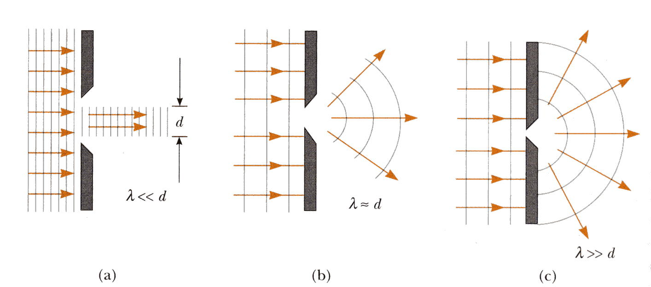

Slide 13
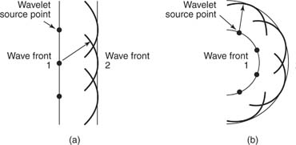
Huygen’s Principle
Wave fronts are made up of tinier wave fronts.
Every point on any wave front is a new source for a secondary wave front.
Notes:
Show this on the board. Use large compass if you can. Ask, why can you have a straight line wave front make circular patterns in the secondary wave front? Do demonstration online. http://www.ngsir.netfirms.com/englishhtm/Diffraction.htm

Slide 14
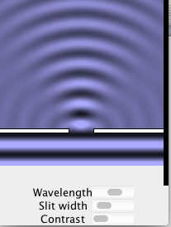
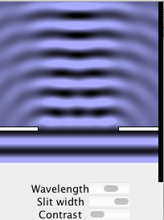

Slide 15
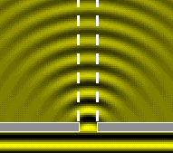
Huygen’s Principle
As the straight waves passed through a narrow hole, they spread out in a circular pattern.
Giving proof to the fact that every point on a wave front is a new source for a new set of wavelets.
http://www.ngsir.netfirms.com/englishhtm/Diffraction.htm

Slide 16
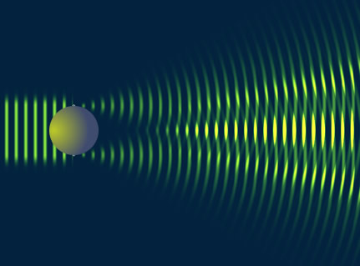
Diffraction
Any bending of a wave around an obstacle or edges of an opening by means other than reflection or refraction.

Slide 17
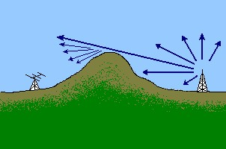
Is Diffraction a Good Thing?
Long AM radio waves can diffract around hills and buildings and can be received better in more places than short waves that don’t diffract as much.

Slide 18
Two point source Interference
Anti-nodal lines – lines of constructive interference
Source 1
Source 2
Nodal lines – lines of destructive interference

Slide 19

Water wave Interference

Slide 20
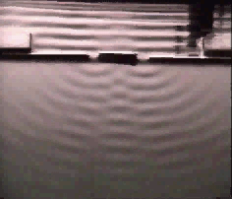
Lines of constructive interference
(antinodes).
n=2
n=2
n=1
n=1
n=0
central maxima

Slide 21
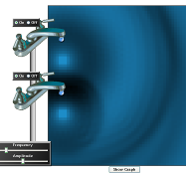
See PhET Wave interference applet applet

Slide 22

Interference of Sound Waves
Imagine two speakers, each playing a pure tone of wavelength 1 meter:
3 m
3 m

Slide 23
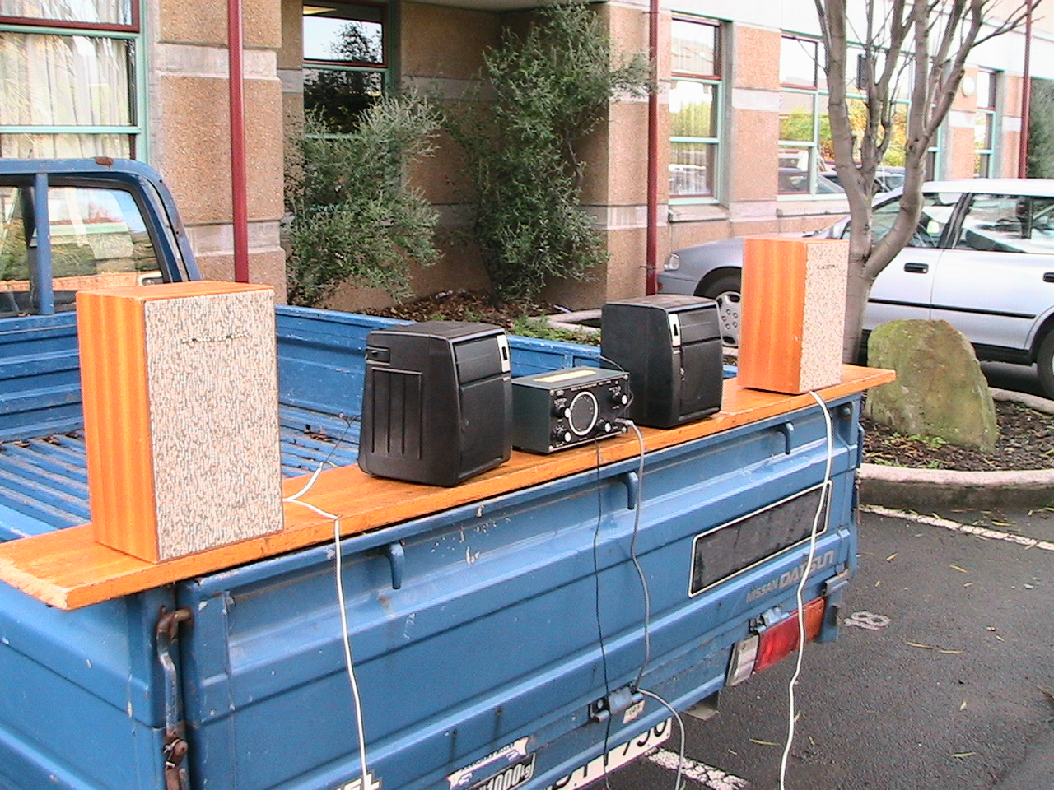

Slide 24
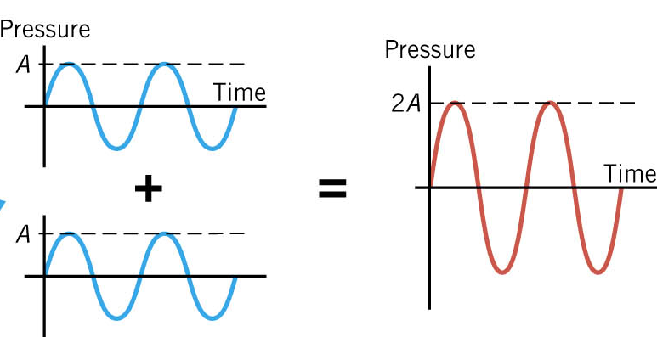
This is called Constructive Interference
We also say that these two waves are In Phase at this point

Slide 25
Now suppose the listener moves:
3 m
5 m
What does she hear now??

Slide 26

She moves again:
3.5 m
6 m
Path length difference = 2.5 m = 2.5 λ
off by ½ wavelength

Slide 27
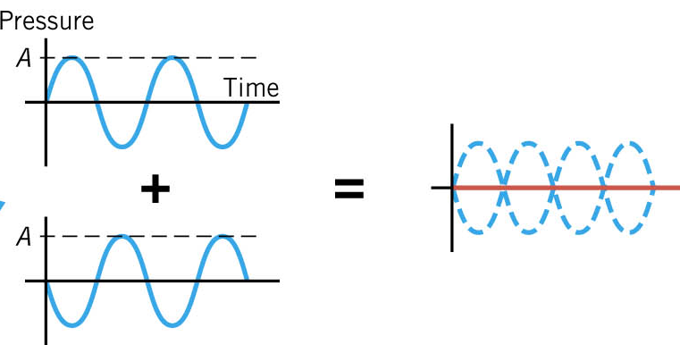
This is called Destructive Interference
We also say that these two waves are Exactly Out of Phase at this point

Slide 28

Interference Summary
path 1
path 2
If the difference in path lengths is………
0, 1λ, 2λ, 3λ, etc…… Constructive
½ λ, 1½ λ, 2½ λ, etc…… Destructive

Slide 29
If the difference in path lengths is………
0, 1λ, 2λ, 3λ, etc…… Constructive Interference
(waves in phase)
½ λ, 1½ λ, 2½ λ, etc…… Destructive
Interference
(waves out of phase)

Slide 30
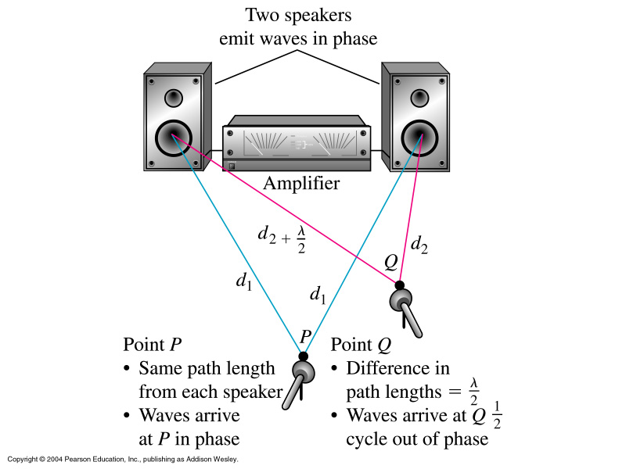

Slide 31
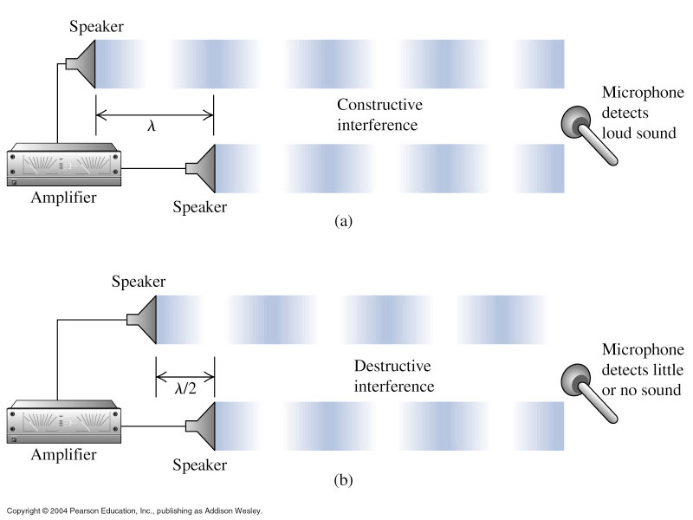
Interference
First, consider case for sound waves, emitted by 2 loudspeakers:
Path difference =nλ
Constructive Interference
Path difference =(n+1/2)λ
Destructive Interference
(n = any integer, m = odd integer)
Notes:
www.sheffield.ac.uk/polopoly_fs/1.14329!/file/topic7.ppt

Slide 32

Ex:
Let v = 345ms⁻¹
If these two speakers are each playing a 460 Hz tone, and the listener is standing 3.75 m away from one and 4.50 m away from the other, what does she hear?

Slide 33
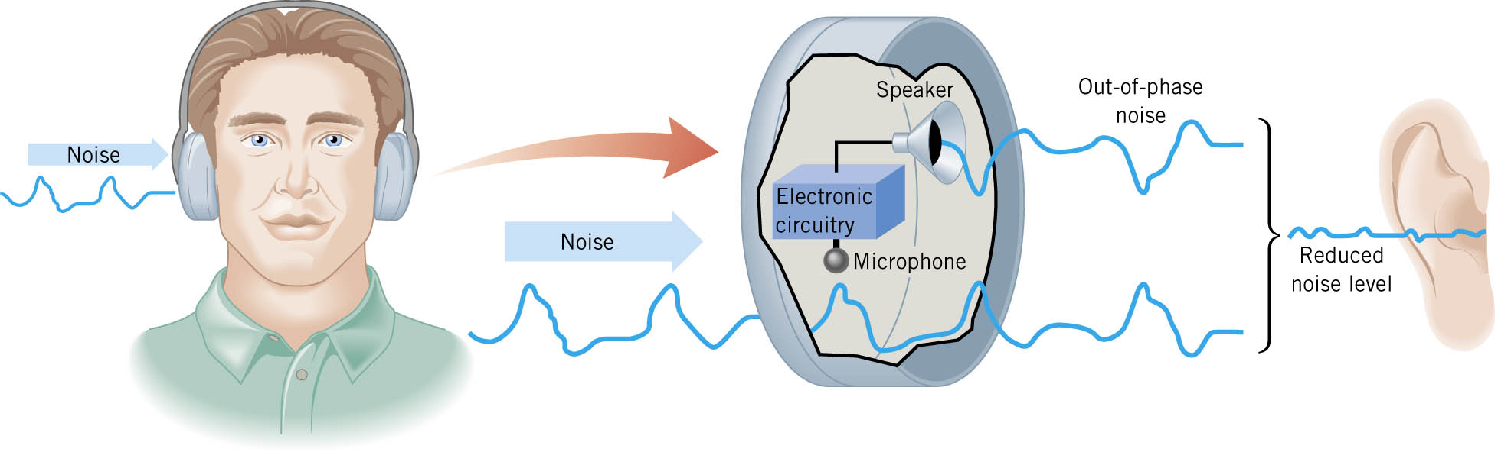
Ex: Noise canceling headphones

