Slide 1
Y12 Mechanics
Term 3 Exam
Excellence
Non Achieved
Revise L2 Merit & Excellence level Questions
Achieved
Merit
Ask yourself:
Work in = results achieved
Revise L2 Merit & Excellence level Questions
Start a Mechanics revision program!

Slide 2
How to revise EFFECTIVELY
Target one thing. e.g. projectile motion
DON’T just revise old exam papers.
Instead PICK a TOPIC to revise i.e. much better to break all of the Achievement standard content down into small manageable sections or bits…
Break it down into WHAT sections / bits?

Slide 3
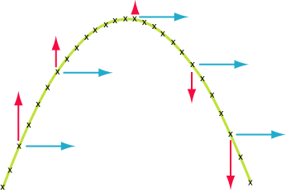
a_{x}=0
a_{y}=-g
Separate vertical and horizontal motion
3b) Projectile Motion
Kinematic equations
3a) Circular motion
Centripetal force: caused by friction or tension or gravity
Centripetal acceleration: due to a change in direction NOT speed
1) Kinematics & Vectors
Vectors have direction
and size
Mechanics
Adding vectors using Pythagoras
Don’t forget the angle!
4) Work, Energy
& springs
2a) Newton’s Laws of Motion
2c) Torque &
Equilibrium
2b) Momentum
& impulse
2nd: Unbalanced resultant force leads to an acceleration
ΣF = ma
3rd: Every action has an equal and opposite reaction
1st: An object will travel at constant velocity it unless acted on by an unbalanced resultant force
ΣF = 0
p = mv
Always conserved (unless acted upon by an unbalanced force)
∑Δp = ∑Δp’
Δp = F Δ t
Torque (N m)
τ = Fd
Clockwise torques = anticlockwise around a pivot point

Slide 4
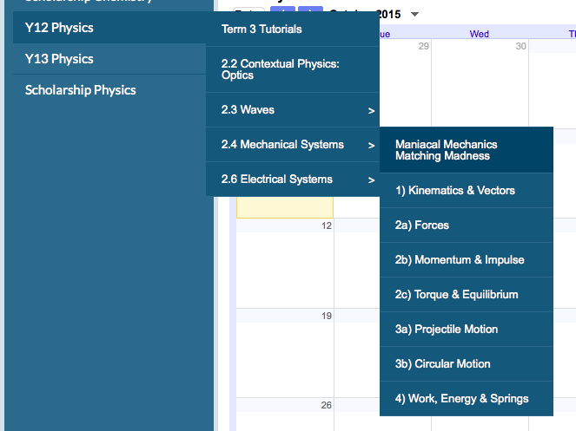

Slide 5
How to revise EFFECTIVELY
Target one thing. e.g. projectile motion
Read about it and make extra notes including definitions and equations
So how do you do this?

Slide 6
How to revise EFFECTIVELY
Target one thing. e.g. projectile motion
Read about it and make extra notes including definitions and equations
Try a practise exam style question
So how do you do this?
Go to Weebly…
and use NCEA collated questions…
Also Video solutions from www.physicslounge.org for 2010, 2011, 2012 & 2013 NCEA exam Papers!

Slide 7
How to revise EFFECTIVELY
Target one thing. e.g. projectile motion
Read about it and make extra notes including definitions and equations
Try a practise exam style question
Mark it
If you didn’t get things right repeat steps 1-4 until you do!

Slide 8
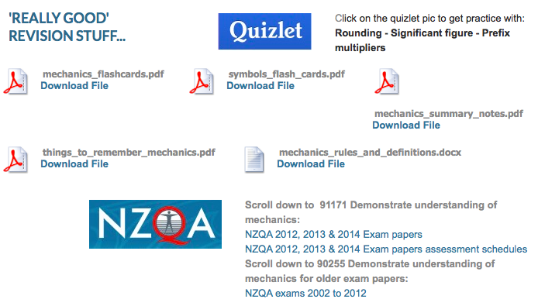
How to revise EFFECTIVELY
Lots of good stuff on Weebly…

Slide 9
Developed by
Shatroj Bethel
Lee O’Neil
Sam York
Situation/Context
Answering Physics questions
Connect any two corners - Merit
Connect three corners - Excellence
Creating good explanations
M
M
E
M
Concept/Physics Principle
Formula

Slide 10
Mechanics
Explain the energy changes that occur in a swinging pendulum.
Explain clearly what happens to momentum and kinetic energy in an elastic and an inelastic collision.
Explain two features that a car has in order to reduce injury to the driver during a collision.
Explain why the motion of the planet orbiting the Sun at constant speed is accelerating.
Explain why a helicopter flying is not an example of projectile motion.

