Slide 1
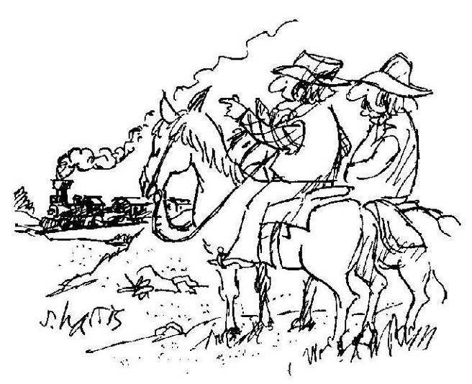
"I love hearing that lonesome wail of the train whistle as the
magnitude of the frequency of the wave changes due to the
Doppler effect."

Slide 2
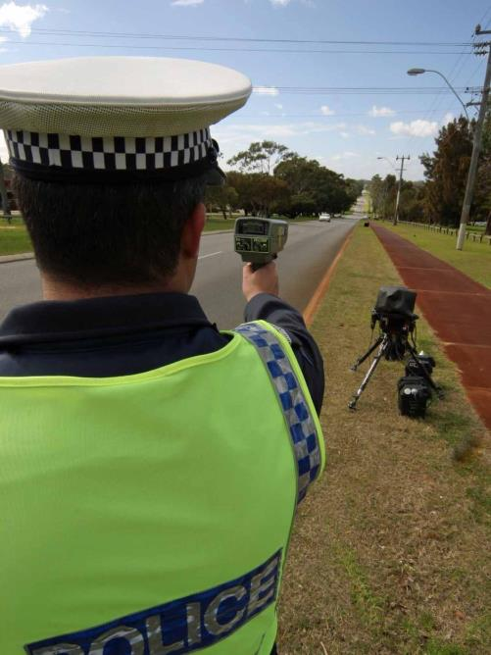

Slide 3
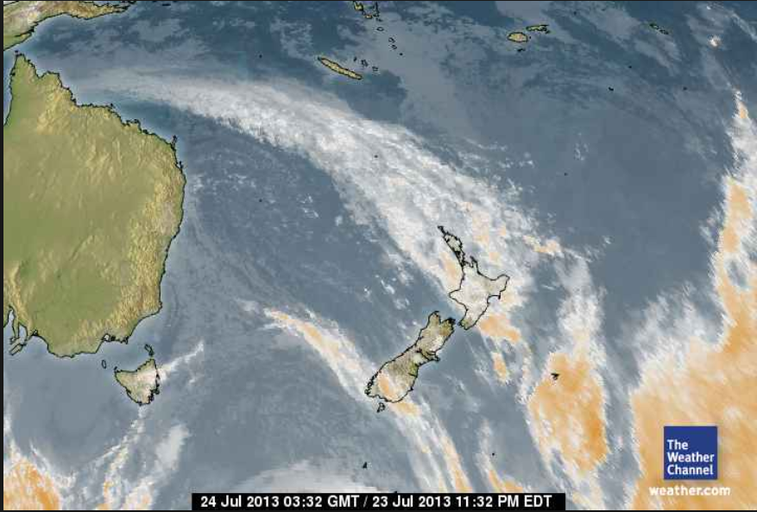
A Doppler radar is a specialized radar that makes use of the Doppler effect to produce velocity data about objects at a distance. It does this by beaming a microwave signal towards a desired target and listening for its reflection, then analyzing how the frequency of the returned signal has been altered by the object's motion.
Notes:
http://en.wikipedia.org/wiki/Doppler_radar

Slide 4
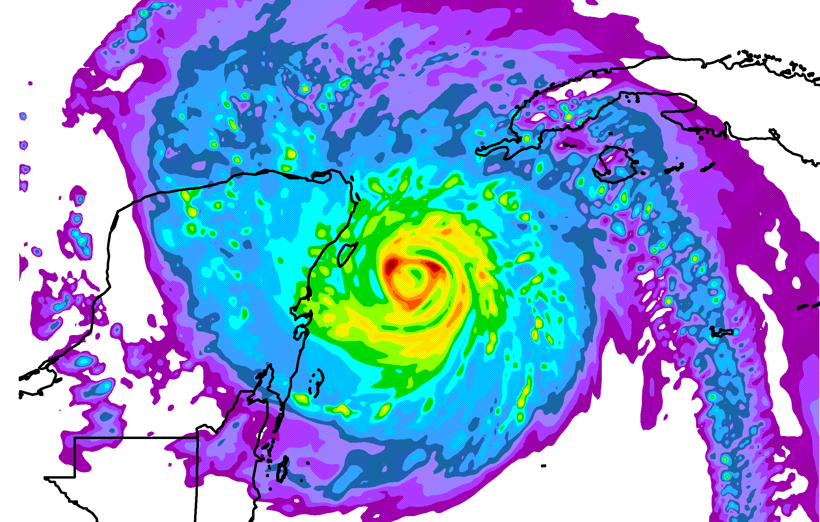

Slide 5
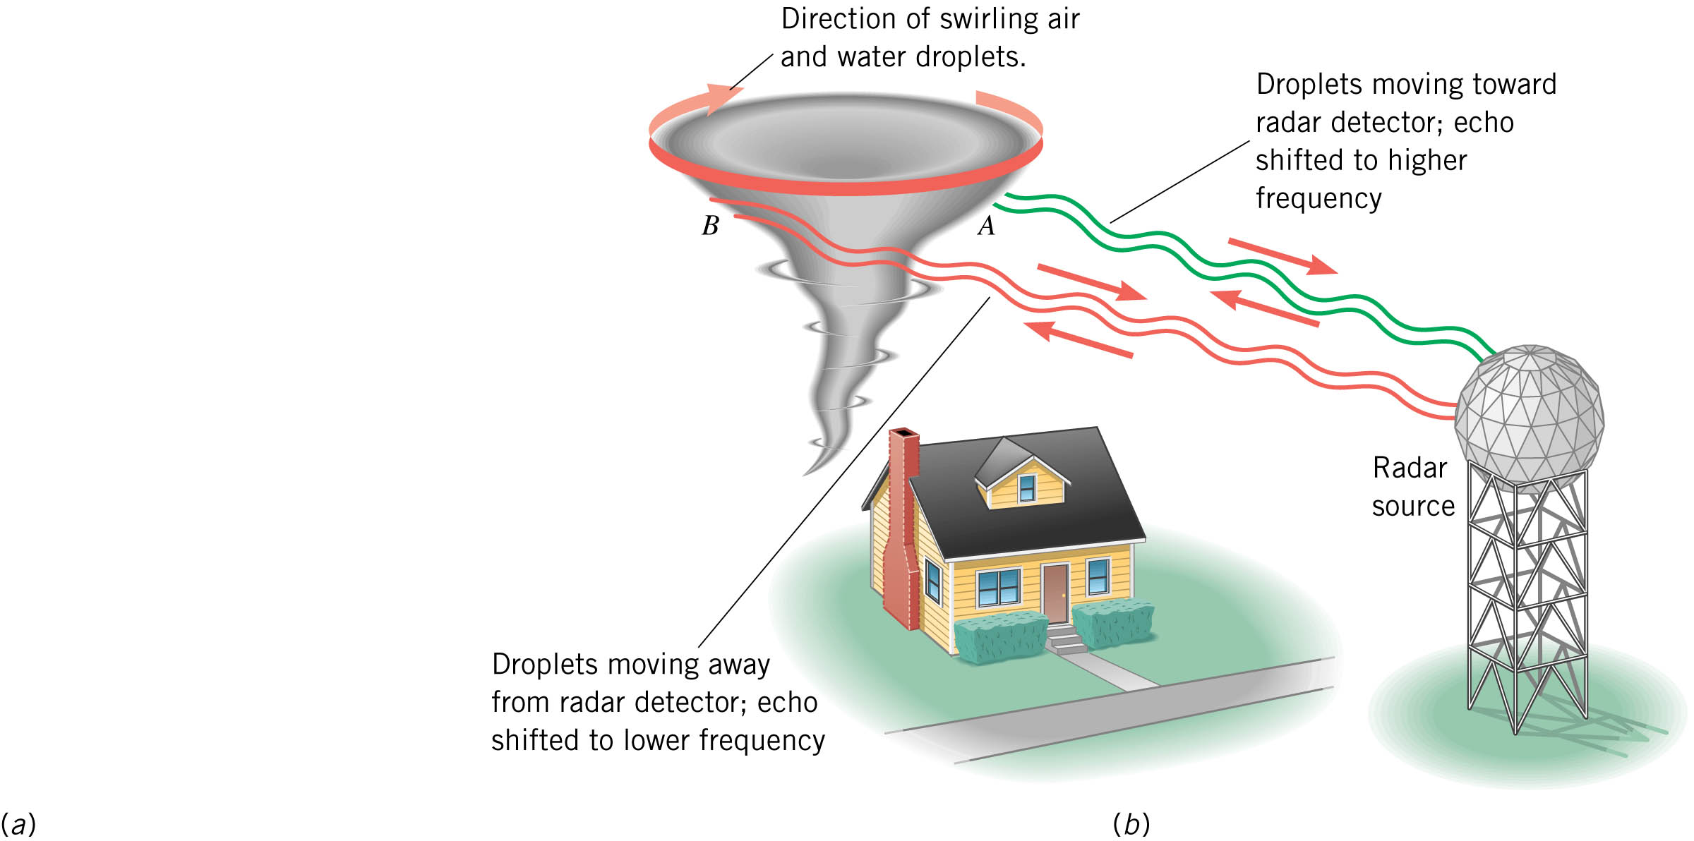

Slide 6


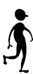

The Doppler Effect-
the change in wave frequency resulting from motion of the source or observer
Consider the waves from a sound source:
Now, consider the waves from a moving source:
You hear a lower frequency as it moves away from you
You hear a higher frequency as it moves toward you

Slide 7
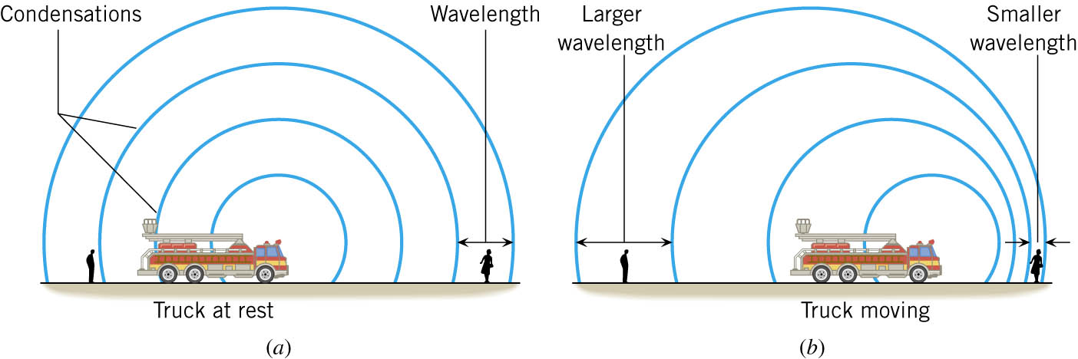

Slide 8
Doppler or apparent frequency
Velocity of wave medium
Velocity of Sound source
Sound source frequency
Which to use + or - ?
Use + if sound source is moving away
(Away ~ Add ~ +)
Use ─ if sound source is approaching

Slide 9
You are standing still. What frequency do you detect if a fire engine whose siren emits at 1550 Hz moves at a speed of 32 m/s
a) toward you?
b) away from you?
A train moving at a constant speed is passing a stationary observer on a platform. On one of the train cars, a flute player is continually playing the note known as concert A (f = 440 Hz). After the flute has passed, the observer hears the sound as a G which has a frequency of 392 Hz. What is the speed of the train? The speed of sound in air is 343 m/s.
= 42 m/s

Slide 10

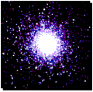
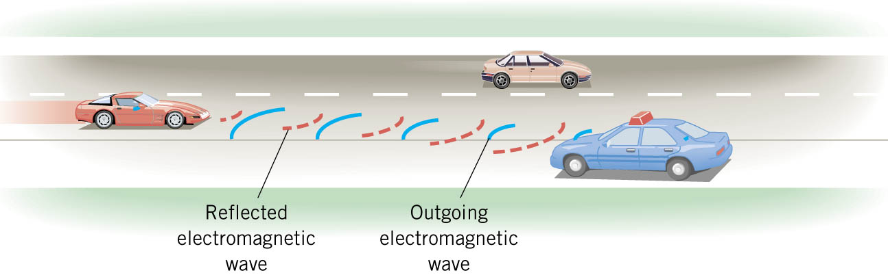
Doppler Shift Examples
Red/Blue Shift:
Police Radar:

Slide 11

Stationary Sound Source
Source moving with v_{source} < v_{sound}
Source moving with v_{source} = v_{sound}
(Mach 1 - breaking the sound barrier )
Source moving with
v_{source} > v_{sound}
(Mach 1.4 - supersonic)
Web link: The Doppler Effect and Sonic Booms

Slide 12
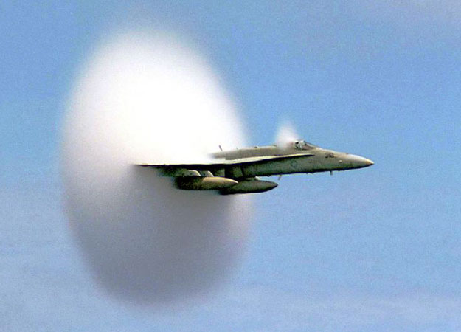
Sonic Boom
When the moving object speed reaches Mach 1
(breaking the sound barrier)
A Very Fast Plane mpeg file (1.32 MB)

