Slide 1
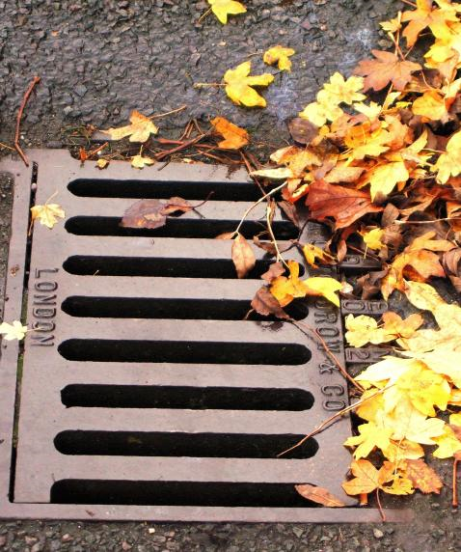
Diffraction grating?

Slide 2
What is a diffraction grating?
They can be either REFLECTION or TRANSMISSION (passes throught) gratings. Essentially they have many lines ruled onto a medium. For a transmission grating the medium is transparent.
If the lines are straight, parallel and evenly spaced then we can talk about them having a particular spacing d (m) between each pair.
d

Slide 3
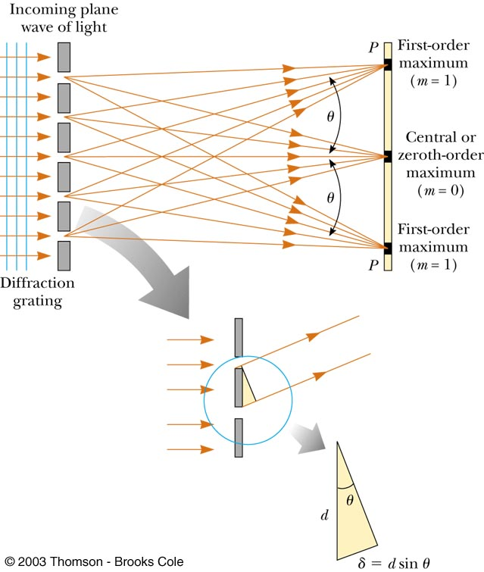

Slide 4
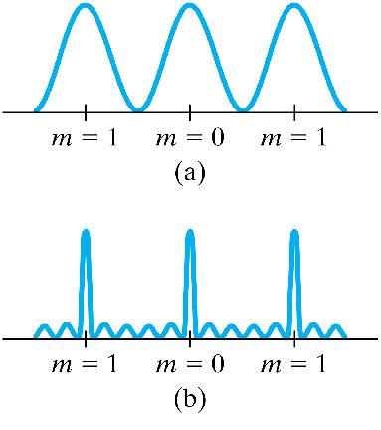
Diffraction Grating
Summary
A diffraction grating consists of a large number of equally spaced narrow slits or lines.
The grating produces an interference pattern similar to a double slit pattern
Features of a grating;
Fringes are brighter because, in total, more light can get through the multiple slits and so greater brightness when they all arrive in phase.
Fringes are further apart because the positions at which multiple waves arrive in phase do not occur as frequently as the positions at which only two waves arrive in phase.
Same formulas are used ie
Note can not use x = nλL/d if θ >10°
Two slits
Multiple slits
Use d= 1/N to find slit spacing where N is # of slits per m

Slide 5
A 3500-line/cm grating produces a third-order fringe at a 28.0º angle. What is the wavelength of light being used?

