Slide 1
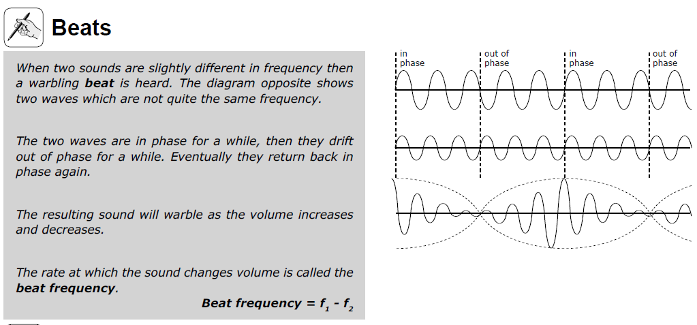

Slide 2
Beating is a regular pulsing of the loudness of a sound which is heard when two sources produce sounds of slightly different frequency.
f_{beat} = f₁ – f₂
For example, when a 552 Hz and a 556 Hz tone are played simultaneously, we hear 556-552, or 4 beats per second. The beat frequency is 4 Hz.
Applet Beats demo
Uses ~ Piano Tuning

Slide 3
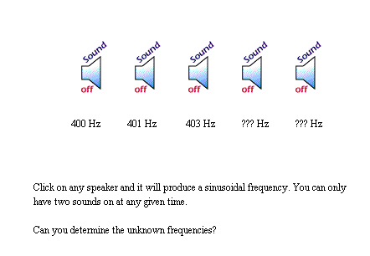

Slide 4
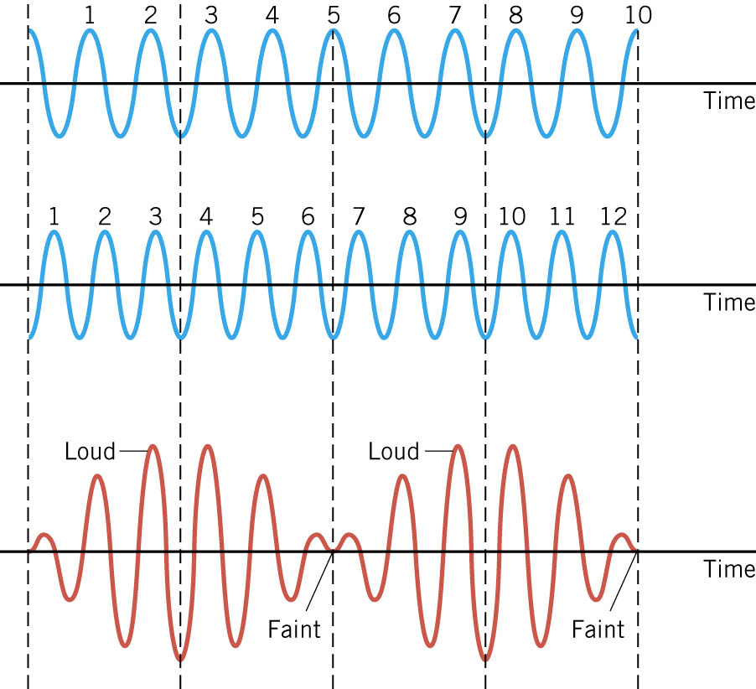

Slide 5
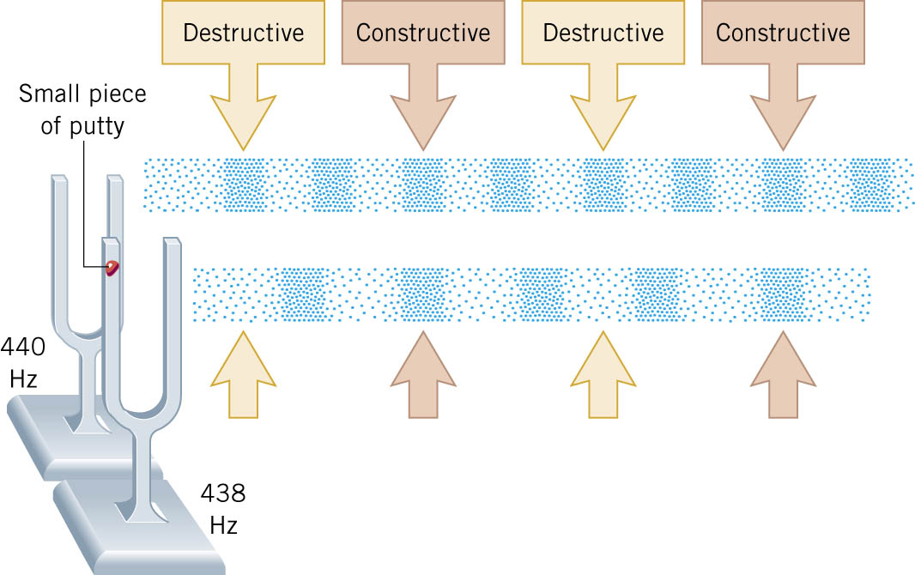

Slide 6
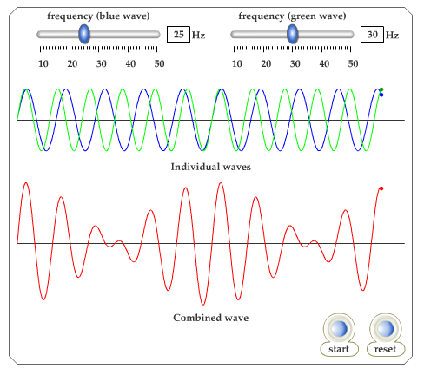
Beats web link

Slide 7
