Slide 1
A field is a region in space where a force may act.
Currently you are in a Gravitational Force field….

Slide 2
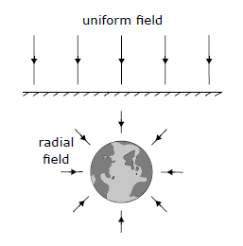
Gravitational Fields
Gravity = Field Force
Gravity = Non-contact force
A gravitational field is region in space where gravitational forces can be detected.
It can be depicted using gravitational field lines.
The direction of the field is shown by an arrow and is the direction a mass would move if placed in the field.
The density of the field lines shows the strength of the gravitational field.

Slide 3
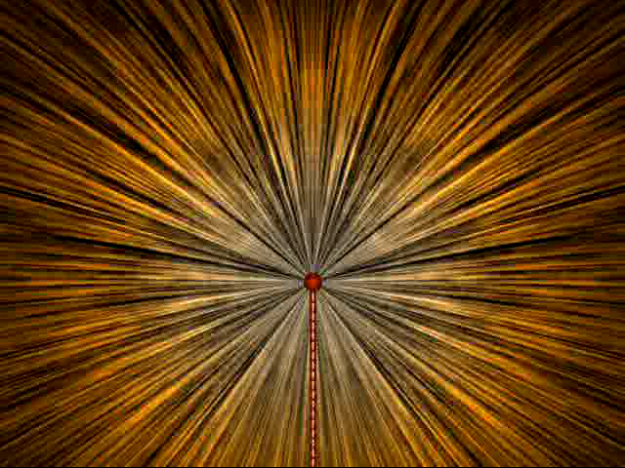
Electric Field
Area where the effect of a charge can be detected
Electric field lines
Imaginary lines drawn in the electric field so that the direction of the line is the direction of the field
Electric field around a Van de Graaff generator

Slide 4
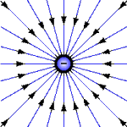
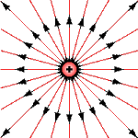
An electric field describes a region where an electric charge will experience a force if placed in that region.
The electric field can be represented by field lines. These lines start on a positive charge and end on a negative charge.
The direction of the field lines show the direction of the electrostatic force that would act on a positive charge, q,
if you placed it there.

Slide 5
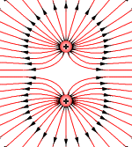
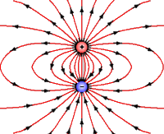
Electric field lines never cross and are drawn perpendicular to a surface.
The electric field is stronger where the field lines are closer together.

Slide 7
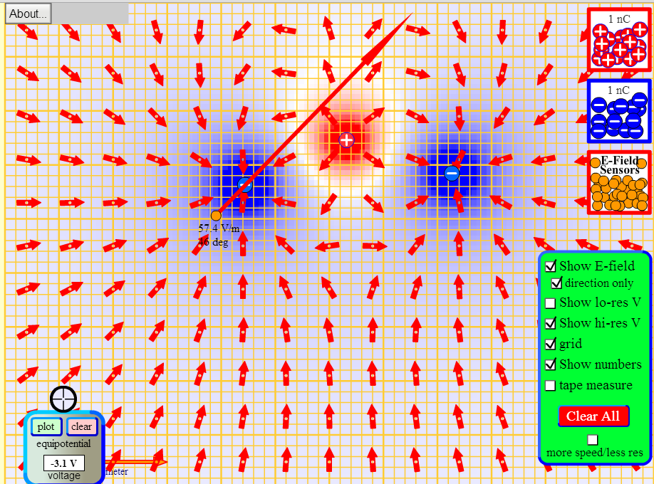

Slide 8
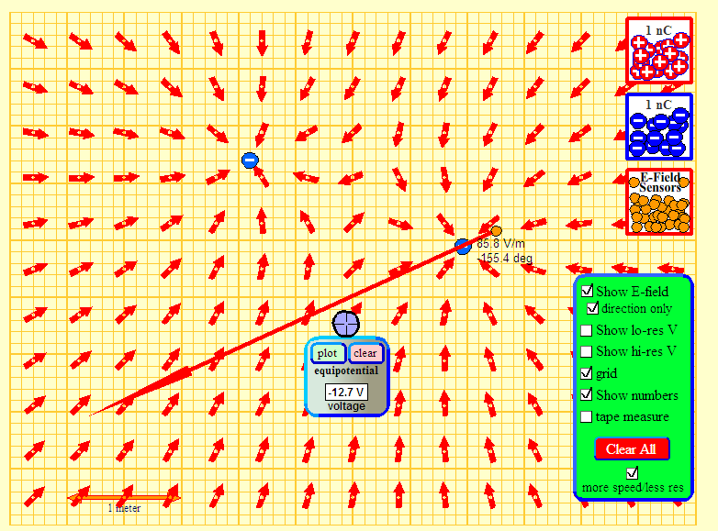
See Charges And Fields PHET applet

Slide 9
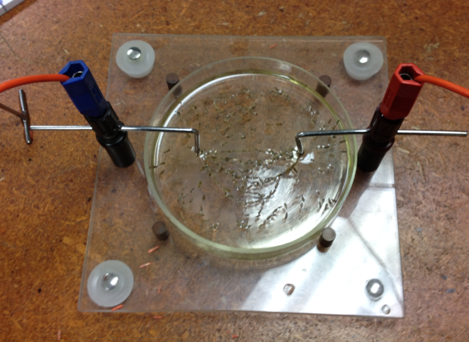

Slide 10
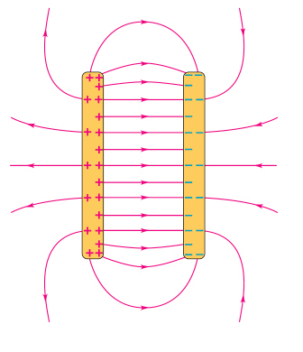
Uniform Electric Field
+
-
Parallel field
lines
Evenly spaced field lines
In a uniform field, the electric field lines are drawn parallel and evenly spaced.

Slide 11
Electric Field Strength
Symbol E
Defined as the force acting per unit of positive charge
Measured in NC⁻¹
Directed from positive to negative
+
+
+
+
+
+
+
+Q
F
-
-
-
-
-
-
-

