Slide 1
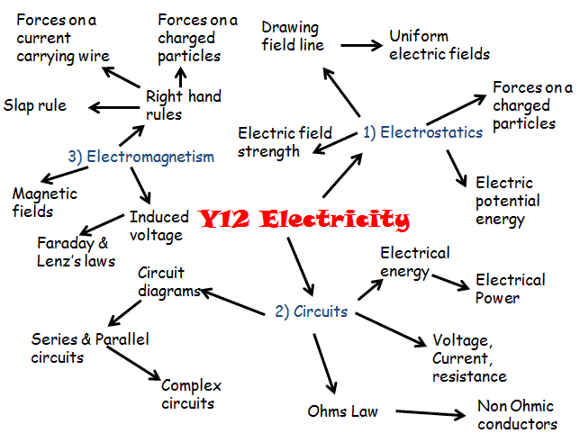

Slide 2
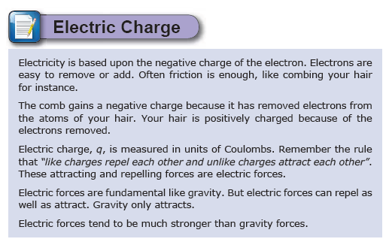

Slide 3
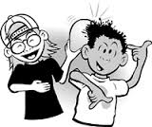
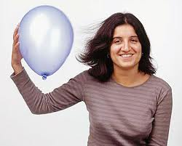
Rub a balloon against
your hair…

Slide 4
Electrostatics is about "charge," and about the attract / repel forces which electric charge creates.
The motion or "static-ness" of the charge is irrelevant.
"Static" and "Current" are NOT opposite kinds of electricity.
"Static electricity" is better termed "High Voltage Electricity”
ie very low current
DC & AC Electricity involves ‘higher’ levels of current…

Slide 5
The structure of the atom
Simple Atomic Structure
ELECTRON
Negative
NEUTRON
No Charge
PROTON
Positive
Two positive protons and two negative electrons
Gain an electron to become negative
Lose an electron to become positive
Notes:
More free powerpoints at http://www.worldofteaching.com

Slide 6
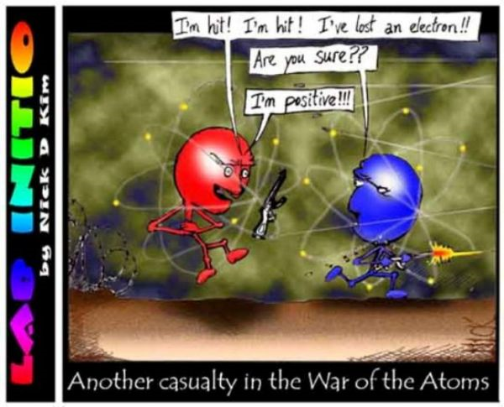

Slide 7
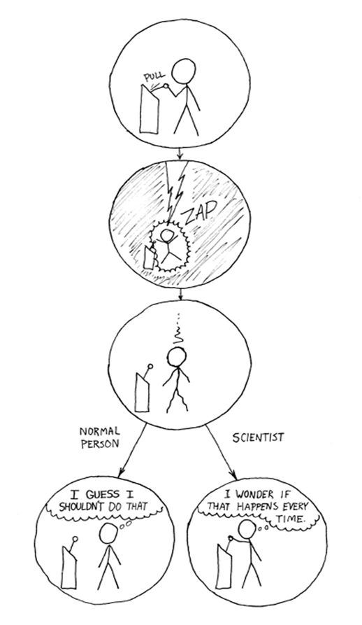

Slide 8
Electrons & Charge
Electrons - negative charge.
Charge (Q) is measured in coulombs (C) 1C = 6x10¹⁸ e
Example: a pin tip holds 6x10¹⁵ e
What is the amount of charge on the pin?
What is the charge on ONE electron?

Slide 9

Smallest possible amount of charge:
1 extra electron: q = -1.60 x 10⁻¹⁹ C
1 missing electron: q = +1.60 x 10⁻¹⁹ C
= e = elementary charge
…
For any charge q:
q = ne , where n = ±1, ±2, ±3, etc…
Charge is quantized
Also:
Charge is conserved

Slide 10
Electric Force RULEs!
Like charges repel each other.
Unlike charges attract each other.
+
+
Force of repulsion
-
-
-
+
Force of attraction
Electric Force = Non-contact force

Slide 11
Electric Force
Like charges repel each other.
Unlike charges attract each other.
+
+
Force of repulsion
-
-
-
+
Force of attraction
Electric Force = Field force

Slide 12
-
-
-
+ + + +
glass
-
-
(rub)
-
silk
- - - -
plastic
(rub)
fur

Slide 13
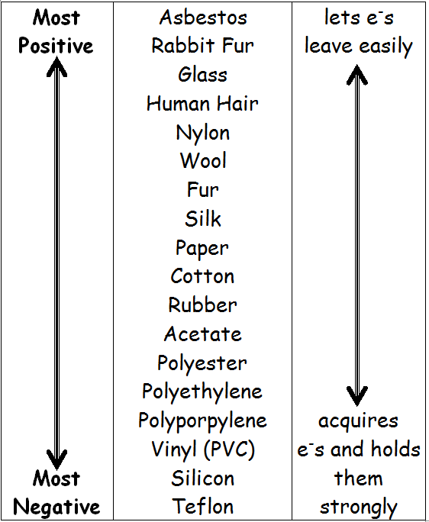
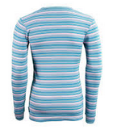
Separating Charge
A material on the bottom of the list will gain electrons from a material above it on the list…

Slide 14
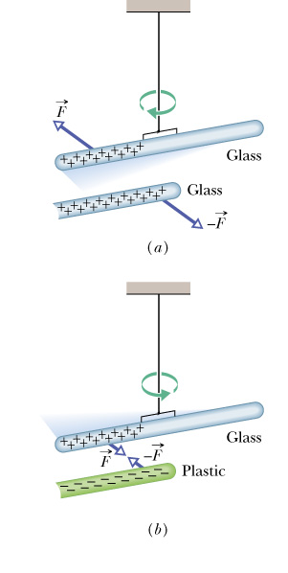
Opposites Charges Attract
Like Charges Repel

Slide 15
Quick Quiz
A person scuffing her feet on a wool rug on a dry day accumulates a charge of -42 µC.
How many excess electrons does she accumulate?
By how much does her mass increase?

Slide 16
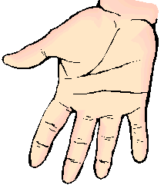
Conductors (such as metals, tap or salt water, and the human body) are good at conducting away any extra charge.
Insulators (like plastic, rubber, pure water, and glass) will not conduct away extra charge.
Metal:
“free electrons”
Use rubber gloves in the lab
Touching it with your hand will discharge it

Slide 17
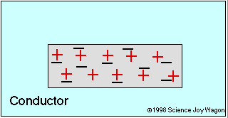
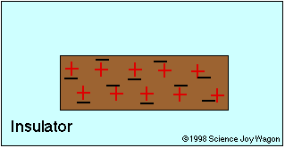
Conductors: are typically metal. In metals, valence electrons are not involved in the interatomic bonds that hold the metal object together. These electrons are able to move around within the object.
Insulator: a substance that does not allow electrons to move. Typically non-metals with electrons bound to nucleus and not free to move around.
Most things are in between perfect conductor/ insulator (semiconductors)
Remember only electrons move!

Slide 18
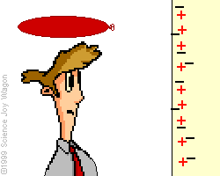

Slide 19
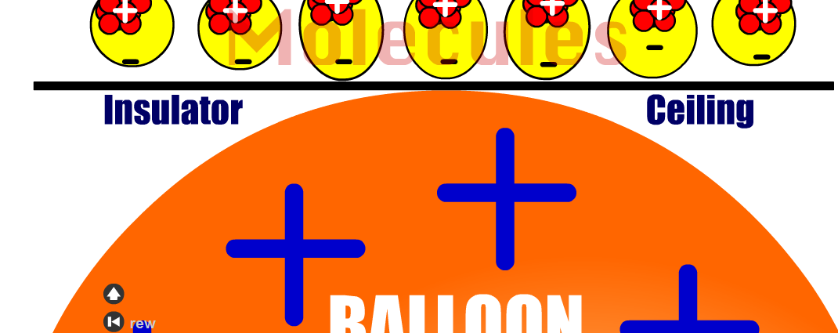

Slide 20
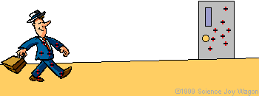
Explain what is happening:

Slide 21
Uses of Static Electricity
Spraying a Car
Positive Car
Negative Spraygun
The paint spreads out as each negative drop repels
No paint is wasted as the positive car attracts the negative paint

Slide 22
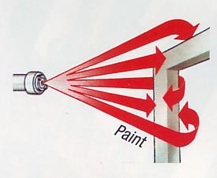
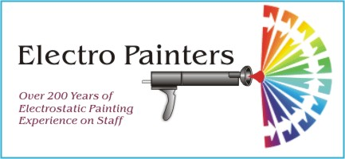

Slide 23

Removing Ash particles from a Chimneys
No smoke leaves the chimney
Negative Plate
Positive Plate
Charged up ash

Slide 24
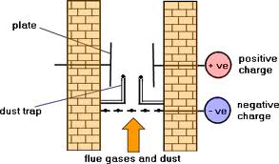

Slide 25
Grounding
- - - -
-
-
-
-
-
Object is discharged or “grounded”
+
-
-
-
+
+
-
+
-
-
+
+
-
+
-
-
+
-
+
The earth is a huge reservoir of positive and negative charge
© Laura Fellman

Slide 26
Earthing Petrol Tankers
Petrol rubbing against the pipe can build up a static charge which could cause an explosion
The tanker is joined to the ground with a wire to stop a charge building up

Slide 27
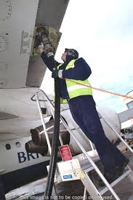
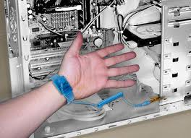

Slide 28

Lightning Physics

