Slide 1
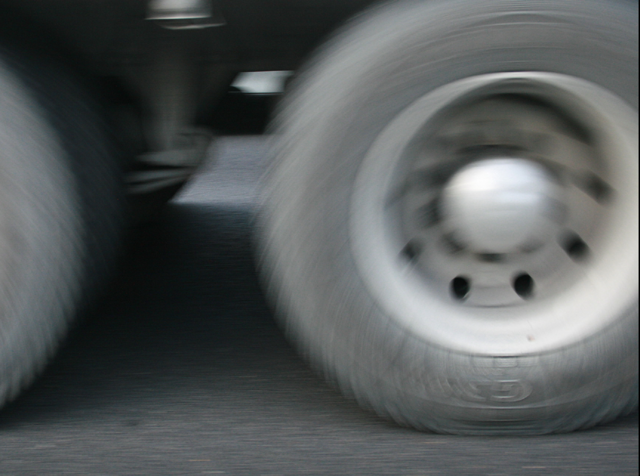
This picture of the wheel of a truck was taken on the motorway.
Explain why the image of the wheel is sharp at the bottom of the picture compared to the wheel at the top of the picture.
Hint: Use vectors.

Slide 2
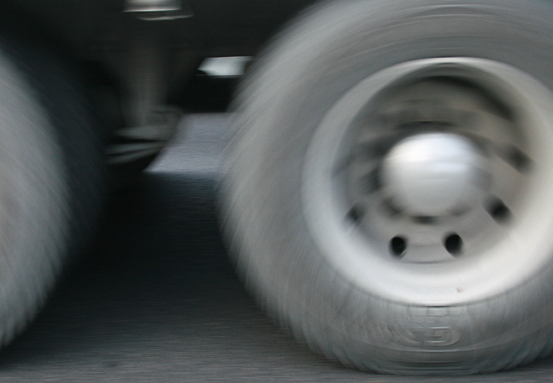
This picture of the wheel of a truck was taken on the motorway.
Explain why the image of the wheel is sharp at the bottom of the picture compared to the wheel at the top of the picture.
Hint: Use vectors.
Using vectors one can show that the instantaneous velocity of the wheel at the bottom is zero.
The velocity of the centre of the wheel is v and at the top of the wheel is 2v
v
v
2v
v
v
+
=
v
v
v = 0
Rotation
Translation

Slide 3
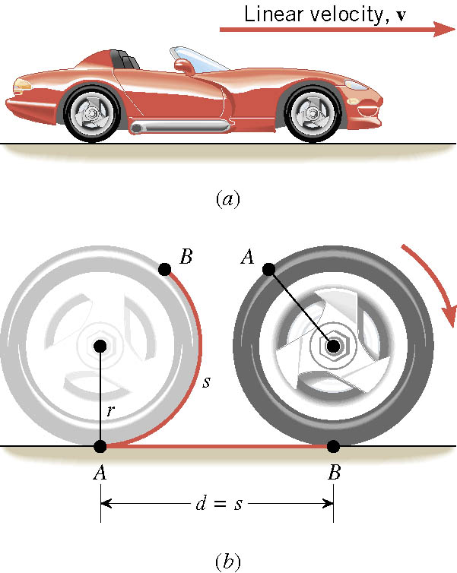
Rolling
(Translation and Rotation)
If the wheel does not slip: the arc length s = the linear distance d
The linear speed of the whole wheel = rω
Web Link: Four views of rolling
The linear acceleration of the whole wheel = rα

Slide 4
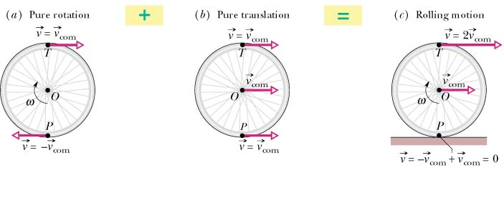
Web Link: Tank Tread Video

