Slide 1
Electromagnetic Induction
&
Lenz’s Law
Very conceptual…
&
Faraday’s Law

Slide 2
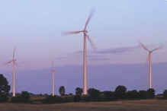
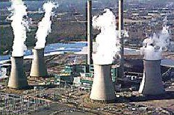
Generators, Motors …. How We get, make & use Electricity…

Slide 3
What is Electricity?
Electricity is energy transported by
the motion of electrons
**We do not make electricity, we CONVERT other energy sources into electrical energy**
Conversion is the name of the game

Slide 4
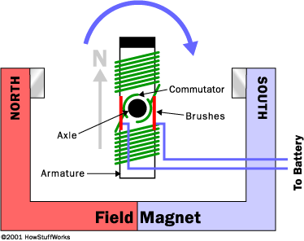
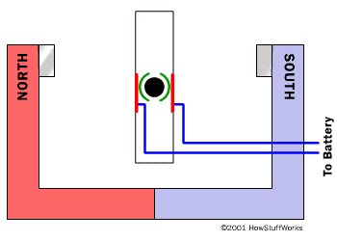
Electric Motor
M
Electrical
Energy
Mechanical
Energy
DC Motor

Slide 5
Electrical Motors transform electrical energy into mechanical energy.
Electric Generators do the opposite. They transform mechanical energy into electrical energy.
The process of using a changing magnetic field to create electric current is called electromagnetic induction.

Slide 6
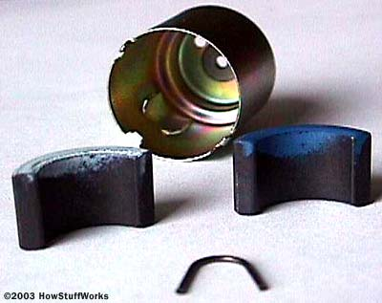
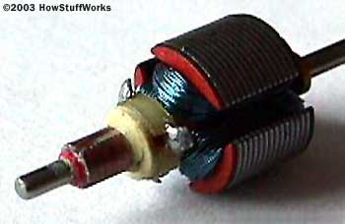
Electric Generator
G
Mechanical
Energy
Electrical
Energy

Slide 7
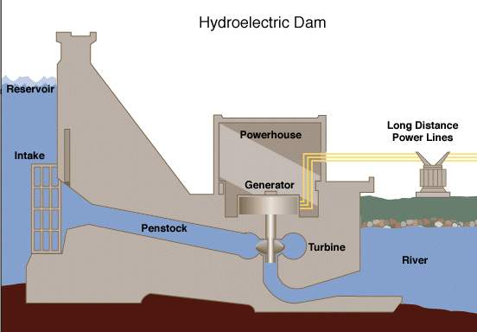

Slide 8
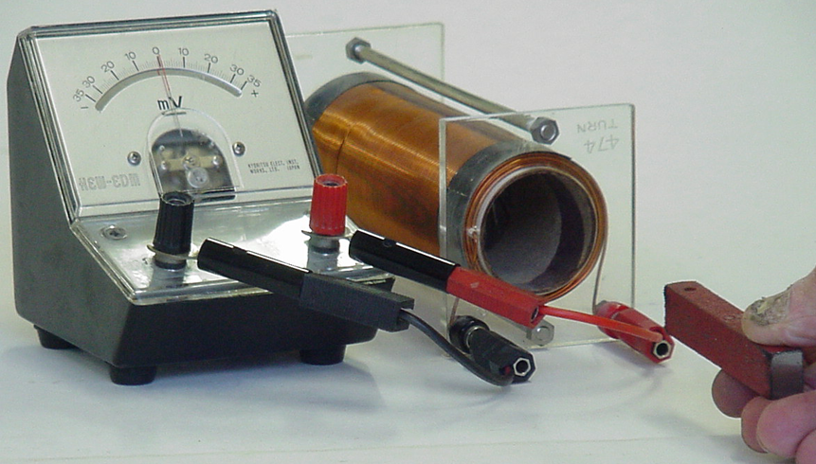
How is V or I induced?

Slide 9
When a loop is pushed into a magnetic field a voltage is induced.
The size of the induced voltage is
S
N
N
S
Where: B is the magnetic field strength
v is the speed of movement across the field lines
L is the length of wire in the field
The current direction is given by Lenz’s law…
The induced Voltage can be increased by
Using a stronger magnet (B)
More turns on the coil (L)
Moving the magnet faster (v)

Slide 10
“L” ~ wire length that cuts the
magnetic field lines

Slide 11
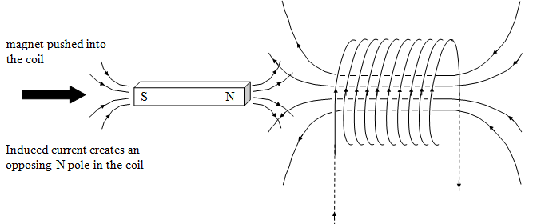
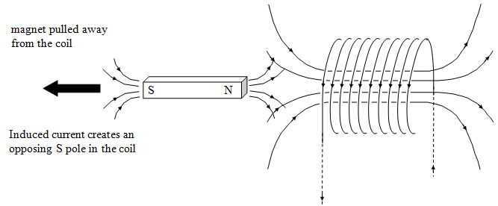

Slide 12
In both cases, magnet moves against a force.
Work is done during the motion & it is transferred as electrical energy.
Induced I always flows to oppose the movement which started it.
Lenz's law
Work must be done against this opposing magnetic field to produce electricity. If this did not happen the law of conservation of energy would be broken (free energy!).

Slide 13
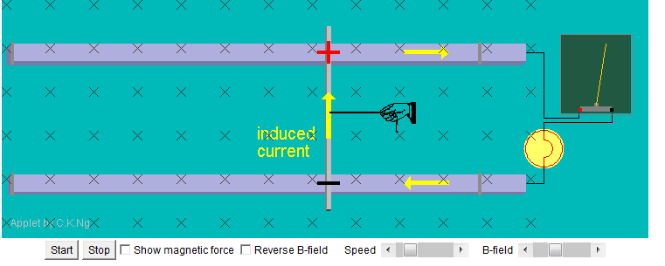
ngsir.netfirms.com/englishhtm/Induction.htm

Slide 14
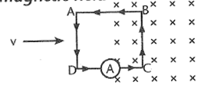
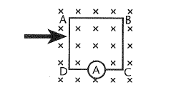
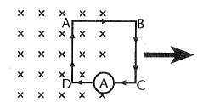
Loop is pushed into the uniform B field.
Force in wire BC due to Lenz’s law
Current direction anti clockwise due to right hand slap rule
Loop is completely in the uniform B field ~ no induced current. Why ?
Induced current in wires AD & BC cancel each other out – no circuit
As the loop is leaving the uniform B field ~ induced current. Why ?
Force in wire AD due to Lenz’s law
Current direction clockwise due to right hand slap rule
Notes:
SKIP!

Slide 15
The rod moves with a speed of 1.6 m/s
is 30.0 cm long, and has a resistance
of 2.5 Ω. The magnetic field is 0.35 T, and the resistance of the U-shaped conductor is 25 Ω at a given instant.
Calculate (a) the induced Voltage,
F _{ext}
(b) the current in the U-shaped conductor
(c) the external force (F _{ext}) needed to keep the rod’s velocity constant at that instant.
(d) Determine the current direction in the loop

Slide 16
A magnetic field can be used to separate + and – charges.
If a conducting rod moves through the field, then the + and – ions will drift to opposite ends of the rod and form an electric field across the rod.
● ● ● ● ● ●
● ● ● ● ● ●
● ● ● ● ● ●
● ● ● ● ● ●
● ● ● ● ● ●
● ● ● ● ● ●
● ● ● ● ● ●
● ● ● ● ● ●
If the rod is draped across two wires and forms a closed loop, then current can develop in the loop… this is called induction.
-
E
+
wires

Slide 17
Electromagnetism
A wire is dropped through the Earth's magnetic field. Rearrange the corresponding article about the induced EMF into the correct order and then apply a rule to determine which end of the wire the electrons cluster.
x x x x x x x x x x
x x x x x x x x x x
x x x x x x x x x x
x x x x x x x x x x
W
E

Slide 18
x x x x x x x x x x
x x x x x x x x x x
x x x x x x x x x x
x x x x x x x x x x
W
E
Now apply a rule to determine which end of the wire the electrons cluster.
No current will flow
Electrons in the wire interact with the Earth's magnetic field. The electrons cluster at one end of the wire.
An electric field is induced (V_{emf} m⁻¹)
The wire is open circuit
Gravity provides the force to drive the conductor through the HORIZONTAL component of the Earth's magnetic field.
The size of the induced V_{emf} = Bvl

Slide 19
Electromagnetism
x x x x x x x x x x
x x x x x x x x x x
x x x x x x x x x x
W
E
1. Gravity provides the force to drive the conductor through the HORIZONTAL component of the Earth's magnetic field.
2. Electrons in the wire interact with the Earth's magnetic field. The electrons cluster at one end of the wire.
3. An electric field is induced (V_{emf} m⁻¹)
4. The size of the induced V_{emf} = Bvl
WEST END
5. The wire is open circuit
6. No current will flow
7. Now apply a rule to determine which end of the wire the electrons cluster.

Slide 20
A loop of wire is dropped through the Earth's magnetic field. Its maximum velocity is 15 m s⁻¹ The magnetic field strength shown is 40 μT.
x x x x x x x x x x
x x x x x x x x x x
x x x x x x x x x x
x x x x x x x x x x
W
E
Answer the following using either conventional current or electron flow.
As the wire falls:-
Is an emf (ε) induced? Explain and if yes, calculate its value.
Is a current induced? Explain and if yes, state its direction.
Which end of the loop will have a net positive charge?

Slide 21
A loop of wire is dropped through the Earth's magnetic field. Its maximum velocity is 15 m s⁻¹ The magnetic field strength shown is 40 μT.
x x x x x x x x x x
x x x x x x x x x x
x x x x x x x x x x
x x x x x x x x x x
W
E
As the wire falls:-
Is an emf (ε) induced? Explain and if yes, calculate its value.
Yes an emf is induced because the wire is cutting the magnetic field lines. The free electrons in the wire interact with the Earth's magnetic field and move towards one end of the wire.
V = BvL
V = BvL
V = 40 x 10⁻⁶ x 15 x 0.3
V = 180 μV

Slide 22
A loop of wire is dropped through the Earth's magnetic field. Its maximum velocity is 15 m s⁻¹ The magnetic field strength shown is 40 µT.
x x x x x x x x x x
x x x x x x x x x x
x x x x x x x x x x
x x x x x x x x x x
W
E
As the wire falls:-
Is a current induced?
No, since charge is moving in the same direction in both the horizontal wires, the net current is zero.
Which end of the loop will have a net positive charge?
Using the modified right hand slap rule or similar the East end will have a net +ve charged

Slide 23
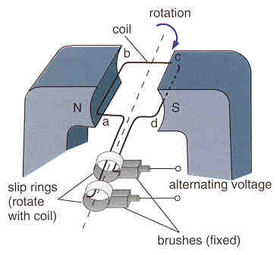
Generators

Slide 24
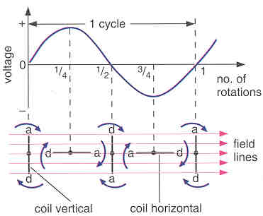
Generators
Describe how a rotating-coil generator works:
The coil is mounted in a strong magnetic field
When the coil is mechanically rotated (eg high pressure steam in a coal fired power station) by Faraday’s Law, a current is induced in the wire.
Due to Lenz’s Law the current direction alternates in order to appose the rotation motion.
Graph of voltage output against time for an A.C. Generator
The induced Voltage is a sine curve, has min & max (when wire is about to ‘cut’ lots of field lines), as well as +ve & -ve values
Key concept:
Mechanical Energy convert
to Electrical Energy

Slide 25
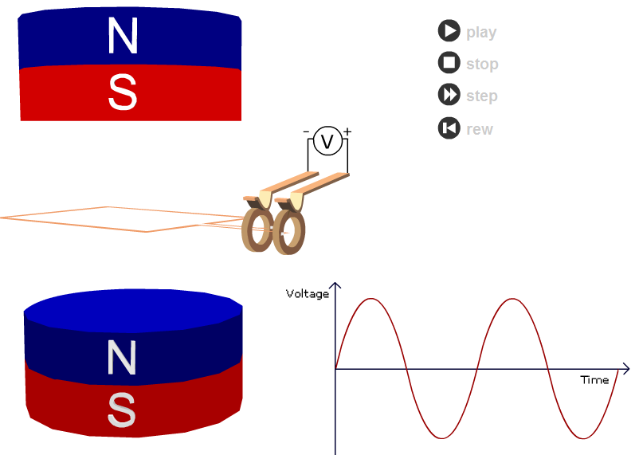
See AC motor applet

