Slide 1
Some Quotes: NUCLEAR POWER
There is no likelihood man can ever tap the power of the atom. The glib
supposition of utilizing atomic energy when our coal has run out is a completely unscientific Utopian dream, a childish bug-a-boo. Nature has introduced a few fool-proof devices into the great majority of elements that constitute the bulk of the world, and they have no energy to give up in the process of disintegration.
-Robert A. Millikan (1863 - 1953) [1928 speech to the Chemists' Club (New York)]
…any one who expects a source of power from the transformation of these atoms is talking moonshine…
-Ernest Rutherford (1871 - 1937) [1933]
There is not the slightest indication that [nuclear energy] will ever be obtainable. It would mean that the atom would have to be shattered at will.
-Albert Einstein, 1932.

Slide 2
That is the biggest fool thing we have ever done. The bomb will never go off, and I speak as an expert in explosives.
-Admiral William Leahy. [Advise to President Truman, when asked his opinion of the atomic bomb project.]
There is little doubt that the most significant event affecting energy is the advent of nuclear power…a few decades hence, energy may be free-just like the unmetered air….
-John von Neumann, scientist and member of the Atomic Energy Commission, 1955.

Slide 3
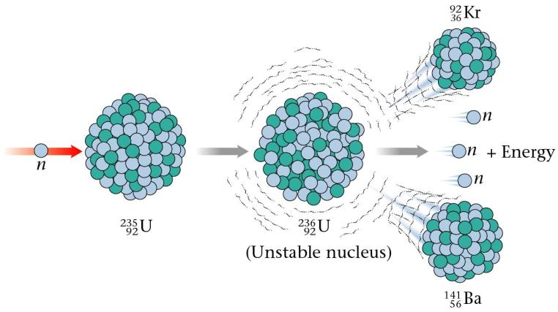
Nuclear Fission
Breaking large / heavy unstable nuclei into smaller ones.
Lots of possible combinations of fragments from one initial nucleus
Eg:
On average 2.5 neutrons released
When a large nucleus is split into smaller fragments or products, mass is lost in the form of an energy release. (WHY? – Y13)

Slide 4
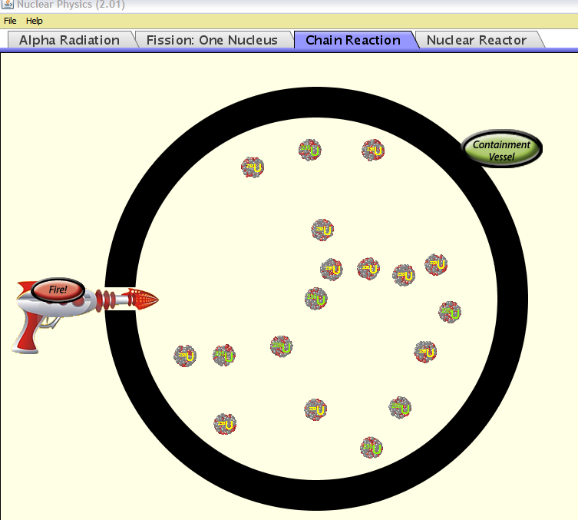
See PhET Nuclear-physics

Slide 5
Only one neutron is needed to start the reaction, but several are produced
This starts a “chain reaction”
n
U
Ba
Kr
n
n
n
U
U
U
Ba
Kr
Ba
Kr
Ba
Kr
n
n
n
n
n
n
n
n
n
If the chain reaction is controlled it can be used in a nuclear reactor
If it is uncontrolled it explodes as a nuclear or atomic bomb

Slide 6
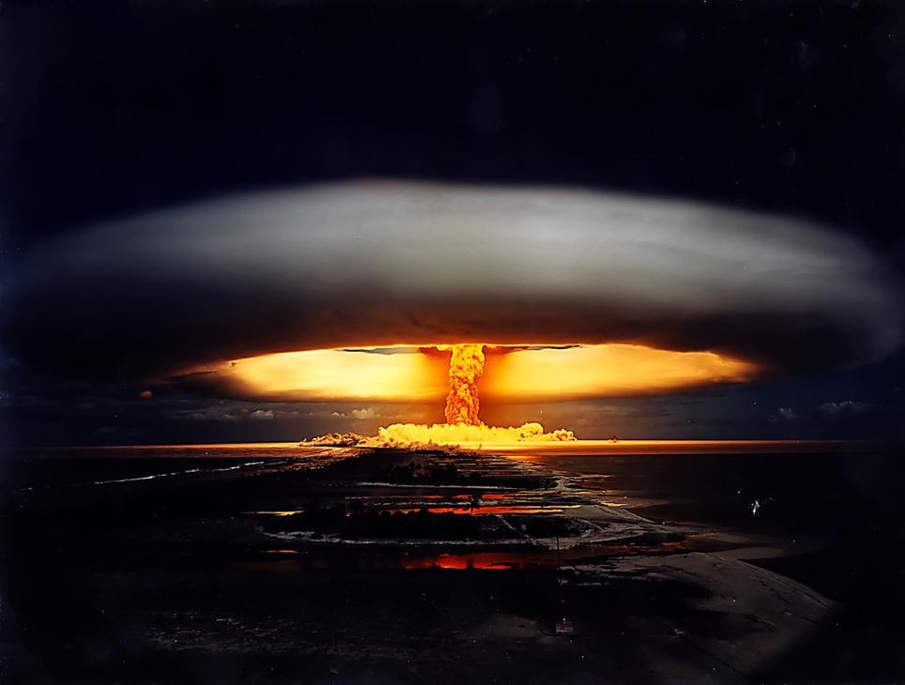
Fangataufa atoll French Polynesia

Slide 8
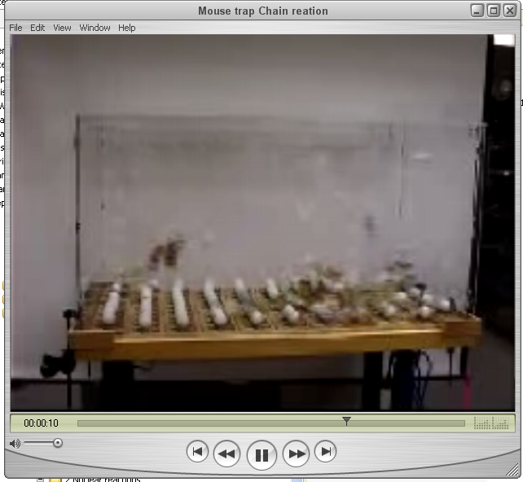

Slide 9
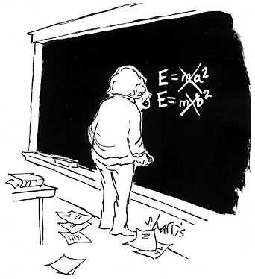
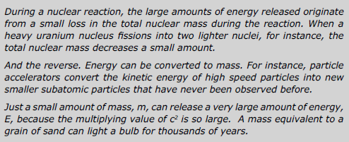
Mass is a form of energy related by
In nuclear reactions
mass – energy is conserved
Also referred to as
mass – energy equivalence

Slide 10
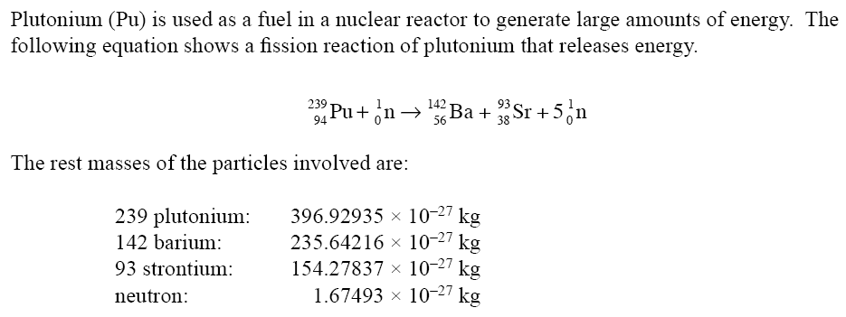
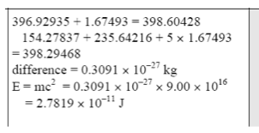
NCEA 2005 qu #3 Old Y13!
This assumes the neutron has minimal kinetic energy!
Joules

Slide 11
Alpha decay Reaction
Polonium 212 decays into lead 208 by emitting an alpha particle. The rest masses of these three are:
3.51986 x 10⁻²⁵ kg 3.45324 x 10⁻²⁵ kg 6.646 x 10⁻²⁷ kg
Reactants
Products
(a) Calculate the difference between the initial rest mass and the total final rest mass.
1.6 x 10⁻²⁹ kg
(b) This mass decrease appears in the form of Kinetic energy. Calculate the kinetic energy released in this reaction.
1.44 x 10⁻¹² J
(c) Assume the Alpha particle, being much less massive than the lead nucleus, gets almost all this energy. Calculate its speed just after the decay.
2. 1x 10⁷ ms⁻¹

Slide 12
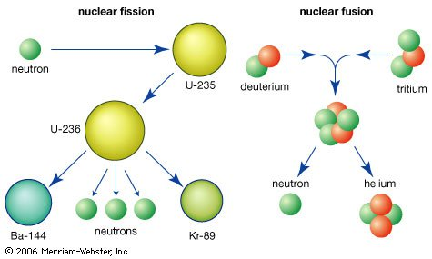

Slide 13
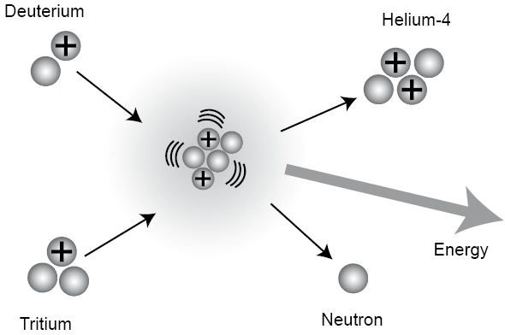
Fusion
The joining of two smaller nuclei to form a larger one.
This is the process that powers the sun
Example of a fusion reaction:
When smaller nuclei combine to form a larger one, mass is lost in the form of an energy release. (WHY? – Y13)

Slide 14
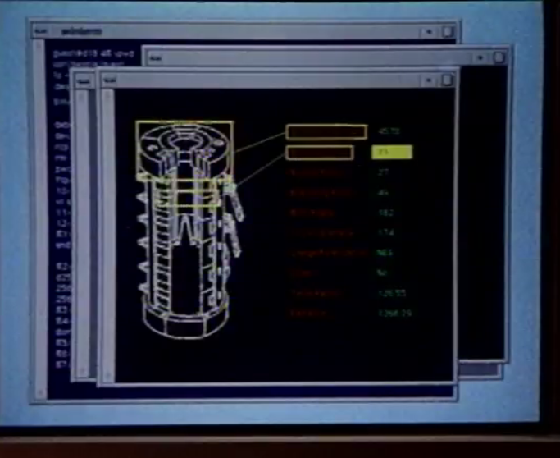
Cold fusion movie clip

Slide 15
