Slide 1
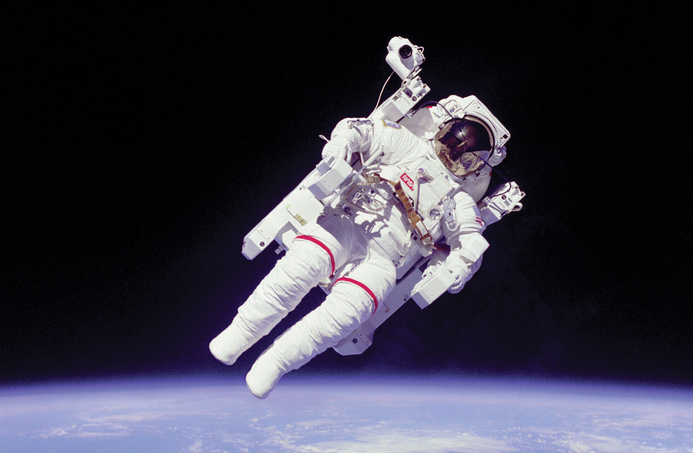

Slide 3
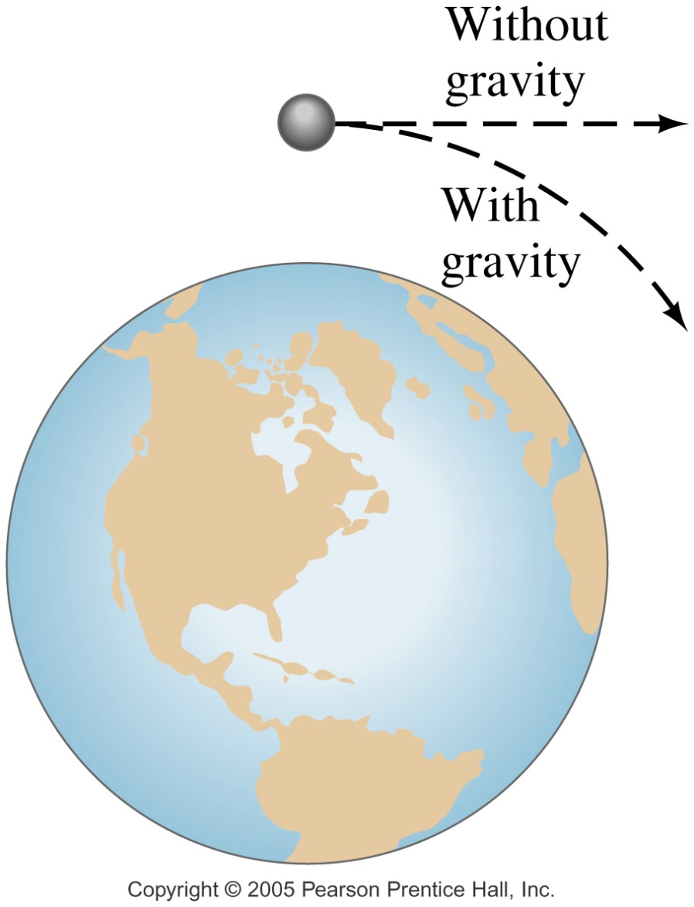
A satellite is kept in orbit by its speed – it is continually falling, but the Earth curves from underneath it.

Slide 4
Weightlessness?
What is it?
Gravity = zero?
Your weight is what you feel
ie your support force
Reading on a scale is zero…

Slide 5
A man stands on a scale
inside a stationary elevator.
Forces acting on the man
F_{s}
Reading
on scale is your
weight force
mg

Slide 6
When Moving Downward With
Constant Acceleration
Forces acting on the man
a
F_{s}
Reading
on scale is your
weight force
mg
You Feel some weightlessness?

Slide 7
Freefalling Downward with acceleration due to gravity
Forces acting on the man
a
Reading
on scale is your
weight force
mg
You are weightless!

Slide 8
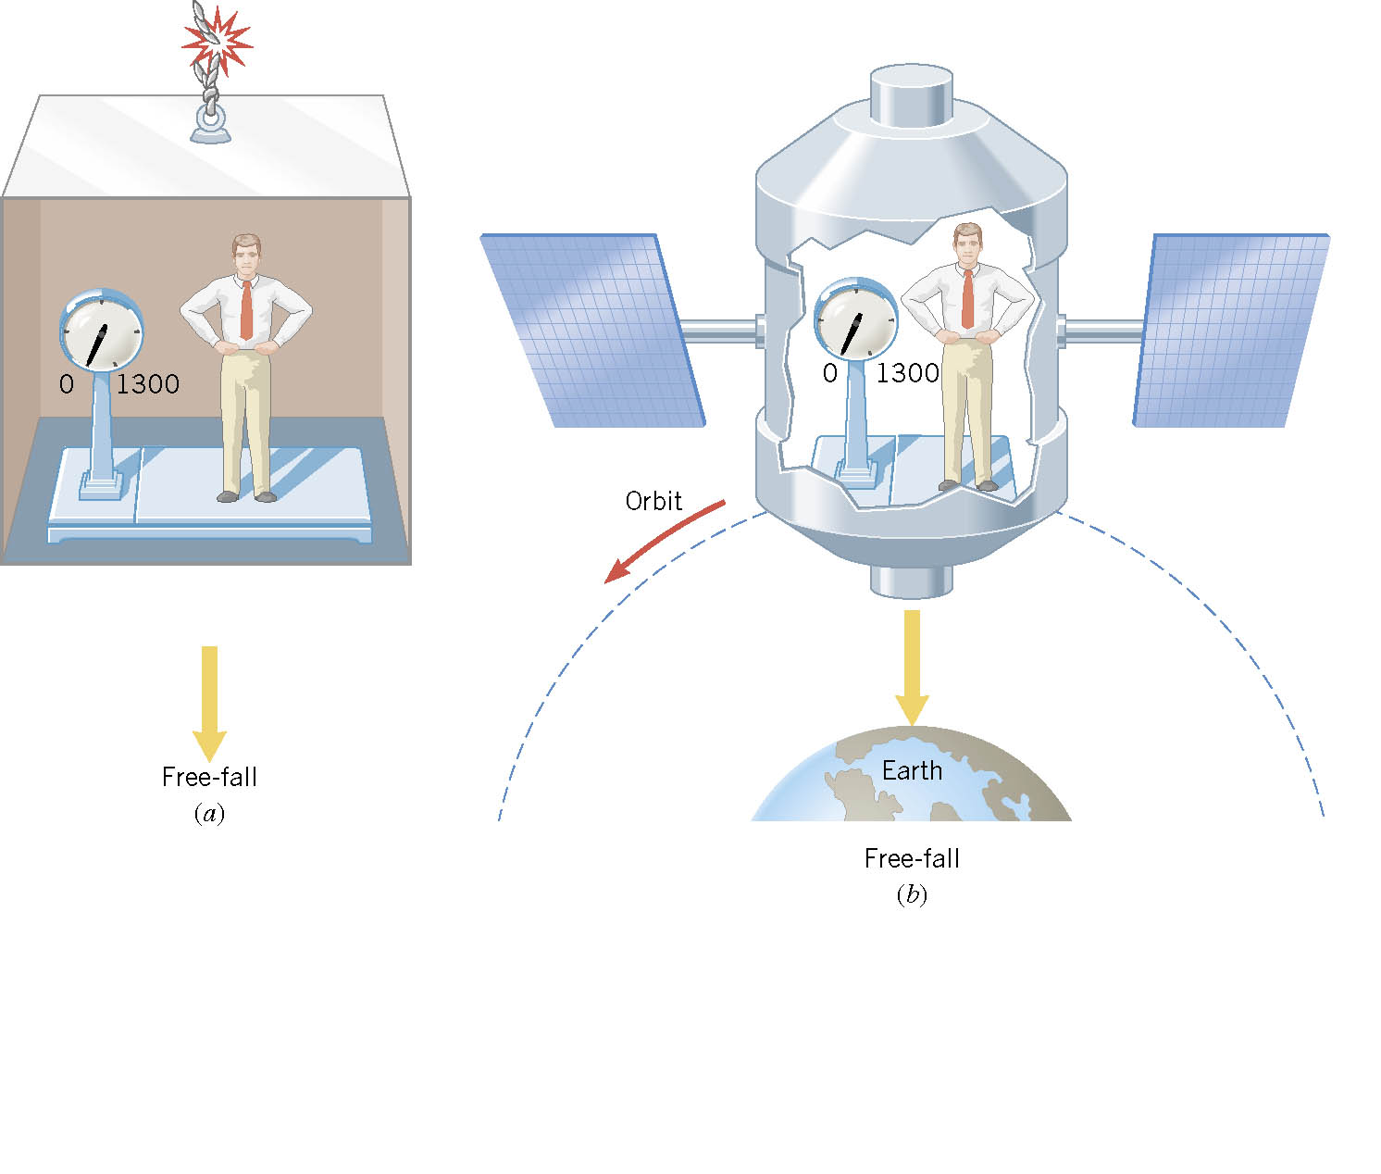
Apparent Weightlessness
The figure shows a person on a scale in a freely falling elevator and in a satellite in a circular orbit. In each case, what apparent weight is recorded by the scale?
Answer: 0

Slide 9
Weightlessness in Orbit
A person feels weightless in orbit simply because he or she is in free fall (doing UCM) along with the satellite and experiences no force of support (Reaction / Normal) from the satellite. The perception of weight comes from the support force exerted upon us by the floor, a chair, etc. If that support force is removed and we are in free fall, we feel no experience of weight.
Most Earth satellite orbits are only a few hundred kilometres above the surface, so the actual weight is diminished very little.
Demo Hyper Physics http://hyperphysics.phy-astr.gsu.edu/hbase/HFrame.html
Notes:
Ballistic trajectory

Slide 10
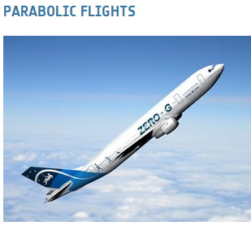
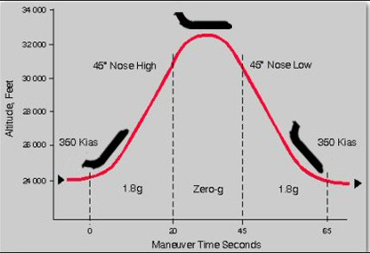
The A300 has now been certified for flying parabolas that provides, in addition to microgravity, reduced gravity levels of 0.16g for approximately 23 s... These gravity levels correspond to Lunar and Martian gravity levels.
http://ataridogdaze.com/weightless/parabolic-flight.shtml>

