Slide 1
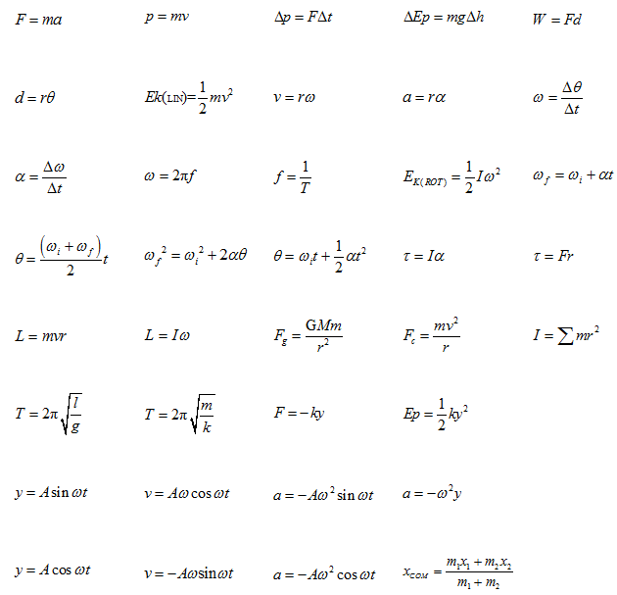
Simple Harmonic Motion

Slide 2
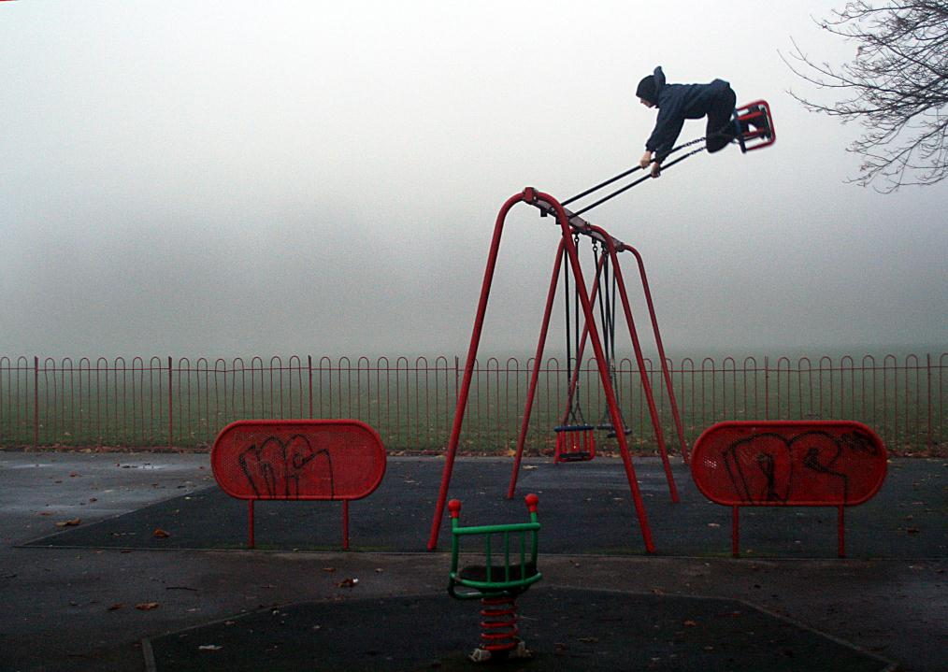
Swings

Slide 3
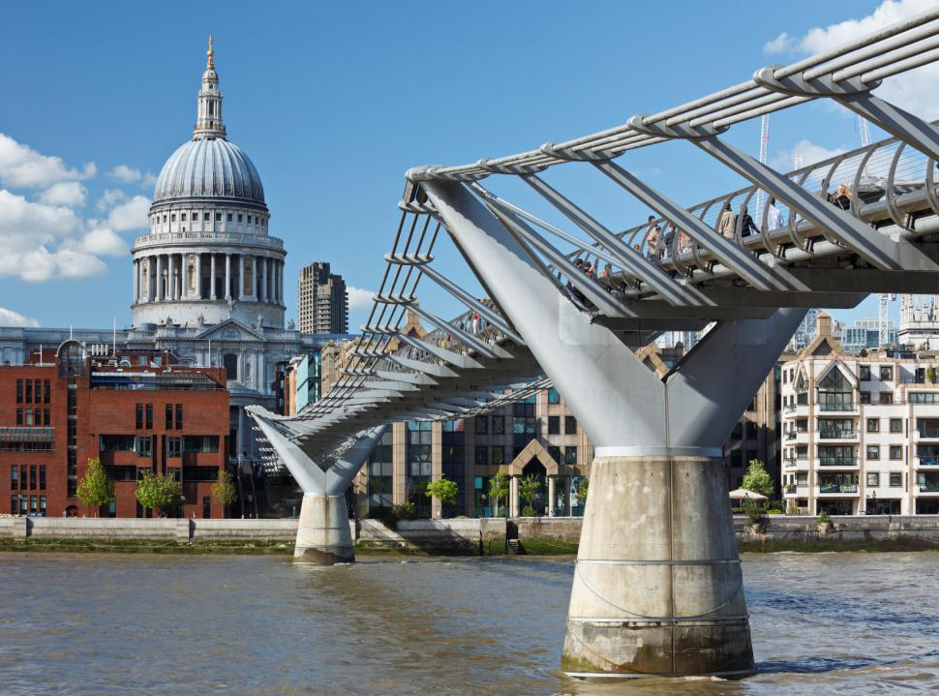
Bridges

Slide 4
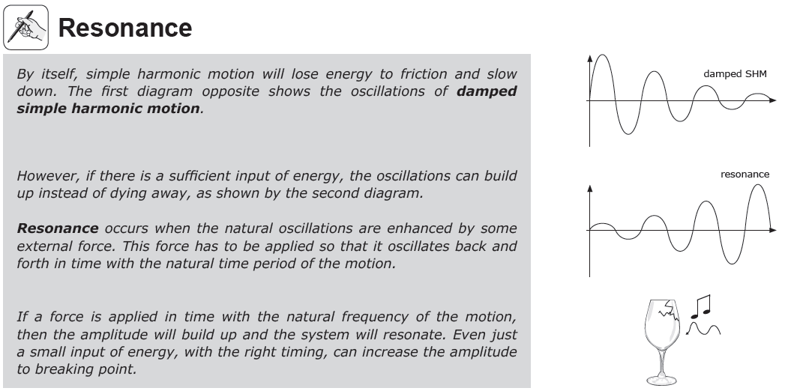
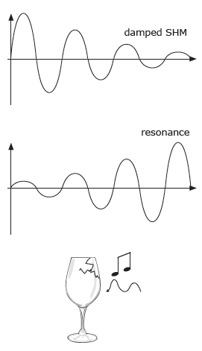

Slide 5
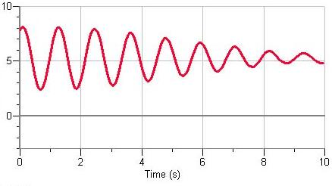
Damped Harmonic Motion
Energy lost to friction will result in the amplitude decreasing over time.

Slide 6
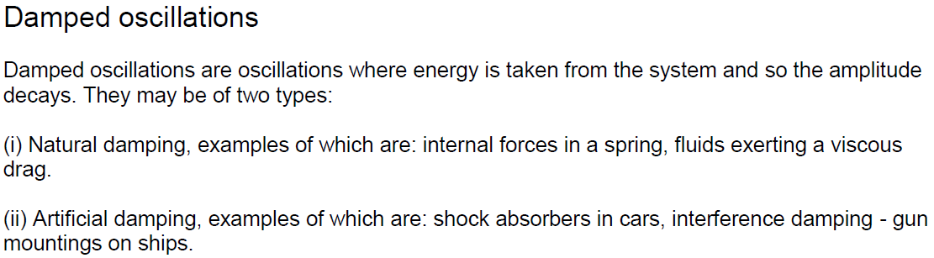

Slide 7
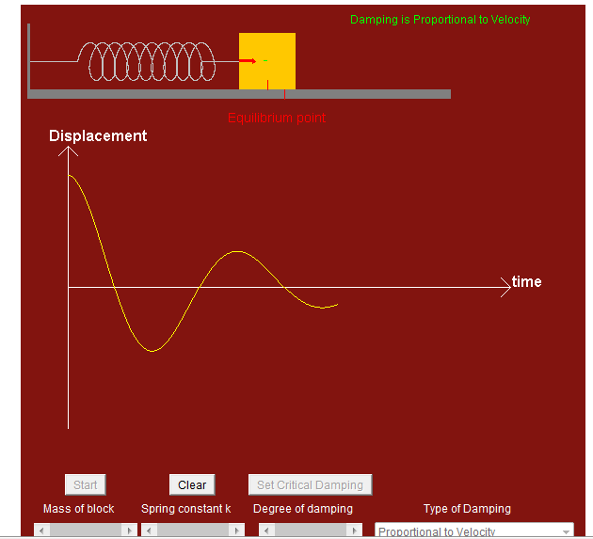
http://www.ngsir.netfirms.com/englishhtm/Damped.htm

Slide 8
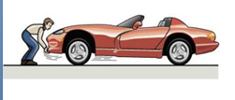

Slide 9
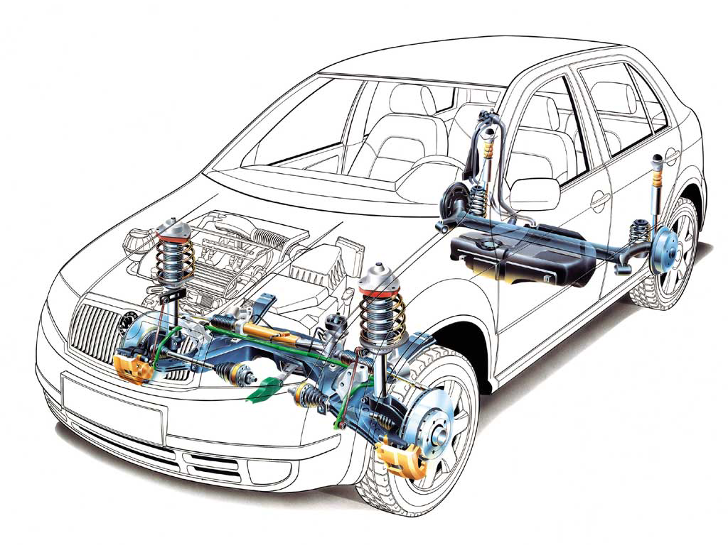
a sprung system

Slide 10
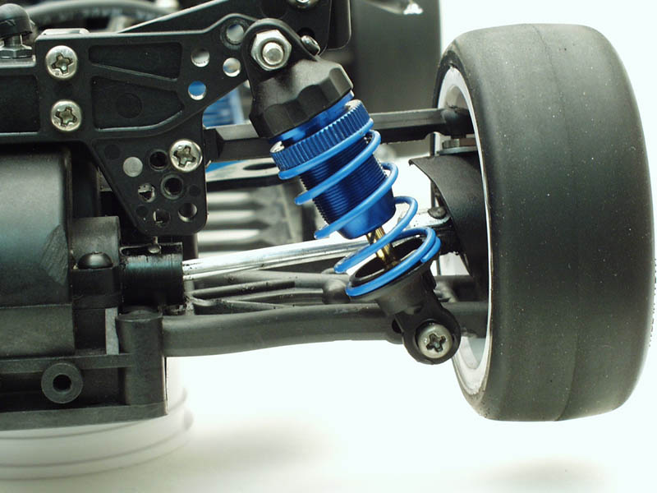

Slide 11
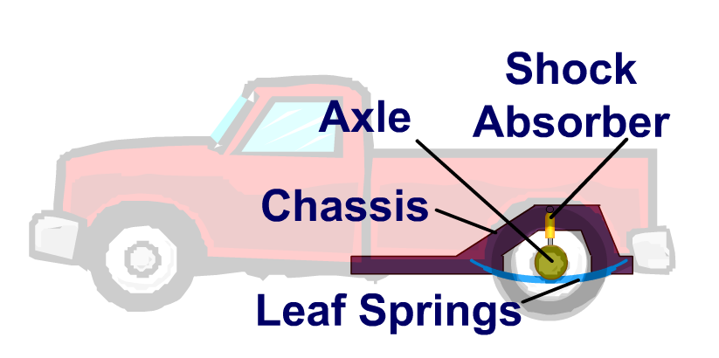
See car_shock applet

Slide 12
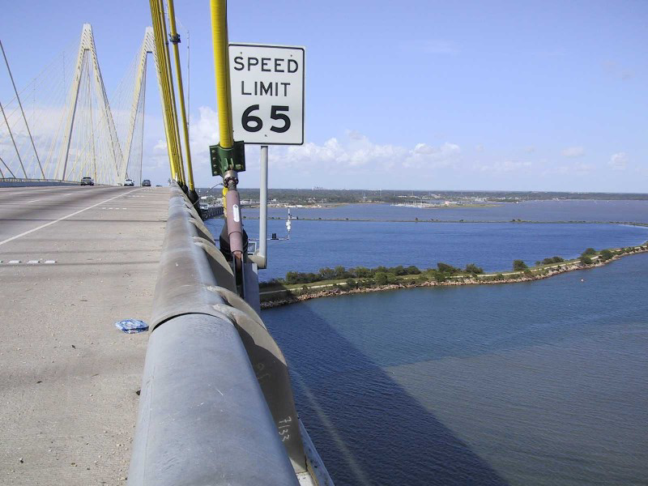
Bridge dampers

Slide 13
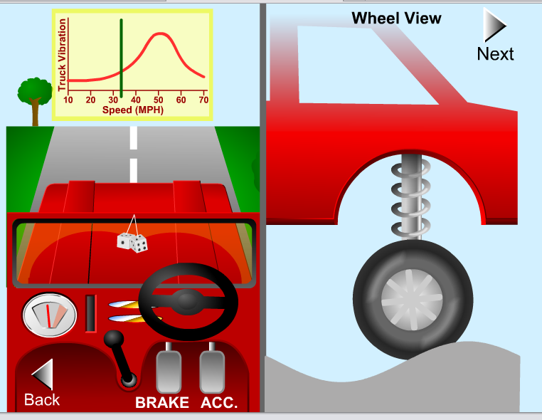
http://www.acoustics.salford.ac.uk/feschools/waves/flash/truck.swf

Slide 14
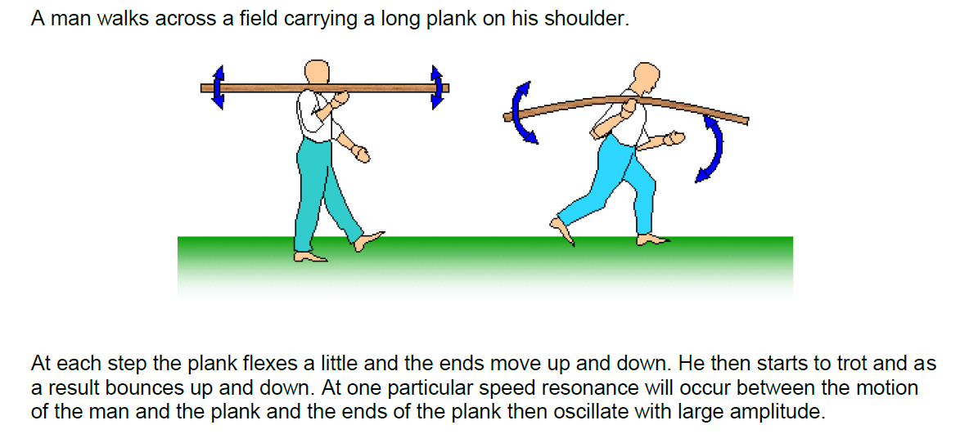
Mr Anderson walks back to B1 with his 2/3 full cup of coffee, invariably he will spill some…

Slide 15

Resonance ~Driven or Forced Harmonic Motion
When a system is disturbed by a periodic driving force and then oscillates, this is called forced oscillation. A system is said to have a ‘natural’ or resonance frequency ( f_{o} ) which is independent of the frequency of the driving force.
If the driving force frequency matches the natural frequency…
Driving Force
then the amplitude can becoming large (and potentially dangerous). This is called Resonance.
Resonance frequencies will be explored in Waves (standing waves / harmonics) & AC Circuits (tuning radios).

Slide 16
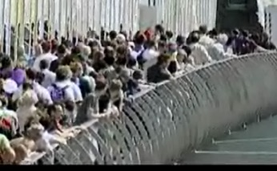
If the driving force frequency matches the natural frequency…then the amplitude can becoming large (and potentially dangerous). This is called Resonance.
The peoples movement (side to side wobble) was synchronised, not a random movement…
The frequency of the peoples sideways movement matched the natural frequency of the bridge…
The vibration developed when a large number of people picked up the slight sideways movement of a bridge and locked into it…
People adjusted their gait (how you walk) in order to stay balanced…

Slide 17
Driven Harmonic Motion
If the driving force matches the natural frequency:
(for springs)
Driving Force
(for pendulums)
Then the amplitude keeps increasing. This is called Resonance.
Web Link: Driven Harmonic Motion

