Slide 2
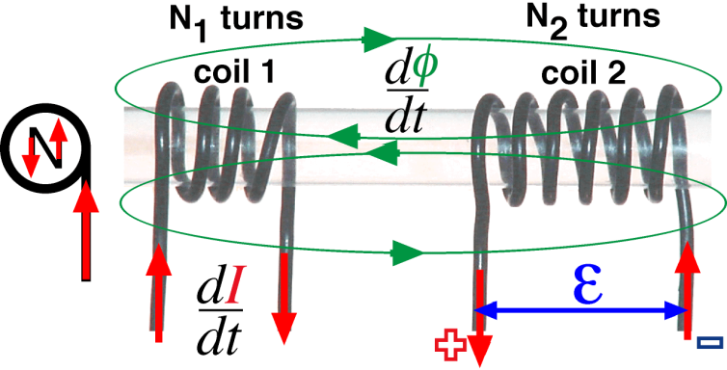
Mutual Inductance
As in a transformer, changing the current in the primary coil causes an induced voltage in the secondary coil i.e. mutual induction has occurred. Φ from the primary coil passes into the secondary coil.
Mutual induction ~ changing current in one coil produces an induced voltage in another coil

Slide 3
Φ is the induced flux in the secondary coil
The unit of mutual inductance is the henry (symbol H).
M depends on size and position of the two coils and the presence of any materials (such as iron core) between them.
The negative sign shows that the induced voltage opposes the change of current (Lenz’s Law)

Slide 4
Mutual Inductance:
When the switch is closed the Ammeter reads +5 A.
Explain the readings on both the Ammeter and the Galvanometer the instant the switch is closed;
stays closed; and
explain the reading of each meter when the switch is opened again.
Start: 1. switch is closed; 2. switch stays closed; 3. switch is opened
Iron bar
A
switch
12 V
G
-ve 0 +ve
-5 0 +5
G
A

Slide 5
You have to understand the phenomena and principles of physics if you are to succeed.
You must answer descriptive type questions with concise explanations that show a clear understanding of the phenomena, concepts and principles of physics.
Students that use bullet points to correctly describe the order of events in their answers to descriptive questions succeed very well.

Slide 6
Mutual Inductance:
When the switch is closed the Ammeter reads +5 A.
Explain the reading of each meter when the switch is closed;
stays closed; and
explain the reading of each meter when the switch is opened again.
Switch is closed
S
N
N
S
S
N
Ammeter swings to 5 A
Simultaneously the Galvanometer swings to –ve because of the change in flux, which is growing, generating a back emf in the second coil, and hence a current that flows in the opposite direction.
A
12 V
G
Switch stays closed
Galvanometer swings back to zero because the flux is no longer changing
-ve 0 +ve
-5 0 +5
Switch is opened
Ammeter swings to zero
G
A
Simultaneously the Galvanometer swings to +ve.
Has a greater emf because the flux is rapidly changing in the first coil,
the magnetic field is collapsing, and
the resulting current in the secondary coil produces a magnetic field in the secondary coil which opposes the change.
Galvanometer finally swings back to zero because the flux, however small, is stationary.

Slide 7
Mutual Inductance: When the switch is closed the Ammeter reads +5 A.
Explain the reading of each meter when the switch is closed, and then explain the reading of each meter when the switch is opened again.
Switch is closed
Ammeter swings to 5 A
Simultaneously the Galvanometer swings to –ve because of the change in flux, which is growing, generating a back emf in the second coil, and hence a current that flows in the opposite direction..
Switch stays closed
Galvanometer swings back to zero because the flux is no longer changing
Switch is opened
Ammeter swings to zero
Simultaneously the Galvanometer swings to +ve.
Has a greater emf because the flux is rapidly changing in the first coil,
the magnetic field is collapsing, and
the resulting current in the secondary coil produces a magnetic field in the secondary coil which opposes the change.
Galvanometer finally swings back to zero because the flux, if any is stationary.

Slide 8
Short Sharp Practical
How is M affected by distance?

Slide 9
Transformers
A transformer consists of two coils, either interwoven or linked by an iron core. A changing voltage in one induces a voltage in the other. Its main purpose is to change the voltage in an AC circuit.
Primary
Secondary
Step up transformer
Isolating “
Step down “

Slide 10
Example
A battery charger contains a transformer to convert 240 V to 12 V. If the primary coils has 1000 turns, how many are on the secondary?
= 1000 x 12 / 240
= 50 turns

Slide 11
Power in primary = Power in secondary
The efficiency of a transformer
Output always less then input energy!
Reduce energy losses with low resistance copper wires…

Slide 13
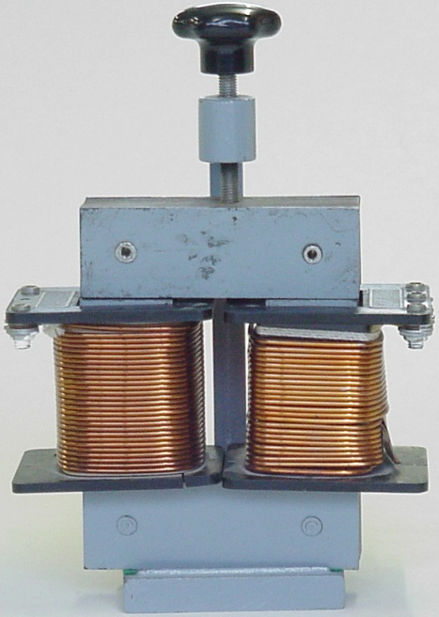

Slide 14
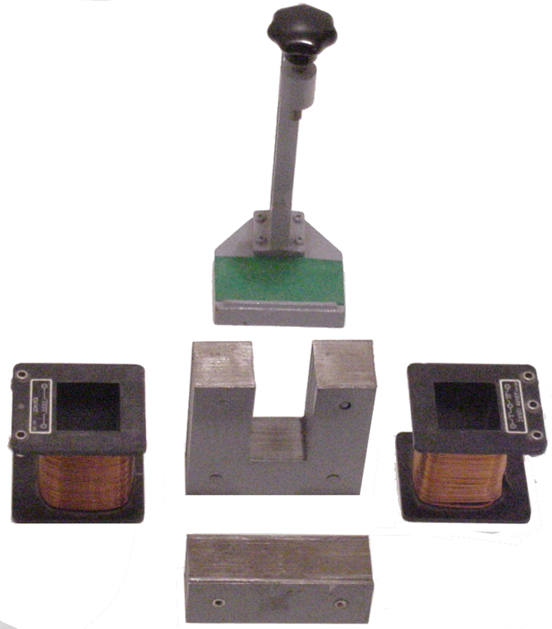

Slide 15
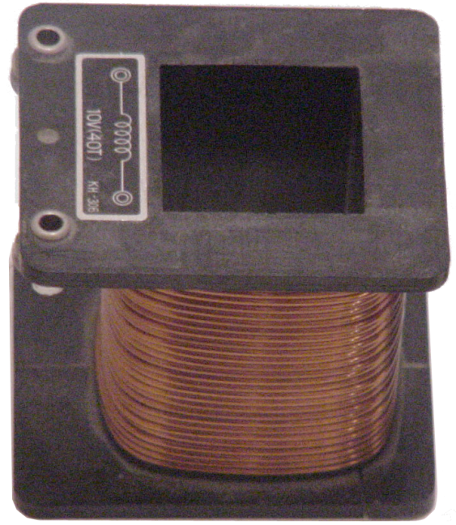

Slide 16
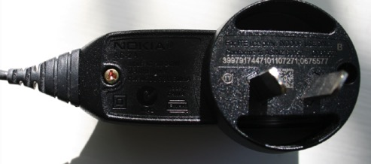
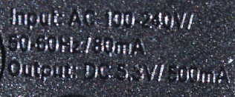
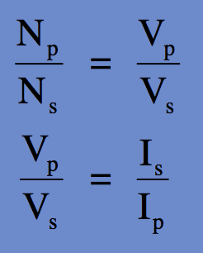
Transformers
240 V
Vs
Cell phone chargers are electronic now.
Calculate the overall efficiency of the modern cell phone charger using the values shown:
Input 240 V/80 mA. Output 5.3V/800 mA.
2. Suggest where the lost energy has gone.

Slide 17
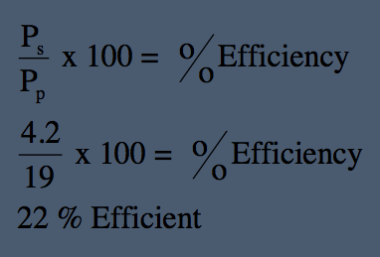
Transformers
240 V
Vs
Cell phone chargers are electronic now.
Input 240 V/80 mA. Output 5.3V/800 mA.
P_{p} = 240 x 80 x 10⁻³ = 19 W.
P_{s} = 5.3 x 800 x 10⁻³ = 4.2 W.
1. Calculate the overall efficiency of the modern cell phone charger.
2. Suggest where the lost energy has gone.
HEAT

Slide 18
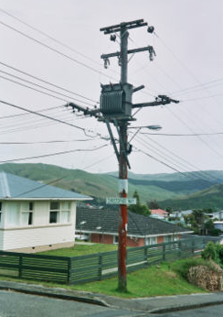
Transformer
The transformer is rated 1 KV/240 V
The house in the picture is using 20 A when cooking the evening meal.
Calculate the Primary current.
Calculate the ratio of the primary to secondary windings.
1 KV/240 V transformer

Slide 19
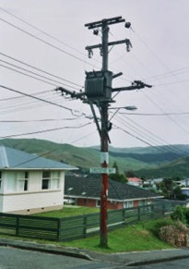
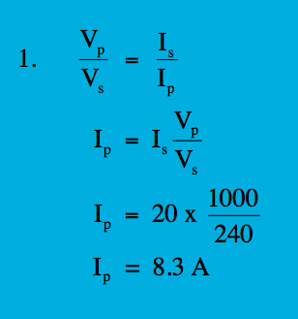
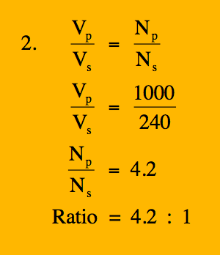
Transformer
1 KV/240 V transformer
The transformer is rated 1 KV/240 V
The house in the picture is using 20 A when cooking the evening meal.
Calculate the Primary current.
Calculate the ratio of the primary to secondary windings.
Primary windings N_{p}
Secondary windings N_{s}
magnetic flux φ
Primary current I_{p}
Primary voltage
1000 V
Secondary voltage
= 240 V
Secondary current
I_{s} = 20 A
transformer
iron core

Slide 20
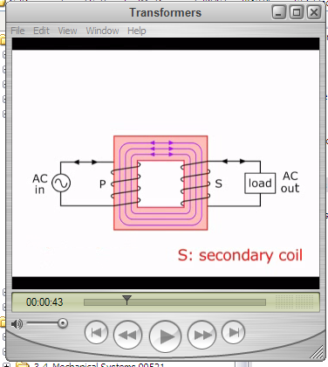
Transformers PTRB.mp4

Slide 21
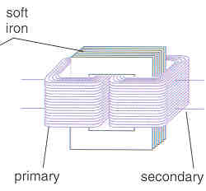
Transformer
1. Describe the construction of a basic iron-cored transformer as used for voltage transformations
A soft-iron core has two separate coils
The primary coil is connected to the supply voltage
The secondary coil provides the output voltage
[The soft-iron core is usually laminated to prevent over-heating and energy losses]
2. Describe the principle of operation of a transformer
The alternating current in the primary produces an alternating magnetic field in the soft-iron core
This changing magnetic field induces an alternating current in the secondary coil
3. What is the Transformer equation?

Slide 22
4. Describe the use of the transformer in high-voltage transmission of electricity
Electrical energy is transmitted over long distances at very high voltages
A Step-Up transformer increases the voltage from the power-station generators
A Step-Down Transformer is used to reduce the voltage again before it is distributed locally
The voltage is further reduced in each house by another step-down transformer
[Step-Up Transformers have more coils on the secondary
Step-Down Transformers have more coils on the primary]
5. Give the advantages of high voltage transmission.
At high voltage, less energy is lost in transmission
This is because at high voltage, less current is needed to provide the same amount of energy per second (i.e. power), and it is the current that causes heating in the wire and therefore energy losses.
The power loss is given by I²R, so the loss is proportional to the current squared
6. What is the equation for power in a transformer? V_{p}I_{p} = V_{s} I_{s}
The equation assumes that the transformer has no energy loss – i.e. 100% efficiency

