Slide 1
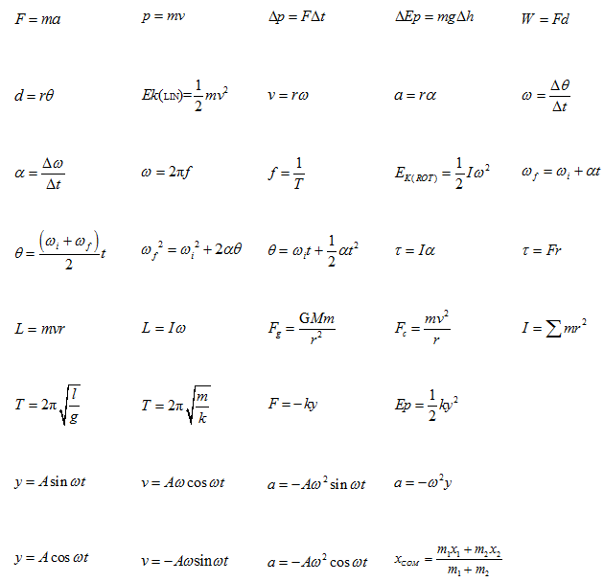
Rotational Motion

Slide 2
Y12
Conservation of Momentum
A system is a pair or group of objects that are interacting in some way.
If a system has no external forces acting on it (eg no friction), then the system is isolated.
Total momentum in an isolated system is said to be conserved.

Slide 3
Angular Momentum (L) unit: kgm²s⁻¹
Any rotating object has angular momentum…

Slide 4
Any rotating object has angular momentum…
Angular Momentum | Linear momentum
L = Iω | P = mv
ΔL = τ Δt | ΔP = FΔt
Conservation of L ΣL_{before} = ΣL_{after} (if no net outside torques) | Conservation of P ΣP_{before} = ΣP_{after} (if no net outside forces)
Compare…
Eg “friction torques”
Eg “friction forces”

Slide 5
What is the angular momentum of a 20 g, 11.8 cm compact disc spinning at 500 rpm? (use I = ½mr²)
m = 0.020 kg
r = 0.059 m
ω = 500 rev/min = 52.4 rad/s
L = Iω = (1/2)mr²ω
L = (1/2) 0.020 (0.059)² · 52.4
L = 0.0018 kg·m²s⁻¹

Slide 6
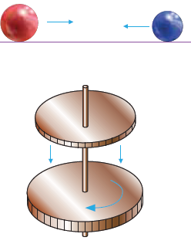

Slide 7
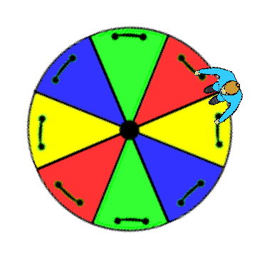
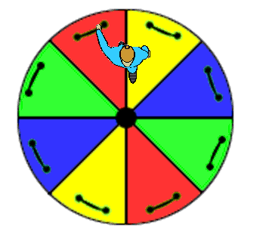
Conservation of Momentum
See merry go round Applet

Slide 8
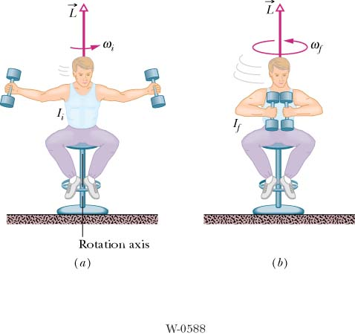

Slide 9
I ω = Ι ω

Slide 10
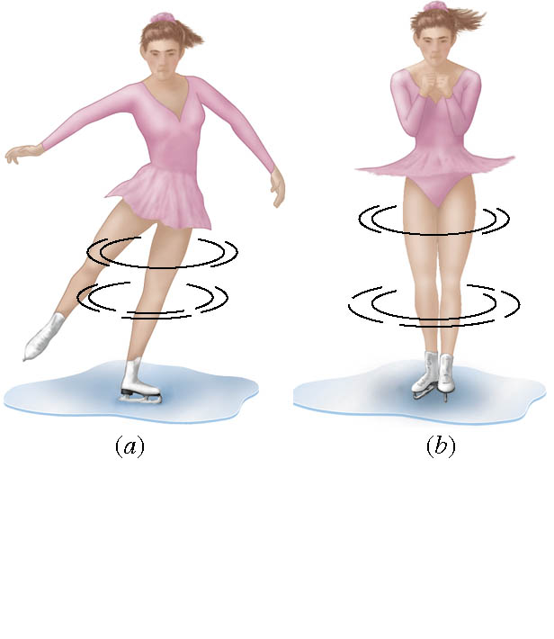

Slide 11
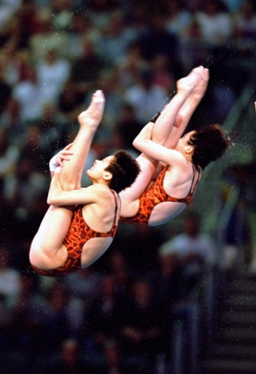
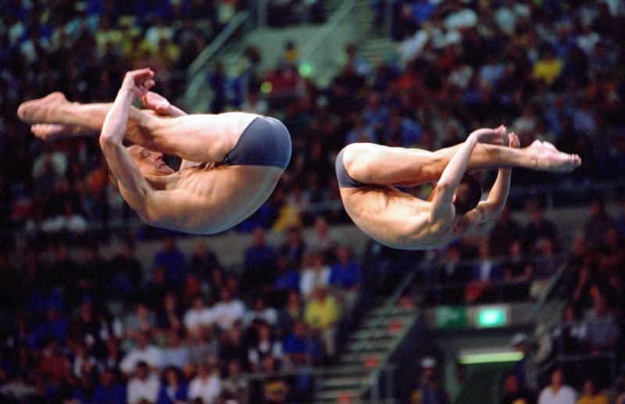

Slide 12
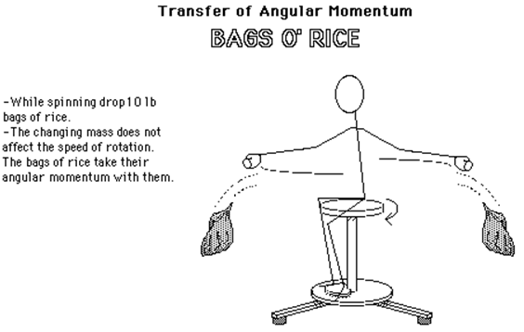

Slide 13
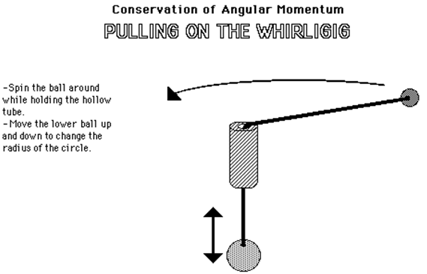

Slide 14
See rotation_joe_ball

Slide 15
Conservation of Momentum problems
with worked solutions…

Slide 16
Linear Motion can provide Angular
Momentum, example:
Bubba and Betty-Sue go to the play-ground. Bubba runs to the spinny-ride and jumps on at the edge. The ride is at rest. Bubba's mass is 81kg and he runs at 3.7m/s. The spinning ride has a diameter of 3.3m.
(a) Calculate the angular momentum of the ride just after Bubba jumps on.

Slide 17
Next to the playground is an iced-over pond. Betty-Sue has brought her ice-skates and goes out and starts to spin while staying in the same place. In this orientation her rotational inertia is 0.064kgm², her mass is 59kg and she is spinning at 39rpm.
(b) Calculate her angular momentum.
(c) She then brings her arms inwards (towards her body).
Explain what happens and why.

Slide 18
(c) She then brings her arms inwards (towards her body).
Explain what happens and why.
As she brings her arms towards her chest she will speed up.
Since more or her mass as near the centre of the spin, she has decreased her rotational inertia.
Since the angular momentum is conserved, assuming no external torque from friction, the L = Iω with arms out must equal L = Iω with arms in.
(d) Her new rotational inertia is 0.014kgm². Calculate her new angular velocity

Slide 19
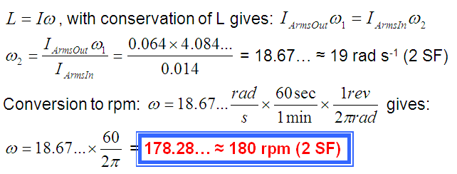
(d) Her new rotational inertia is 0.014kgm². Calculate her new angular velocity.

Slide 20
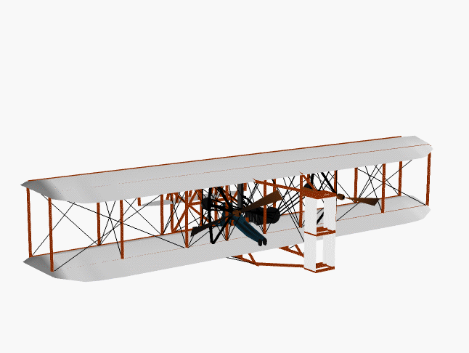

Slide 21
Bubba has a model airplane. Each set of propellers has a rotational inertia of 0.0018kgm² and are spinning at ~1800 rpm.
(e) Explain to Bubba why each propeller spins opposite directions.
If there was only one propeller the body of the airplane would try to rotate in the opposite direction as the propeller because of the conservation of angular momentum, L.
Each propeller spins in opposite circles so that they cancel out their angular momentum, L, and the body of the airplane does not have any torque and does not try to spin.
This cancelling out of each propellers angular momentum assumes each propeller has identical rotational inertia, I and angular velocity, ω.

Slide 22
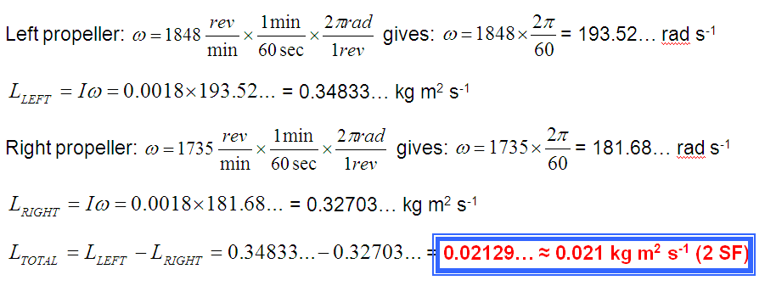
(f) Calculate the total angular momentum of both propellers if the left propeller spins at 1848rpm clockwise while the right propeller spins at 1735rpm anticlockwise?

Slide 23
(g) If it takes 1.45s for the propellers to reach a speed of 1840rpm starting from rest, calculate the angular displacement and the angular acceleration of a single propeller.

Slide 24
(h) If each blade on the propeller is 12.5cm long, calculate the linear velocity of the tip of each blade while at this 1840rpm.

