Slide 1
NCEA 2007

Slide 2
LR Time Constant
As with Capacitors, if an Inductance is connected in series with a resistor then there is delay in obtaining the full current/voltage.
R
L
I = V/R
Final steady state current
I = V/R
V
Time
Time
t
t
Growth of Current in Inductor
Decay of Current in Inductor

Slide 3
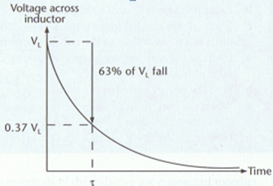
RL Circuits
IR
x
I
y
V_{s}
V_{L}
Switch to X, I increases from 0 to I_{max}. While I is increasing Inductor V_{L} acts against the supply voltage V_{s}. At any moment: V_{s} – IR – V_{L}=0 (loop rule)
At t = 0+, the current is just starting to flow, but there is still negligible voltage drop across resistor
V_{s} – IR – V_{L}=0
V_{s} – 0 – V_{L}=0
V_{s} = V_{L}= L ΔI/Δt
Time constant τ = L/R
τ = time taken for a change of 63%

Slide 4
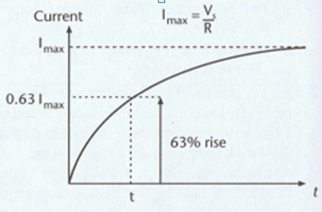
Current in the circuit…
τ = L/R
For t >> τ (ie 5 τ) Assume I_{max}
No change in current through inductor, V_{L} in inductor is 0.
V_{s} – IR – V_{L}=0
V_{s}– IR – 0 = 0
I = V_{s} /R

Slide 5
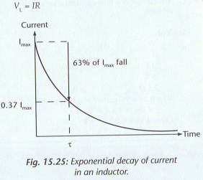
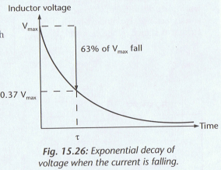
x
IR
Switch to y, I decreases from steady I_{max} to 0. While I is decreasing Inductor V_{L} acts to prevent current fall. At any moment: V_{L}- IR = 0 (loop rule)
I
y
V_{s}
V_{L}

Slide 6
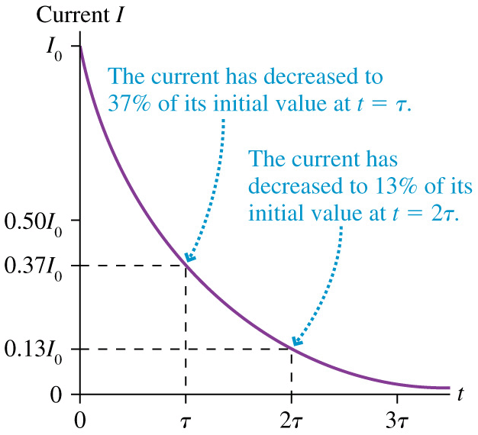

Slide 7
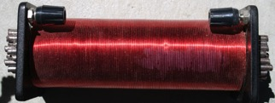
Inductor
A voltage V_{L} vs time t graph of an inductor in a DC circuit when the switch is closed.
V_{L}
V_{L} (V)
switch
12
9
6
3
0
V_{S}
L = 750 mH
3 Ω
V_{s}
t (s)
Calculate the time constant τ , L = 750 mH
Show on the graph the coordinate (τ, V_{L})
3. a) Calculate I_{max}
b) Sketch the current vs time graph for the above circuit.
c) On your graph show the coordinates with values of I_{max}, τ and V_{L}.

Slide 8
Inductor
A voltage V_{L} vs time t graph of an inductor in a DC circuit when the switch is closed.
V_{L}
V_{L} (V)
switch
12
9
6
3
0
V_{S}
L = 750 mH
3 Ω
V_{s}
4.4
τ
t (s)
Calculate the time constant τ , L = 750 mH
2. Show on the graph the coordinate (V_{L,} τ)
V_{L} = V_{S} e⁻¹
V_{L} = 37% x V_{S}
V_{L} = 4.4 V

Slide 9
I (A)
I_{max}
4
3
2
1
0
V_{L}
2.5
switch
L = 750 mH
3 Ω
τ
t (s)
I_{max} = V ÷ R
I_{max} = 12 ÷ 3 ∴ I_{max} = 4 A
V_{s}
3. a) Calculate I_{max}
b) Sketch the current vs time graph for the above circuit.
c) On your graph show the coordinates with values of I_{max}, τ and V_{L}.

Slide 10
Inductor
Exponential decay of current vs time t graph for an inductor with a 'make before break' switch
I_{L} (A)
V_{L}
V_{L}
4
3
2
1
0
I_{max}
Make before break switch
L = 750 mH
Make before break switch
L = 750 mH
V_{S}
V_{S}
3 Ω
3 Ω
t (s)
When the switch is re-connected as shown
Calculate I_{max}
Calculate the time constant τ, L = 750 mH
On the graph show I_{L} = 1.5 A after one time constant.
Sketch the voltage vs time graph for the above circuit.
On your graph show the coordinates with values for τ and V

Slide 11
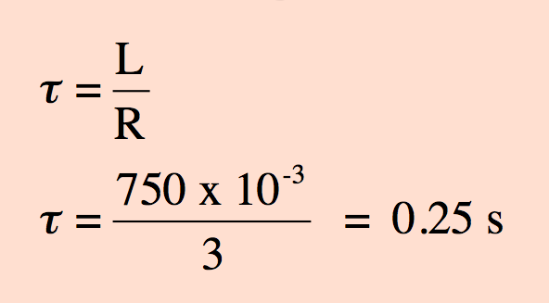
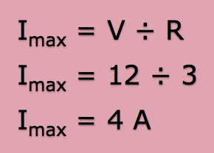
Inductor
Exponential decay of current vs time t graph for an inductor with a 'make before break' switch
I_{L} (A)
V_{L}
4
3
2
1
0
I_{max}
Make before break switch
L = 750 mH
V_{S}
3 Ω
t (s)
Calculate I_{max}
2 Calculate the time constant τ

Slide 12
Inductor
Exponential decay of current vs time t graph for an inductor with a 'make before break' switch
I_{L} (A)
V_{L}
4
3
2
1
0
I_{max}
Make before break switch
L = 750 mH
V_{S}
3 Ω
1.5
t (s)
0.25
3. On the graph show I_{L} = 1.5 A after one time constant.

Slide 13
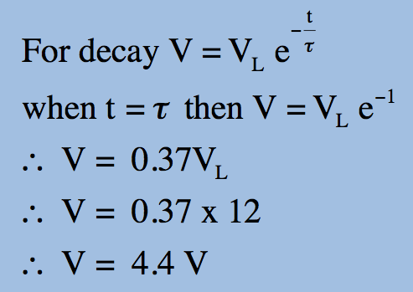
Inductor
When the switch is connected as shown
4. Sketch the voltage vs time graph for the circuit.
V_{L}
Exponential decay of volts V vs time t graph for an inductor with a 'make before break' switch
V (V)
Make before break switch
L = 750 mH
V_{L}
V_{S}
3 Ω
100%
67%
50%
33%
12
9
6
3
0
4.4
t (s)
0.25
5. On your graph show the coordinates with values for τ and V

Slide 14
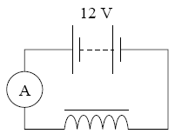

Slide 15
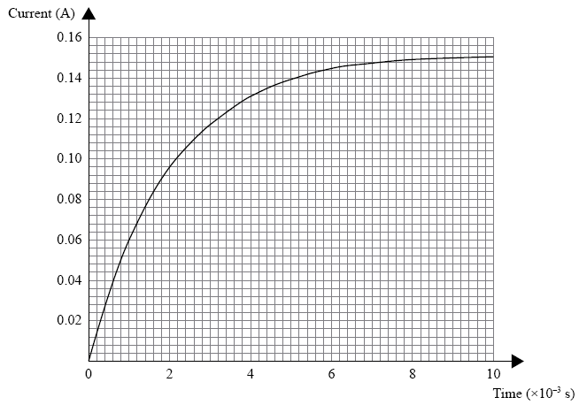

Slide 16
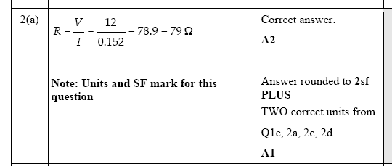

Slide 17
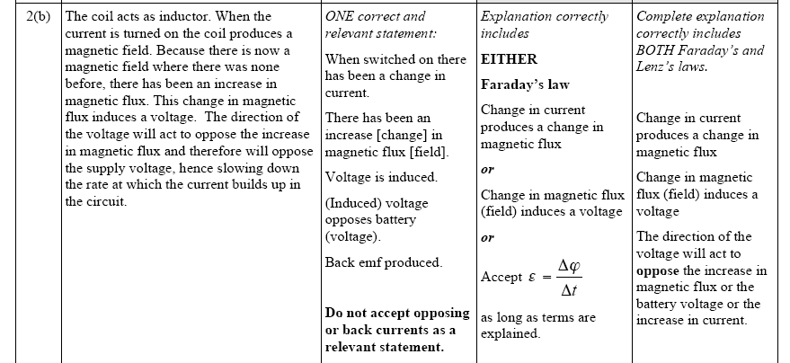

Slide 18
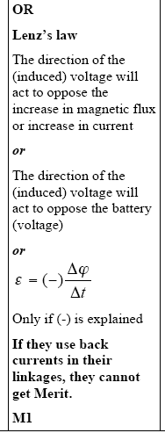

Slide 19
