Slide 1
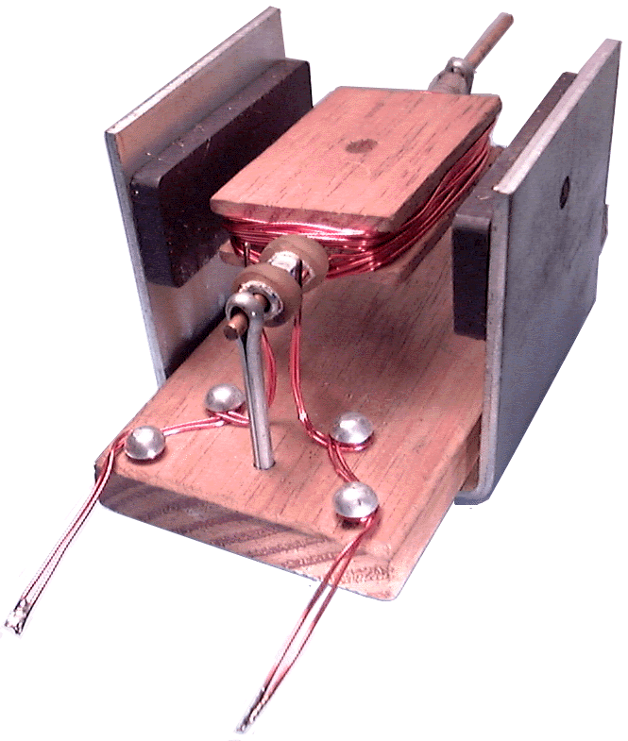

Slide 2
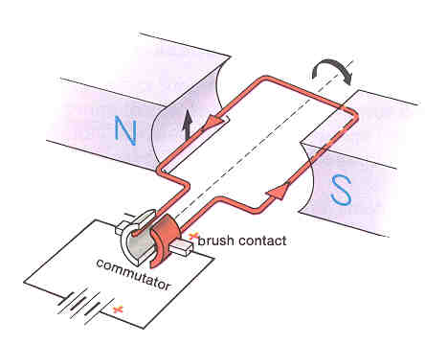

Slide 3
DC Motor
Describe how a d.c. motor works:
A current-carrying coil in a magnetic field experiences a turning effect
This effect can be used to produce a continuous rotation (in one direction) by swapping the direction of the current once the coil has turned half a turn. This is done using a split ring commutator
Note the Torque is not continuous (has max & min values)
How can the speed of the motor can be increased ?
Increase the number of turns on the coil
Increase the strength of the magnets
Increase the current flowing in the coil (by increasing the source Voltage, lower circuit resistance)
Electrical Energy is
converted to Mechanical Energy
Key concept:

Slide 5
All of the force is contributing to spinning the motor
F
N
S
Same force, but different torque.
i.e. not all the force is being used to spin the motor
F
F
N
S
F

Slide 6
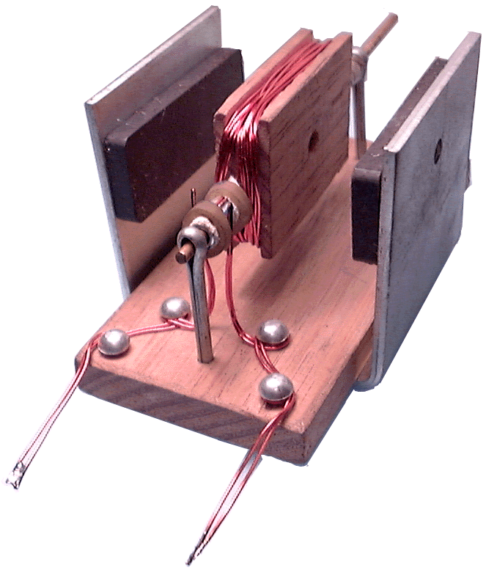

Slide 7
In the following position, no torque is being produced. However, the same amount of force is being produced.
F
N
S
F

Slide 8
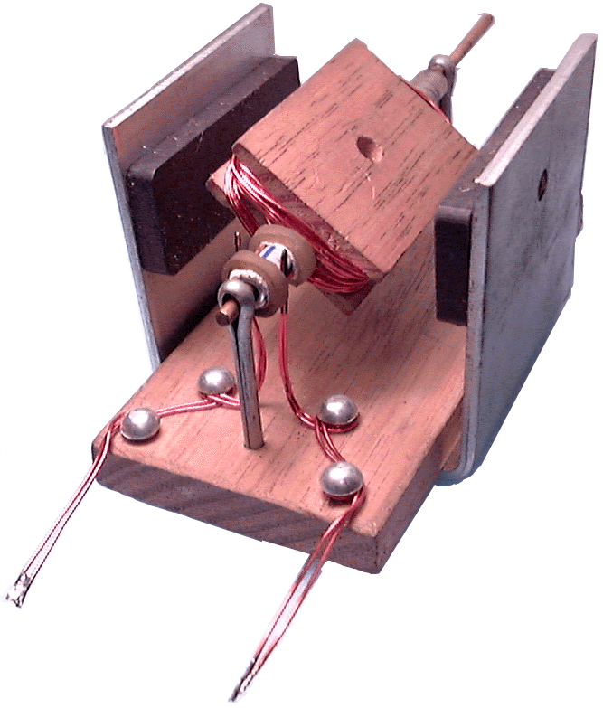

Slide 9
Problem?
F
N
S
F

Slide 10
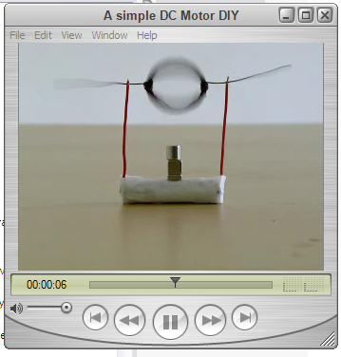

Slide 11
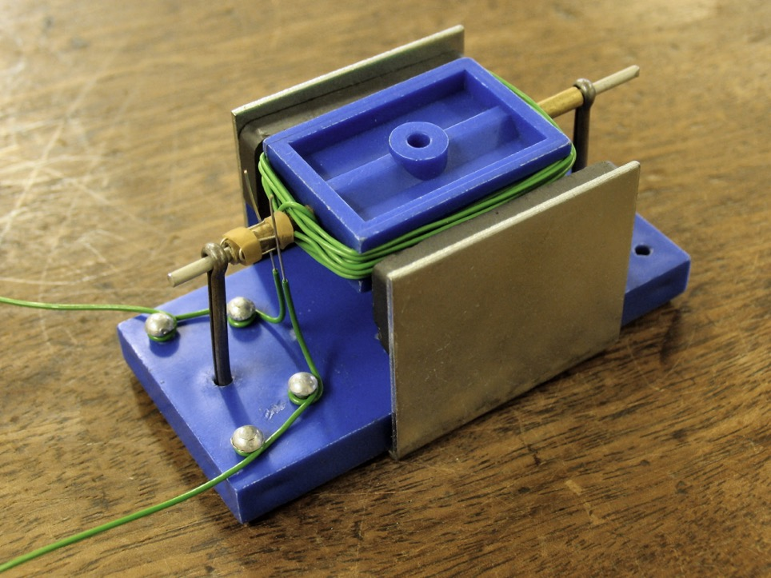

Slide 12
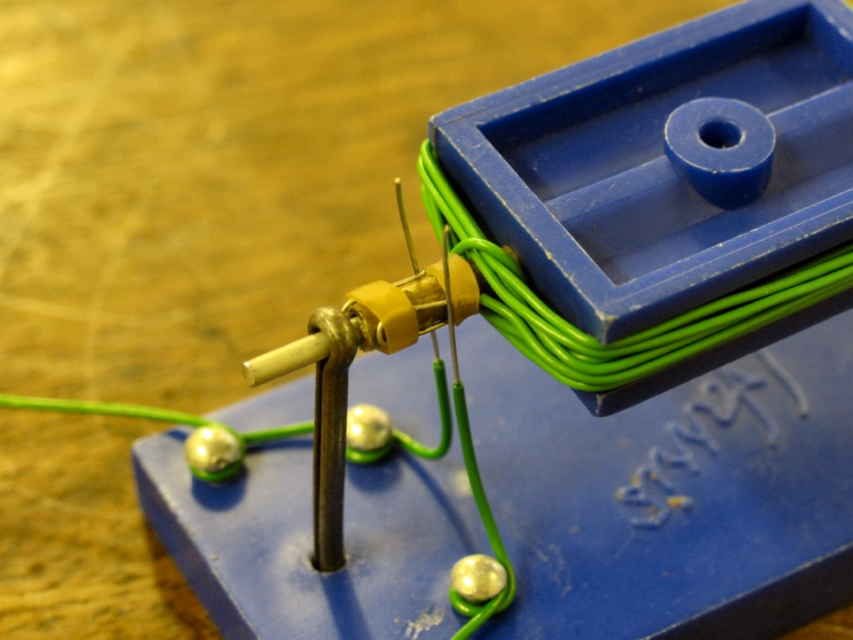
brushes & commutator

Slide 13
