Slide 1
Inductance review…
X X
X X X
X X
X X
X X X
X X
Consider the loop at the right.
The switch is closed, current starts to flow in the loop, it will take time for I to build from 0 to steady state.
While the I is increasing there will be a changing flux (ΔΦ) in side the coil.
As there is a ΔΦ inside the coil, due to Faraday law a voltage is induced
Due to Lenz’s Law , this is an opposing Voltage and slows the build-up of current
DC
Self-Induction: a changing current through a loop induces an opposing voltage in that same loop that acts to slow current flow.

Slide 2
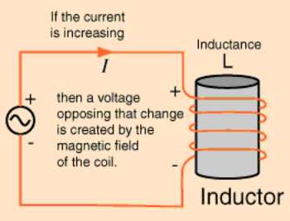
AC

Slide 3
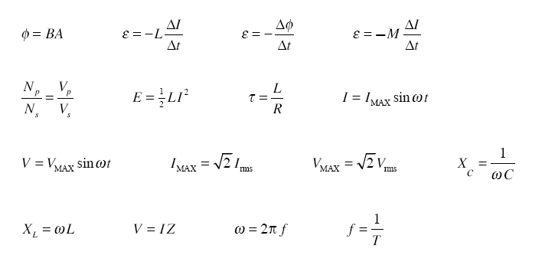

Slide 4
AC in an Inductor
V_{S}
Inductors always appose a change in current, so in an AC circuit the inductor will act to limit the flow of current.
AC supply
V_{R}
V_{L}
X_{L} is the ‘Reactance’ of the inductor, unit ohm (Ω)
Inductors store energy in their magnetic fields, which is then returned to the circuit as electrical energy. There is no net dissipation of energy by an ideal inductor, only by resistance in the circuit. Y13 AC theory will assume ideal inductors with negligible resistance.
larger L means more X_{L} due to greater opposing voltage
Greater f means I is changing at a greater rate so more opposing voltage

Slide 5
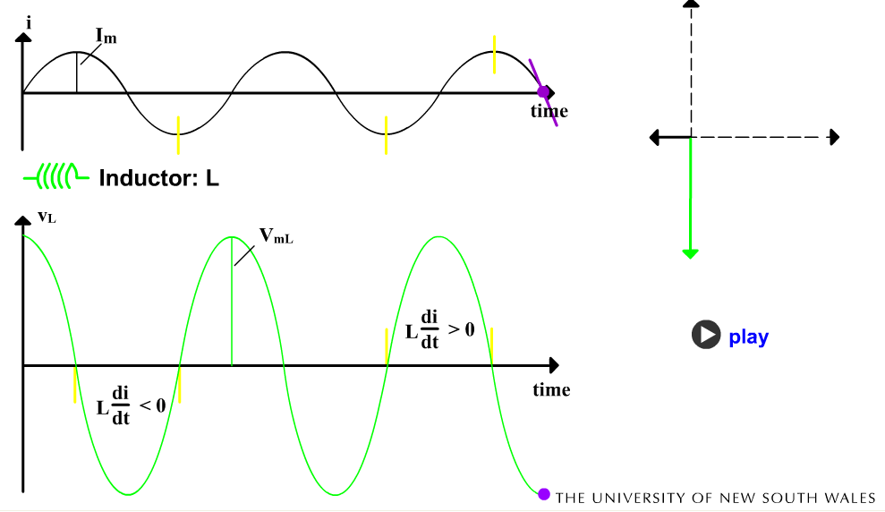
See 5 L & I Phasors applet

Slide 6
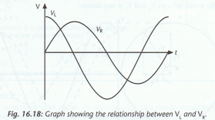
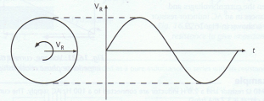
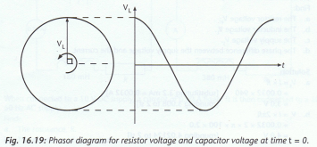
The phase relationship between V_{L} & V_{R}
Out by ¼ of a cycle or 90º
Phasors are rotating anticlockwise, V_{L} is always 90º ahead of V_{R} at any time “ the Inductor voltage is leading the resistor voltage by 90º”

Slide 7
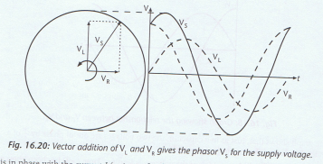
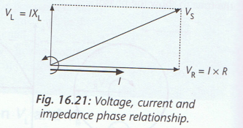
Voltage relationship between V_{S}, V_{L} & V_{R}
For components in series
V_{S} = V_{L} + V_{R}
To get V_{S} add V_{L} & V_{R} phasors as vectors,
Current is in phase with the resistor voltage.

Slide 8
Impedance

Slide 9
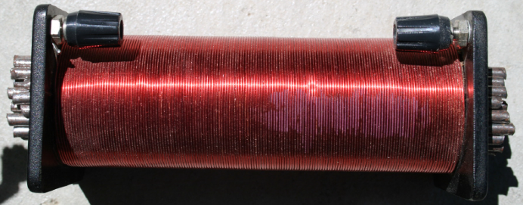
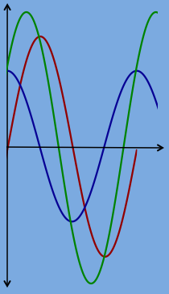
RL circuit
This RL circuit has a 10 mH inductor, a 4.7 Ω resistor and a 50 Hz power supply.
The current in the circuit is 2.2 A
The reactance X_{L} of the inductor is 3.1 Ω
L = 10 mH
4.7 Ω
Calculate the potential drop across the inductor (V_{L}) and the potential drop across the resistor (V_{R})
Determine the supply voltage (V_{S})
Determine the phase difference between the current and the supply voltage (V_{S})
From your phasor diagram label the waves on the graph with V_{R}, V_{L} and V_{S}.

Slide 10
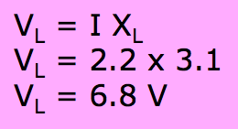
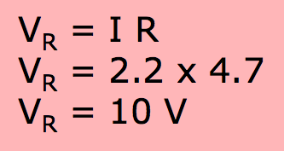
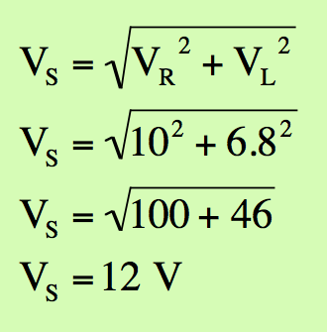
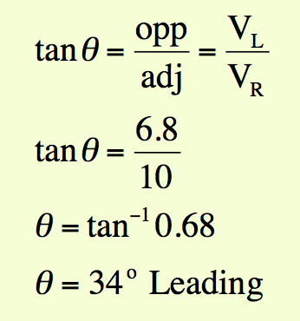
RL circuit
This RL circuit has a 10 mH inductor, a 4.7 Ω resistor and a 50 Hz power supply.
The current in the circuit is 2.2 A
The reactance X_{L} of the inductor is 3.1 Ω
L = 10 mH
4.7 Ω
Calculate the potential drop across the inductor (V_{L}) and the potential drop across the resistor (V_{R})
2. Determine the supply voltage (V_{S})
V_{L} = 6.8 V
V_{S} = 12 V
θ
V_{R} = 10 V
3. Determine the phase difference between the current and the supply voltage (V_{S})
V_{S} leading current by 34º ± 2º

Slide 11
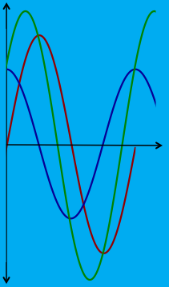
RL circuit
4. From your phasor diagram label the waves on the graph with V_{R}, V_{L} and V_{S}.
L = 10 mH
4.7 Ω
V_{S}
V_{S}
V_{L}
V_{L}
θ
V_{R}
V_{R}
Formative practice enables students to gain frequent feedback and feedforward on the progress of their education

Slide 12
A coil having resistance and inductance draws a current of 1.1 A when connected across a 110 V battery. When the coil is connected across 110 V, 60 Hz AC source it draws 0.55 A.
V_{rms} = 110 V
f = 60 Hz
V = 110 V
I = 1.1 A
I = 0.55 A
A
A
What is the resistance of the coil?
What is the impedance of the coil?

Slide 13
What is the inductive reactance (X_{L}) of the coil?
What is the inductance of the coil?

Slide 14
https://www.consumer.org.nz/products/cooktops/overview

Slide 15
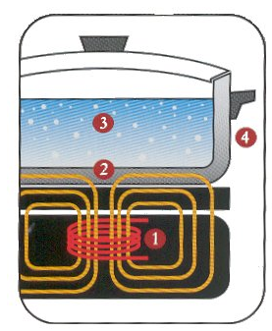
How Induction Cooking Works:
The element's electronics power a coil (the red lines) that produces a high-frequency electromagnetic field (represented by the orange lines).
That field penetrates the metal of the ferrous (magnetic-material) cooking vessel and sets up a circulating electric current, which generates heat. (But see the note below.)
The heat generated in the cooking vessel is transferred to the vessel's contents.
Nothing outside the vessel is affected by the field--as soon as the vessel is removed from the element, or the element turned off, heat generation stops.

