Slide 1
Kinematic Equations (Equations of Motion)
symbol | variable | unit
v_{i} | initial velocity | ms⁻¹
v_{f} | final velocity | ms⁻¹
a | acceleration | ms⁻²
d | distance | m
t | time | s

Slide 2
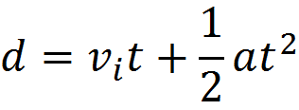
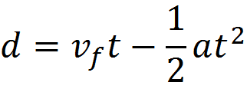
Kinematic Equations (Equations of Motion)
d = ½ ( v_{i} + v_{f} )t

Slide 3
Kinematic Equations: 6 steps
1. Read problem carefully!
2. If possible sketch what is happening - very useful!
3. List all Info & variables
ie write out v_{f}, v_{i}, d, t & a
4. Identify appropriate equations
5. Solve the equations
6. Check answers, round sig fig, units

Slide 4
A race car accelerates from 18.5 ms⁻¹ to 46.1 ms⁻¹ in 3.47 seconds. Find the acceleration of the car.
2. A ball dropped from rest falls freely until it hits the ground with a speed of 20 ms⁻¹. What is the time during which the ball is in free fall?

Slide 5
3. An airplane accelerates down a runway at 3.20 ms⁻² for 32.8 s. Find the distance travelled before takeoff. We need to assume it started from rest!
4. A feather is dropped on the moon from a height of 1.40 meters. The acceleration of gravity on the moon is 1.67 ms⁻². Find the time for the feather to fall to the surface of the moon.

Slide 6
5. A bike accelerates uniformly from rest to a speed of 7.10 ms⁻¹ over a distance of 35.4 m. Determine the acceleration of the bike.
6. A kangaroo is capable of jumping to a height of 2.62m. Determine the takeoff speed of the kangaroo.

Slide 7
7. A race car accelerates from 18.5 ms⁻¹ to 46.1 ms⁻¹ in 2.47 seconds. Find the distance travelled.
8. While gliding down a steep hill, a bike rider experiences constant acceleration. After 4.50 s, he reaches 7.50 ms⁻¹. The bike's displacement was 19.0m. How fast was the bike travelling initially?

Slide 8
