Slide 1
Internal Resistance, r
Short circuiting a battery demo…
High current?
Dangerous ?

Slide 3
The internal resistance of a battery is dependent on the specific battery's size, chemical properties, age, temperature and the discharge current
Notes:
http://en.wikipedia.org/wiki/Internal_resistance

Slide 4
Battery ~ Internal Resistance (r)
R
V_{T} = IR
I
V_{T}
V_{T} = ε − Ir
+
−
ε = IR + Ir
ε
r
Inside the
Battery
All batteries have a small internal resistance (r), which reduces the terminal voltage (V_{T}) from the batteries emf (ε).

Slide 5
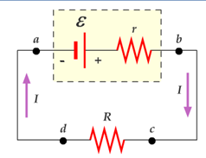
Battery ~ Internal Resistance (r)
Terminal voltage (V_{T} or V_{ab}) is the voltage a battery delivered to the circuit. Define as the voltage between the battery terminals.
Electromotive force (emf, ε) is the voltage produced by the chemical reaction of the battery.
When no current is drawn from the battery, the terminal voltage is equal to the emf ε.
When a current is drawn in a circuit the actual terminal voltage delivered to the circuit is
When a current is drawn from a battery, the terminal voltage delivered to the circuit by the battery will over time drop below its listed ε due to increasing internal resistance r.

Slide 6
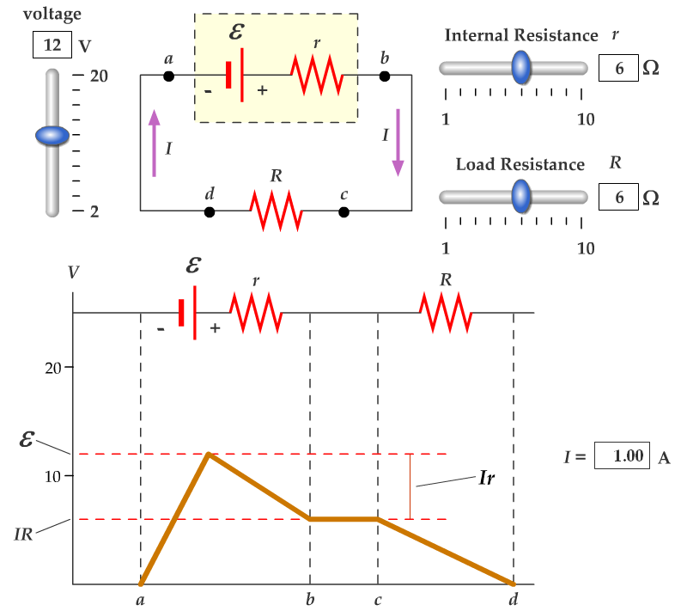

Slide 7
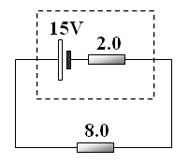
In the circuit shown, a 15 V battery has an internal resistance of 2.0 Ω. It is connected to an 8.0 Ω resistor.
Ω
a) Calculate the current in the circuit.
Ω
b) Calculate the actual voltage supplied by the battery to the 8.0 Ω resistor.

Slide 8
The voltage loss in the internal resistance is:
The output voltage (Terminal Voltage) of the cell is:

Slide 9
Notice that when the current is zero, the output voltage is the EMF.
So the EMF can be thought of as the output voltage when the current is zero
i.e. if an AA cell is 1.5V, this is the EMF

Slide 10
As the switches are closed, the current………
increases:
The voltage loss in the internal resistance ………..
increases
The output voltage goes ………
down
V

Slide 11
EMF
Output Voltage
Gradient =
r
Current

Slide 12
10Ω
Explain what happens to the lamp’s brightness if the rheostat slider moves to the right.
R_{circuit}
1Ω 20Ω
I_{circuit}
V_{T}
Voltage across lamp
Power
Brightness

Slide 13
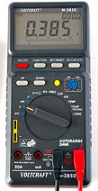
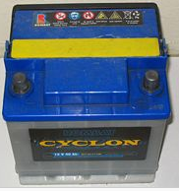
EMF and Internal resistance
13.7
The circuit shows a car battery connected through a switch to a starter motor.
The switch is open.
Negative terminals
Positive terminals
-
+
The voltmeter (V) across the terminals reads 13.7 V
State the emf of the battery
Explain your answer.
emf
r
V
switch
starter motor

Slide 14
EMF and Internal resistance
13.7
The circuit shows a car battery connected through a switch to a starter motor.
The switch is open.
The voltmeter (V) across the terminals reads 13.7 V
State the emf of the battery
Explain your answer.
The emf = 13.7 V
With the switch open, there is only a negligible current (μA) flowing through the voltmeter circuit.
Negligible electrical energy is transformed into heat by the internal resistance.
The voltmeter reads all the energy per unit of charge (V = JC⁻¹) that is available in the battery.
emf = Terminal voltage + V_{r}
now V_{r} = Ir and I = 0
emf = Terminal voltage = 13.7 V
Negative terminals
Positive terminals
-
+
emf
r
V
switch
starter motor

Slide 15
13.7
The circuit shows a car battery connected through a switch to a starter motor.
The switch is open.
The voltmeter reads 13.7 V.
State the emf of the battery.
When the switch is closed the voltmeter reads 12.0 V.
State the emf of the battery now.
Negative terminals
Positive terminals
-
+
The starter motor has a resistance of 0.06 Ω and draws a current of 200 A.
Show the potential difference (pd) across the motor is 12 V.
Calculate the internal resistance of the battery.
r
emf
V
switch
starter motor

Slide 16
The circuit shows a car battery connected through a switch to a starter motor.
The switch is open.
The voltmeter reads 13.7 V.
State the emf of the battery.
-
+
emf
r
1. emf = 13.7 V
12
switch
When the switch is closed the voltmeter reads 12.0 V.
State the emf of the battery now.
starter motor
2. emf = 13.7 V
3. V = RI
V = 0.06 x 200
V = 12 V
The starter motor has a resistance of 0.06 Ω and draws a current of 200 A.
Show the potential difference (pd) across the motor is 12 V.
Calculate the internal resistance of the battery.
Σ ΔV_{r} = Σ ΔV_{d}
ε = ΔV_{motor} + ΔV_{r}
13.7 V = 12 + 1.7 V
r = V/I
r = 1.7/200
r = 0.009 Ω
CORRECT SIGNIFICANT FIGURE

Slide 17
13.7
12.0
The circuit shows a car battery connected through a switch to a starter motor.
The switch is open.
The voltmeter (V) across the terminals reads 13.7 V
When the switch is closed the voltmeter reads 12 V
State the emf of the battery.
Explain why the terminal voltage is not the same as the emf when the switch is closed.
Negative terminals
Positive terminals
-
+
1. The emf = 13.7 V
emf
r
The internal resistance of the battery transforms some of the electrical energy to heat before the charge leaves the battery.
The voltmeter can only read the energy per coulomb of charge available to the external circuit.
V
switch
starter motor

