Slide 1


Slide 2
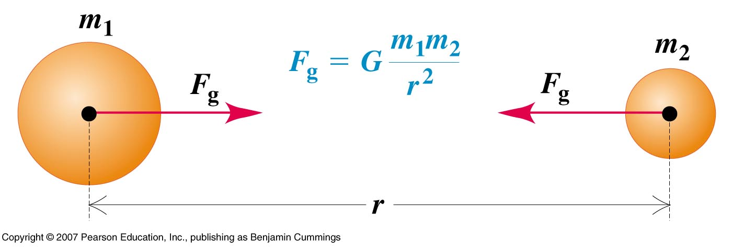
Newton’s Universal Law of Gravitation
Every particle in the universe attracts every other particle with a force along the line joining them. The force is directly proportional to the product of their masses and inversely proportional to the square of the distance between them.

Slide 3
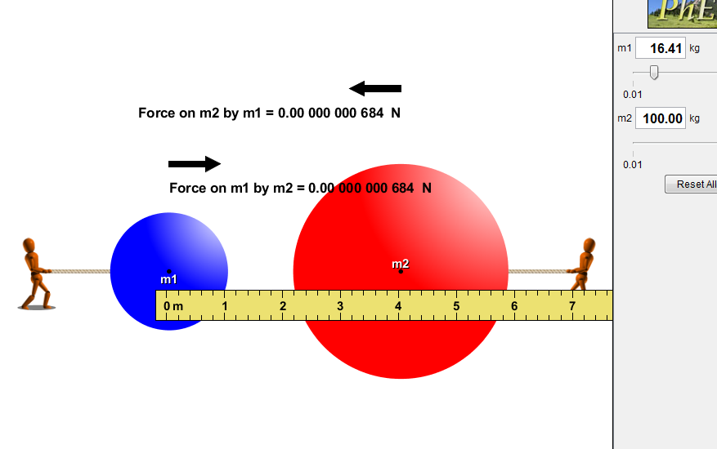
PhET gravity-force-lab

Slide 4
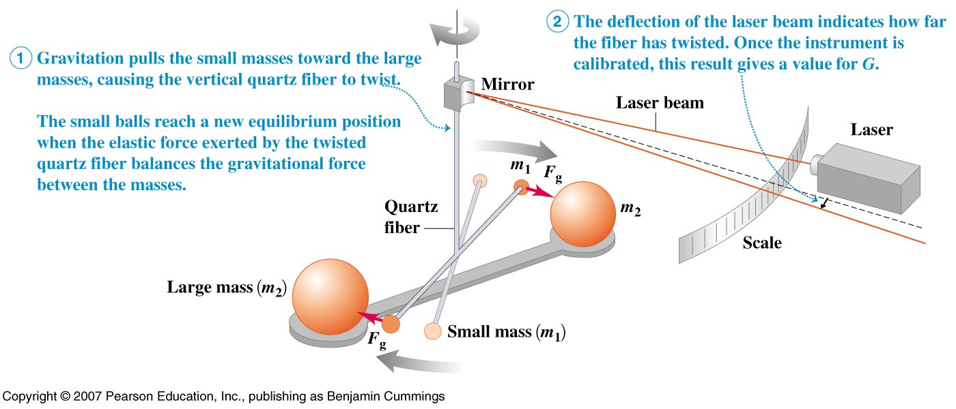
Cavendish Balance
The slight attraction of the masses causes a nearly imperceptible rotation of the string supporting the masses connected to the mirror.
Use of the laser allows a point many meters away to move through measurable distances as the angle allows the initial and final positions to diverge.

Slide 5
Acceleration of Gravity
near the Earth’s surface
m
R_{e}
M_{e}

Slide 6
m
Acceleration of Gravity
far above the Earth’s surface
h
R
R_{e}
M_{e}
What the value of g change much on top of Mt Everest (8850m)?

Slide 7
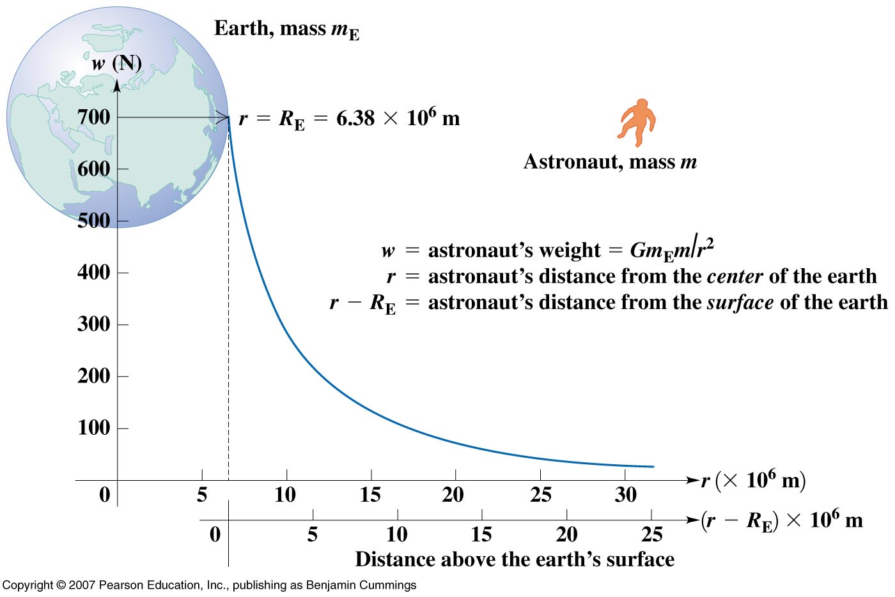
Gravitational force falls off quickly

Slide 8
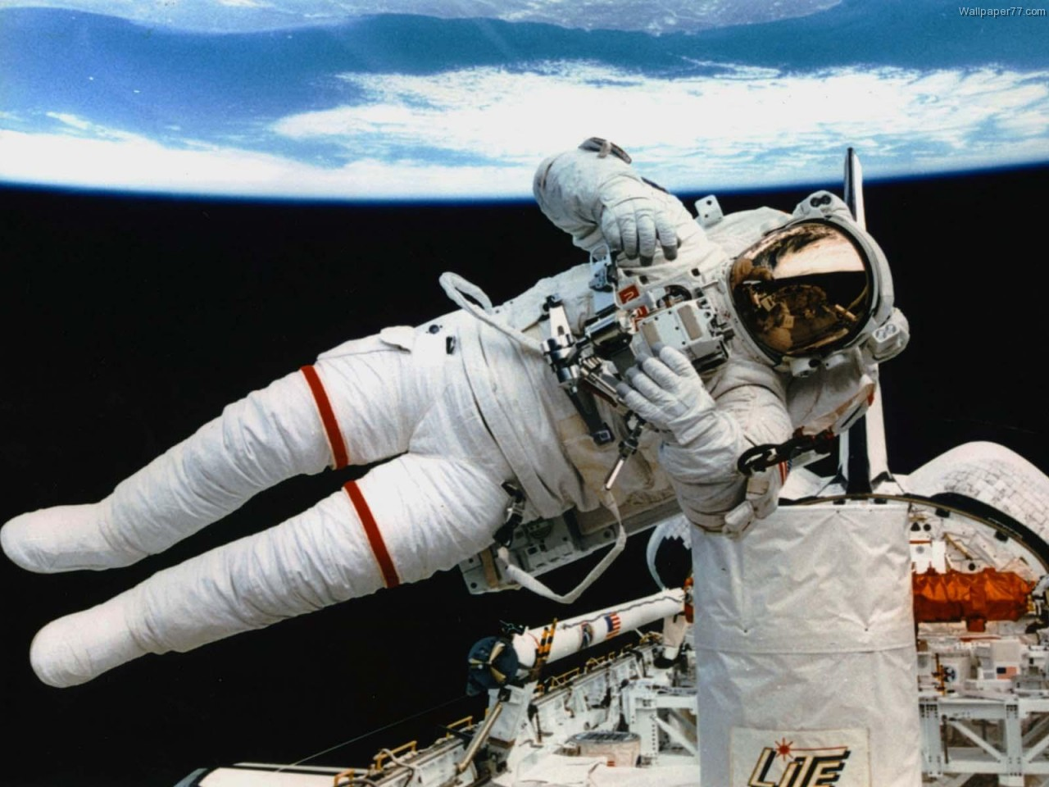

Slide 9
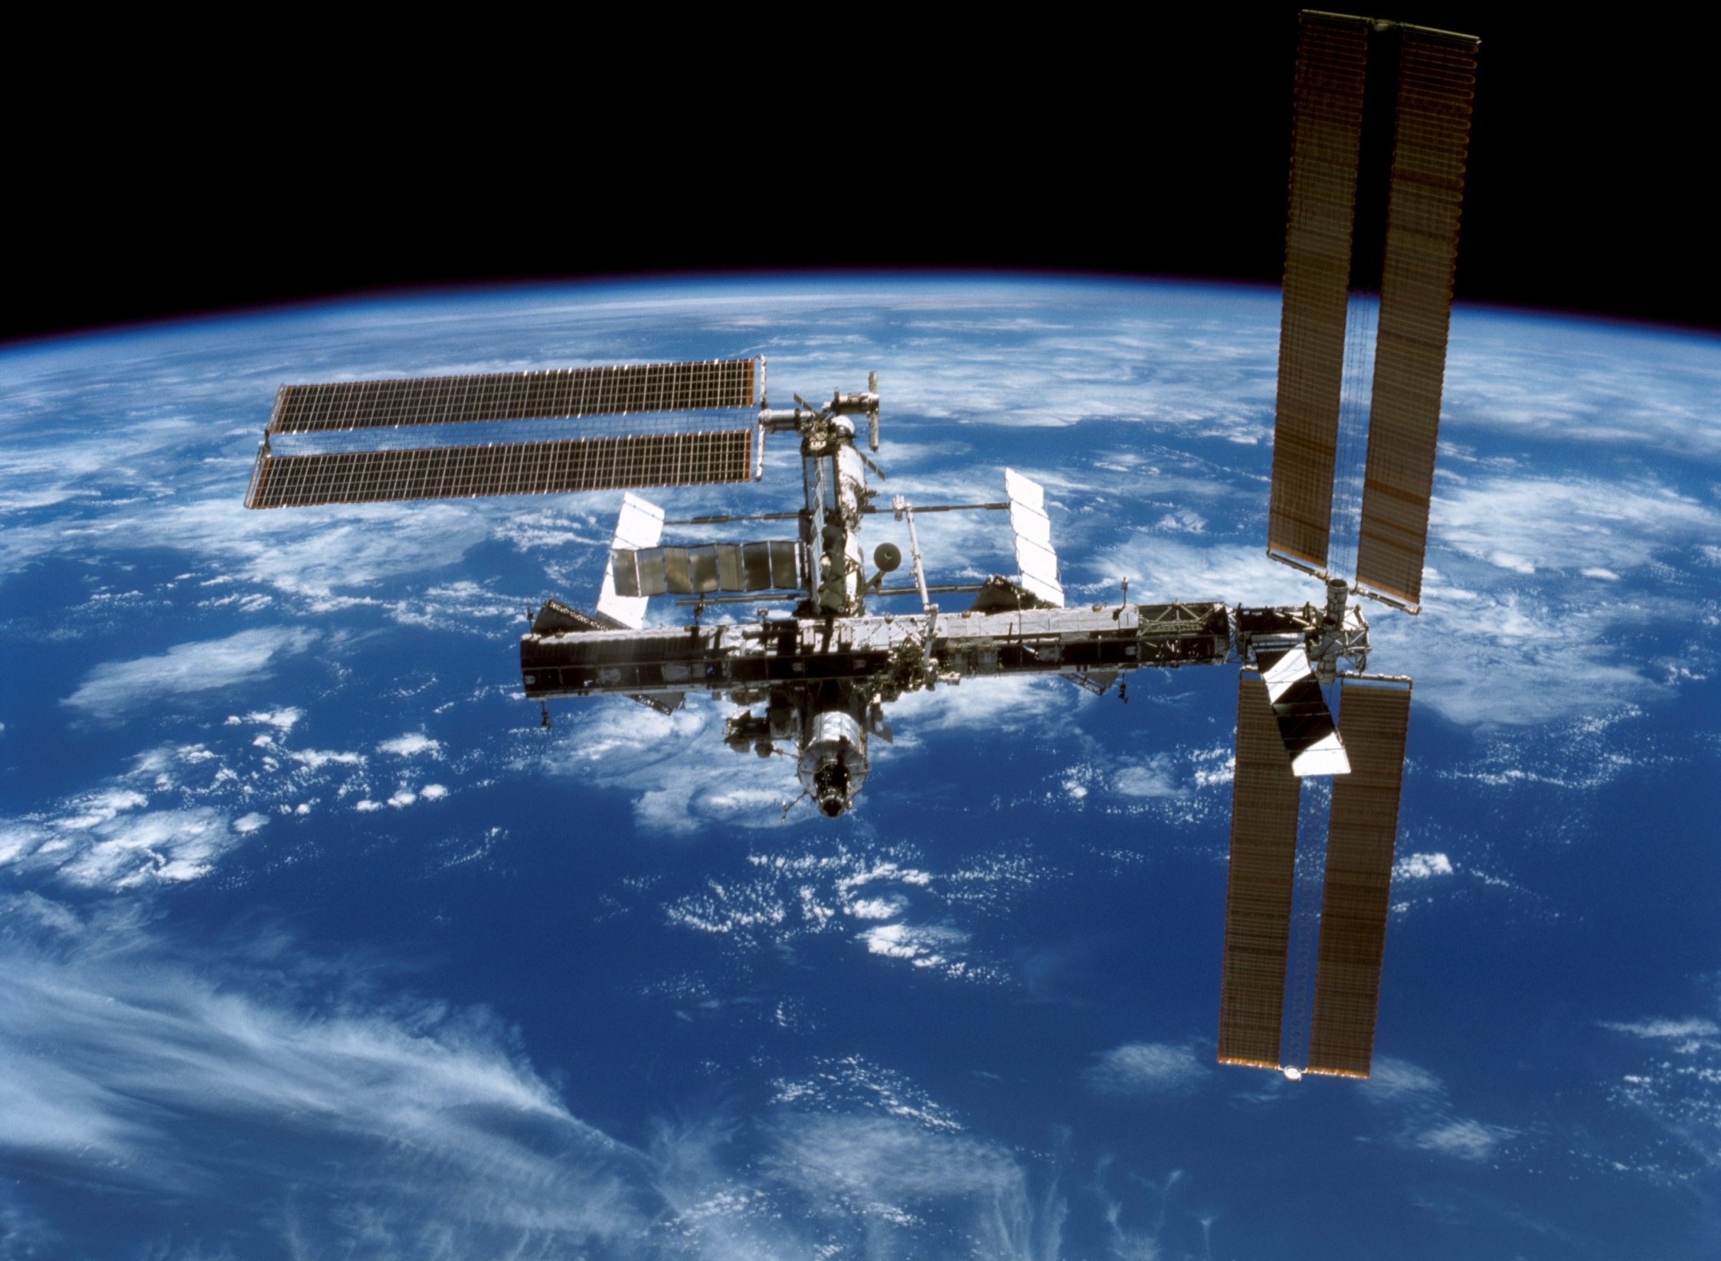

Slide 10
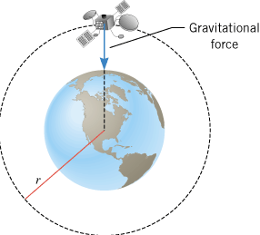
Satellites in Circular Orbits

Slide 11
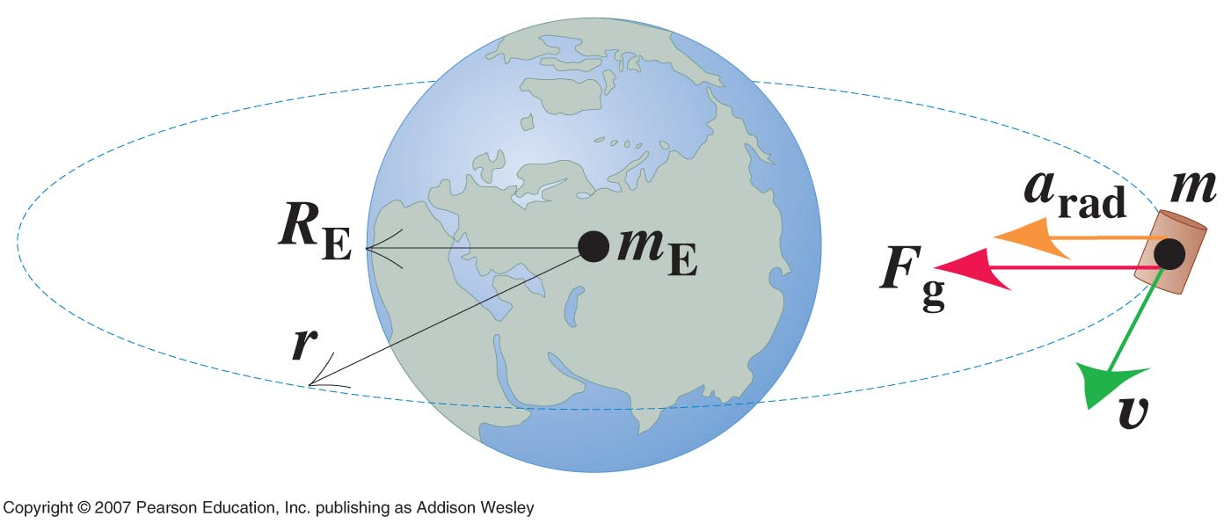

Slide 12
Speed of a Satellite
v
m
F
F
R
M

Slide 13
Satellites
mass m
speed v
Provided by gravity
r
M
what it’s orbiting
Speed of a Satellite
distance from center

Slide 14
v
Speed of a satellite
m
M_{E} = 5.98 x 10²⁴ kg
R = 7.40 x 10⁶ m

Slide 15
mass m
speed v
r
Now we can also derive a formula for the period of motion of a satellite:
M
and
So…
Period of motion of a satellite

Slide 16
Satellite Period
v
m
M_{E} = 5.98 x 10²⁴ kg
R = 7.40 x 10⁶ m

Slide 17
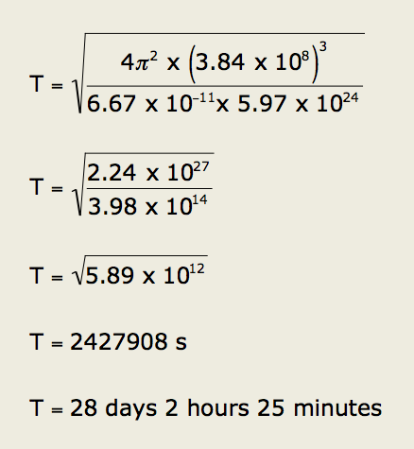
Calculate the time (days) for the Moon to orbit the Earth.
Radius of the Earth
= 6.38 x 10⁶ m
Mass of the Earth (M)
= 5.97 x 10²⁴ kg
Radius of the moon
= 1.74 x 10⁶ m
Mass of the moon (m)
= 7.35 x 10²² kg
Distance between the center of the Earth and the center of the Moon = 3.84 x 10⁸ m
G = 6.67 x 10⁻¹¹ m³ kg⁻¹ s⁻²

Slide 18
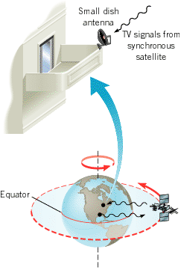
Geosynchronous Satellites
These satellites move around their orbits in a way that is synchronized with the rotation of the earth.
A synchronous satellite orbits the earth once per day on a circular path that lies in the plane of the equator.
Digital satellite system television uses such satellites as relay stations for TV signals

Slide 19

Geosynchronous Satellites – have a period of motion that matches the earth’s rotation, and therefore remain above the same spot on the earth.

Slide 20

Excellence Level question
(a) Sputnik was launched in 1957. It had an orbital speed of 7700 ms⁻¹. Calculate its height above the ground.
Height above ground = R – radius of Earth = 360 km
gives:
(b) Calculate its period and hence calculate the time in minutes it is above the horizon if it passes directly overhead. Scholarship Level question
38º/360º = t/91 min
θ
6300 km
6750 km
Θ = 19º
2Θ = 38º
θ
If no mountains or obstacles to block view: time above horizon ≈ 9.6 min

