Slide 1
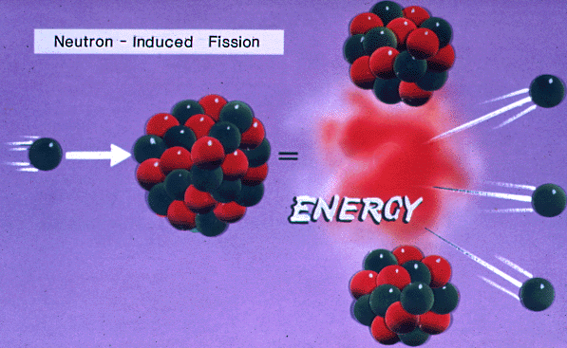
Ex: Nuclear Power (Fission)
Big nucleus
2 smaller nuclei
(less total mass, less energy)
Web Link: Fission

Slide 2
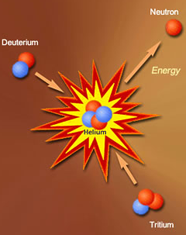
Ex: The Sun (Fusion)
Two small nuclei
Larger nucleus
(less total mass, less energy)
Web Link: Fusion

Slide 3
The sun loses over 4 billion kg per second due to fusion
(Don’t worry, it will last for another 5 billion years or so)

Slide 4
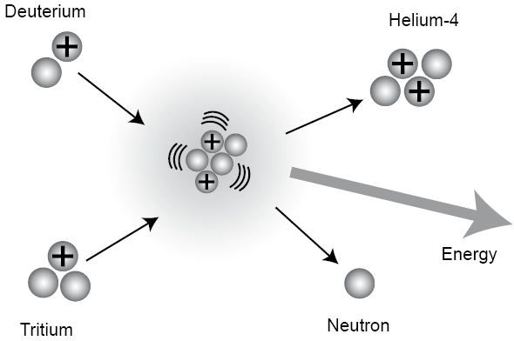
Fusion
The joining of two smaller nuclei to form a larger one.
This is the process that powers the sun
Example of a fusion reaction:
When smaller nuclei combine to form a larger one, mass is lost in the form of an energy release. WHY?
Fusing two smaller nuclei together results in a nucleus with a higher binding energy per nucleon (see curve) and less energy stored as mass compared to the smaller nuclei. This difference in mass between the smaller and larger nuclei results in a release of energy.
Fusion requires extreme temperature (eg millions of degrees) to occur, and has not practically and economically been used in power generation (yet...)
The high temperatures are needed to provide the energy for the nuclei to collide and overcome the net repulsion between the two positive nuclei.

Slide 5
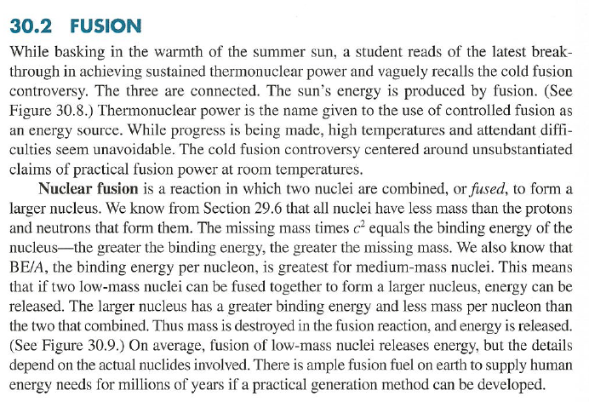

Slide 6
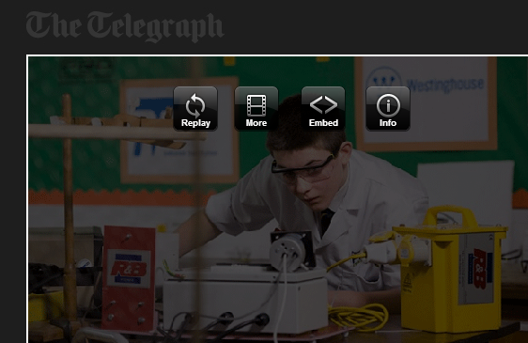
http://www.telegraph.co.uk/news/science/science-news/10679744/British-schoolboy-13-becomes-youngest-to-build-nuclear-fusion-reactor.html

Slide 7
Fusion Summary…
Mass-Energy is conserved.
Small nuclei have some of their mass-energy as binding energy. The rest of their mass-energy is in the nucleons, as mass.
If two smaller nuclei fuse into a nucleus that has more binding energy per nucleon, the nucleons of the new nucleus have less mass-energy in them.
The difference in mass-energy between the reactants and the product is given off as energy, usually as E_{k} of the products and/or radiation.
Need high temperatures so that particles have high kinetic energies to overcome repulsive electrostatic forces in order to fuse.

Slide 9
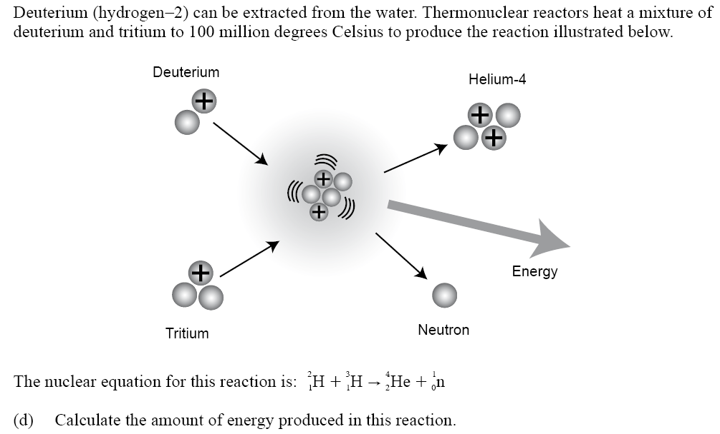
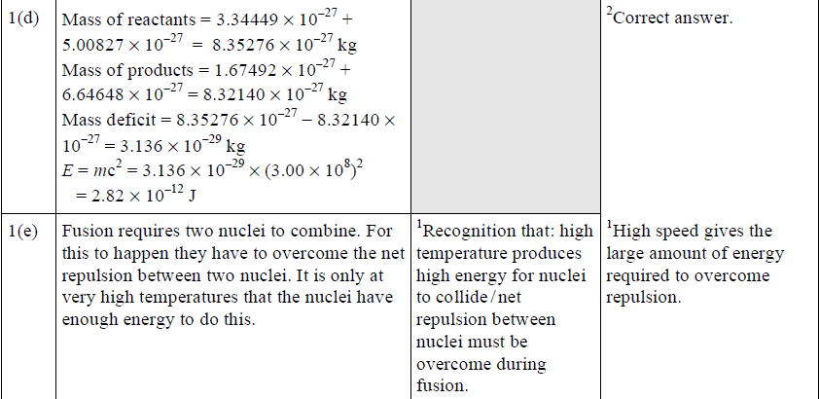
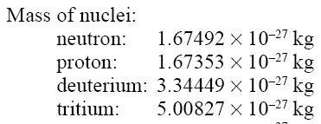

Slide 10
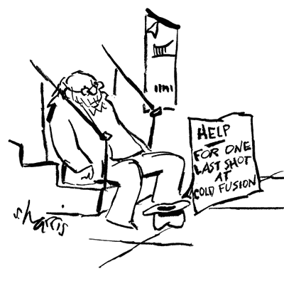

Slide 11
