Slide 1
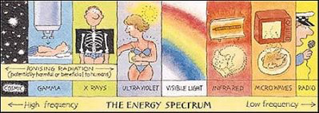
What is Radiation?
Energy emitted from a source is generally referred to as radiation.
Can be either wave or particles…
EM Wave radiation

Slide 2
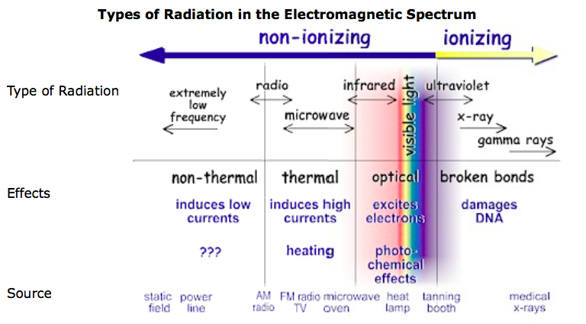
Wave radiation:
Radiation that has enough energy to move atoms in a molecule around or cause them to vibrate, but not enough to remove electrons, is referred to as "non-ionizing radiation."
Examples of this kind of radiation are sound waves, visible light, and microwaves.
“Ionizing radiation” has enough energy to remove tightly bound electrons from atoms, thus creating ions. We take advantage of its properties to generate electric power, to kill cancer cells etc

Slide 3
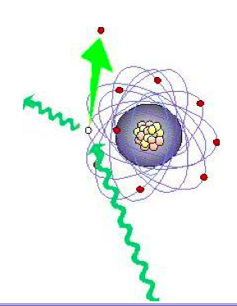

Slide 4
What is Particle Ionizing Radiation?
Is where moving particles (α,β), with enough energy, interaction with an atom and can remove / knock off tightly bound electrons from the orbit of an atom, causing the atom to become charged or ionized.
α particle
Electron
The alpha particle is slowed down as it hits atoms…

Slide 5
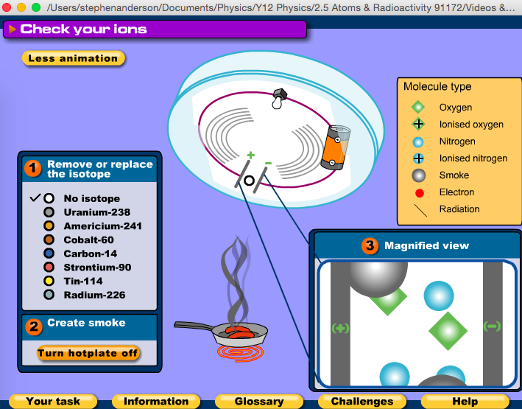
How does this work?

Slide 6
α can travel 30 mm in air

