Slide 1
PROPERTIES
Alpha, Beta and Gamma all have different properties:
They travel different distances
Different strengths
They are stopped by different
materials.

Slide 2
Radioactivity
Copy the diagram below and complete the arrows for each type. Then use the words at the bottom to construct an explanation in your own words.
α
β
γ
Alpha, Beta, Gamma, Thick lead, Paper, Aluminium

Slide 3
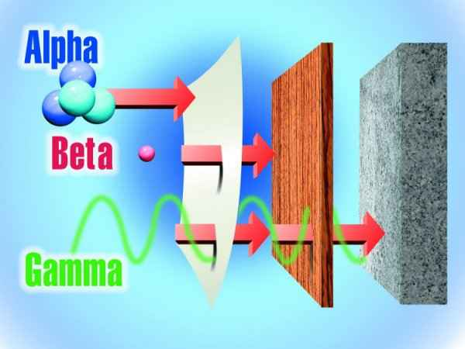

Slide 4
Type of radiation | Symbol | What is it made from? | How far will it travel in air? | What stops it?
Alpha | α | Helium nucleus. 2 protons & 2 neutrons
Beta | β | High speed electron
Gamma | γ | High energy wave
Type of radiation | Symbol | What is it made from? | How far will it travel in air? | What stops it?
Alpha | α | Helium nucleus. 2 protons & 2 neutrons | cm | Air /paper
Beta | β | High speed electron | m | Aluminium
Gamma | γ | High energy wave | Lots of m | Thick lead & concrete

Slide 5
Identifying Alpha/Beta/Gamma Penetration
Alpha – stopped by paper, or a few cm of air.
Beta- penetrates paper and several m of air – stopped by a few mm of aluminium
Gamma penetrates aluminium – stopped by several m of concrete or several cm of lead
Paper a few mm A few cm
Aluminium Lead

Slide 6
Identify the radiation!!
Smoke detectors are safe because the plastic case easily stops the _______ radiation that is used.
________ is dangerous because it easily penterates skin but is stopped (absorbed) by the body.
Nuclear power stations are built in thick concrete to block _______ radiation.
The thickness of card can be measured using ______ radiation because some is absorbed but some passes through.
________ radiation can be used to see inside metal parts as it is able to penetrate, similar to x-rays
ALPHA
BETA
GAMMA
BETA
GAMMA

