Slide 1
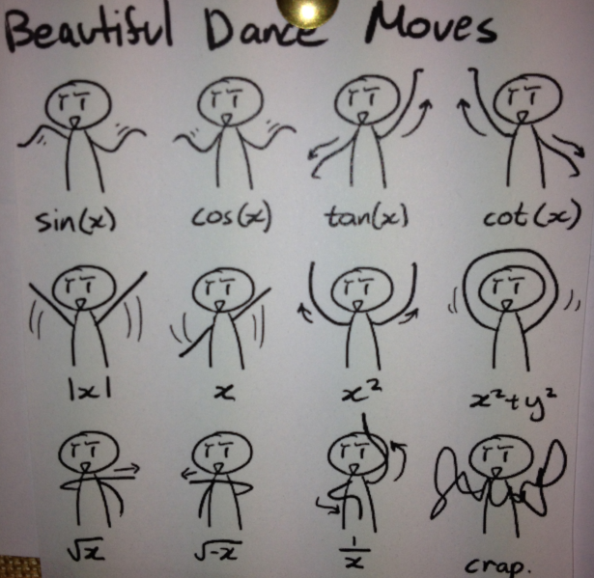

Slide 2
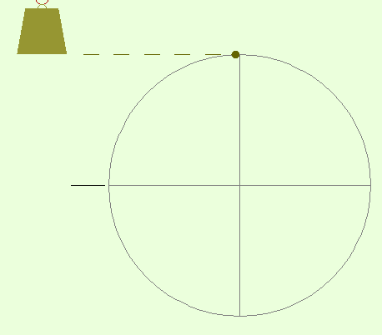
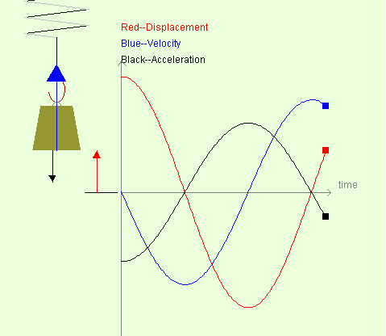
http://www.ngsir.netfirms.com/

Slide 3
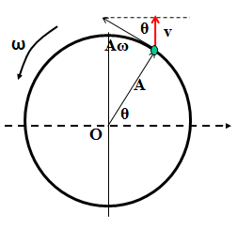
Velocity
Velocity of object can be obtained from the Reference circle velocity
UCM: Velocity is tangential to the curve, size from v = rω
Starting equations

Slide 4
Acceleration
ω
Acceleration can be determined from a reference circle…
Aω²
a
θ
Note from UCM:
Acceleration is directed towards
the center
Size can be found from
a= v²/r with v = rω
a_{max} = Aω²
O

Slide 5
UCM ~ SHM
connection
v_{max}= Aω
θ
v
ω
y
Aω²
a
v = rω
v_{max} = Aω
A
a= v²/r with v = rω
a_{max} = Aω²
θ
O
a α –y
a = - ω² A

Slide 6
Do lots (x2)
Ncea paper problems…

