Slide 1
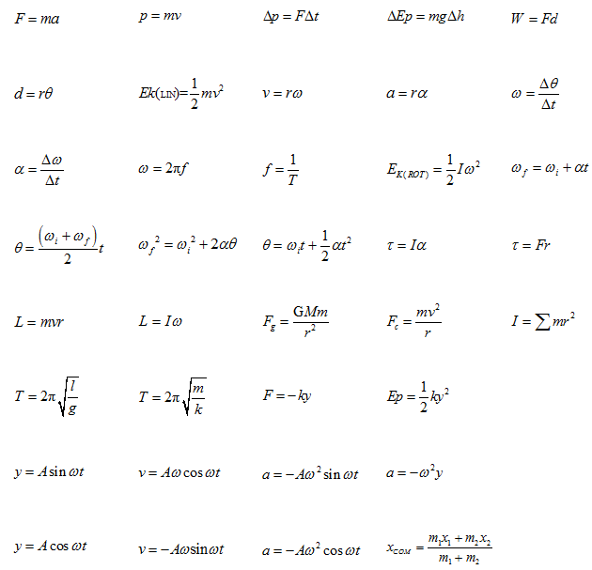
Rotational Motion

Slide 2
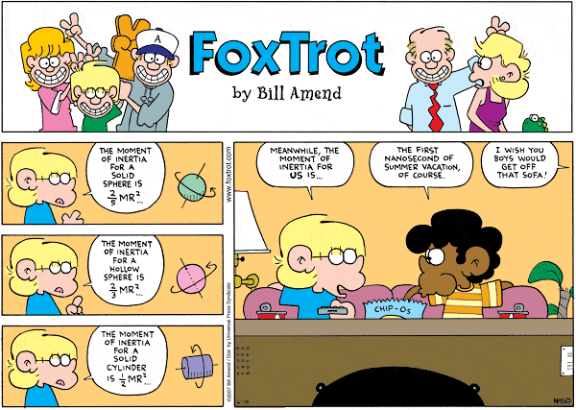

Slide 3
Ex: A meter stick
45 cm
Find the Torque exerted on the meter stick due to the 50 g mass that is suspended from it.

Slide 4
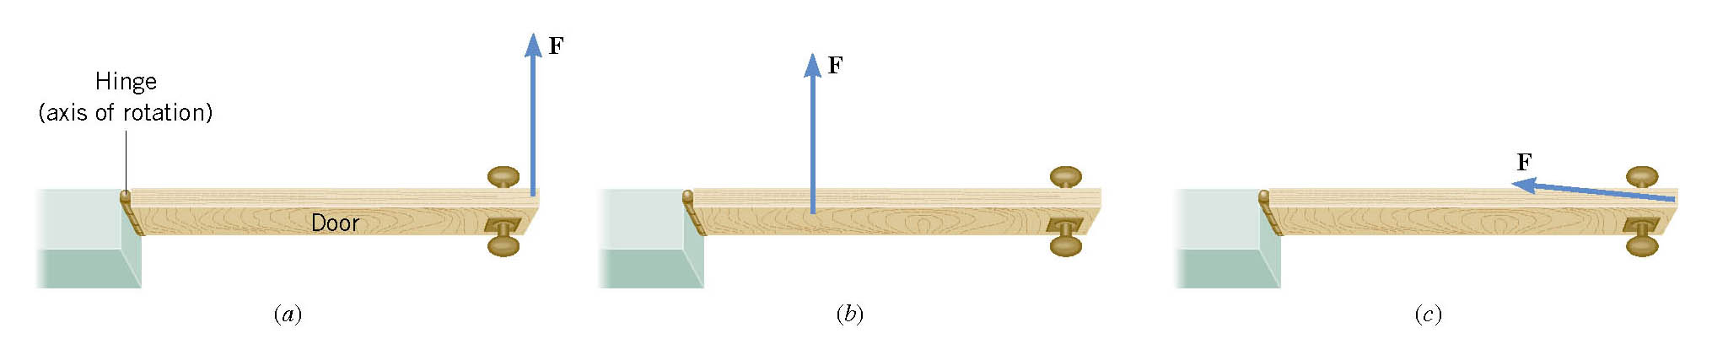
Ex: The torque on a door
ℓ
τ = F ℓ

Slide 5
Remember Newton’s 2nd Law?
For linear motion : ∑F=ma
a
m
F
For rotational motion : ∑τ=Iα
I
α
τ

Slide 6
Torque and Angular acceleration:
Relation between τ and α is analogous to relation between F and a
linear Inertia
Rotational Inertia
r
F
m
a

Slide 7
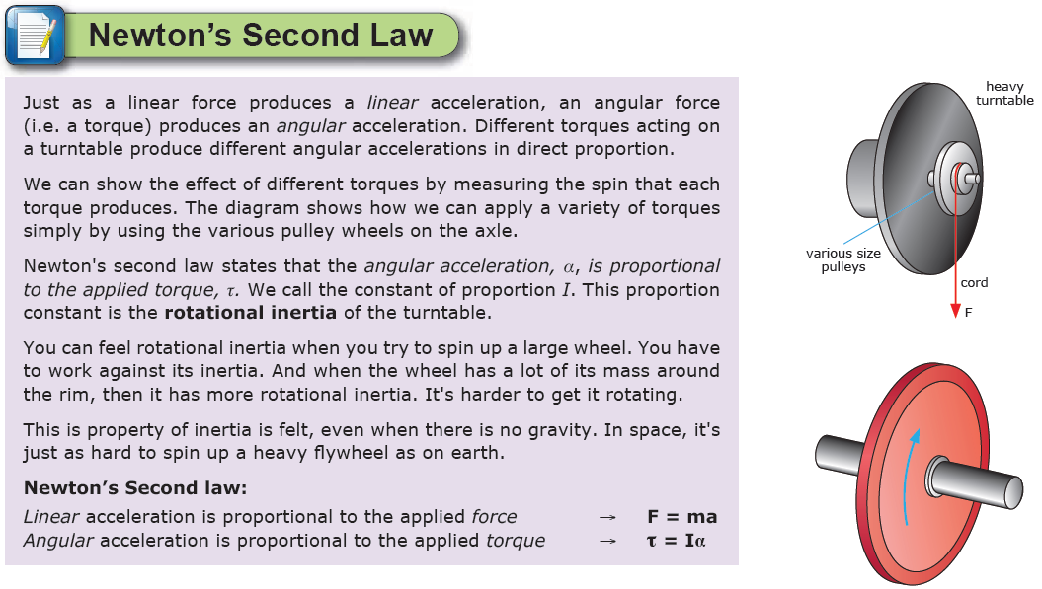
Rotational Inertia: I (kgm²)
Gives a measure of how ‘reluctant’ an object is to changing its angular speed. High I means harder to accelerate, ie more τ required.

Slide 8
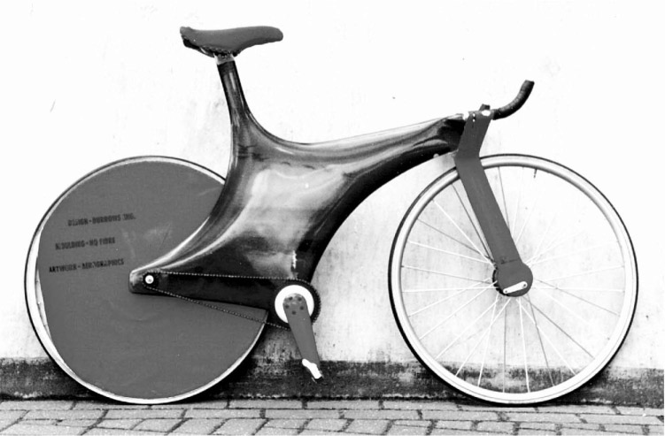
The rotational inertia of an object depends on:
Its mass
Distribution of its mass relative to the center
(If an object’s mass is distributed further from the axis of rotation, its inertia will be larger…)

Slide 9
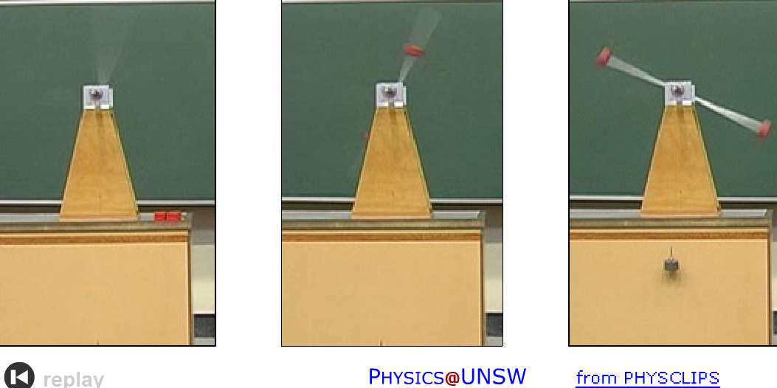
See rotation_masses

Slide 10
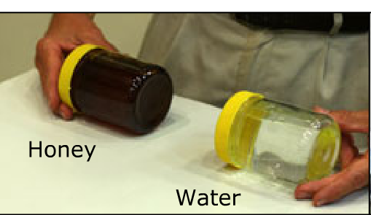
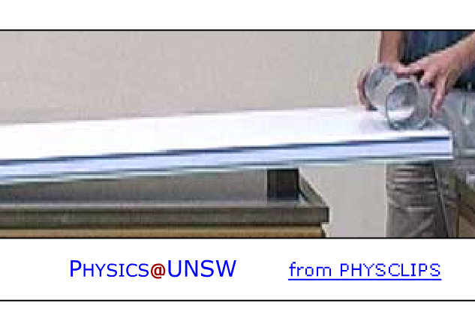

Slide 11
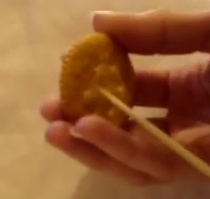
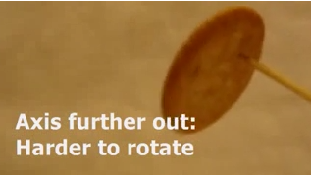
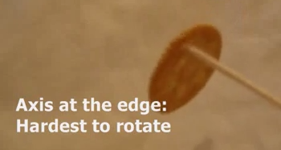
Biscuit inertia

Slide 12
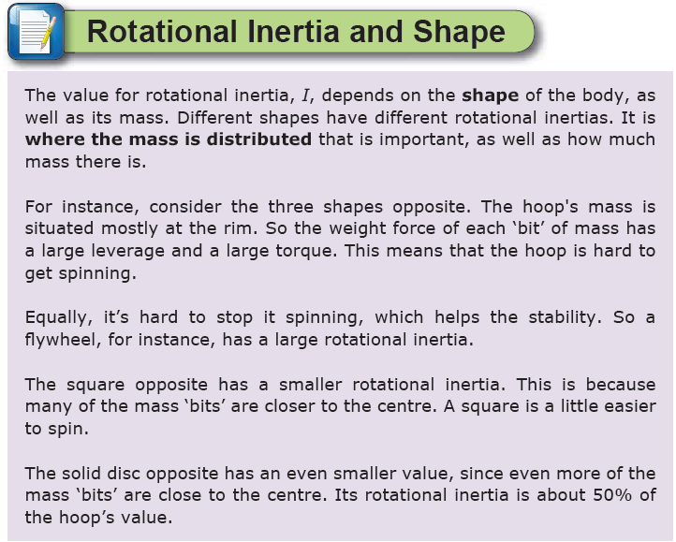
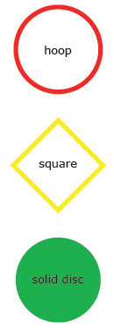

Slide 13


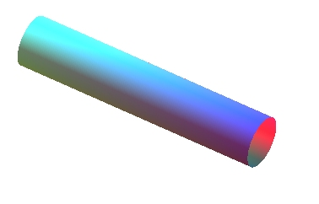
Recall: m = mass = resistance to translation
Now: I = rotational inertia = resistance to rotation
Also called “moment of inertia”
How to calculate rotational inertia (I):
For discrete particles: I = ∑mr²
For solid continuous objects: see table
(results from calculus)

Slide 14
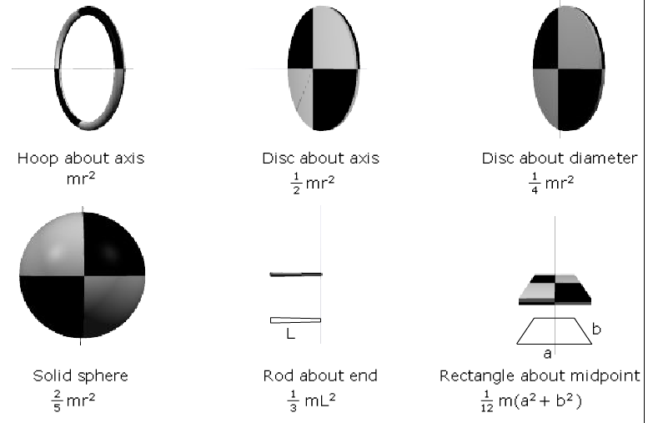
See rotation_spin_multi

Slide 15
Notes on Rotational Inertia
In general: the more mass far from the axis the harder it is to rotate the larger the rotational inertia value.
Moments of inertia add.
Example: Find the rotational inertia for a Solid Sphere and a Solid Cylinder rotating together
m = 2.00 kg
r = 15.0 cm
1
m = 3.00 kg
r = 18.0 cm
2

Slide 16
What is the mass of a basketball whose diameter is 30 cm and whose moment of inertia is 0.0075 kg·m2?
R = 0.15 m
I = 0.0075 kg·m²
M = ?
Use I = (2/3) MR² [hollow sphere]
M = (3/2)I / R²
M = 0.5 kg
How much torque is needed to angularly accelerate a 3 kg·m² fan blade at 12 rad/s²?
I = 3kg·m² α = 12 rad/s²
τ = Iα
τ = 36 N·m

Slide 17
Ex: Combining rotation and translation in the ultimate example
Pulley:
a disk
m = ?
r = 0.20 m
T
a=2.0 m/s²
2.0 kg
20°
Treat the spindle as a solid cylinder.
a) Find the tension in the string.
b) Find the torque on the pulley.
c) Find the angular acceleration of the pulley.
d) Find the rotational inertia of the pulley.
e) Find the mass of the pulley.

Slide 18
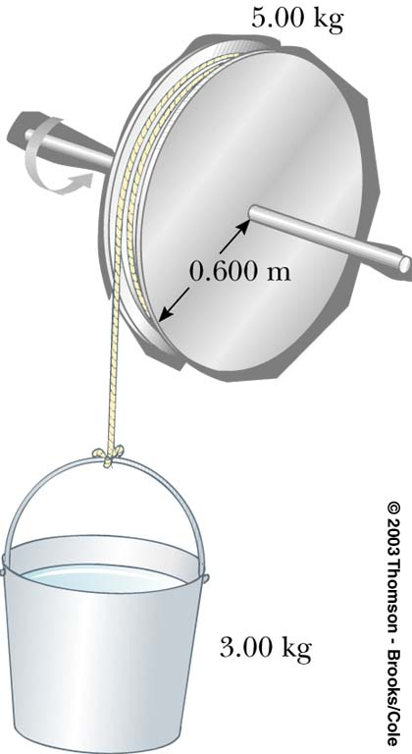
Example
Treat the spindle as a solid cylinder.
a) What is the moment of Inertia of the spindle?
b) If the tension in the rope is 10 N, what is the angular acceleration of the wheel?
c) What is the acceleration of the bucket?
d) What is the mass M, of the bucket?
m =
M

Slide 19
Solution
a) What is the moment of Inertia of the spindle?
Given: m = 5 kg, r = 0.6 m
M
= 0.9 kgm²

Slide 20
Solution
b) If the tension in the rope is 10 N, what is α?
Given: I = 0.9 kg m², T = 10 N, r = 0.6 m
c) What is the acceleration of the bucket?
Given: r=0.6 m, α = 6.67 rad/s
m

Slide 21
Solution
d) What is the mass of the bucket?
Given: T = 10 N, a = 4 m/s²
M

Slide 22
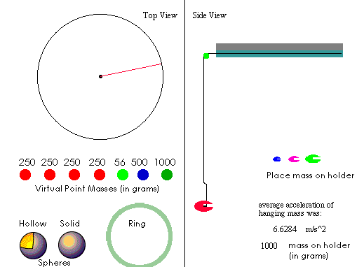

Virtual investigation
r = 0.25m
I _{turn table} = 0.03 kgm²
Confirm the turntable inertia is 0.03 kgm²

Slide 23
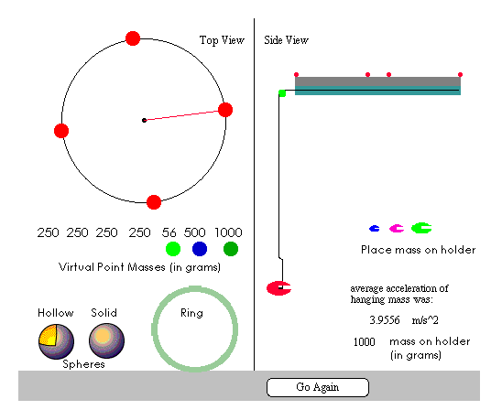
Virtual investigation
r = 0.25m
I _{turn table} = 0.03 kgm²
Place four 0.25 kg masses equally apart on the edge, what is their combined effect on the turntables inertia?

Slide 24
Scholarship level
What would happen to the length of a day if everybody migrated to the tropics. [1]
The people would be further from the earth’s axis, so the rotational inertia is greater. Angular momentum is conserved because there are no outside torques, so if I is greater, angular velocity will be less, so the time to make one rotation will be greater so the day will get longer. (slightly)

Slide 25
You are given two metal balls with the same mass and radius. One is hollow, the other is solid. How could you determine which is which? [1]
Roll them both down a ramp. The hollow ball has greater rotational inertia. The same torque acts on both so the solid ball has greater angular acceleration and will reach the end first.

Slide 26
Zoe is playing with a yoyo.
(i) Explain what causes its angular acceleration as it falls.
(ii) Write a Newton’s 2nd law equation for the translation and rotation.
(iii) Derive an equation for the linear acceleration of the yoyo in terms of:
Its rotational inertia
Its mass
Its axle radius & “g”

Slide 27
Gravity produces a force through the center the tension force is caused by the string and is upwards at a tangent to the axle. This produces a torque.

