Slide 1
Y12 Review… Simple circuit…
Voltage Drops Around a Series Circuit
b
c
2 Ω
1 Ω
2 A
3 Ω
+ −
a
d
12 V

Slide 2
Introducing Mr Coulomb
I = 2 A
12 V
1 Ω
2 Ω
3 Ω
d
a
b
c
d
b
c
2 Ω
1 Ω
2 A
3 Ω
+ −
a
d
12 V

Slide 3
Voltage Drops
I = 2 A
12 V
1 Ω
2 Ω
3 Ω
d
a
b
c
d
12
10
8
V6
4
2
0

Slide 4
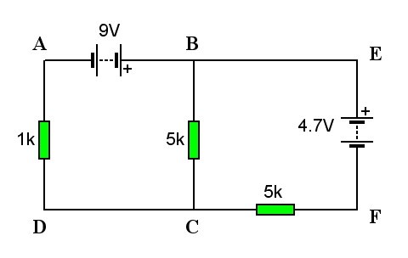
Simple Circuits
No problem!
In a simple circuit like the one shown here, it is a simple task to identify the direction of current flow and calculate the voltages in various places using ohm’s law. . .
V_{1k} = I x R
= 1.5 x 10⁻³ x 1000 = 1.5V
V_{5k} = I x R
= 1.5 x 10⁻³ x 5000 = 7.5V
Current, I _{total} = V _{total} ÷ R _{total}
= 9 ÷ (1000 + 5000)
= 1.5 x 10⁻³ A (1.5mA)

Slide 5
BUT!. . . In a branched circuit with more than one source of Voltage (battery), the task becomes much more complicated. . .
Kirchhoff’s laws give us a method to achieve this

Slide 6
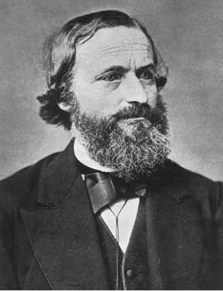
Kirchhoff’s laws
Kirchoff’s laws
Kirchhoff’s Rules
Kirchoff’s laws
Gustav Robert Kirchhoff
1824 - 1887

Slide 7
Kirchoff’s Laws / Rule
1) Point / Junction Rule
Current into a point equals current out
I₁
I₃
I₁ + I₂ =
I₂
I₃

Slide 8
2) Loop Rule
Total voltage around a loop is zero
Voltage gained
Voltage lost
The potential differences around any closed loop sum to zero.
This rule assume Conservation of energy

Slide 9
Example
Voltage gained
Voltage lost

Slide 10
We could go the other way around
Voltage gained
Voltage lost

Slide 11
I
Voltage decrease
I
Voltage gain
Voltage gain
Voltage decrease

Slide 12
Why a clockwise direction?
I
R₁
R₂
Cells are all 2.0 V
R₁ = 3Ω R₂ = 1Ω
Find the current
First write a loop equation.

Slide 13
Year 12 Merit problem
Determine the current in each branch using Kirchhoff rules
I₂
R₁ = 5 Ω
R₂ = 15 Ω
R₃ = 10 Ω
I₃
+
R₁
V= 12 V
R₃
-
R₂
I₁
This loop (clockwise):
+V - I₂R₁ - I₂R₂ = 0

Slide 14
Year 13 Merit problem
A student sets up the following circuit to investigate Kirchhoff's laws.
1.00 V
R
A
B
3.00 Ω
0.150 A
F
C
3.00 Ω
I₁
D
E
2.00 V
Apply Kirchhoff's voltage law around loop CDEF to calculate I₁
Use Kirchhoff's law of currents to calculate the current along the branch AB.
c) Use Kirchhoff's law of voltages to show that the resistance of resistor R is 3.96 Ω

Slide 15
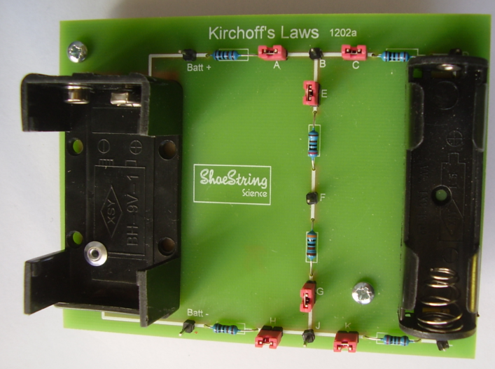

Slide 16
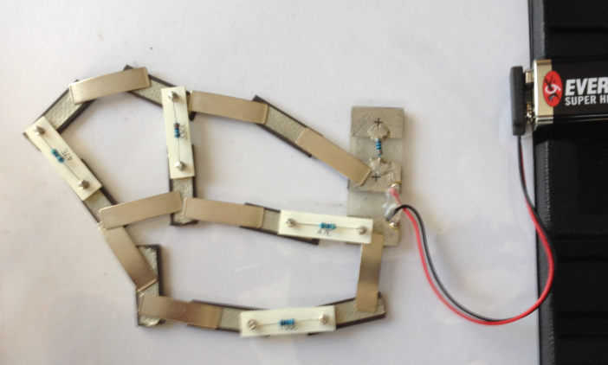

Slide 17
Kirchhoff's Laws
State Kirchhoff's 1st law
State Kirchhoff's 2nd law
Which law deals with the conservation of charge?
Which law deals with the conservation of energy?
Gustav Robert Kirchhoff
1824 - 1887

Slide 18
Kirchhoff's Laws
State Kirchhoff's 1st law
The sum of the currents coming into a junction is equal to the sum leaving the junction.
Σ(currents entering the junction) = Σ(currents leaving the junction)
State Kirchhoff's 2nd law
The sum of all the potential differences around a complete loop is equal to zero.
Σ(potential rises) + Σ(potential drops) = 0
Rearranging:
Σ(potential rises) = Σ(potential drops)
Gustav Robert Kirchhoff
1824 - 1887
Which law deals with the conservation of charge?
Kirchhoff's 1st law
Which law deals with the conservation of energy?
Kirchhoff's 2nd law

