Slide 1
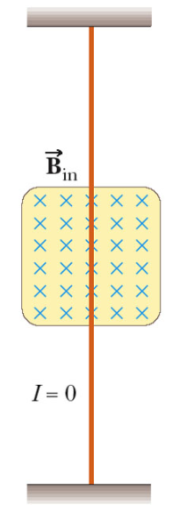
Magnetic Force on a Current-Carrying Conductor
Notes:
Graphics from Ted Vittitoe

Slide 2
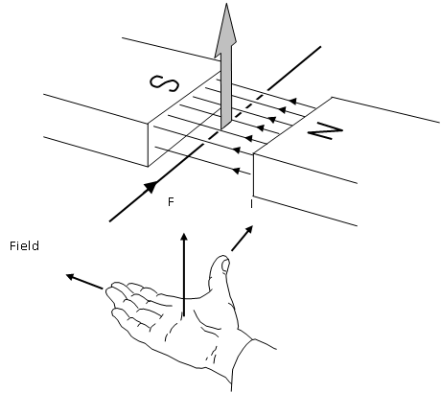

Slide 3
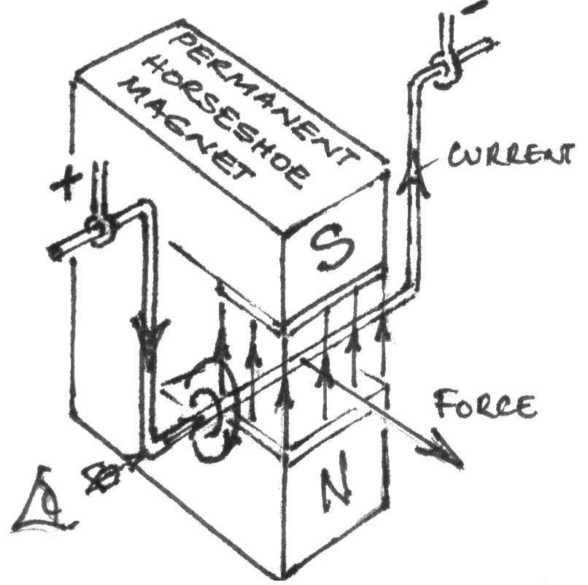

Slide 4
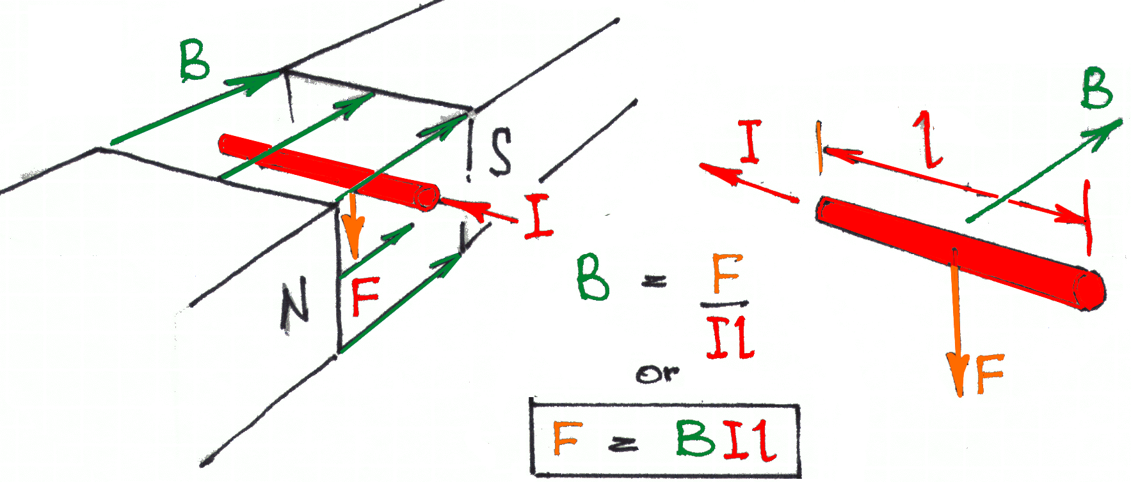
Force on an Electric Current in a Magnetic Field
A current-carrying wire in a B-field wire experience a Force

Slide 5
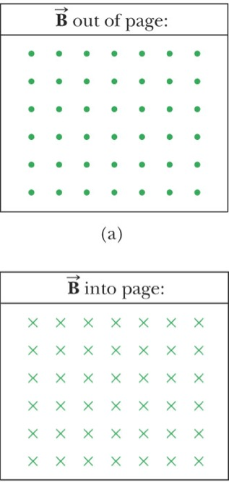
dot is coming out of the page
cross is going into the page

Slide 6
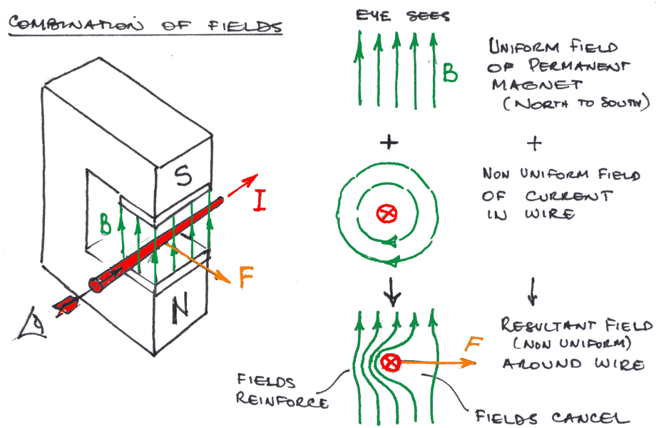
A Force occurs due to the combination of magnetic fields

Slide 7
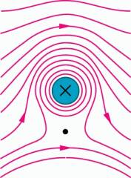
×
+
=
neutral point

Slide 8
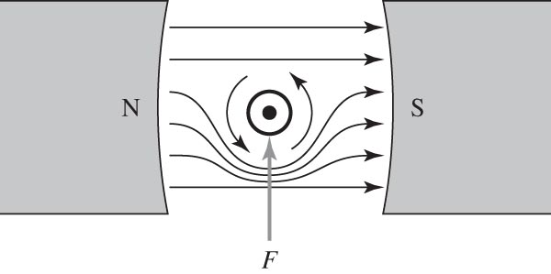

Slide 9
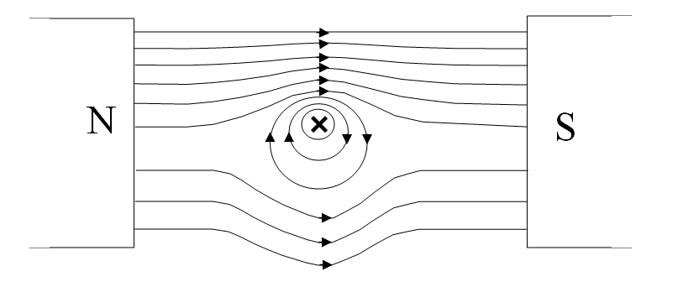

Slide 10
Find the magnitude and direction of the current that must flow through the red bar in order to remove the tension from the springs.
x
x
x
x
x
B = .440 T
x
x
x
x
x
L = 62.0 cm
x
x
x
x
x
m = 13.0 g
x
x
x
x
x
x
x
L

Slide 11
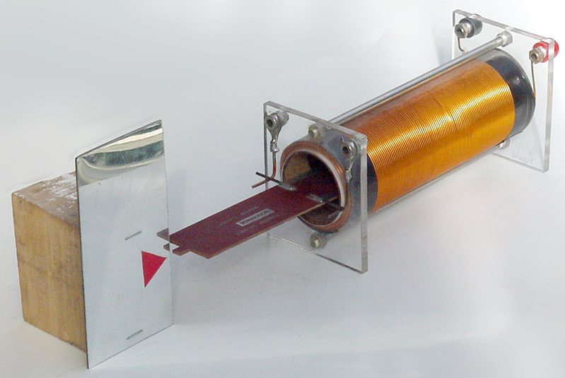

Slide 12
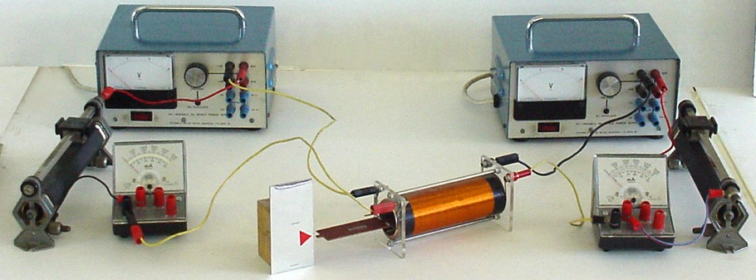

Slide 13
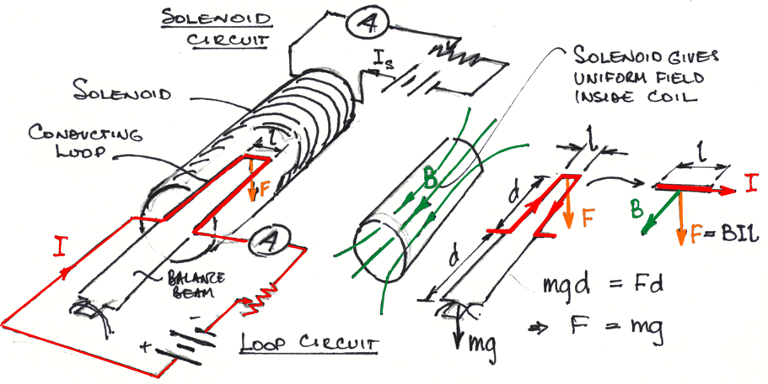
Current Balance practical

Slide 14
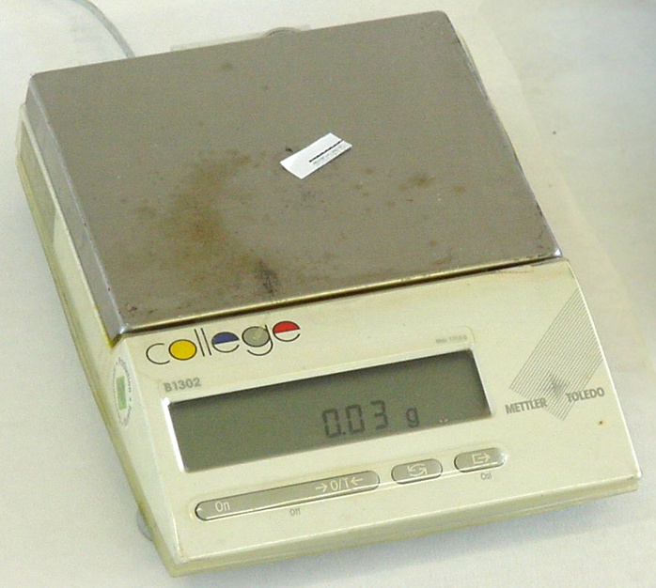

Slide 15
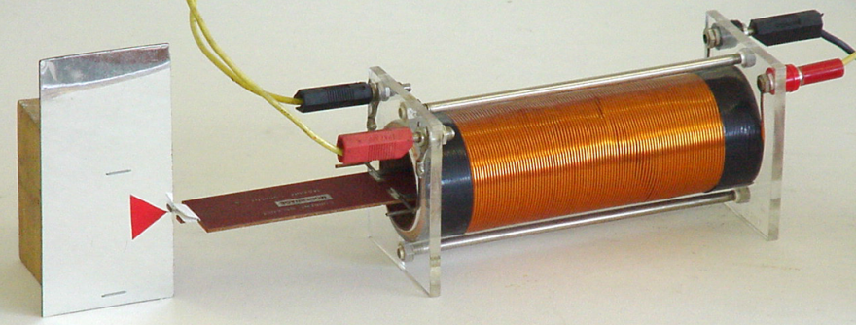

Slide 16
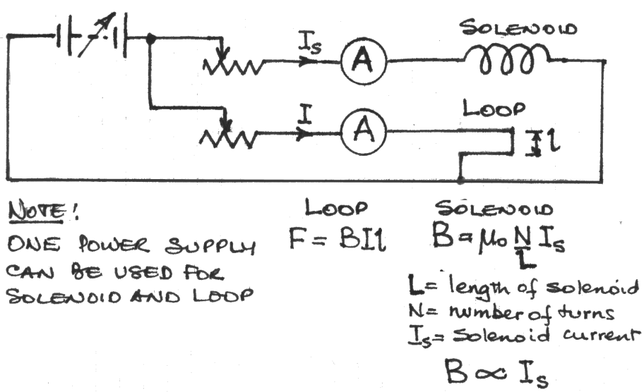
http://hyperphysics.phy-astr.gsu.edu/hbase/HFrame.html

