Slide 1
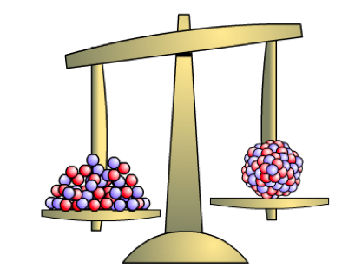
Binding energy analysis all quite theoretical…
Nuclear reactions all quite real…

Slide 2
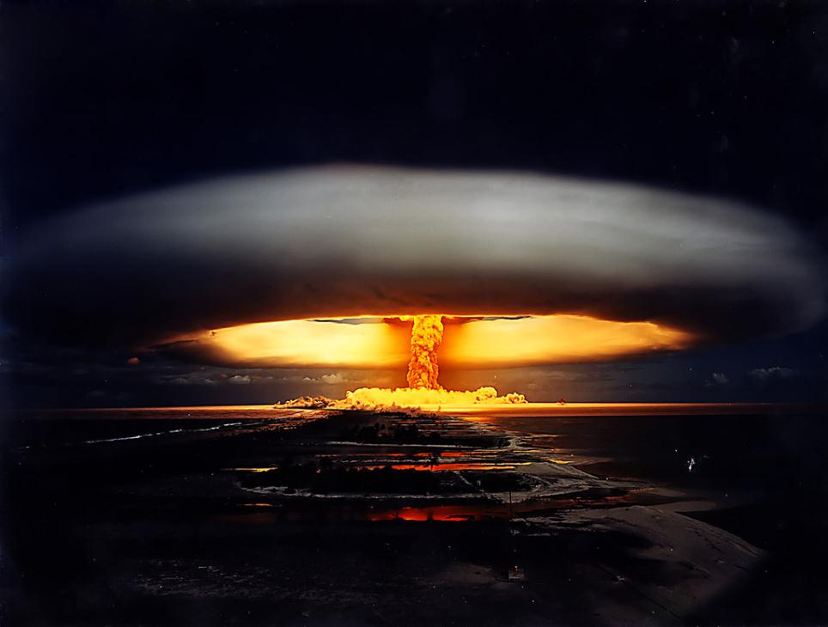
Fangataufa atoll French Polynesia

Slide 4
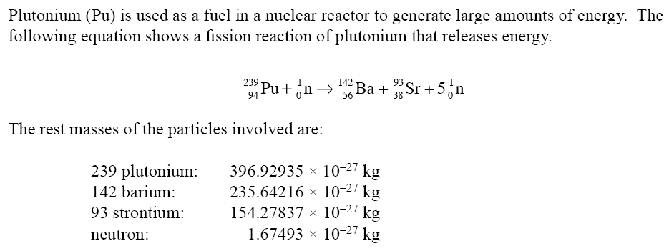
NCEA 2005 qu #3

Slide 5
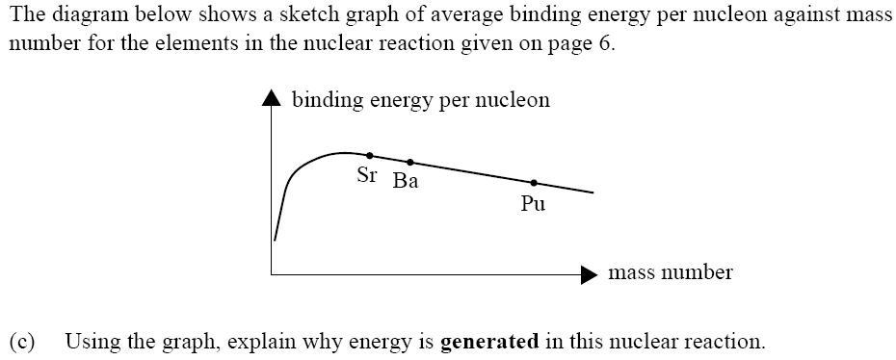

Slide 6
B.E per nucleon
(MeV)
⁵⁶Fe
8
²³⁸U
⁴He
Squashing lighter atoms to form heavier ones (fusion) releases energy
6
Splitting very heavy nuclei (fission) releases energy
⁷Li
4
2
Fusion
Fission
Mass number
50
100
150
200
Heavy nuclei increase their stability by nuclear fission
Light nuclei increase their stability by nuclear fusion
It comes down to stability…

Slide 7
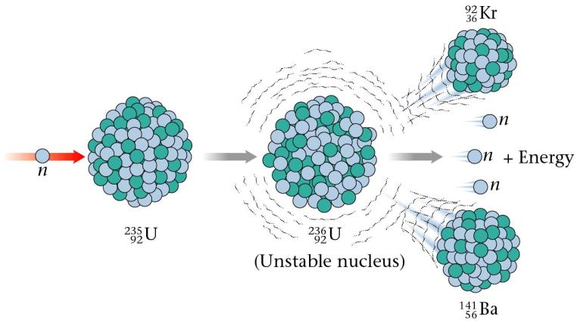
Nuclear Fission
Breaking large / heavy unstable nuclei into smaller ones.
Lots of possible combinations of fragments from one initial nucleus
Eg:
When a large nucleus is split into smaller fragments or products, mass is lost in the form of an energy release.
WHY is this?

Slide 8
B.E per nucleon
(MeV)
⁴He
⁵⁶Fe
⁵⁶Fe ~ 9 MeV BE / nucleon
²³⁵U ~ 7 MeV BE / nucleon
8
²³⁵U
6
Fission Reactions
⁷Li
4
Why is mass lost & energy released?
²H
2
50
100
150
200
Mass number
Large reactant nucleus (eg U-235) have a ‘lower’ binding energy per nucleon compared to Iron.
Why are the ‘daughter’ products more stable? – they have less protons and smaller in size / radius.
When a larger nucleus splits into smaller product nuclei they have a higher binding energy per nucleon and so less energy stored as mass.
This difference in mass between the reactant and products results in a release of energy (i.e. product’s may gain kinetic energy, and or radiation is emitted).

Slide 9
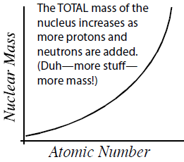

Slide 10
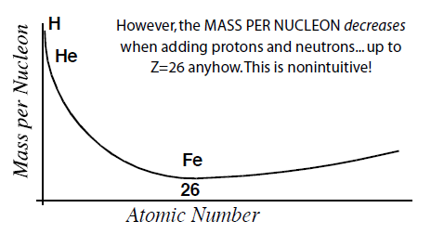
The higher the binding energy per nucleon means lower mass per nucleon.
Lower mass per nucleon means lower overall energy (due to mass - energy equivalence).

Slide 11
Fission Summary…
Mass-Energy is conserved!
A large nucleus has some of its mass-energy as binding energy. The rest (most) of its mass-energy is in the nucleons, as mass.
When the large nucleus splits into smaller product nuclei, they will have more binding energy per nucleon and less mass-energy then the original large nucleus.
The difference in mass-energy between the large nucleus and product nuclei is given off as energy, usually as E_{k} of the products and/or radiation.

Slide 12
NCEA 2005 qu #3

Slide 14
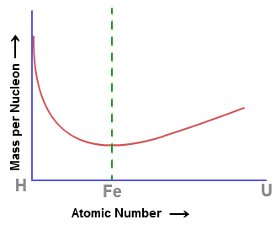
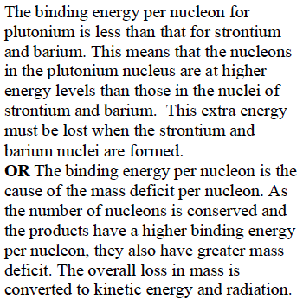

Slide 15
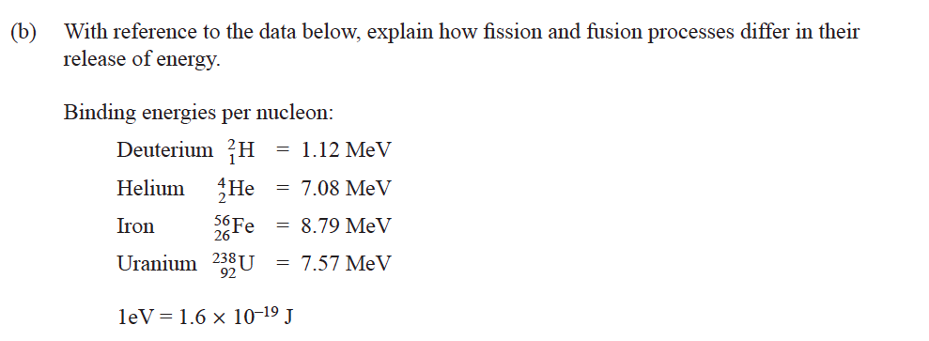

Slide 17
