Slide 1
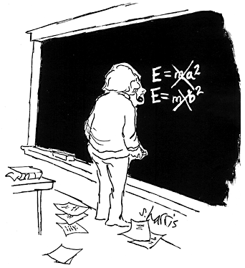
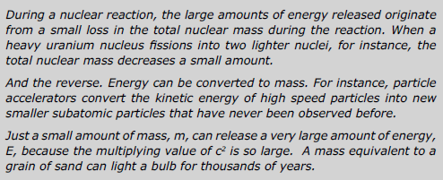
Mass is a form of energy related by
In nuclear reactions
mass – energy is conserved
Also referred to as
mass – energy equivalence

Slide 2
Alpha decay Reaction
Polonium 212 decays into lead 208 by emitting an alpha particle. The rest masses of these three are:
3.51986 x 10⁻²⁵ kg 3.45324 x 10⁻²⁵ kg 6.646 x 10⁻²⁷ kg
Reactants
Products
(a) Calculate the difference between the initial rest mass and the total final rest mass.
1.6 x 10⁻²⁹ kg
(b) This mass decrease appears in the form of Kinetic energy. Calculate the kinetic energy released in this reaction.
1.44 x 10⁻¹² J
(c) Assume the Alpha particle, being much less massive than the lead nucleus, gets almost all this energy. Calculate its speed just after the decay.
2. 1x 10⁷ ms⁻¹

Slide 3
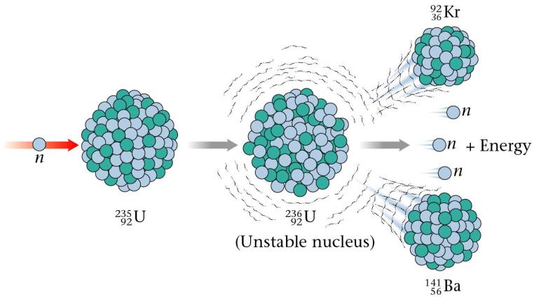
Nuclear Fission
Breaking large / heavy unstable nuclei into smaller ones.
Lots of possible combinations of fragments from one initial nucleus
Eg:
On average 2.5 neutrons released
When a large nucleus is split into smaller fragments or products, mass is lost in the form of an energy release. (WHY? – Y13)

Slide 4
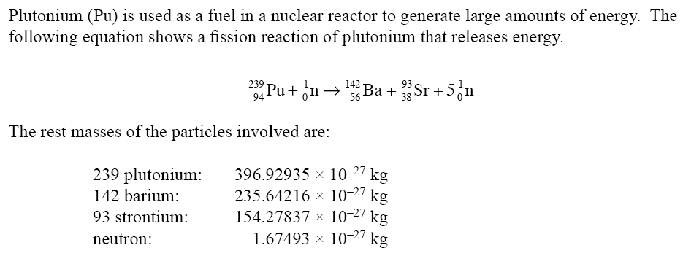
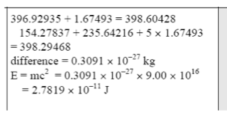
NCEA 2005 qu #3 Old Y13!
This assumes the neutron has minimal kinetic energy!
Joules

Slide 5
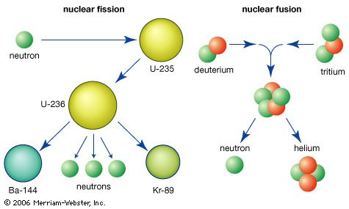

Slide 6
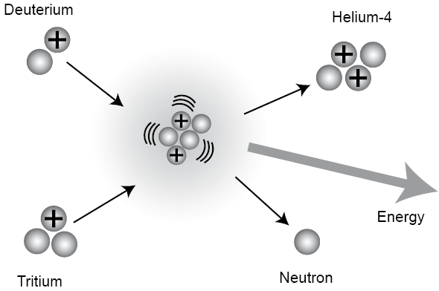
Fusion
The joining of two smaller nuclei to form a larger one.
This is the process that powers the sun
Example of a fusion reaction:
When smaller nuclei combine to form a larger one, mass is lost in the form of an energy release. (WHY? – Y13)

