Slide 1
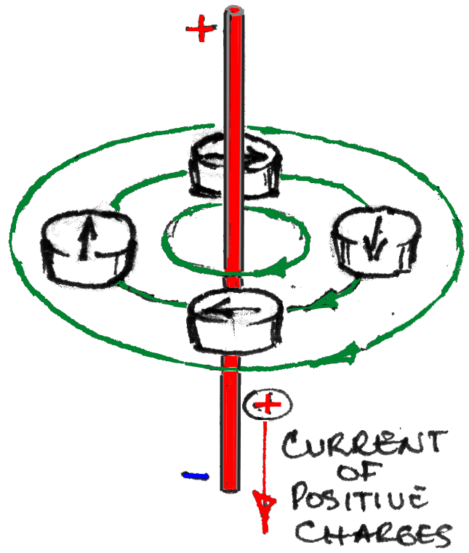

Slide 2
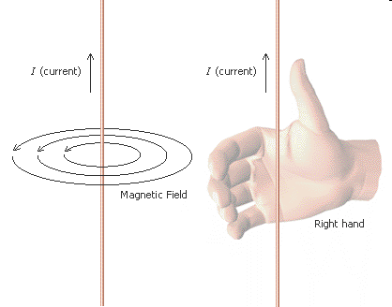

Slide 3
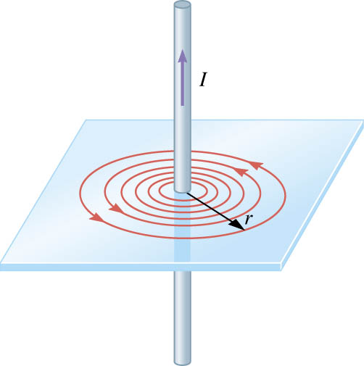
Calculating the magnetic field strength around a current carrying wire:
B= Magnetic field strength [T]
I = Current [A]
d = Distance [m]
d
Right hand screw rule
fingers ~ field
Thumb ~ current

Slide 4
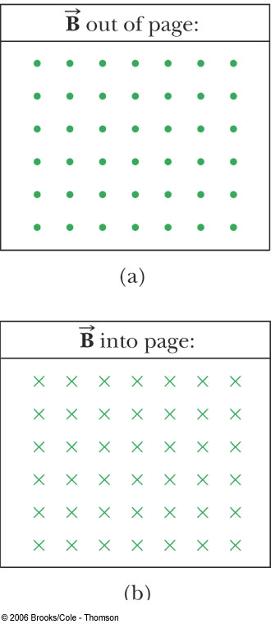
Since it’s difficult to draw in 3-D, adopt the following symbols:
dot is coming out of the page
cross is going into the page

Slide 5
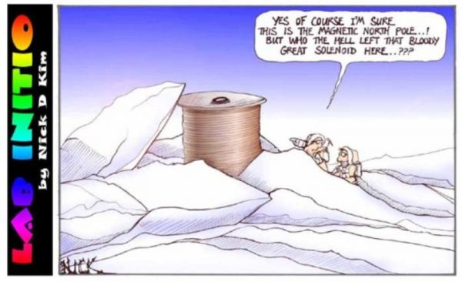

Slide 6
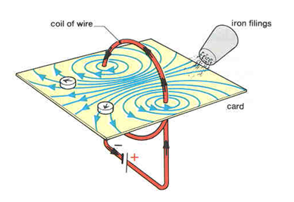

Slide 7
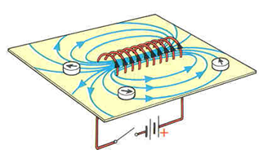

Slide 8
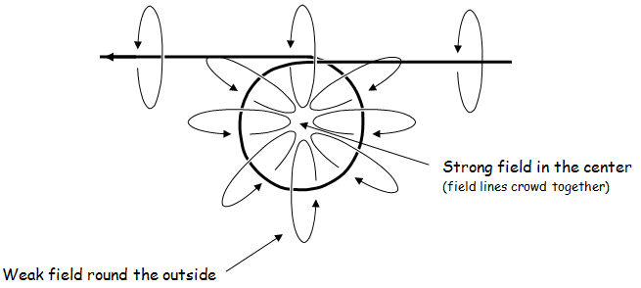
Bend a straight current carrying wire into a loop and investigate the field

Slide 9
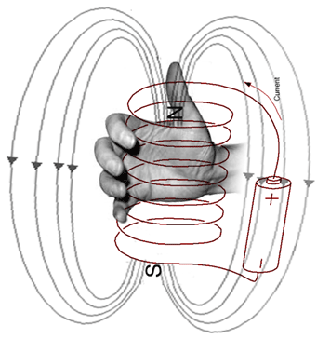
Right Hand Rule (solenoid)
If you wrap your fingers around the coil in the direction of the current, your thumb points north.
Thumb points to N
Fingers curl with I

Slide 10
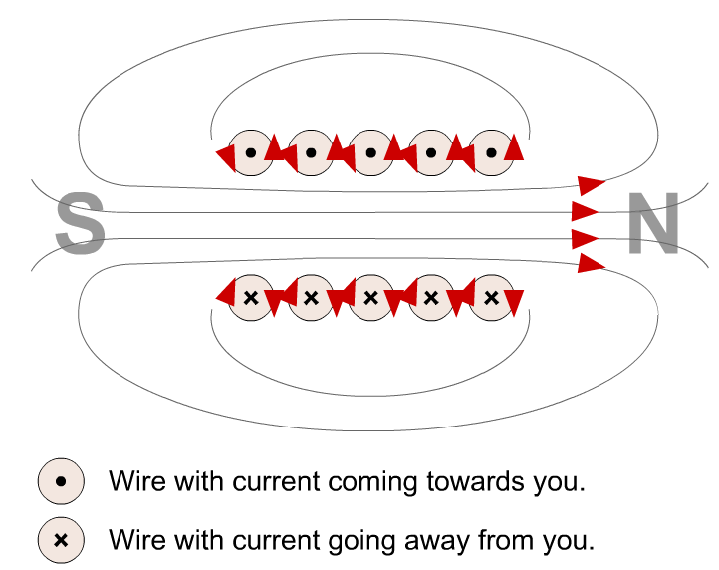
See Solenoid applet

Slide 11
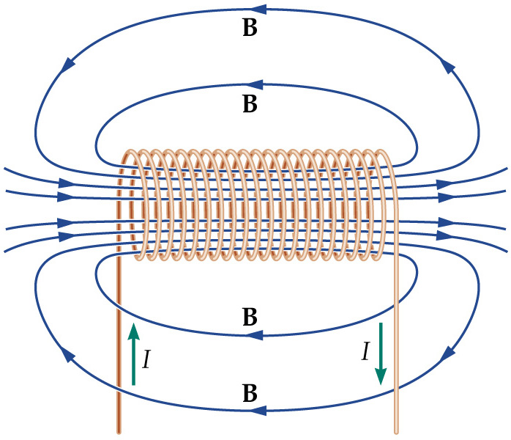
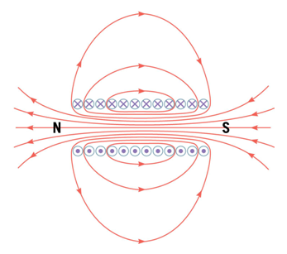
A solenoid is a long coil of wire. If it is tightly wrapped, the magnetic field in its interior is almost uniform:
B α nI

Slide 12
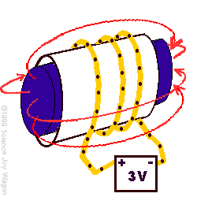
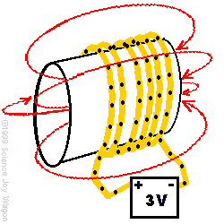
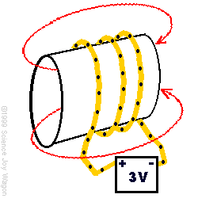
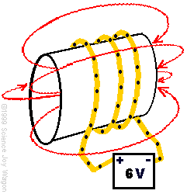
This solenoid has a soft iron core which is more permeable and as a result, creates a much stronger magnetic field. As a result, it is a much stronger electromagnet.
the number of turns of wire around a solenoid is directly related to the magnetic field strength of the solenoid.
the magnetic field strength of a solenoid is directly related to the current through the coil.

Slide 13
a stronger field round a solenoid
the field can be made stronger by:
using an iron core
using more turns of wire
increasing the current

Slide 14
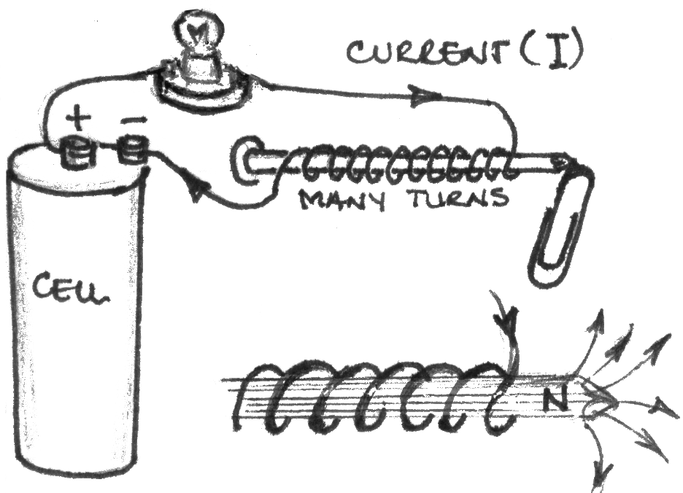

Slide 15
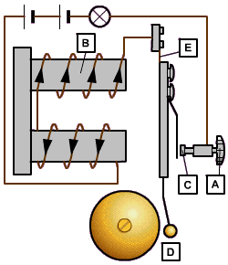
The electric bell below uses an electromagnet to make it work.
When the bell push, A, is closed, electric current can flow through the coil and the electromagnet, B, attracts the hammer, D.
The hammer is connected to a contact, C, and as the hammer moves it breaks the circuit and the electricity stops flowing. The springy metal, E, pulls the hammer back into its position.
This image and text came from
www.bbc.co.uk/.../ physics/electromag2_5.shtml

