Slide 1
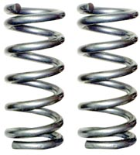
Springs
Web Link: Introduction to Springs
the force required to stretch it
the change in its length
∝
F
= k x
k=the spring constant

Slide 2
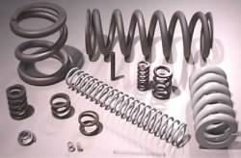
Does a larger k value mean that a spring is
    easier to stretch, or
    harder to stretch?

Slide 3
Ex:
If a spring stretches by 20 cm when you pull horizontally on it with a force of 2 N, what is its spring constant?
2 N
How far does it stretch if you suspend a 2 N weight from it instead?
2 N

Slide 4
The same equation works for compression:
F = k x
the force required to compress it
the decrease in its length
∝
* For an ideal spring, the spring constant is the same for stretching and compressing.

Slide 5
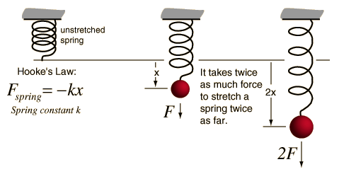
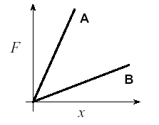
A spring is an example of an elastic object - when stretched; it exerts a restoring force which bring it back to its original length.
This restoring force is proportional to the amount of stretch, as described by Hooke's Law:
When the spring is stationary
F_{spring} = mg
The spring constant k is equal to the slope of a Force (mg) vs. Stretch graph.
Stiffer springs yield graphs with greater gradients e.g. k_{A} > k_{B}

Slide 6
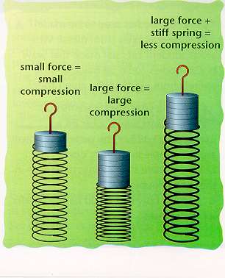
When a force is exerted on a spring it will either compress (push the spring together) or stretch the spring if the weight is hung on it.

Slide 7
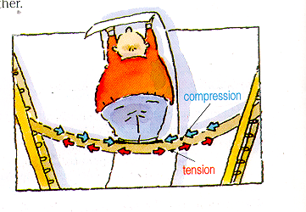
Some objects like bridges will also behave like springs. When a weight is placed on a bridge parts will be stretched and under tension, other parts will be be squashed together or compressed

Slide 8
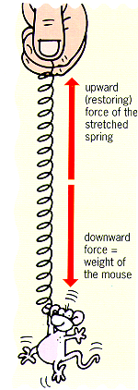
When the weight and the upward, restoring force are equal the spring is said to be in equilibrium

Slide 9
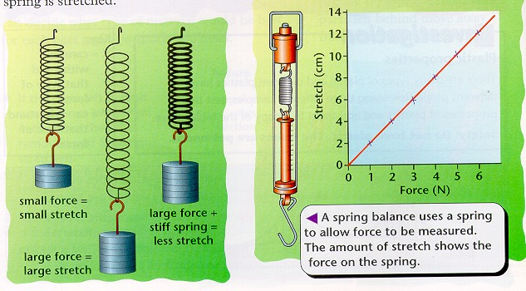
Because springs stretch proportionally we can use them as a spring balance to measure a force.

Slide 10
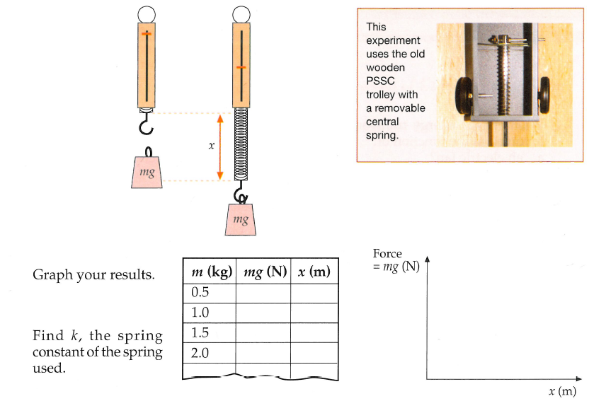
Determine the spring constant (k) for a single spring by finding the gradient from a graph of F (N) vs x (m)
  Use masses 50g to 250g, let g = 10ms⁻²
Repeat for:
  2 springs in series
  2 springs in parallel
Record all data in a labelled table
Plot all your data onto one graph (3 lines!)
Compare your experimental values for k_{series} and k_{parallel} with the theoretical formula given below
Hookes Law lab

Slide 11
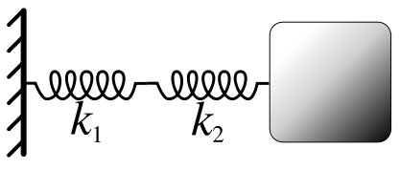
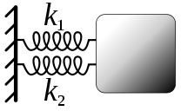
See Wikipedia for theory!

Slide 12
Spring Potential Energy, E_{p}
x
F = kx
F
kx
Work
0
x

Slide 13
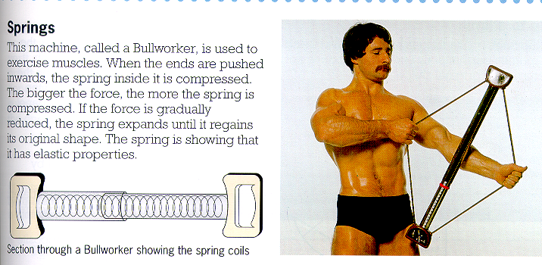

Slide 14
Energy Transformations
Work done by a spring
v
m
m
k
x

