Slide 1
Reference Circles…
The big idea…
How to relate rotational / circular motion to SHM…

Slide 3
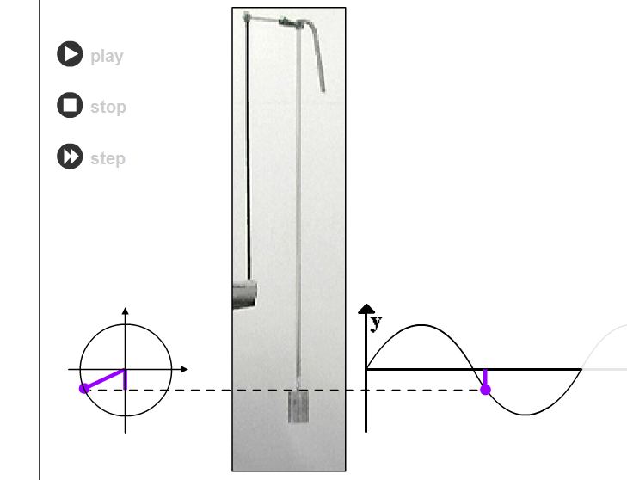
See shm spring applet

Slide 4
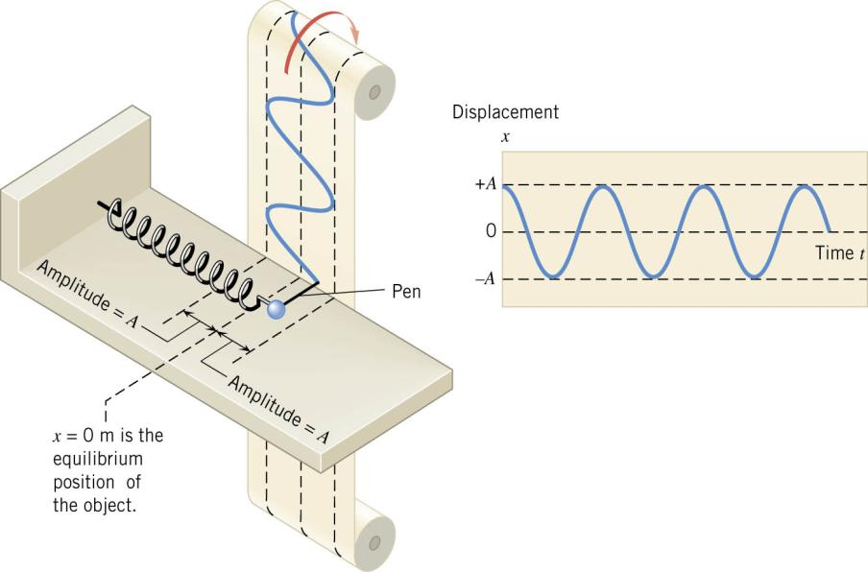

Slide 5
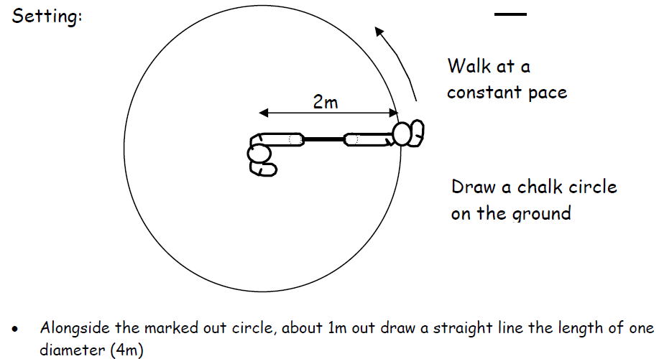
Practical Activity : Developing the Reference Circle Approach

Slide 6
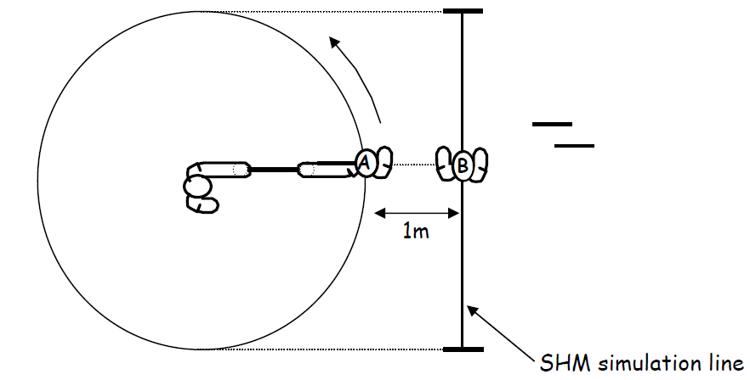

Slide 7
SHM, UCM & the Reference Circle
y
SHM is closely connected to an object undergoing UCM, eg moving pedals on a bicycle, ideal spring mass on a frictionless surface.
Use a reference circle (RC) to study the SHM …
ω
P
x
−A
+A
Point P moves around the RC so that the
object M is always vertically in line with P.
x_{o}
M
Radius = Amplitude A
Center = equilibrium position x_{o}
Period of object M (T_{M}) = Period of point P (T_{P})
Point P moving at a constant speed (ie UCM!)
Mass M velocity & acceleration is continually changing
Objects in a RC rotate in an anticlockwise direction
You can model object Displacement, velocity & acceleration with ‘Phasors’
angular velocity
ω = θ/t unit ~ rads⁻¹

Slide 8
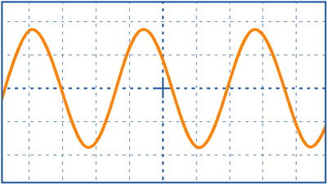
Displacement
When the motion of an object is undergoing SHM motion, its displacement (y) can be graphed as a sinusoidal function (sinθ or cosθ graph)
A is the amplitude of the oscillation
ω is the angular velocity (ω = θ/t)
y
+A
ω
θ
y
A
θ
0
t
O
-A
Maths… the graph period (T)
is determined from

Slide 10
A diving board vibrates up & down 20 times in 5.5 s.
Find f and ω

Slide 11
since
and
ω = 2πf = angular frequency
(But wasn’t ω called angular velocity ??)
In the context of circular motion, we call ω angular velocity (or angular speed).
In the context of simple harmonic motion, we call ω angular frequency.
Any SHM ! Not just the reference circle………

Slide 12
A diving board vibrates up & down 20 times in 5.5 s.
Find f and ω

Slide 13
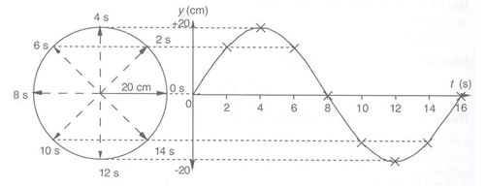
Solving problems…
Reference
Circle?
or
Trig graph?

Slide 14
A mass is attached to a vertical spring and undergoes SHM with a period of 20 s and amplitude of 25 cm. Find the displacement of the mass at;
t = 7.5 s [Let y = 0 cm at t = 0 s and moving upwards]
b) t = 10.0 s
Solution
+25cm
b) When t = 10.0 s
a) When t = 7.5 s
t=7.5s
y =?
t=0s
y_{o}
(Radians not °)
-25cm
What about letting y = -25 cm at t = 0 s find a) & b) ?

Slide 15
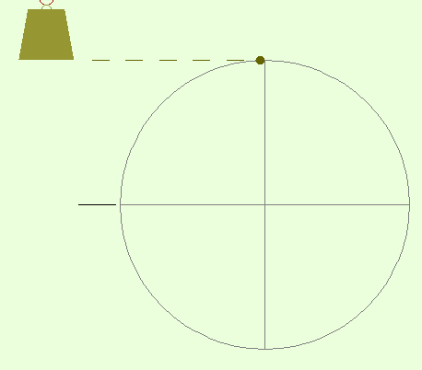
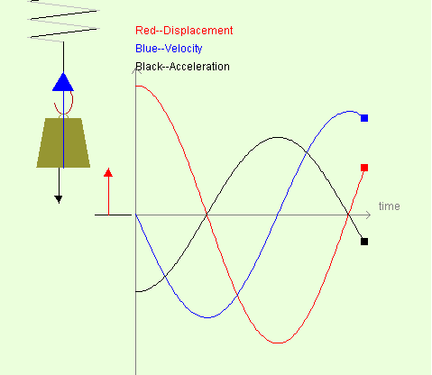
http://ngsir.netfirms.com/englishhtm/SpringSHM.htm

Slide 16
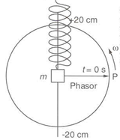
A object performs SHM according to the equation
y = 0.2 cos (5t) t is in seconds, y is in meters
Find
The Amplitude
The angular frequency
The period
The frequency
y at t = 0 s
y at t = 10 s
V_{max}
a_{max}
A= 0.2 m
ω = 5 rads⁻¹
T= 1.256 s
f= 0.80 Hz
y= 0.2m
y= 0.19m
V_{max} =1 m/s
a_{max} =5 m/s²

