Slide 1
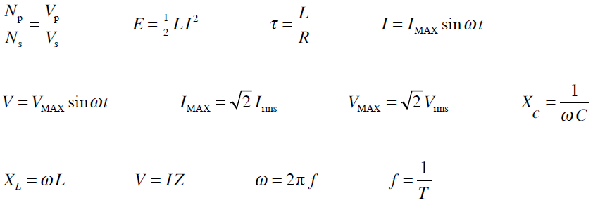
“RC” - AC circuits
Unless stated otherwise all AC voltage & current values are rms values

Slide 2
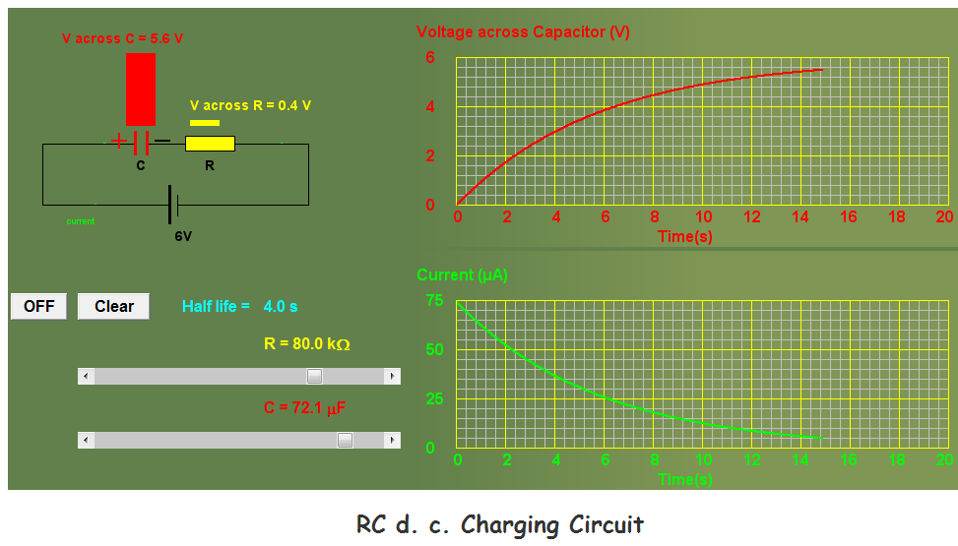
ngsir.netfirms.com/englishhtm/RC_dc.htm

Slide 3
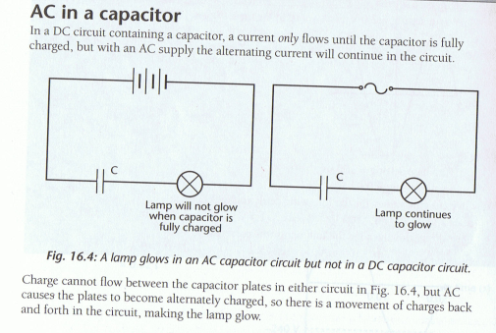

Slide 4
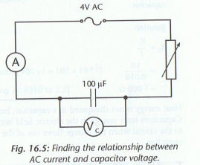
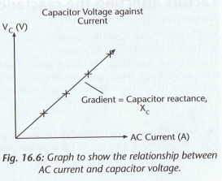
X_{C} is the ‘Reactance’ of the capacitor, unit ohm (Ω)
Reactance is the property of a capacitor to limit AC current in a circuit.
Similar to resistance but is affected by the frequency of the AC supply
larger C means more q stored so more I flow
Greater f means q is moving on & off the plates at a greater rate ie higher I

Slide 5
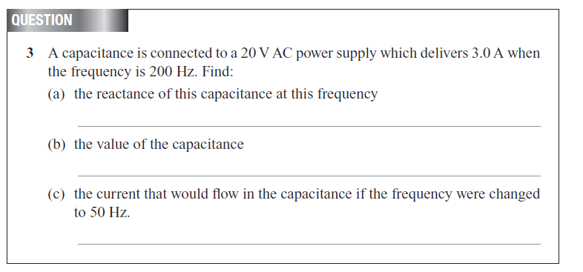
Unless stated otherwise all AC voltage & current values are rms values

Slide 6
V_{S}
AC supply
V_{R}
V_{C}
Unless stated all AC voltage & current values are rms values
For the above circuit the following voltages were measured:
V_{R} = 6.0 V
V_{C} = 8.0 V
V_{S} = 10.0 V
V_{S} =14.0 V ?
Voltages across R & C are out of phase…

Slide 7
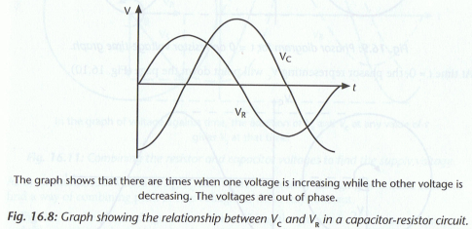
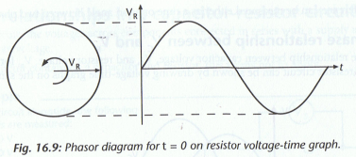
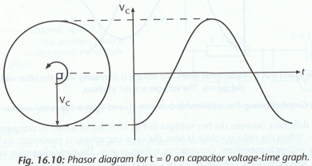
The phase relationship between V_{C} & V_{R}
V_{S}
Out by ¼ of a cycle or 90º
AC supply
V_{R}
V_{C}
Why? – 160
Phasors are rotating anticlockwise, V_{R} is always 90º ahead of V_{C} at any time
“ the resistor voltage is leading the capacitor voltage by 90º”

Slide 8
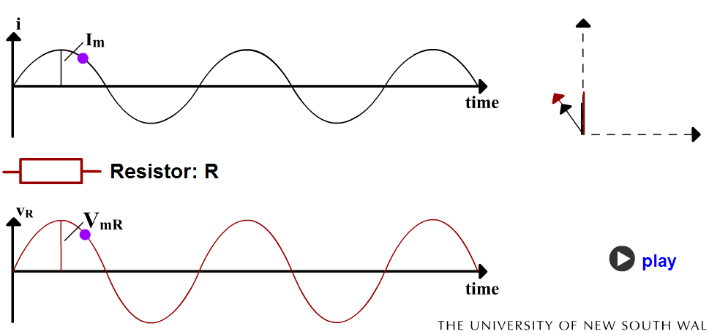
2 R & I Phasors Applet

Slide 9
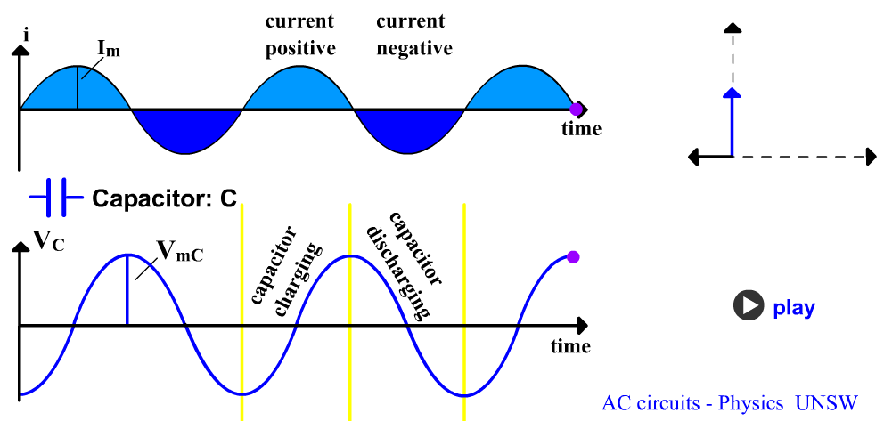
See 3 C & I Phasors applet

Slide 10
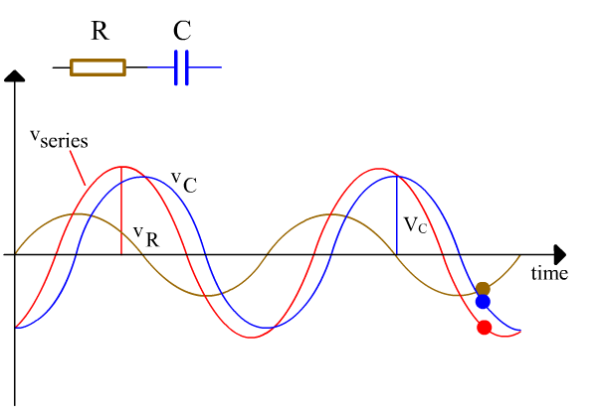
See 4 RC circuits applet

Slide 11
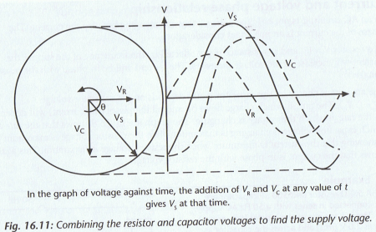
Voltage relationship between V_{S}, V_{C} & V_{R}
For components in series V_{S} = V_{C} + V_{R}
To get V_{S} add V_{C} & V_{R} phasors as vectors
Current is in phase with the resistor voltage

Slide 12
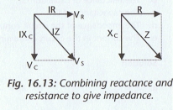
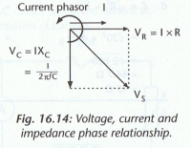
Impedance
Resistance & reactance both impede the flow of current in a circuit. There combined effect is called impedance, symbol Z, unit Ω
Combining the voltages gives:

Slide 13
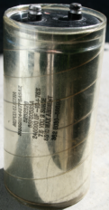
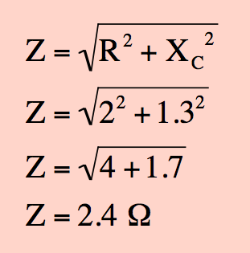
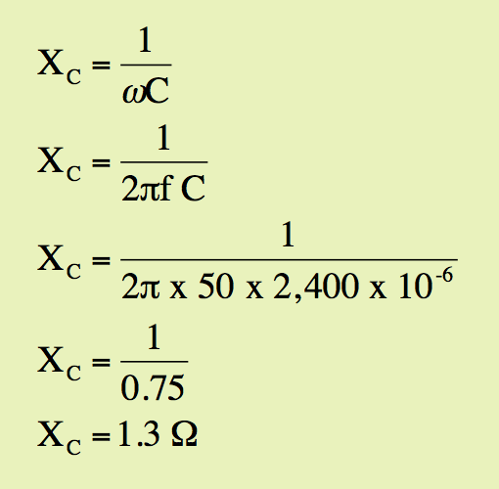
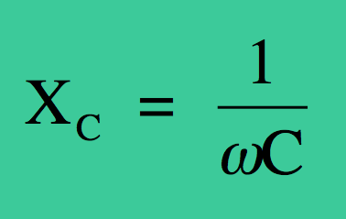
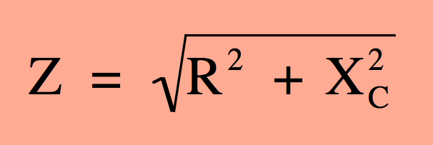
RC circuit
C = 2,400 µF
R =2.0 Ω
This RC circuit comprises of a 2,400 µF capacitor and a 2.0 Ω resistor and a 50 Hz power supply.
Calculate the reactance of the capacitor.
Draw a phasor diagram and determine the impedance of the circuit.
50 Hz
2
1
R = 2.0 Ω
Z = 2.4 Ω
X_{C} = 1.3 Ω

Slide 14
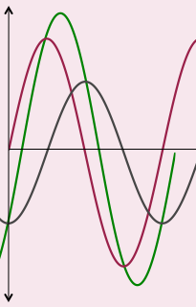
RC circuit
C = 2,400 µF
This RC circuit comprises of a 2,400 µF capacitor, a 2.0 Ω resistor and a 50 Hz power supply.
The current in the circuit 4.2 A
The reactance X_{C} of the capacitor is 1.3 Ω.
R =2.0 Ω
50 Hz
Calculate the potential drop across the capacitor (V_{C}) and the potential drop across the resistor (V_{R})
Determine the supply voltage (V_{S})
Determine the phase difference between the current and the supply voltage (V_{S})
Label the waves on the graph with V_{R}, V_{C} and V_{S}.

Slide 15
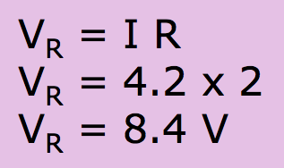
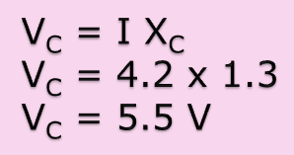
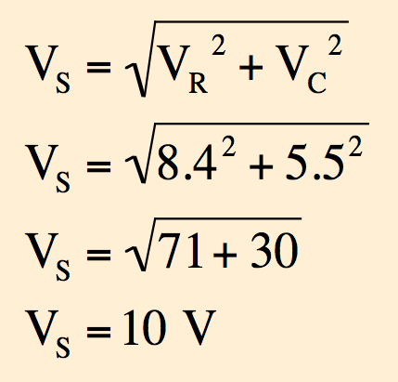
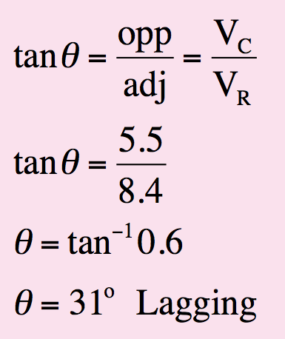
RC circuit
C = 2,400 µF
This RC circuit comprises of a 2,400 µF capacitor, a 2.0 Ω resistor and a 50 Hz power supply.
The current in the circuit 4.2 A
The reactance X_{C} of the capacitor is 1.3 Ω.
R =2.0 Ω
50 Hz
Calculate the potential drop across the capacitor (V_{C}) and the potential drop across the resistor (V_{R})
2. Determine the supply voltage (V_{S})
Both correct
2
θ
V_{R} = 8.4 V
V_{S} = 10 V
V_{C} = 5.5 V
3. Determine the phase difference between the current and the supply voltage (V_{S})
By measurement or by calculation
31º ± 2º only
V_{S} lagging current by 31º ± 2º

Slide 16
RC circuit
C = 2,400 µF
4. Label the waves on the graph with V_{R}, V_{C} and V_{S}.
R =2.0 Ω
Further Explanation
50 Hz
Reference circles not required for answer
V_{S}
V_{C}
V_{R}
V_{R}
31º
V_{C}
V_{S}
Formative practice enables students to gain frequent feedback and feedforward on the progress of their education

Slide 17
R = 25 Ω
Problem
What is the phase angle (between V_{s} and I) of the circuit shown in the diagram?
120 V
60 Hz
R
C
C = 30 μF
R
φ
X_{C}
Z

