Slide 1
Horizontal Projectiles

Slide 3
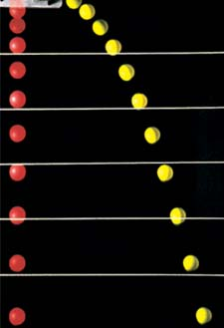
Which ball hits the ground first?
Red ball
Yellow ball
Both hit at the same time

Slide 4
Horizontal (x) motion and vertical (y) motion
are independent!
x-motion = constant velocity
This is an example of: Projectile Motion
y-motion
=
free-fall
Any 2-dimensional problem =
Two 1-dimensional problems
Solve them separately!

Slide 5
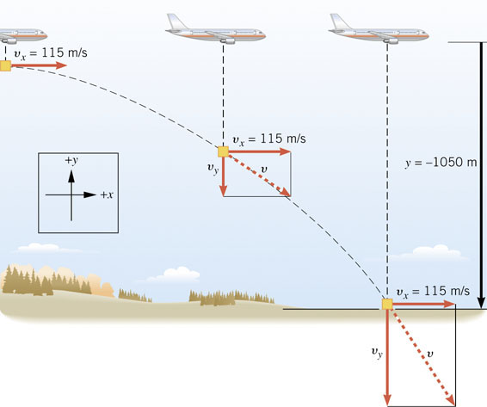
Key Concepts:
a_{x}= 0
a_{y}= -g
V_{x} = x/t_{air}
Use kinematic equations

Slide 6
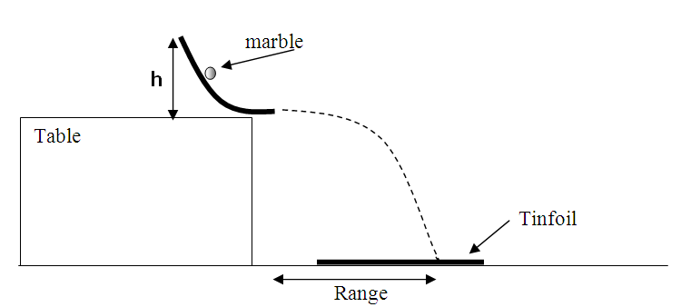
Can you predict the impact point of a projectile launched from the edge of the table with horizontal velocity?

Slide 7
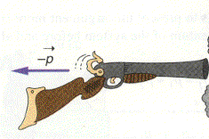
Horizontal Example Problem
A rifle is aimed horizontally at a target 30 m away. The bullet hits the target 1.9 cm below the aiming point.
What is the bullets time of flight
What is the bullets speed as it emerges from the rifle?

Slide 8
Example Problem 2.
y
A ball is tossed from an upper-story window of a building. The ball is given an initial velocity of 8.00 m/s at an angle of 20° below the horizontal. It strikes the ground 3.00 s later.
θ
x
How far horizontally from the base of the building does the ball strike the ground?
Find the height from which the ball was thrown.
How long does it take the ball to reach a point 10 m below the level of launching?

Slide 9
Ex: If you throw a dart horizontally at 30 m/s toward a target 2.0 m away, how far below your aiming point will it hit?

Slide 10
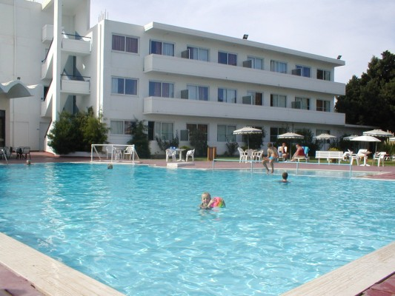
If someone foolishly tries to run horizontally off the roof of a 12 m tall hotel and land in the pool, how fast must they run if the pool is 3 m from the base of the hotel?

