Slide 1
To a physicist, mathematics is a toolbox. Before attacking a particular problem, you should have the necessary tools for the job!
Are your Maths tools sharp and good to go?

Slide 2
Physics WoF
Right Angled
Trigonometry
Calculator
Pythagoras
EXP button
Maths
Toolbox
Estimation
Exponents
Fractions
manipulations
formulae
Substitutions
Solving
Equations
Rearrange Equations
Algebra

Slide 3
Physics WoF
Calculator
EXP button
Maths
Toolbox

Slide 4
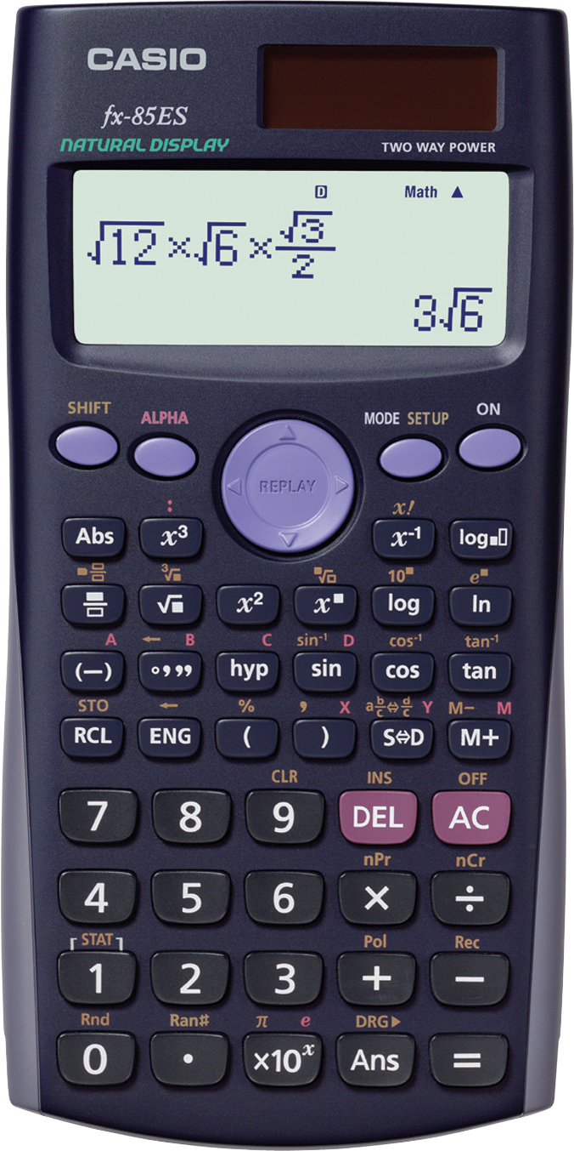
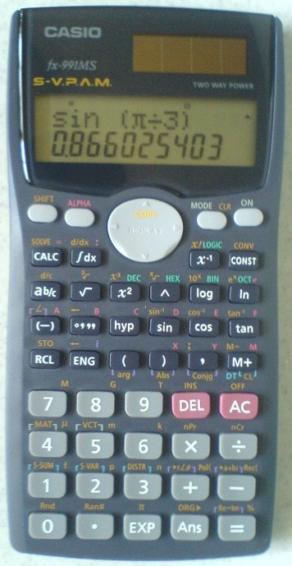

Slide 5
Calculation example:
(2 × 10³) × (3 × 10⁵) = 6 × 10⁸
Note! To enter a number like 1.5 × 10¹¹
press 1.5 Exp 11 or 1.5 11
NOT 1.5 × 10 Exp 11

Slide 6
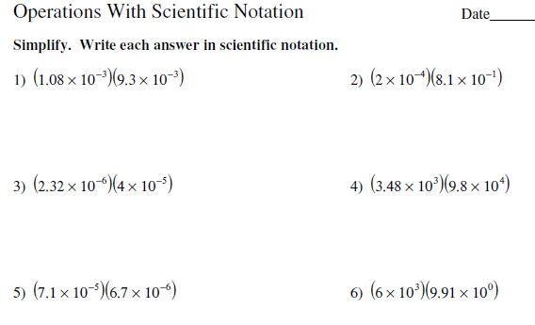
Look on Moodle for practice!

Slide 7
Physics WoF
Calculator
EXP button
Maths
Toolbox
Estimation

Slide 8
Estimation - make it 1 sf !
$\frac{\left(1.115\right)\left(412\right)(11.834)}{(53)}=$
$$\sqrt{19.96+ {9.9015}^{2}}$$

Slide 9
Physics WoF
Calculator
EXP button
Maths
Toolbox
Estimation
formulae
Substitutions

Slide 10
Substitution
Substitute the values into the equation
Calculate the answer to the correct significant figures
Give the correct unit to your answer.
d = v_{i}t + ½ at²
calculate d
when v_{i} = 4 m s⁻¹, t = 2 s, a = 9.8 m s⁻²

Slide 11
Substitution
Substitute the values into the equation
Calculate the answer to the correct significant figures
Give the correct unit to your answer.
v_{f}² = v_{i}² + 2ad
calculate v_{f}
when: v_{i} = 3.0 m s⁻¹, a = 9.8 m s⁻², d = 15 m

Slide 12
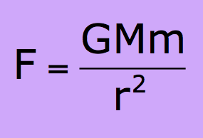
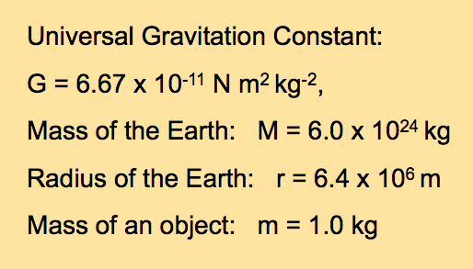
Calculate F
given

Slide 13
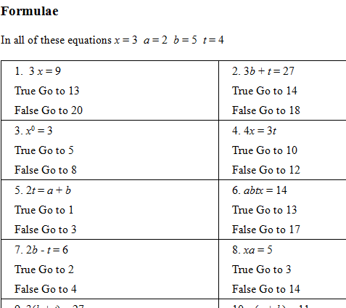
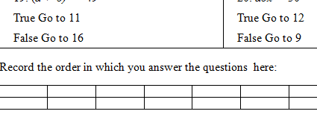
Look on Moodle for practice!

Slide 14
Physics WoF
Calculator
EXP button
Maths
Toolbox
Estimation
formulae
Substitutions
Rearrange Equations

Slide 15
Equations
Make the letter in brackets the subject of the equation.

Slide 16
Equations
Make the letter in brackets the subject of the equation.
d = v_{i}t + ½ at² (a) when v_{i} = 0

Slide 17
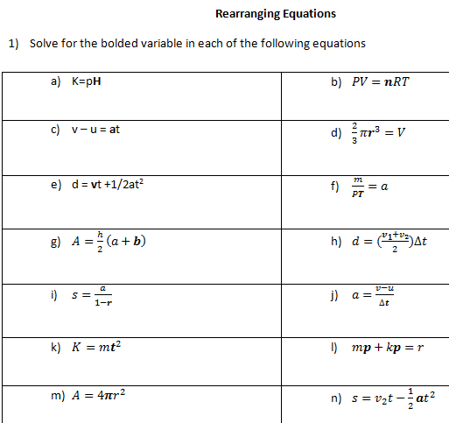
Look on VLC for practice!

Slide 18
Physics WoF
Calculator
EXP button
Maths
Toolbox
Estimation
formulae
Substitutions
Solving
Equations
Rearrange Equations
Algebra

Slide 19
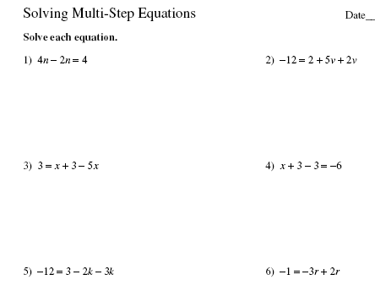
Look on Moodle for practice!

Slide 20
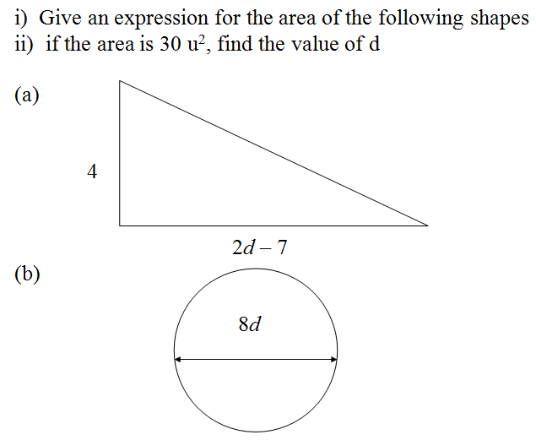

Slide 21
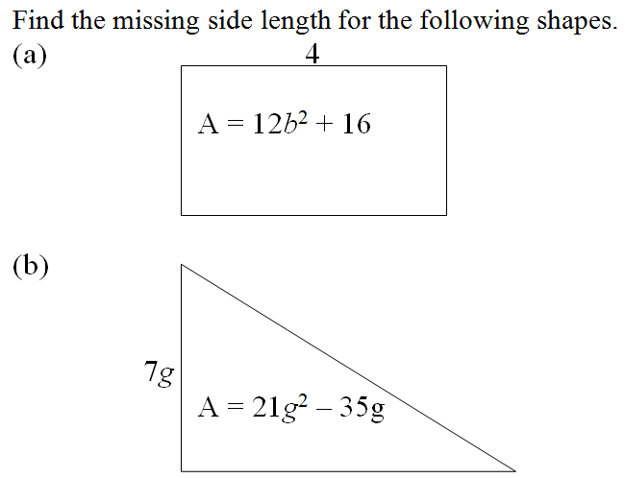

Slide 22
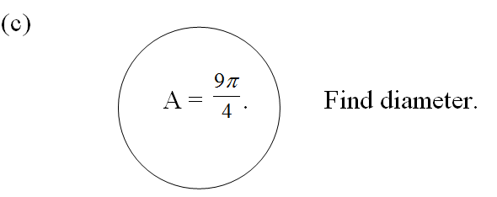

Slide 23
Physics WoF
Calculator
EXP button
Maths
Toolbox
Estimation
Fractions
manipulations
formulae
Substitutions
Solving
Equations
Rearrange Equations
Algebra

Slide 24
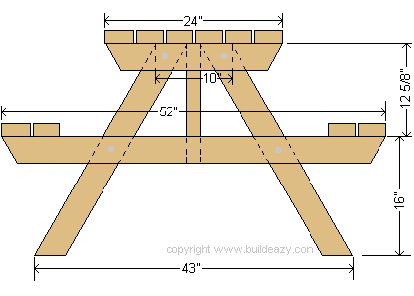
upside down picnic table method
Victoria eats ¼ of a pie and Laura eats 2/3 of a pie.
a) What fraction do they eat altogether?
b) What fraction of pie is left over?

Slide 25
Simplify where
possible
1.
4.
2.
3.
5.

Slide 26
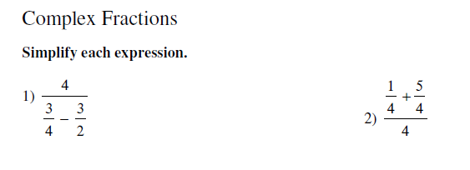
Look on VLC for practice!

Slide 27
Physics WoF
Calculator
EXP button
Maths
Toolbox
Estimation
Exponents
Fractions
manipulations
formulae
Substitutions
Solving
Equations
Rearrange Equations
Algebra

Slide 28
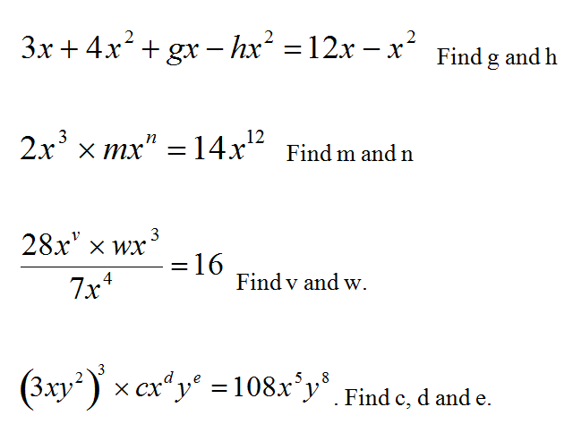
Y11 Algebra Review: Exponents / Indices

Slide 29
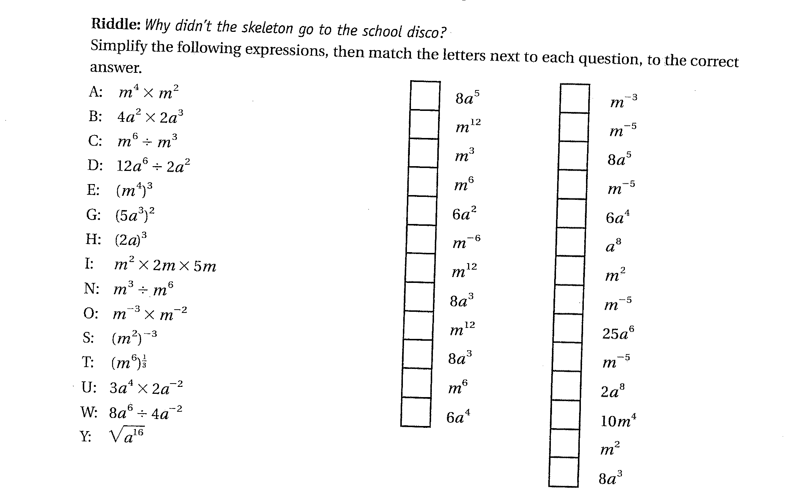

Slide 30
Physics WoF
Calculator
Pythagoras
EXP button
Maths
Toolbox
Estimation
Exponents
Fractions
manipulations
formulae
Substitutions
Solving
Equations
Rearrange Equations
Algebra

Slide 31
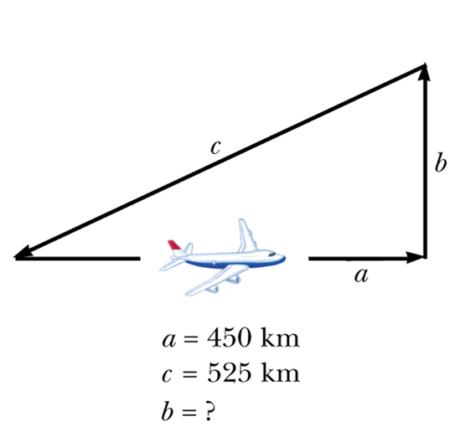
525² = 450² + b²
73125 = b²
b = 270.42
b= 270 km

Slide 32
Physics WoF
Right Angled
Trigonometry
Calculator
Pythagoras
EXP button
Maths
Toolbox
Estimation
Exponents
Fractions
manipulations
formulae
Substitutions
Solving
Equations
Rearrange Equations
Algebra

Slide 33
First identify the sides of the triangle
The longest side is called the…
Hypotenuse.
The side opposite is called the…
Opposite.
The remaining side is the…
Adjacent
HYP
OPP
θ
ADJ

Slide 34
Right angled Trig Ratios
HYP
OPP
θ
ADJ
S^{O}_{H}C^{A}_{H}T^{O}_{A}

Slide 35
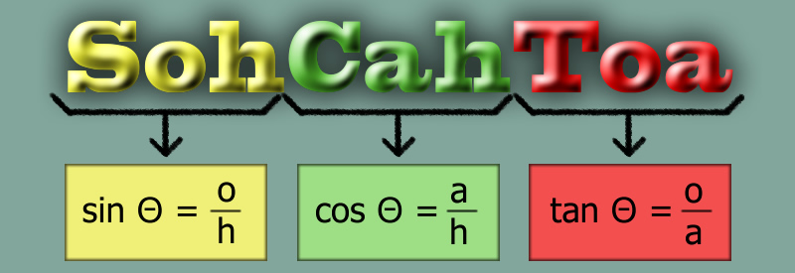

Slide 37
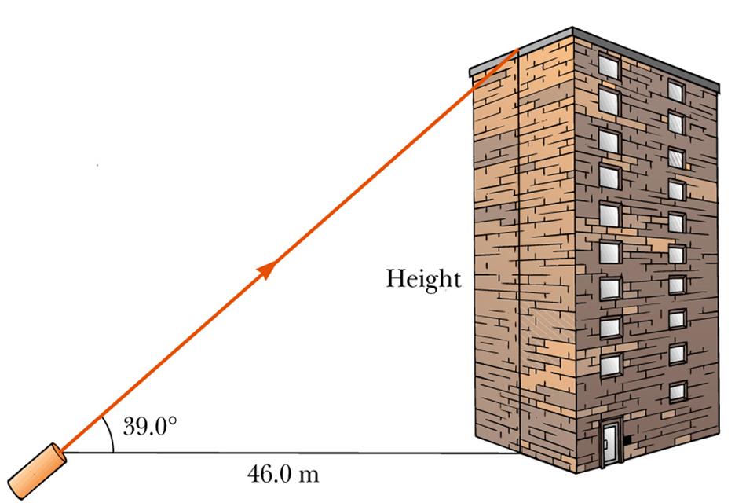
S^{O}_{H}C^{A}_{H}T^{O}_{A}

Slide 38
S^{O}_{H}C^{A}_{H}T^{O}_{A}

Slide 39
Joe buys a ladder which extends to 5.0 metres.
However he would not feel safe if the angle of the ladder is less than 70°
How far up the wall would the ladder extend at this angle of 70°?
OPP
Why would he not feel safe if the ladder angle is less than 70°?
70°

Slide 40
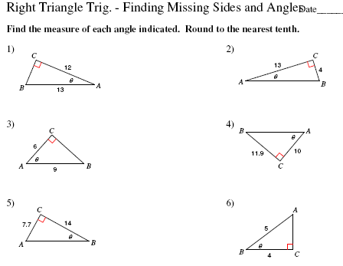
Look on VLC for practice!

